Slide 1
Linear Systems

Slide 2
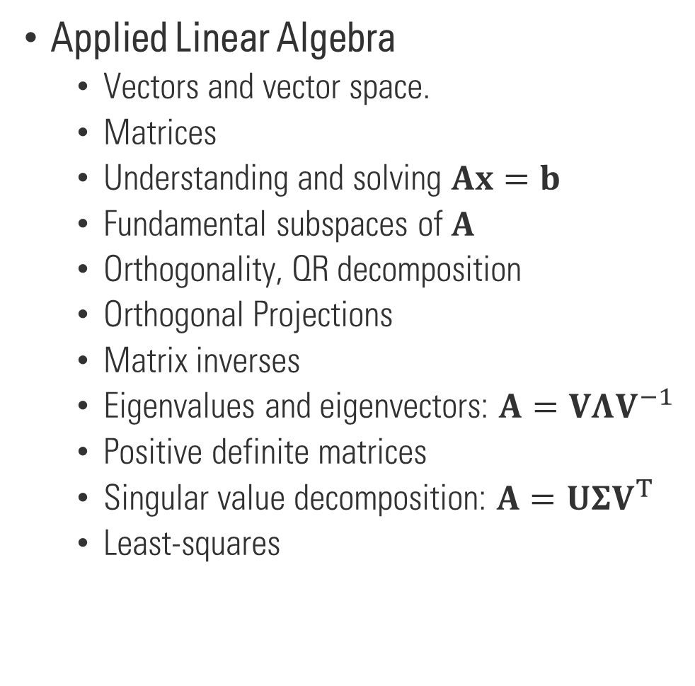
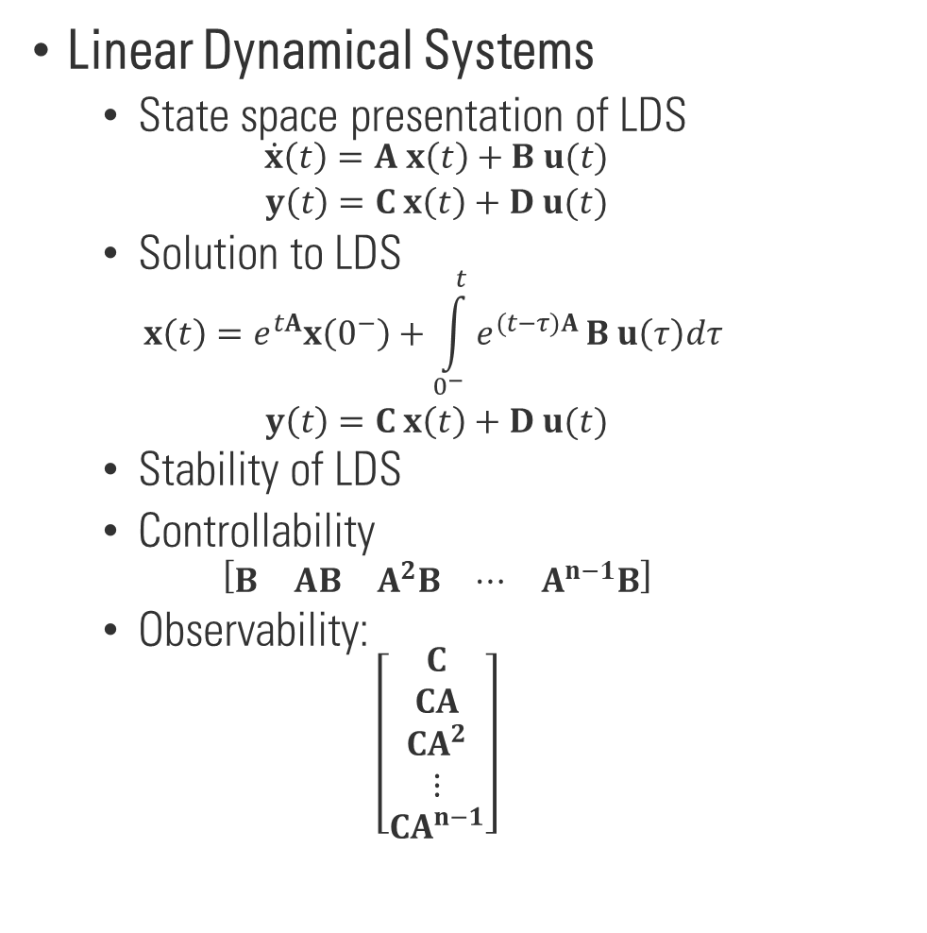
Course review
Applied Linear Algebra
Vectors and vector space.
Matrices
Understanding and solving $Ax=b$
Fundamental subspaces of $A$
Orthogonality, QR decomposition
Orthogonal Projections
Matrix inverses
Eigenvalues and eigenvectors: $A=VΛV^{−1}$
Positive definite matrices
Singular value decomposition: $A=UΣV^{T}$
Least-squares
Linear Dynamical Systems
State space presentation of LDS
$$\begin{matrix}\dot{x}\left(t\right)=A x\left(t\right)+B u(t) \\ y\left(t\right)=C x\left(t\right)+D u(t)\end{matrix}$$
Solution to LDS
$$\begin{matrix}x\left(t\right)=e^{tA}x\left(0^{−}\right)+\int_{0^{−}}^{t}{e^{(t−τ)A}}B u\left(τ\right)dτ \\ y\left(t\right)=C x\left(t\right)+D u(t)\end{matrix}$$
Stability of LDS
Controllability
$$\left[\begin{matrix}B & AB & A^{2}B & ⋯ & A^{n−1}B\end{matrix}\right]$$
Observability:
$$\left[\begin{aligned}C \\ CA \\ CA^{2} \\ ⋮ \\ CA^{n−1}\end{aligned}\right]$$

Slide 3
What next?
Linear algebra
Linear Dynamical Systems
Optimization
Control theory
(linear and non-linear)
State feedback & Compensator design
Observer design
Optimal control
Adaptive control
Signal Processing
Machine learning
Robotics
Probability theory
& Statistics

