Slide 1
Linear Systems
Sivakumar Balasubramanian
Dept. of Bioengineering
Christian Medical College Vellore

Slide 2


What is this course about?
A system is a group of interacting or interrelated elements that act according to a set of rules to form a unified whole.
System
$$x$$
$$y$$
Linear Systems
Multi-Input Multi-Output System
Dynamical System

Slide 3
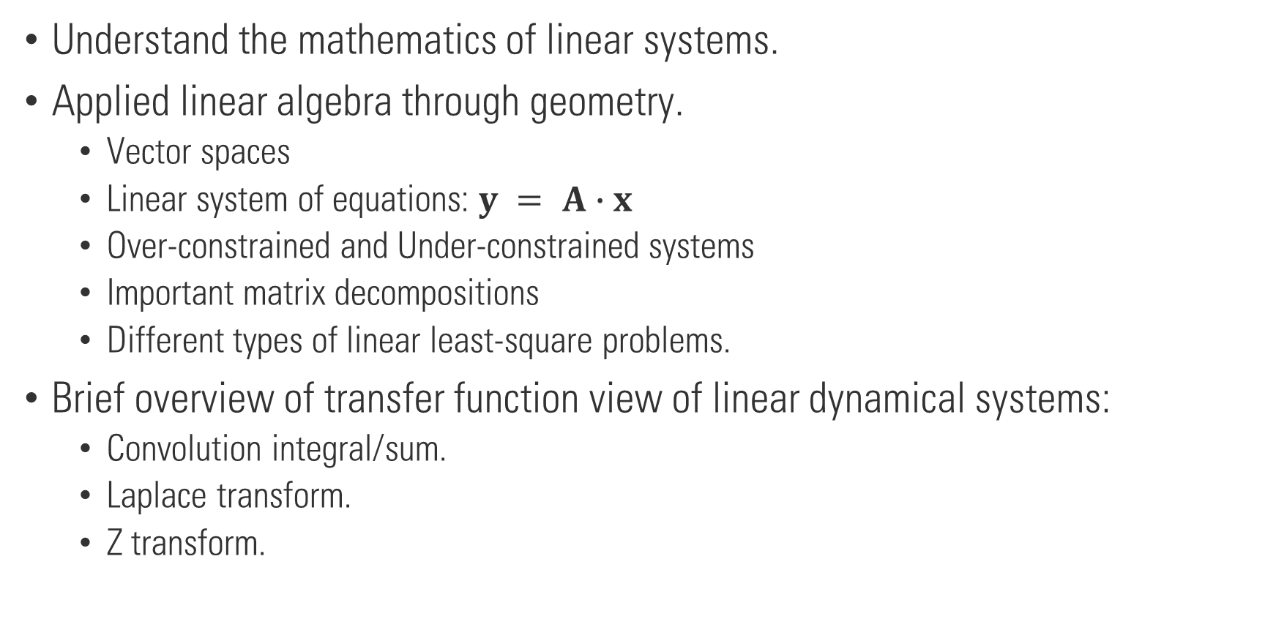
What is this course about?
Understand the mathematics of linear systems.
Applied linear algebra through geometry.
Vector spaces
Linear system of equations: $y = A∙x$
Over-constrained and Under-constrained systems
Important matrix decompositions
Different types of linear least-square problems.
Brief overview of transfer function view of linear dynamical systems:
Convolution integral/sum.
Laplace transform.
Z transform.

Slide 4
What is this course about?
State space view of systems:
States of a dynamical system
State evolution and measurement equations
LDS solution
Stability
Controllability
Observability
Design of observers and state-feedback controllers

Slide 5
Why linear systems?
A large body of theory available at our disposal – analysis and design tools.
A good understanding of linear systems is essential for the study of non-linear systems.
Many non-linear system can often be approximated by a linear system.
It works well in most practical applications.

Slide 6
Assignment, Quizzes, and Exams
One assignment per module
One quiz per lecture
Midterm in the 2nd week of October
Final in the 3rd week of December

