Slide 1
Transducers & Instrumentation
Module 01/01
(Measurement; Transducers; Sensors; Sensor Static Characteristics)

Slide 2
Measurement
What is measurement?
A process of comparing an unknown quantity with a known or standard quantity.
Different levels of measurements:
Nominal
Ordinal
Interval
Ratio
In the physical science, we primarily use interval or ratio scales for measuring physical quantities.

Slide 3
Why measure?
Gain information about an object of interest (scientific purpose).
For the purpose of commerce.
To influence or control the state of a system (engineering , medicine, etc.)
“To measure is to know.”
“If you cannot measure it, you cannot improve it.”
“When you can measure what you are speaking about, and express it in numbers, you know something about it; but when you cannot measure it, when you cannot express it in numbers, your knowledge is of a meagre and unsatisfactory kind.”
- Lord Kelvin

Slide 4
Measuring instrument
What is measuring instrument?
A device used to measure a physical quantity.
Physical Quantity
Measuring Instrument
Value
Magnitude | Units
A unit is definite magnitude of a physical quantity that is established as a standard.

Slide 5
Measuring instruments
Fast and automatic measurements are essential for various applications.
Modern day instruments measure a physical quantity by converting it into a signal that can be processed by a human observer/machine or be stored/recorded.
Processed by a human or a machine
Physical Quantity
Measuring Instrument
Stored or recorded in a suitable medium

Slide 6
Transducers
A device that converts energy from one form of energy to another from.
General Transducers:
Sensors: Convert energy in one form to electrical energy. Produce signals that contain information about the measurand.
Actuators: Responsible for moving or controlling a system.
Bidirectional transducers: Transduce in both directions. Physical phenomenon to electrical energy and electrical energy to physical phenomenon.

Slide 7
Transducers
Examples of transducers:

Slide 8
Sensors
Physical phenomenon
Sensor
Electrical signal
voltage, current, or charge
Measurand: Physical quantity, property or condition of interest.
E.g., motion, force, pressure, flow, temperature, biopotential, impedance, and chemical concentrations.
Sensor output can be channelled, amplified, and modified by electronic circuits.
The output signal can be described in terms of its amplitude, frequency, phase, and digital code.

Slide 9
Sensors Classification
Direct vs. Complex
Direct sensor: Converts a stimulus directly into to an electrical signal.
E.g., Piezoelectric sensor: mechanical energy is converted to electric charge displacement.
Complex sensor: Uses a cascade of transducers for energy conversion before employing a direct sensor at the end.
E.g., A fibre optic displacement sensor.

Slide 10
Sensors Classification
Passive vs. Active
Passive: Do not need additional source of energy to generate a signal in response to the measurand.
E.g., Photodiode.
Active: Require external power supply for their operation – excitation signal, which is modified by the measurand.
E.g., Resistive strain gauge.

Slide 11
Sensors Classification
Absolute vs. Relative
Absolute: Measures with respect to an absolute physical scale.
E.g., Thermistor’s resistance directly relates to the absolute temperature scale in Kelvins.
Relative: Measures with respect to a custom set reference.
E.g., Thermocouple produces a voltage that is proportional to the temperature gradient between.

Slide 12








Sensor characteristics
General Input-Output relationship of a Sensor.
$$x_{d}$$
$$f_{d}\left(∙\right)$$
(Measurand)
$$y=y_{d}+y_{i}+ε$$
$$x_{m}$$
(Modifying Input)
$$f_{i}\left(∙\right)$$
$$y_{d}=f_{d}\left(x_{d},x_{m}\right)$$
$$y_{i}=f_{i}\left(x_{i},x_{m}\right)$$
$$x_{i}$$
(Interfering Input)

Slide 13
Sensor characteristics
Examples of different types of inputs.
Manometer
Strain gauge

Slide 14
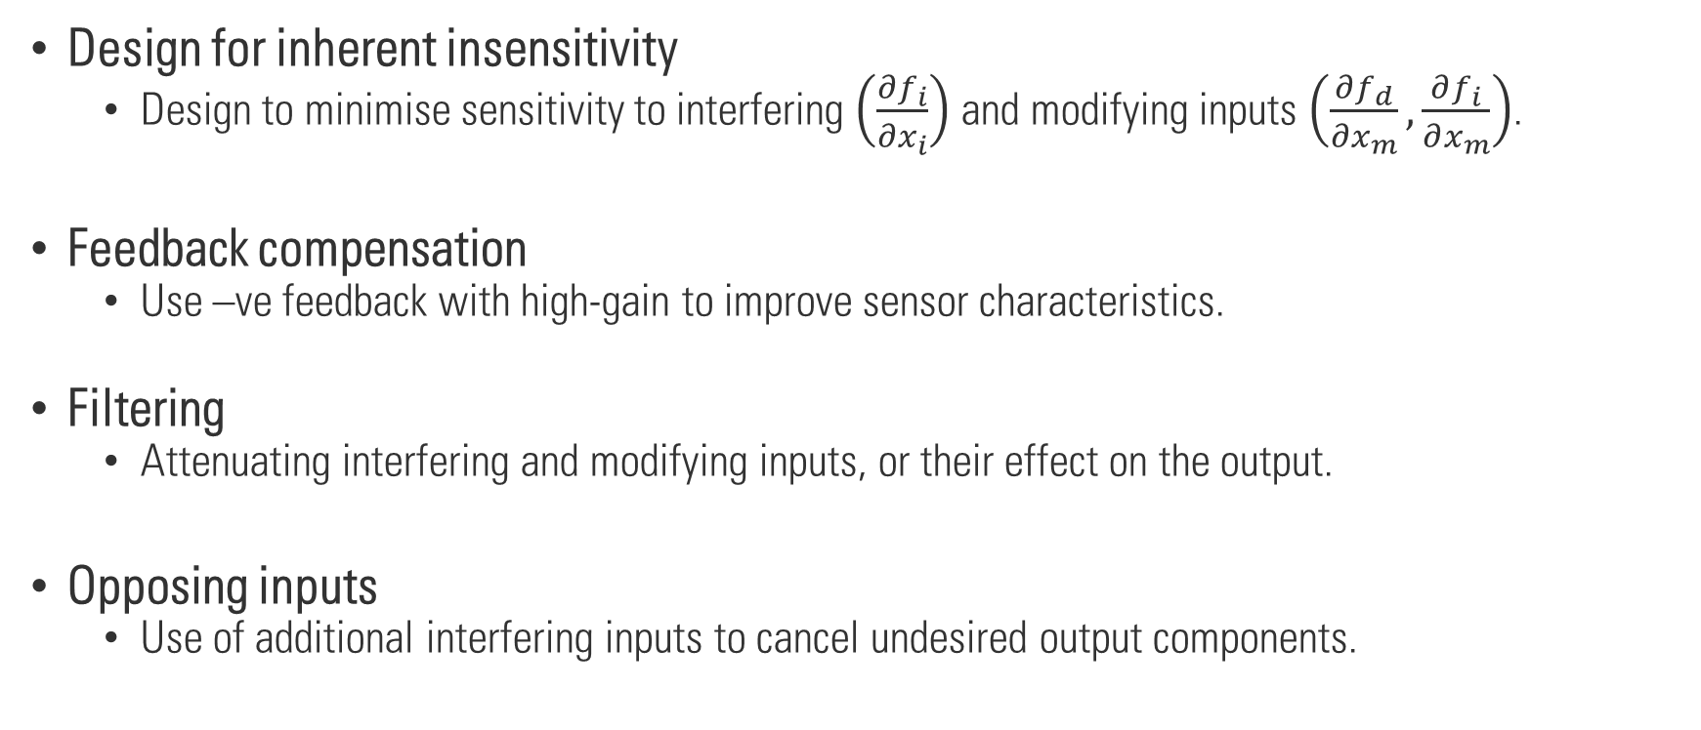
Methods for compensation
$$y=f_{d}\left(x_{d},x_{m}\right)+f_{i}\left(x_{i},x_{m}\right)+ε$$
Design for inherent insensitivity
Design to minimise sensitivity to interfering $\left(\frac{∂f_{i}}{∂x_{i}}\right)$ and modifying inputs $\left(\frac{∂f_{d}}{∂x_{m}},\frac{∂f_{i}}{∂x_{m}}\right)$.
Feedback compensation
Use –ve feedback with high-gain to improve sensor characteristics.
Filtering
Attenuating interfering and modifying inputs, or their effect on the output.
Opposing inputs
Use of additional interfering inputs to cancel undesired output components.

Slide 15
Generalized sensor characteristics
All sensors are non-linear dynamical systems.
Static and/or Linear approximations are often possible and very useful.
General sensor characteristics are divided into static and dynamic characteristics.
Static characteristics. Response to constant or slow varying measurands.
Dynamic characteristics. Response to time varying measurands.

Slide 16
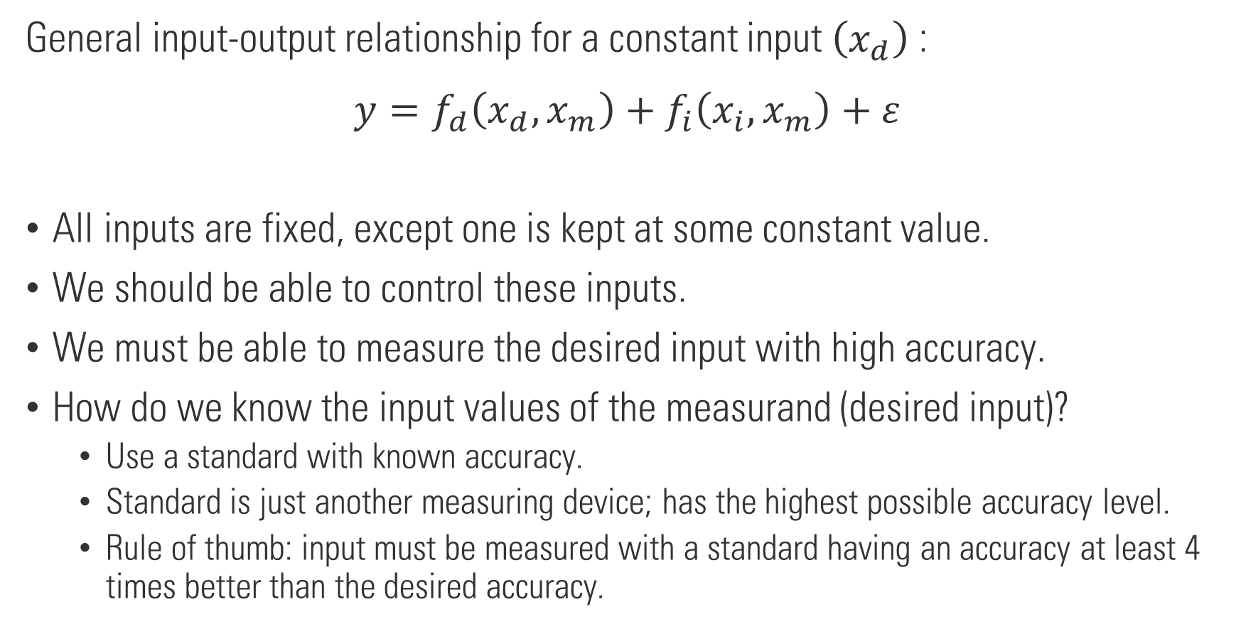
Static calibration
General input-output relationship for a constant input $\left(x_{d}\right)$:
$$y=f_{d}\left(x_{d},x_{m}\right)+f_{i}\left(x_{i},x_{m}\right)+ε$$
All inputs are fixed, except one is kept at some constant value.
We should be able to control these inputs.
We must be able to measure the desired input with high accuracy.
How do we know the input values of the measurand (desired input)?
Use a standard with known accuracy.
Standard is just another measuring device; has the highest possible accuracy level.
Rule of thumb: input must be measured with a standard having an accuracy at least 4 times better than the desired accuracy.

Slide 17
Static calibration
General Procedure:
Identify all possible inputs to the sensor and choose the desired inputs.
Get the necessary devices to vary all desired inputs over the necessary range. Use the appropriate standard for measuring the input levels.
Holding all other inputs constant, vary the desired inputs and record the output(s).
Develop the desired input-output model.

Slide 18
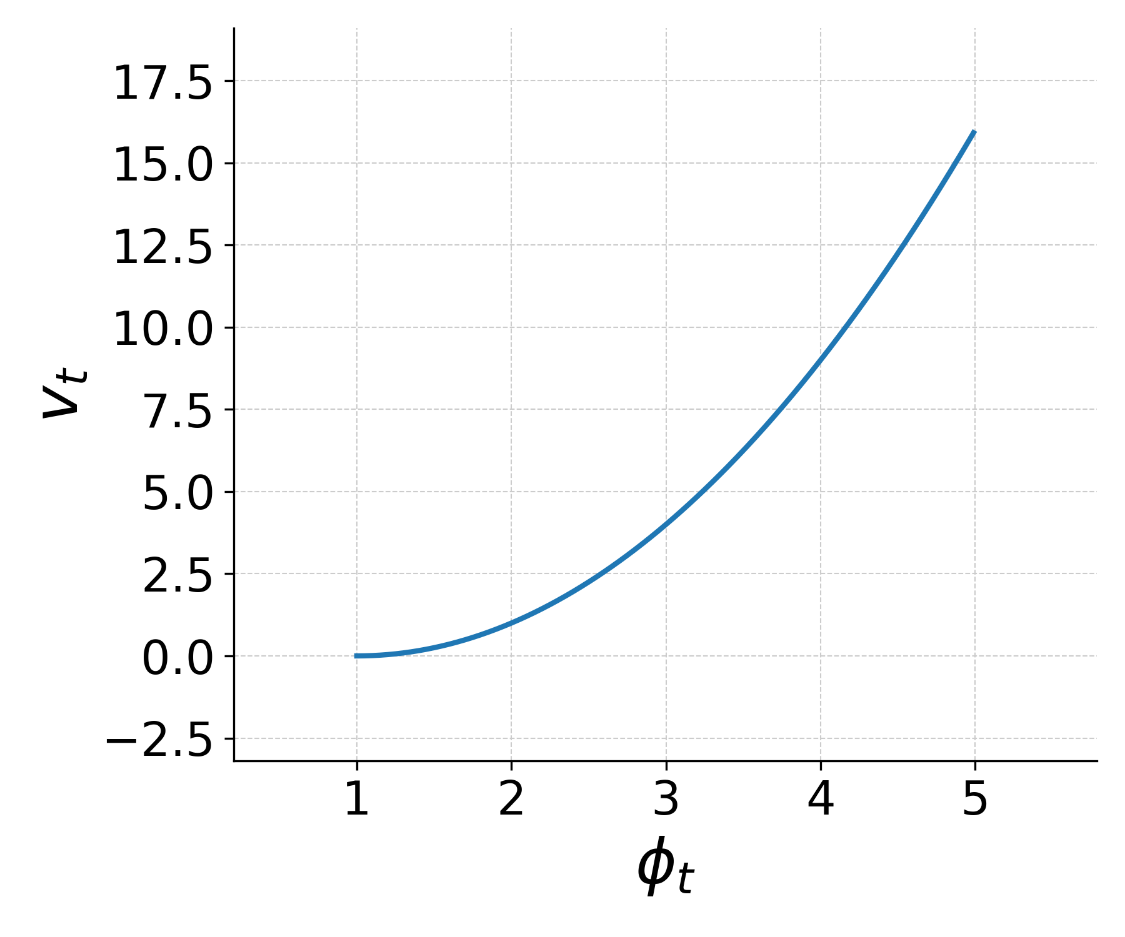

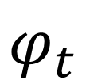
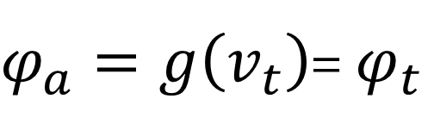



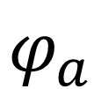

Static characteristics
Sensor
$$v_{t}$$
$$φ_{t}$$
$$g\left(∙\right)$$
$$φ_{a}$$
Measurand vs. Sensor Output
$$v_{t}=f\left(φ_{t}\right)$$
$$φ_{a}=g\left(v_{t}\right)$$
Under ideal conditions:
$$g=f^{−1}$$
$φ_{a}=g\left(v_{t}\right)$= $φ_{t}$

Slide 19
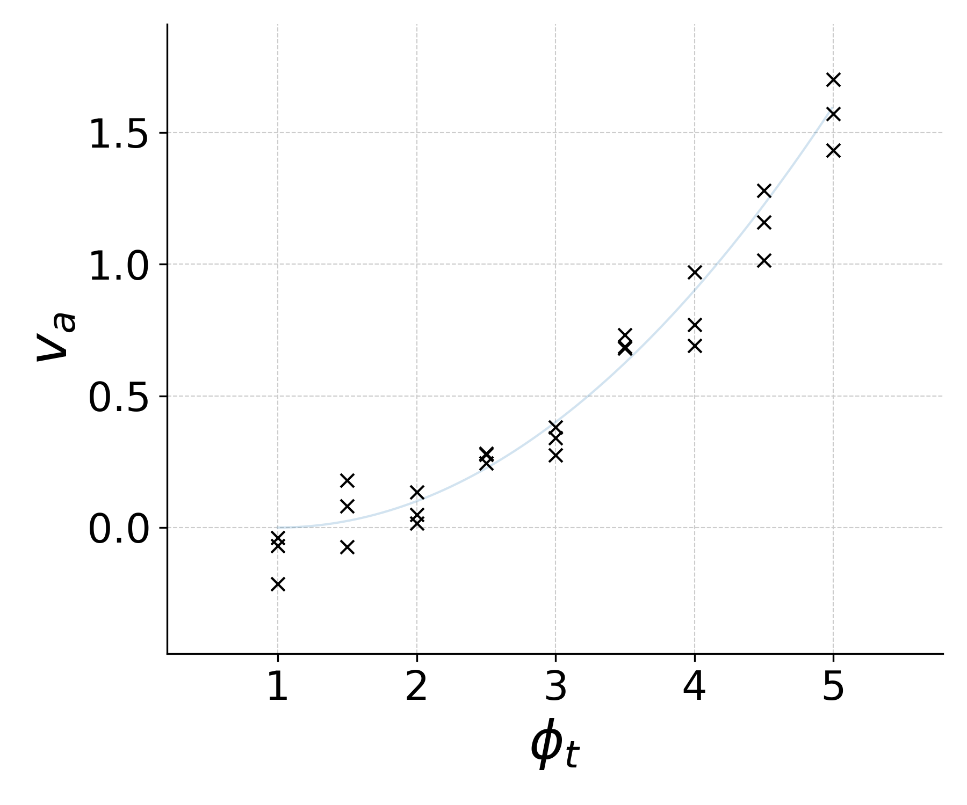
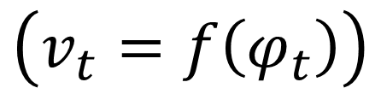



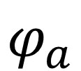
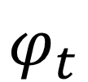
Static characteristics
Sensor
$$v_{a}$$
$$φ_{t}$$
$$g\left(∙\right)$$
$$φ_{a}$$
Measurand vs. Sensor Output
In reality,
$$v_{a}=v_{t}+ε$$
$$\left(v_{t}=f\left(φ_{t}\right)\right)$$

Slide 20
Sensor characteristics – Systematic & Random Errors
Repeated measurements for a fixed value of the measurand.

Slide 21
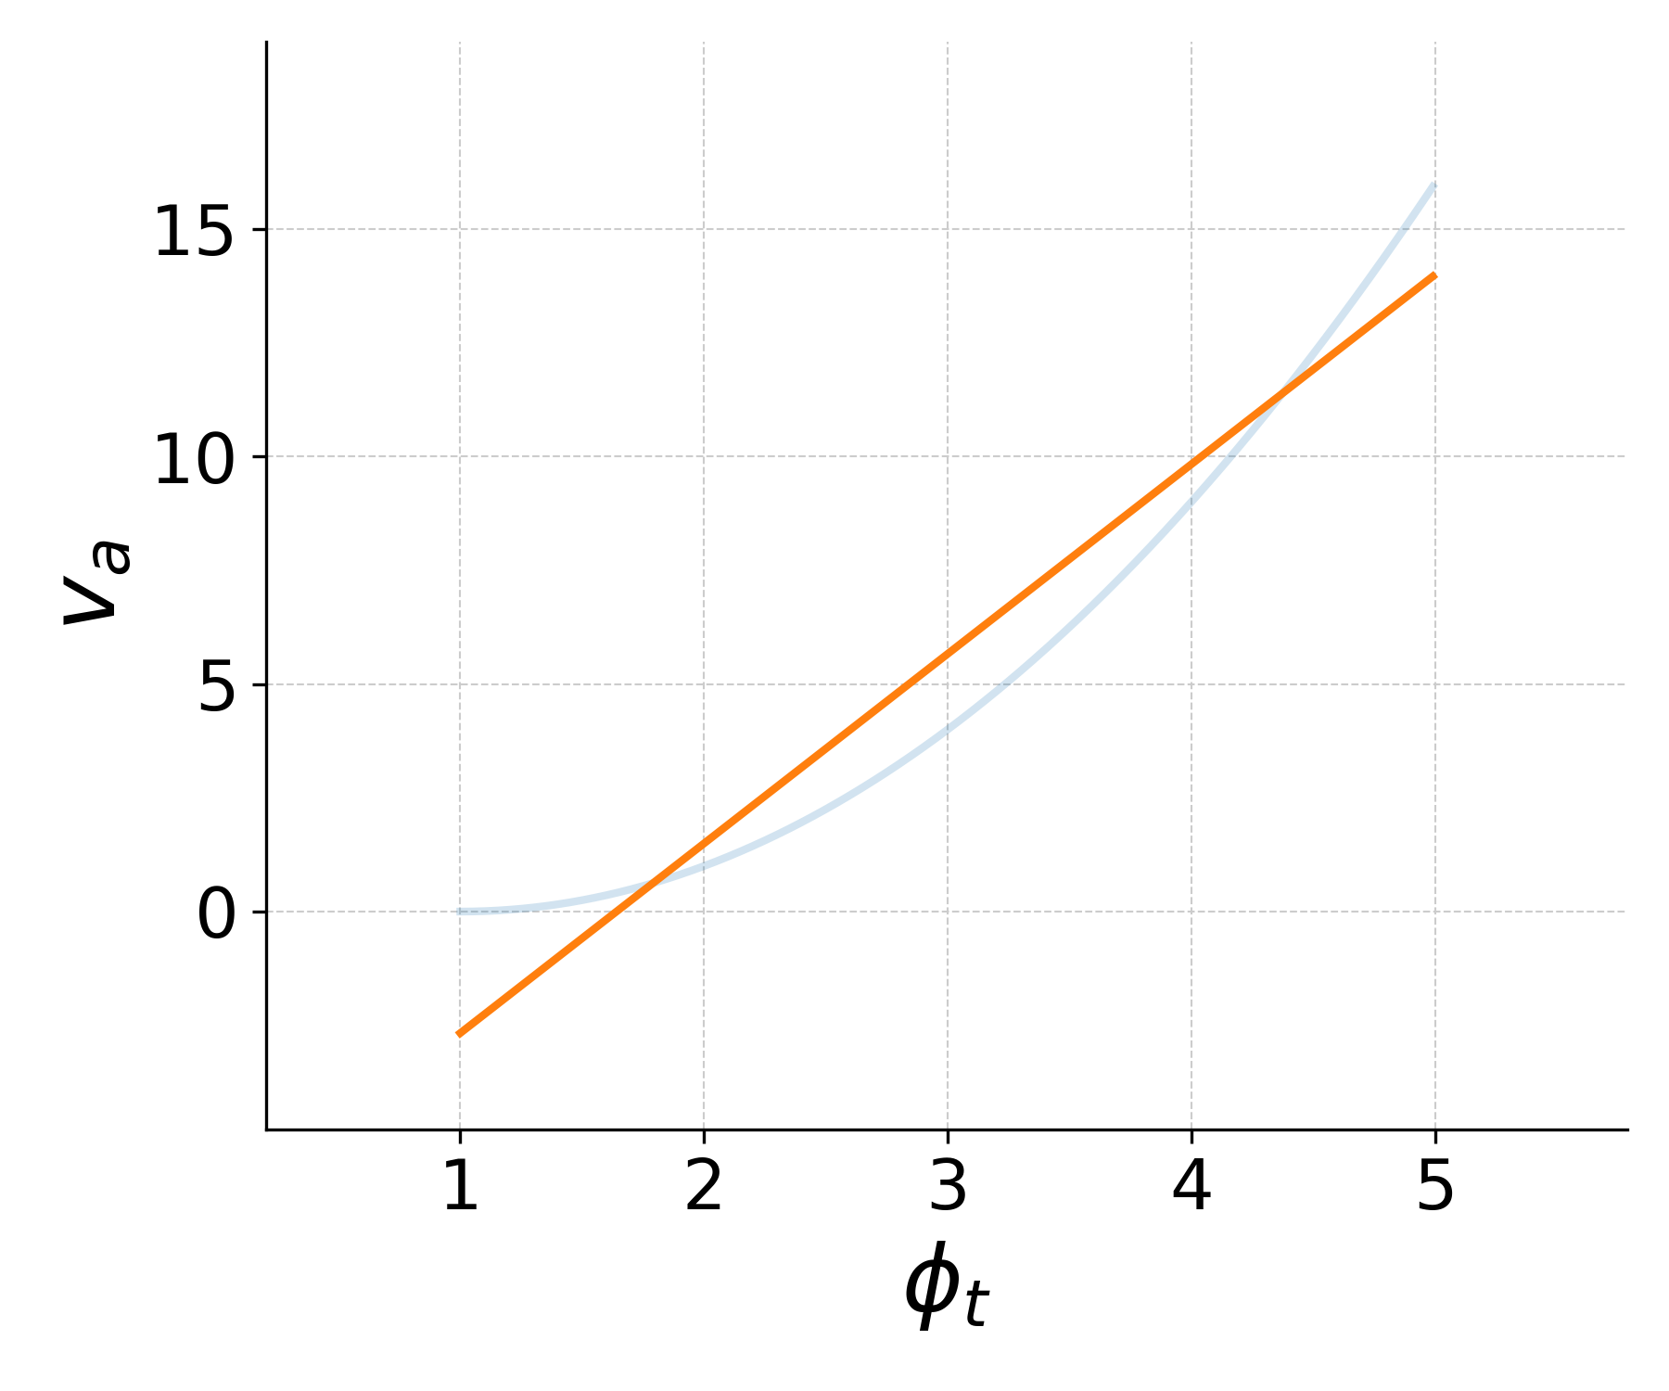
Sensor characteristics: Sources of Systematic Error
Errors in calibration: Mistake in the chosen model.

Slide 22
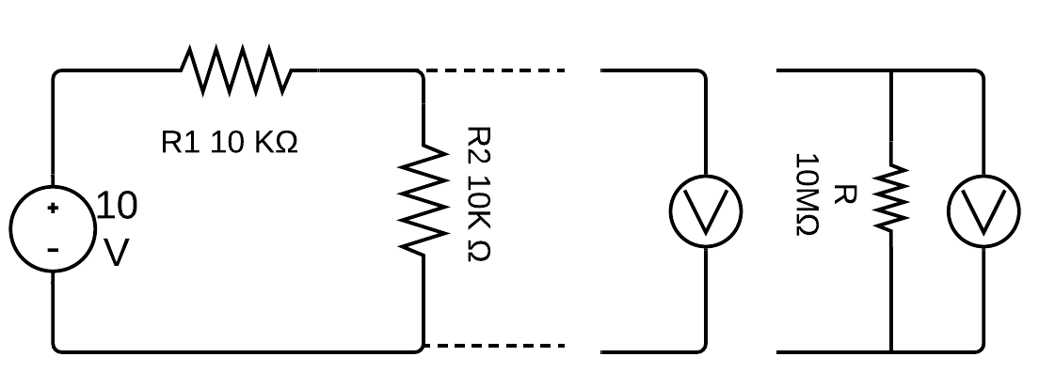
Sensor characteristics: Sources of Systematic Error
Loading effects: The measurement system affects the measurand.

Slide 23
Sensor characteristics: Sources of Systematic Error
Effect of other variables: Effect of some unaccounted variable.

Slide 24
Sensor characteristics: Sources of Random Error
Arise from the measurement system, the experimental system, and the environment.

Slide 25
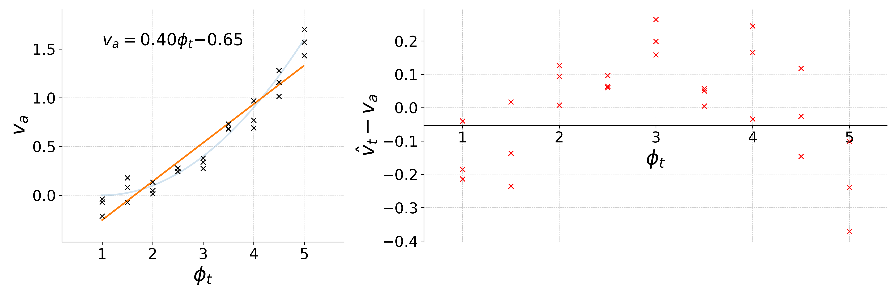
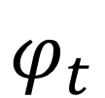




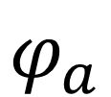
Static characteristics
$$v_{a}$$
$$v_{a}=v_{t}+ε$$
$$φ_{t}$$
Sensor
$$φ_{a}$$
$$g\left(∙\right)$$
$$\left(v_{t}=f\left(φ_{t}\right)\right)$$

Slide 26
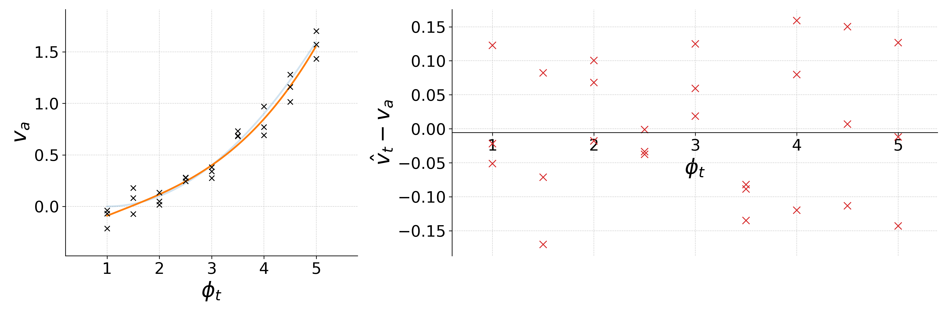
Static characteristics
$$v_{a}$$
$$v_{a}=v_{t}+ε$$
$$φ_{t}$$
Sensor
$$φ_{a}$$
$$g\left(∙\right)$$
$$\left(v_{t}=f\left(φ_{t}\right)\right)$$

Slide 27
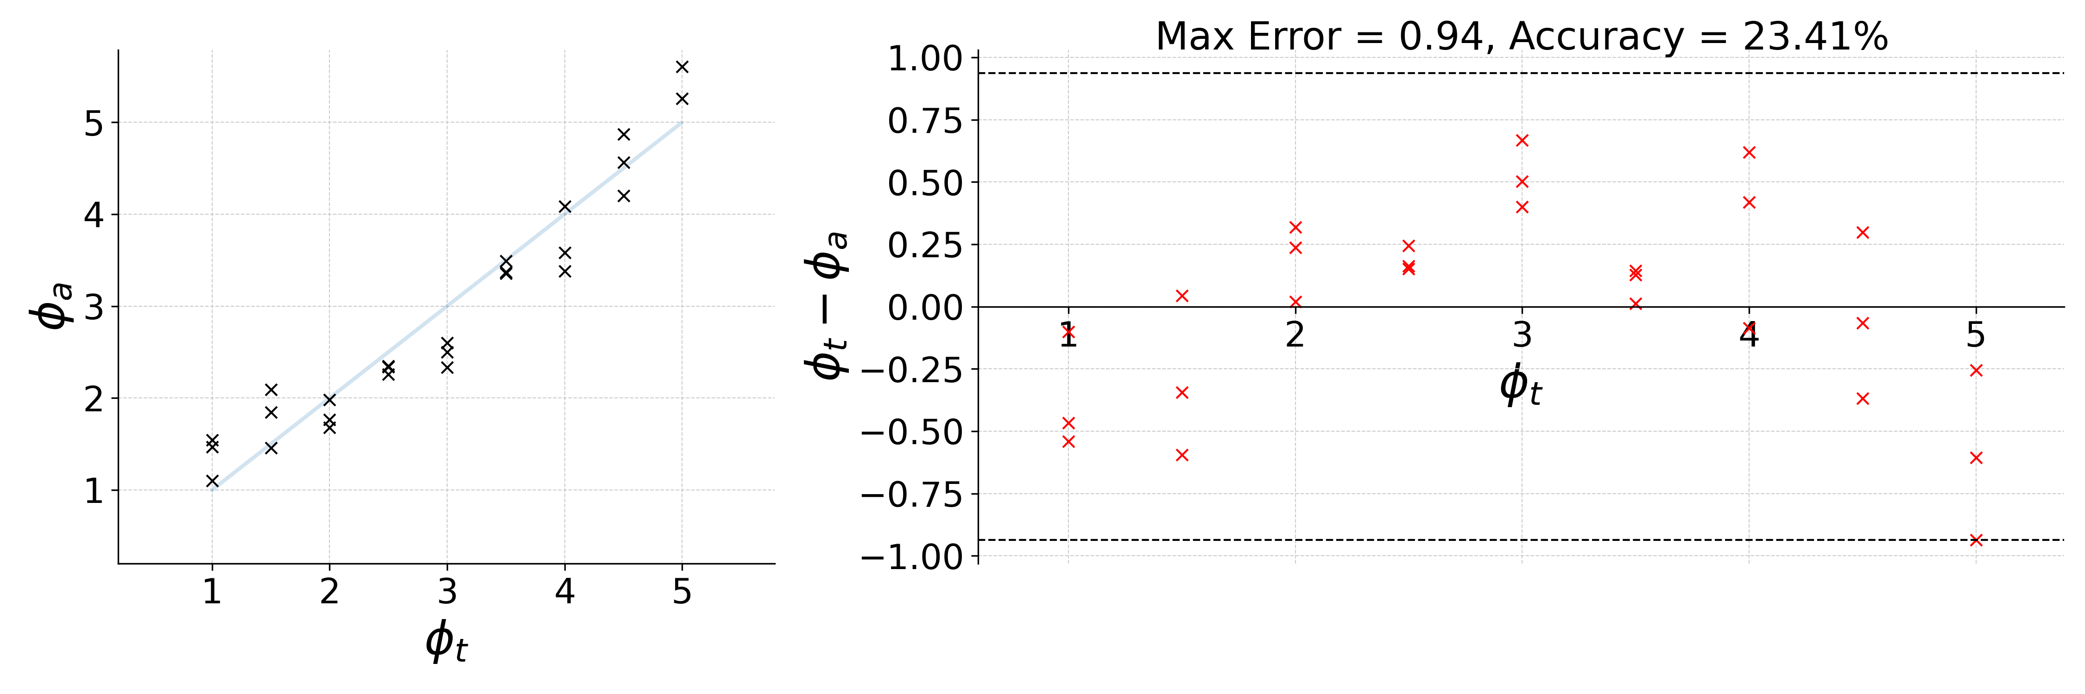
Sensor static characteristics
Accuracy
A measure of the difference between the true value and the actual value.
Usually expressed as a percentage of the full-scale value of the measurand.

Slide 28
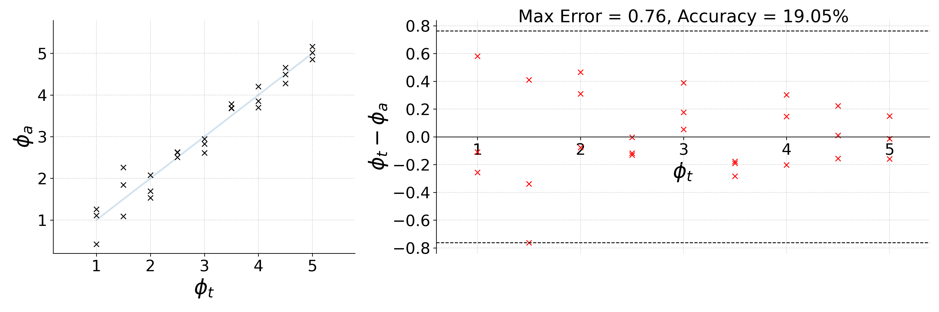
Sensor static characteristics
Accuracy
A measure of the difference between the true value and the actual value.
Usually expressed as a percentage of the full-scale value of the measurand.

Slide 29
Sensor static characteristics
Precision
A measure of repeatability of the sensor output.

Slide 30
Sensor static characteristics
Linearity

Slide 31
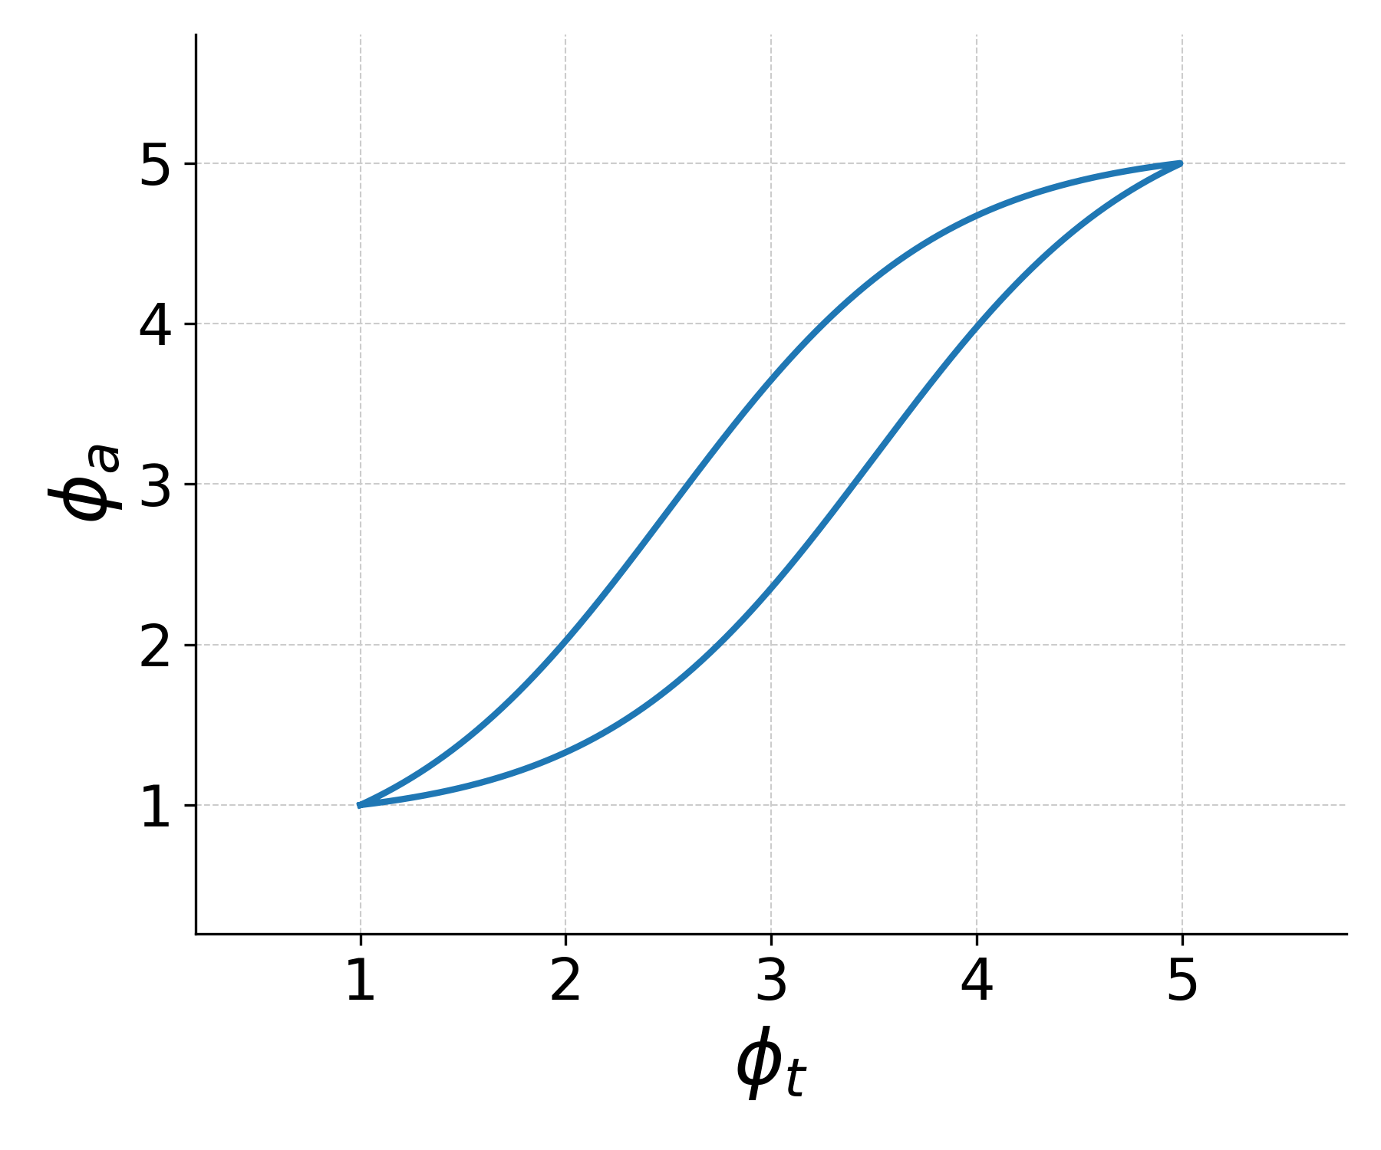
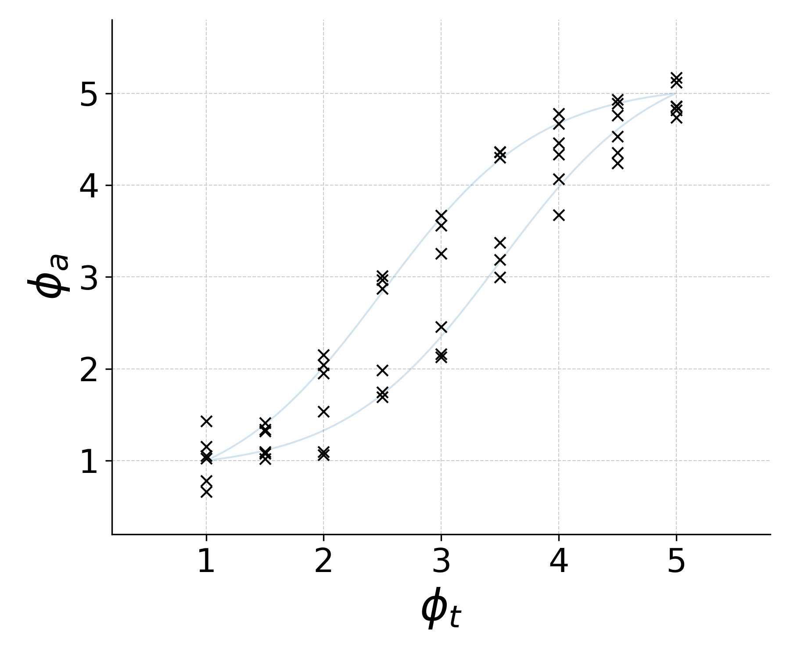
Sensor static characteristics
Hysteresis

Slide 32
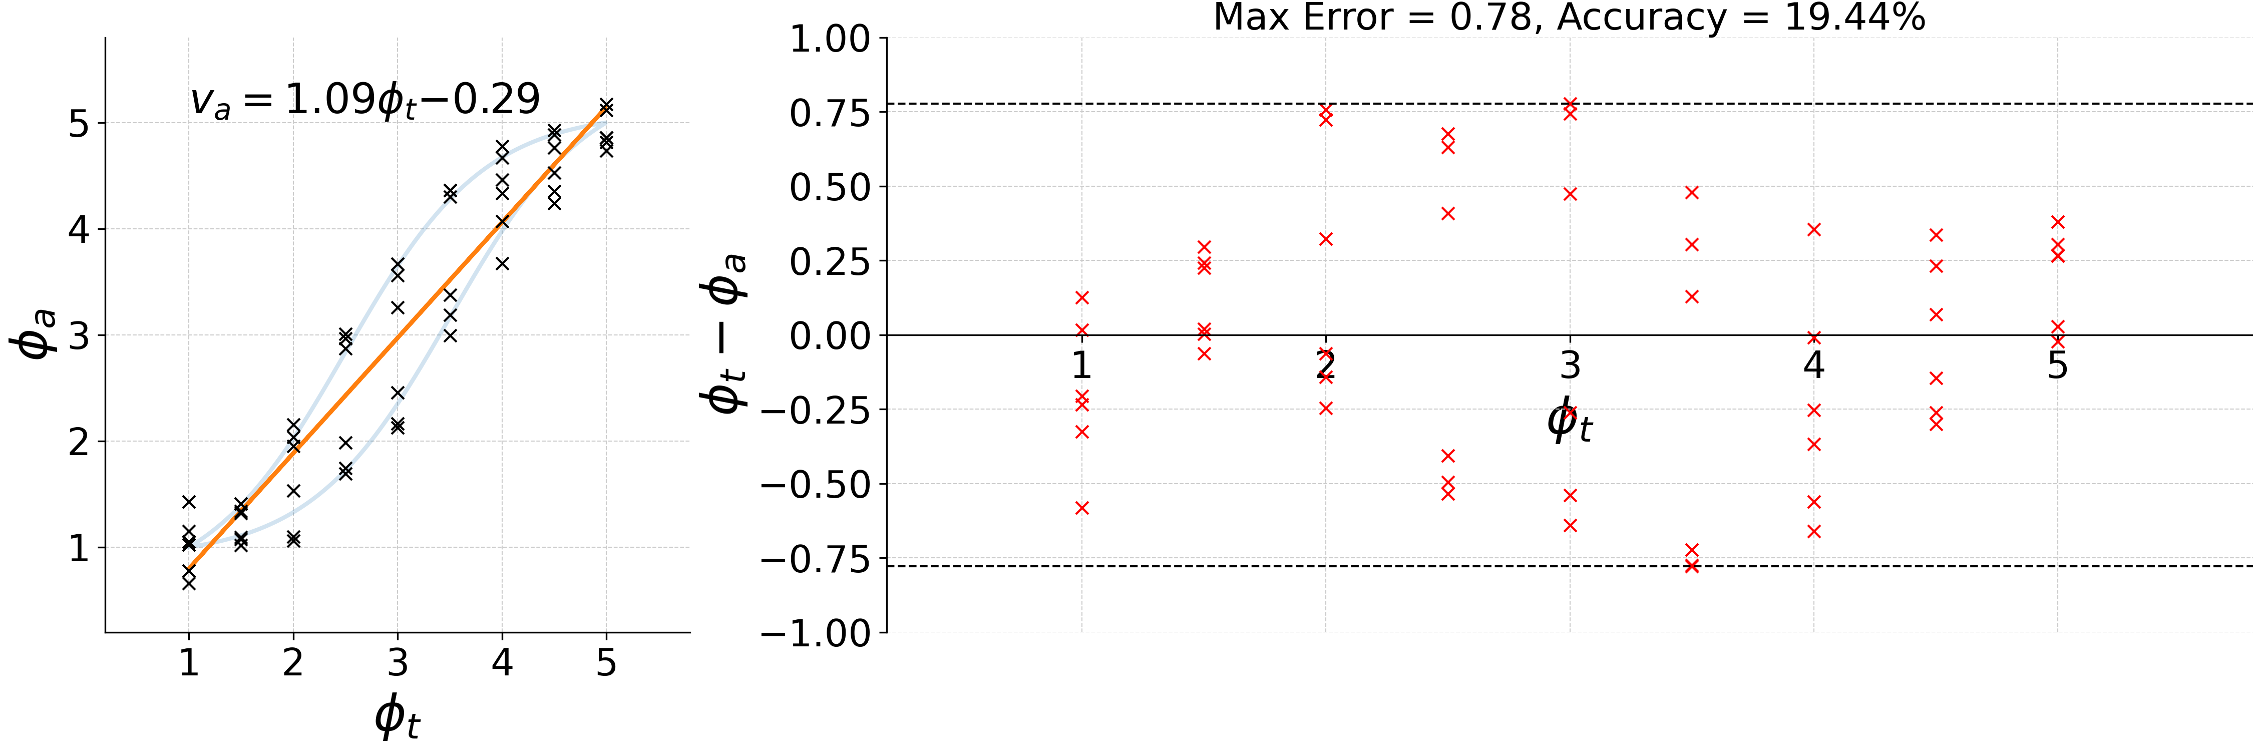
Sensor static characteristics
Hysteresis

Slide 33
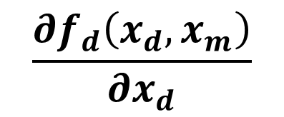
Sensor static characteristics
Static sensitivity.
$$\frac{∂f_{d}\left(x_{d},x_{m}\right)}{∂x_{d}}$$
$$y=f_{d}\left(x_{d},x_{m}\right)+f_{i}\left(x_{i},x_{m}\right)+ε →$$

Slide 34
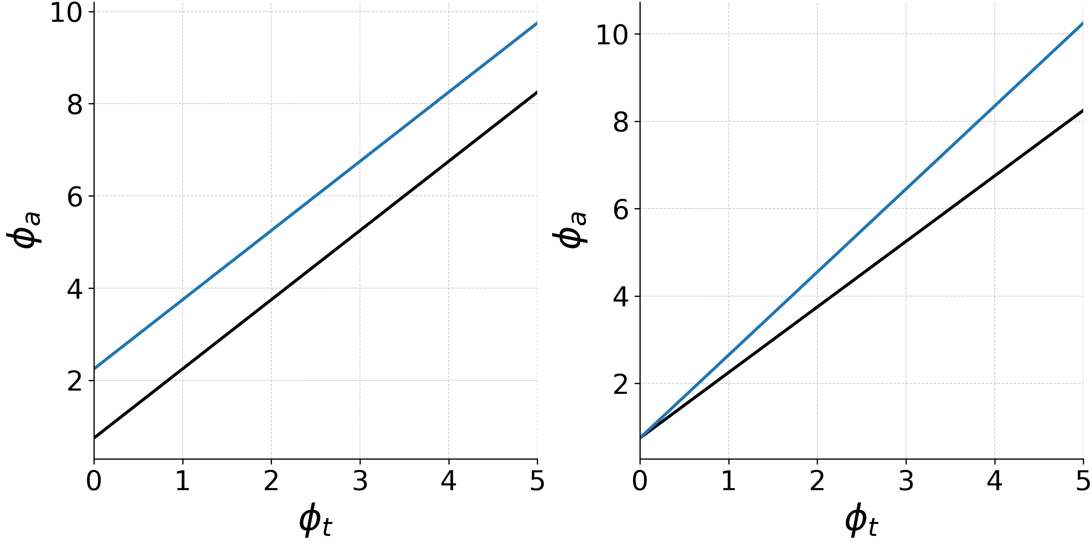
Sensor static characteristics
Zero drift and Sensitivity drift

