Slide 1
Transducers & Instrumentation
Module 01/02
(Sensor Dynamics Characteristics; LTI system; Convolution; Laplace Transform; Frequency Response; Zero, First, and Second Order LTI systems)

Slide 2
Sensor dynamic characterization
Many sensors do not respond instantaneously to a given input.
E.g., Contact thermometer
Mathematically described using differential equations relating the measured and other inputs to the sensor output.
A common and very useful model for such dynamical systems are linear time invariant systems.

Slide 3
Linear Time Invariant Systems
Both Linear and Time Invariant.
Linear Time Invariant System

Slide 4

Some useful signals
Step signal: $1\left(t\right)=\left\{\begin{matrix}1 & t≥0 \\ 0 & t<0\end{matrix}\right.$
Exponential signal: ${A∙e}^{βt}$
Sinusoidal signals: $A∙\sin\left(ωt+φ\right)$

Slide 5

Some useful signals
Dirac Delta Function $δ\left(t\right)$: $\int_{a}^{b}{δ\left(t\right)dt=\left\{\begin{matrix}1, & 0∈[a, b] \\ 0, & 0∉[a, b]\end{matrix}\right.}$
$$\int_{a}^{b}{f\left(t\right)δ\left(t−t_{0}\right)dt=\left\{\begin{matrix}f\left(t_{0}\right), & t_{0}∈[a, b] \\ 0, & t_{0}∉[a, b]\end{matrix}\right.}$$

Slide 6


Input-Output Relationship of LTI systems
LTI System
$$x\left(t\right)$$
$$y\left(t\right)$$

Slide 7


Impulse Response
LTI System
$$δ\left(t\right)$$
$$h\left(t\right)$$

Slide 8
Convolution
LTI System
$$x\left(t\right)$$
$$y\left(t\right)$$

Slide 9


Another Description of LTI systems
LTI System
$$x\left(t\right)$$
$$y\left(t\right)$$
$$a_{n}\frac{d^{n}y}{{dt}^{n}}+a_{n−1}\frac{d^{n−1}y}{{dt}^{n−1}}+⋯+a_{1}\frac{dy}{dt}+a_{0}y=b_{m}\frac{d^{m}x}{{dt}^{m}}+b_{m−1}\frac{d^{m−1}x}{{dt}^{m−1}}+⋯+b_{0}x$$

Slide 10
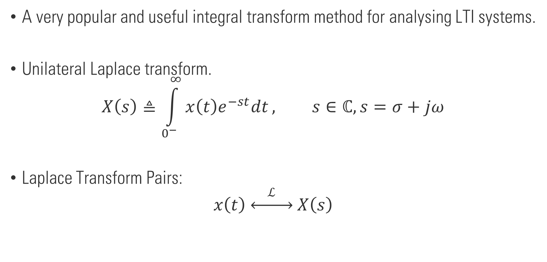
Laplace Transform
A very popular and useful integral transform method for analysing LTI systems.
Unilateral Laplace transform.
$$X\left(s\right)≜\int_{0^{−}}^{∞}{x\left(t\right)e^{−st}dt}, s∈ℂ, s=σ+jω$$
Laplace Transform Pairs:
$$x\left(t\right) \underset{↔}{ ℒ } X\left(s\right)$$

Slide 11
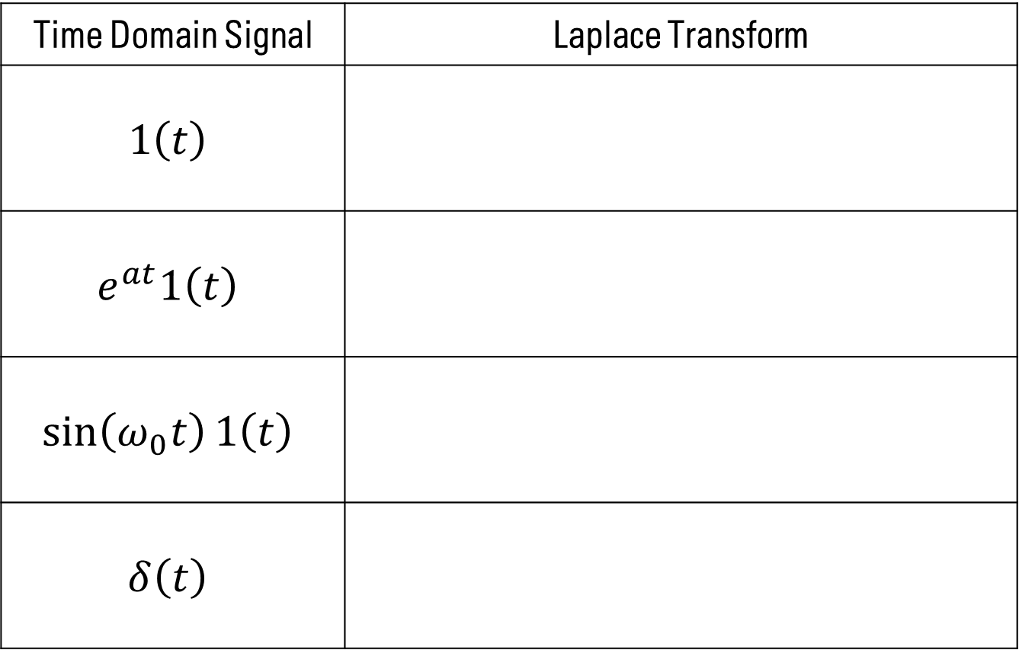
Laplace Transform Pairs
Time Domain Signal | Laplace Transform
$$1\left(t\right)$$
$$e^{at}1\left(t\right)$$
$$\sin\left(ω_{0}t\right)1\left(t\right)$$
$$δ\left(t\right)$$

Slide 12

Laplace Transform Property
$x\left(t\right)$ and $X\left(s\right)$ are Laplace transform pairs. Then,
$$y\left(t\right) \underset{↔}{ ℒ } Y\left(s\right)⟹ax\left(t\right)+by\left(t\right)\underset{↔}{ ℒ }a X\left(s\right)+bY(s)$$
$$x\left(t\right) \underset{↔}{ ℒ } X\left(s\right)⟹\frac{dx}{dt} \underset{↔}{ ℒ } sX\left(s\right)−x\left(0^{−}\right)$$

Slide 13
Why is the Laplace Transform useful for LTI systems?
LTI System
$$x\left(t\right)$$
$$y\left(t\right)$$

Slide 14

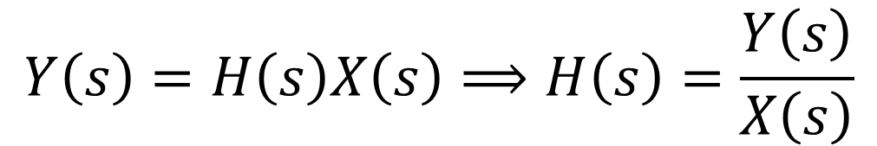
Transfer Function of an LTI system
LTI System
$$x\left(t\right)$$
$$y\left(t\right)=h\left(t\right)∗x\left(t\right)$$
$$Y\left(s\right)=H\left(s\right)X\left(s\right)⟹H\left(s\right)=\frac{Y\left(s\right)}{X\left(s\right)}$$

Slide 15
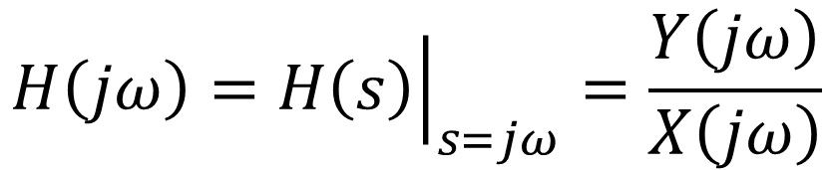
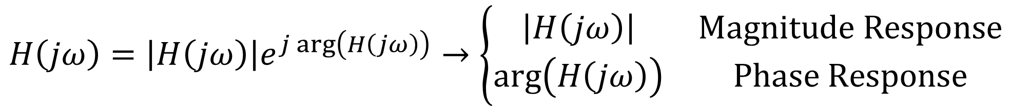
Frequency Response of an LTI System
LTI System
$$x\left(t\right)$$
$$y\left(t\right)=h\left(t\right)∗x\left(t\right)$$
$$H\left(jω\right)={\left.H\left(s\right)\right|}_{s=jω}=\frac{Y\left(jω\right)}{X\left(jω\right)}$$
$$H\left(jω\right)=\left|H\left(jω\right)\right|e^{j arg\left(H\left(jω\right)\right)}→\left\{\begin{matrix}\left|H\left(jω\right)\right| & Magnitude Response \\ arg\left(H\left(jω\right)\right) & Phase Response\end{matrix}\right.$$

Slide 16



Zero Order System
LTI System
$$x\left(t\right)$$
$$y\left(t\right)$$
$$a_{0}y\left(t\right)=b_{0}x\left(t\right)$$
Pure Linear Resistor
Pure Linear Spring

Slide 17
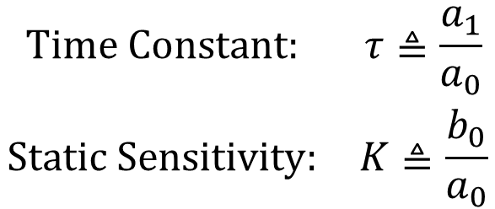
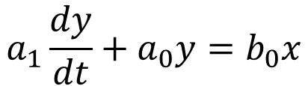
First Order System
LTI System
$$x\left(t\right)$$
$$y\left(t\right)$$
$$a_{1}\frac{dy}{dt}+a_{0}y=b_{0}x$$
$$\begin{matrix}Time Constant: & τ≜\frac{a_{1}}{a_{0}} \\ Static Sensitivity: & K≜\frac{b_{0}}{a_{0}}\end{matrix}$$

Slide 18


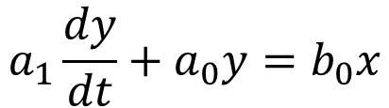
First Order System
LTI System
$$x\left(t\right)$$
$$y\left(t\right)$$
$$a_{1}\frac{dy}{dt}+a_{0}y=b_{0}x$$
RC / RL circuits
Spring-damper/Mass-damper

Slide 19
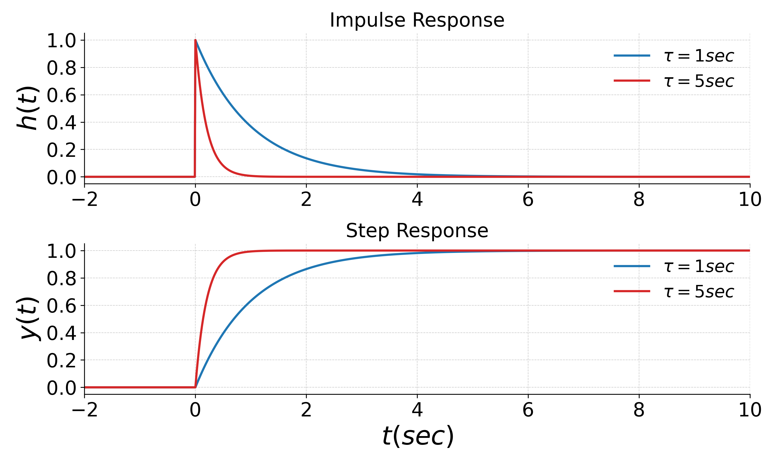
First Order System

Slide 20
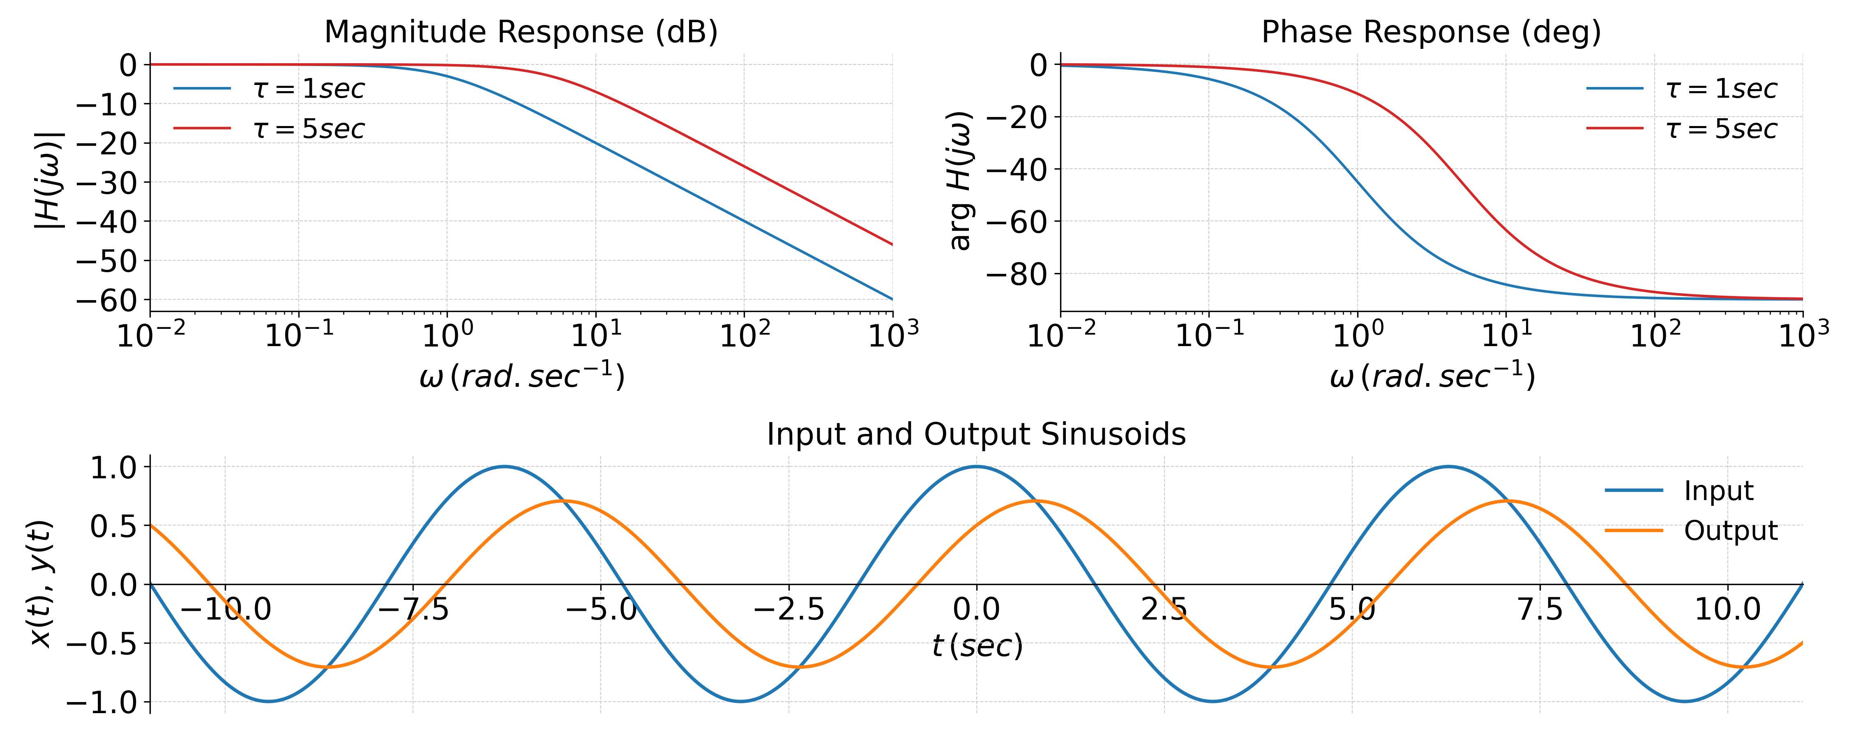
First Order System

Slide 21
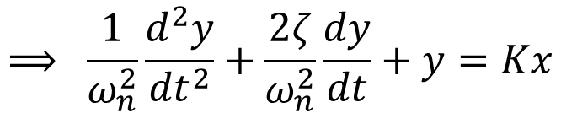
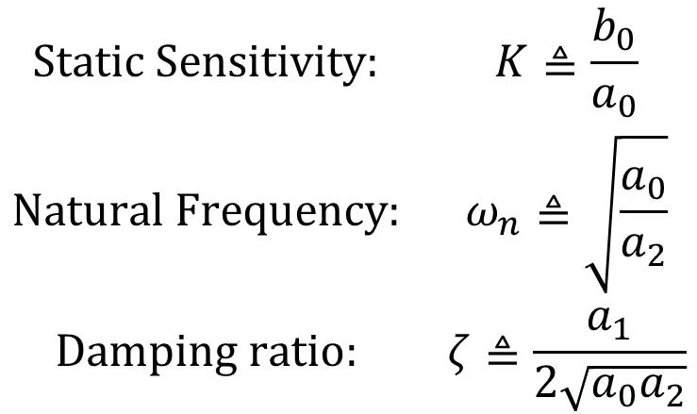
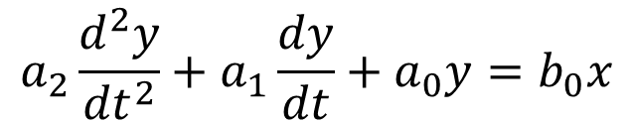
Second Order System
LTI System
$$x\left(t\right)$$
$$y\left(t\right)$$
$$a_{2}\frac{d^{2}y}{{dt}^{2}}+a_{1}\frac{dy}{dt}+a_{0}y=b_{0}x$$
$$\begin{matrix}Static Sensitivity: & K≜\frac{b_{0}}{a_{0}} \\ Natural Frequency: & ω_{n}≜\sqrt{\frac{a_{0}}{a_{2}}} \\ Damping ratio: & ζ≜\frac{a_{1}}{2\sqrt{a_{0}a_{2}}}\end{matrix}$$
$$⟹ \frac{1}{ω_{n}^{2}}\frac{d^{2}y}{{dt}^{2}}+\frac{2ζ}{ω_{n}^{2}}\frac{dy}{dt}+y=Kx$$

Slide 22
Second Order System
LTI System
$$x\left(t\right)$$
$$y\left(t\right)$$
$$a_{2}\frac{d^{2}y}{{dt}^{2}}+a_{1}\frac{dy}{dt}+a_{0}y=b_{0}x$$
RLC circuits
Mass-Spring-damper

Slide 23
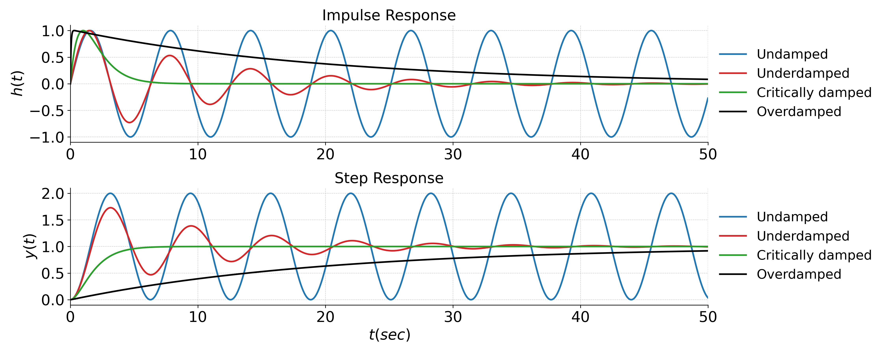
Second Order System Response

Slide 24
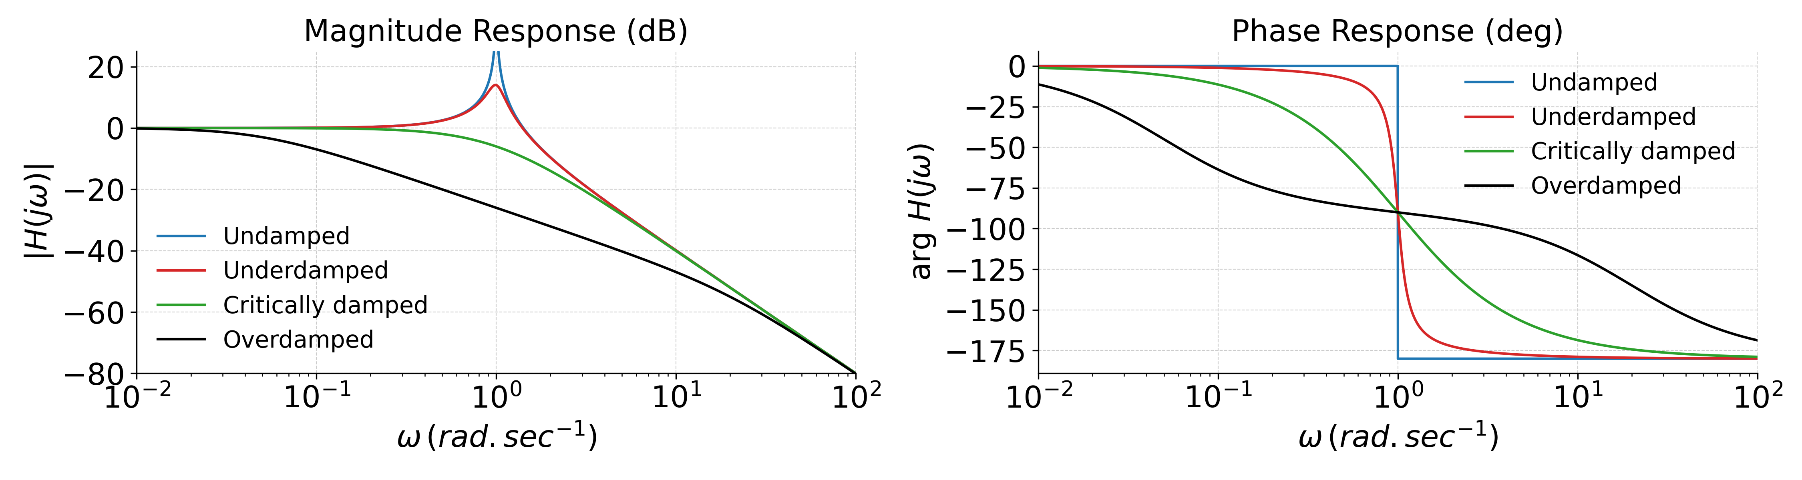
Second Order System – Frequency Response

Slide 25
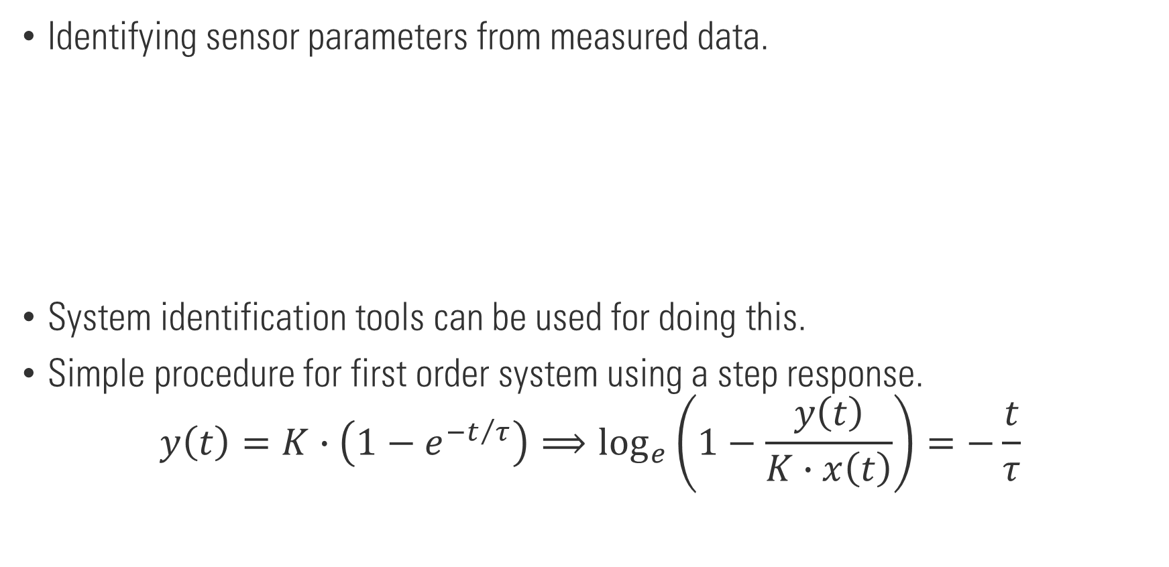
Dynamic characterization of sensors
Identifying sensor parameters from measured data.
System identification tools can be used for doing this.
Simple procedure for first order system using a step response.
$$y\left(t\right)=K∙\left(1−e^{−t/τ}\right)⟹\log_{e}\left(1−\frac{y\left(t\right)}{K∙x\left(t\right)}\right)=−\frac{t}{τ}$$
LTI System
$$x\left(t\right)$$
$$y\left(t\right)$$

Slide 26
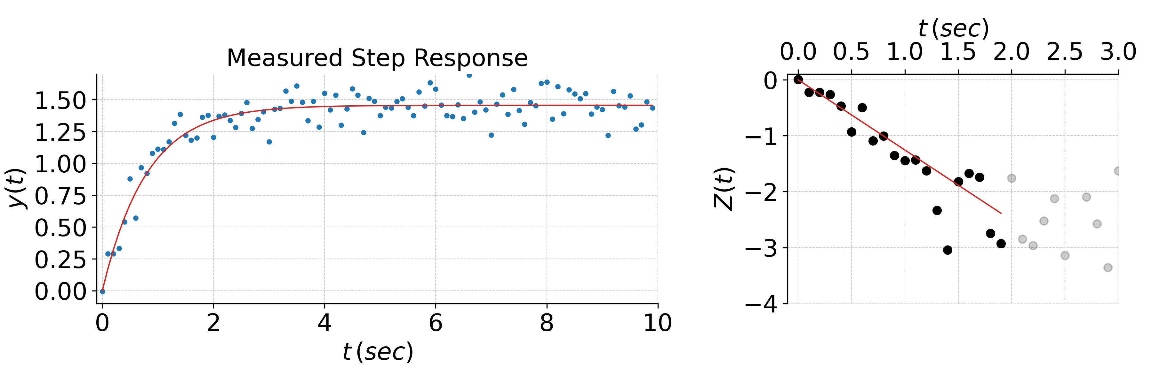
Dynamic characterization of sensors

Slide 27


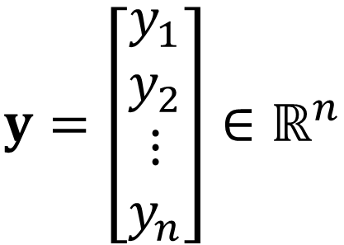
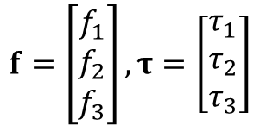

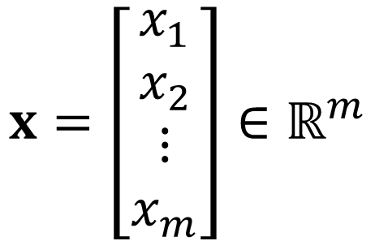

Multi-Input Multi-Output Case
We are often interested in measurands that have multiple components.
Sensor
$$f=\left[\begin{matrix}f_{1} \\ f_{2} \\ f_{3}\end{matrix}\right],τ=\left[\begin{matrix}τ_{1} \\ τ_{2} \\ τ_{3}\end{matrix}\right]$$
$$x$$
$$y$$
$$x=\left[\begin{matrix}x_{1} \\ x_{2} \\ ⋮ \\ x_{m}\end{matrix}\right]∈ℝ^{m}$$
$$y=\left[\begin{matrix}y_{1} \\ y_{2} \\ ⋮ \\ y_{n}\end{matrix}\right]∈ℝ^{n}$$
$$x_{i}∈ℝ, 1≤i≤m$$
$$y_{i}∈ℝ, 1≤i≤n$$

Slide 28
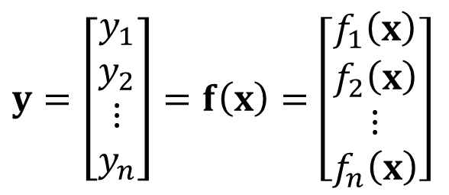
Multi-Input Multi-Output Case
A general MIMO sensor
$$y=\left[\begin{matrix}y_{1} \\ y_{2} \\ ⋮ \\ y_{n}\end{matrix}\right]=f\left(x\right)=\left[\begin{matrix}f_{1}\left(x\right) \\ f_{2}\left(x\right) \\ ⋮ \\ f_{n}\left(x\right)\end{matrix}\right]$$
$f_{i}\left(x\right):$ Sensor output due to all the individual measurands at the input.

Slide 29
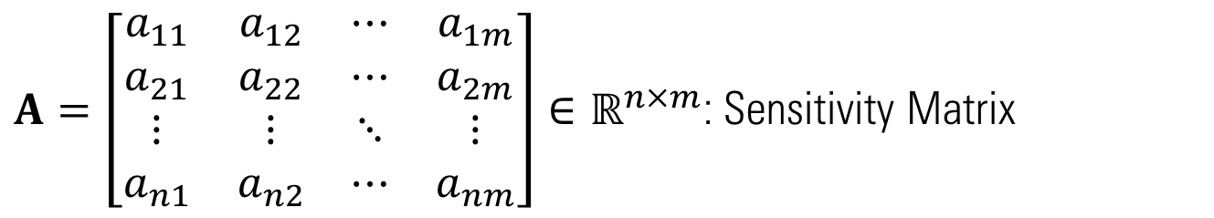
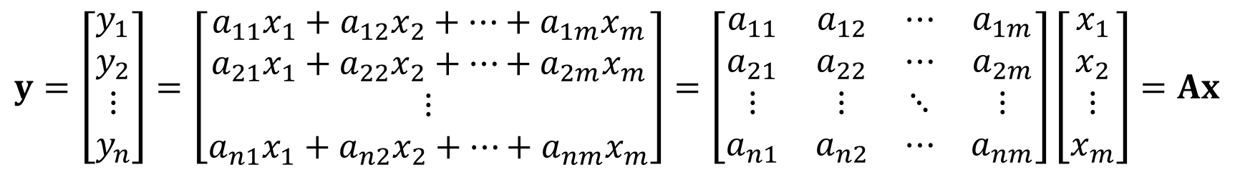
Linear MIMO Sensor
$$y=\left[\begin{matrix}y_{1} \\ y_{2} \\ ⋮ \\ y_{n}\end{matrix}\right]=\left[\begin{matrix}a_{11}x_{1}+a_{12}x_{2}+⋯+a_{1m}x_{m} \\ a_{21}x_{1}+a_{22}x_{2}+⋯+a_{2m}x_{m} \\ ⋮ \\ a_{n1}x_{1}+a_{n2}x_{2}+⋯+a_{nm}x_{m}\end{matrix}\right]=\left[\begin{matrix}a_{11} & a_{12} & ⋯ & a_{1m} \\ a_{21} & a_{22} & ⋯ & a_{2m} \\ ⋮ & ⋮ & ⋱ & ⋮ \\ a_{n1} & a_{n2} & ⋯ & a_{nm}\end{matrix}\right]\left[\begin{matrix}x_{1} \\ x_{2} \\ ⋮ \\ x_{m}\end{matrix}\right]=Ax$$
$A=\left[\begin{matrix}a_{11} & a_{12} & ⋯ & a_{1m} \\ a_{21} & a_{22} & ⋯ & a_{2m} \\ ⋮ & ⋮ & ⋱ & ⋮ \\ a_{n1} & a_{n2} & ⋯ & a_{nm}\end{matrix}\right]∈ℝ^{n×m}$: Sensitivity Matrix
$a_{ij}=\frac{∂y_{i}}{∂x_{j}}$: Sensitivity of the i^{th} output to the j^{th} input.

Slide 30
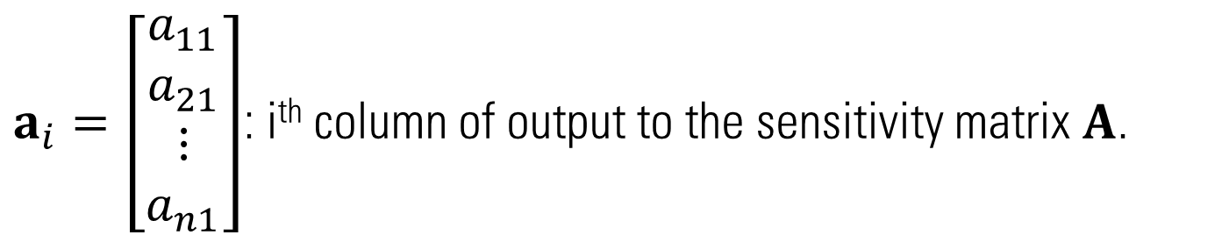

Linear MIMO Sensor
$$y=\left[\begin{matrix}y_{1} \\ y_{2} \\ ⋮ \\ y_{n}\end{matrix}\right]=\left[\begin{matrix}a_{11} \\ a_{21} \\ ⋮ \\ a_{n1}\end{matrix}\right]x_{1}+\left[\begin{matrix}a_{12} \\ a_{22} \\ ⋮ \\ a_{n2}\end{matrix}\right]x_{2}+⋯+\left[\begin{matrix}a_{1m} \\ a_{2m} \\ ⋮ \\ a_{nm}\end{matrix}\right]x_{m}=Ax$$
$a_{i}=\left[\begin{matrix}a_{11} \\ a_{21} \\ ⋮ \\ a_{n1}\end{matrix}\right]$: i^{th} column of output to the sensitivity matrix $A$.

Slide 31
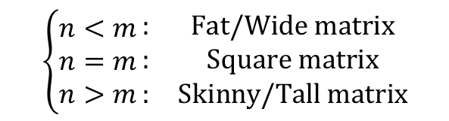


Linear MIMO Sensor
$$\left\{\begin{aligned}n<m \\ n=m \\ n>m\end{aligned}\right.\begin{matrix}: & Fat/Wide matrix \\ : & Square matrix \\ : & Skinny/Tall matrix\end{matrix}$$
$$y=Ax$$
$$A∈ℝ^{n×m}$$
For sensing $A$ must be square or tall, i.e., more outputs than inputs.
Square or Tall $A$ is full rank $→Ax=0$ if and only if $x=0$.
If $A$ is square and full rank, then $A^{−1}$ exists, where $AA^{−1}=A^{−1}A=I_{n}$.
$$⟹x=A^{−1}y$$
Real scenario:
$$y=Ax+ε ⟹ \hat{x}=A^{−1}y=x+A^{−1}ε$$

Slide 32



Linear MIMO Sensor
$$\left\{\begin{aligned}n<m \\ n=m \\ n>m\end{aligned}\right.\begin{matrix}: & Fat/Wide matrix \\ : & Square matrix \\ : & Skinny/Tall matrix\end{matrix}$$
$$y=Ax$$
$$A∈ℝ^{n×m}$$
When $A$ is tall, there is no $A^{−1}$ but we can use the pseudoinverse,
$$A^{†}={\left(A^{T}A\right)}^{−1}A^{T}$$
Where, $A^{†}A=I_{m}$
Real scenario:
$$y=Ax+ε ⟹ \hat{x}=A^{†}y=x+A^{†}ε$$
$\hat{x}=A^{†}y$ is the least squares estimate of $x$, which allows to average out the contribution of the noise $ε$.

