Slide 1
Transducers & Instrumentation
Module 02
(Basic Instrumentation)

Slide 2


A typical measurement system
Sensor
Analog Processing System
Analog-to-Digital Converter
Display Unit
(or)
Computing Unit
Physiological Process
Amplification
Attenuation
Filtering
Signal conversion
.
.
.
$$i_{1}$$
Sensor
Analog Processing System
$$v_{1}$$
Interface

Slide 3
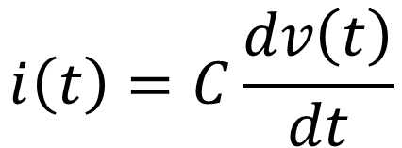
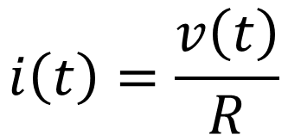
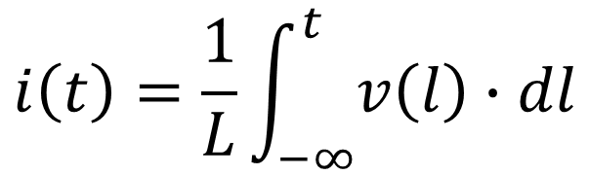
Basic (linear) Electrical Circuits
$$i\left(t\right)=\frac{v\left(t\right)}{R}$$
$$i\left(t\right)=C\frac{dv\left(t\right)}{dt}$$
$$i\left(t\right)=\frac{1}{L}\int_{−∞}^{t}{v\left(l\right)∙dl}$$

Slide 4
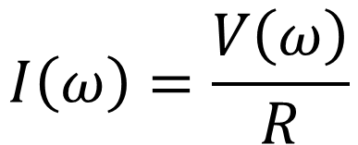
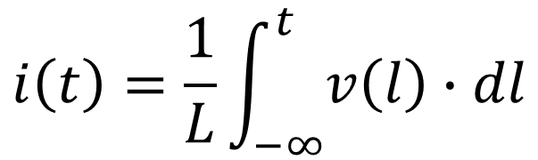
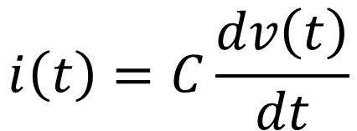
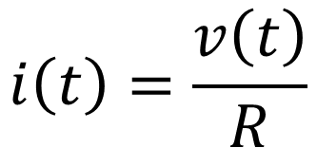
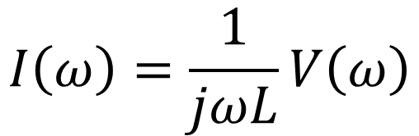

Linear Electrical Circuits – Frequency Domain Characteristics
$$i\left(t\right)=\frac{v\left(t\right)}{R}$$
$$I\left(ω\right)=\frac{V\left(ω\right)}{R}$$
$$i\left(t\right)=C\frac{dv\left(t\right)}{dt}$$
$$I\left(ω\right)=jωC∙V\left(ω\right)$$
$$i\left(t\right)=\frac{1}{L}\int_{−∞}^{t}{v\left(l\right)∙dl}$$
$$I\left(ω\right)=\frac{1}{jωL}V\left(ω\right)$$

Slide 5
Behaviour of some simple linear circuits

Slide 6
Equivalent circuit
Thevenin Equivalent Circuit

Slide 7


Analog processing of sensor output
Sensor Equivalent Circuit
Interface
$$i_{1}$$
Sensor
Analog Processing System
$$v_{1}$$
Sensor as seen by the analog processing system
Analog processing circuit seen by the sensor
Output Impedance
Input Impedance

Slide 8





Analog processing of sensor output
Interface
Loading occurs because of the finite input and non-zero output impedance
$$i_{1}$$
Sensor
Analog Processing System
$$v_{1}$$
$v_{1}=\frac{R_{L}}{R_{s}+R_{L}}v_{s} ⟹ v_{1}$< $v_{s}$
$$i_{1}$$
How can we reduce loading?
$$v_{1}$$
Analog Processing System
Sensor

Slide 9




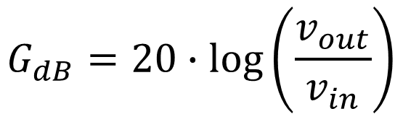

Analog processing: Amplifier
Amplifier
$$v_{in}$$
$$v_{out}$$
Frequency Response of amplifier
$$v_{out}=G∙v_{in}$$
$$G\left(ω\right)$$
$$G_{dB}=20∙\log\left(\frac{v_{out}}{v_{in}}\right)$$
$$ω$$

Slide 10








Analog processing: Amplifier
Sensor
Amplifier
Load
Amplifier
$$v_{out}$$
$$R_{s}$$
$$R_{out}$$
$$v_{in}$$
$$g∙v_{in}$$
$$v_{out}$$
$$R_{l}$$
$$v_{s}$$
$$R_{in}$$
Loading in real amplifiers

Slide 11

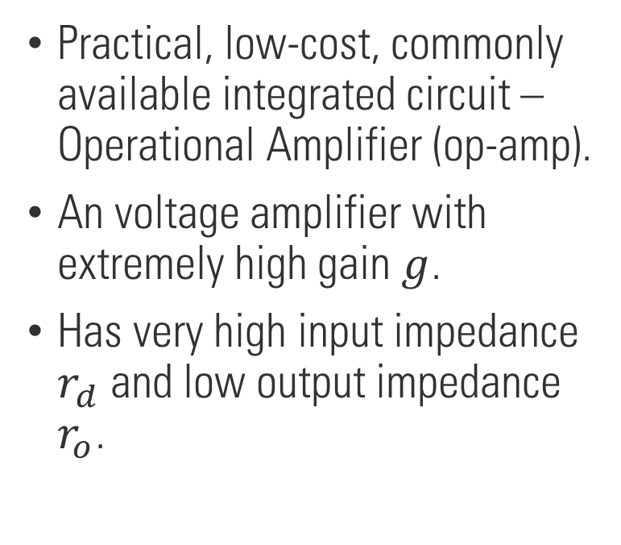




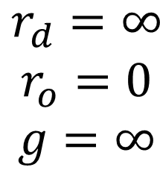



Operational Amplifier
Practical, low-cost, commonly available integrated circuit – Operational Amplifier (op-amp).
An voltage amplifier with extremely high gain $g$.
Has very high input impedance $r_{d}$ and low output impedance $r_{o}$.
$$−$$
$$v_{n}$$
$$r_{o}$$
$$v_{o}$$
$$r_{d}$$
$$v_{p}$$
$$+$$
Ideal Op-amp
$$v_{o}=g∙v_{d}=g∙\left(v_{p}−v_{n}\right)$$
$$\begin{matrix}r_{d}=∞ \\ r_{o}=0 \\ g=∞\end{matrix}$$

Slide 12









Operational Amplifier
$$V_{cc}/V_{ss}$$
$$−$$
$$v_{n}$$
$$r_{o}$$
$$v_{o}$$
$$r_{d}$$
$$v_{p}$$
$$+$$
$$V_{EE}/V_{DD}$$

Slide 13


Non-Inverting Amplifier
$$v_{in}$$
$$v_{out}$$

Slide 14

Voltage follower
$$v_{in}$$
$$v_{out}$$

Slide 15


Inverting Amplifier
$$v_{in}$$
$$v_{out}$$

Slide 16











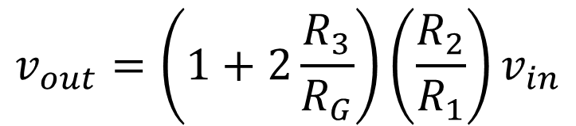
Three OpAmp Instrumentation Amplifier
$$−$$
$$R_{1}$$
$$R_{2}$$
$$R_{3}$$
$$−$$
$$v_{in}$$
$$R_{G}$$
$$v_{out}=\left(1+2\frac{R_{3}}{R_{G}}\right)\left(\frac{R_{2}}{R_{1}}\right)v_{in}$$
$$R_{3}$$
$$R_{1}$$
$$R_{2}$$
$$+$$

Slide 17
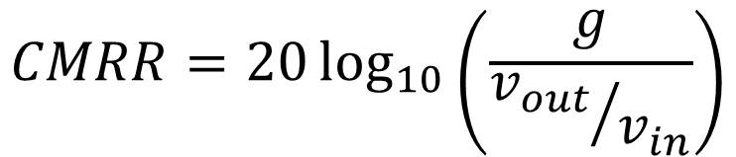


Common Mode Rejection
The ability of an op-amp to reject a common signal that appears at both its input terminals.
$$v_{in}$$
$$v_{out}$$
$$CMRR=20\log_{10}\left(\frac{g}{{v_{out}}/{v_{in}}}\right)$$

Slide 18
Frequency selective filters
LTI system can be used for implementing frequency selective filters, i.e. to modify the amplitude and phase of sinusoidal signals without affecting their frequency.

Slide 19
Frequency selective filters

Slide 20
Passive filters
Passive filters are made from passive elements – resistors, capacitors, and inductors.

Slide 21
Active filters
Active filter use active elements, e.g. op-amp.
Avoid attenuation introduced by the filter in the passband.
Provide interstage isolations.
Can implement filters without inductors.

Slide 22

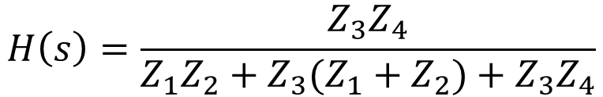



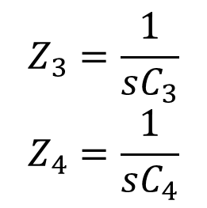


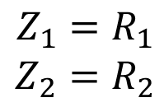
Active Lowpass Filter
$$C_{3}$$
$$H\left(s\right)=\frac{Z_{3}Z_{4}}{Z_{1}Z_{2}+Z_{3}(Z_{1}+Z_{2})+Z_{3}Z_{4}}$$
$$R_{1}$$
$$R_{2}$$
$$Z_{3}=\frac{1}{sC_{3}}$$
$$Z_{4}=\frac{1}{sC_{4}}$$
$$Z_{1}=R_{1}$$
$$Z_{2}=R_{2}$$
$$v_{in}$$
$$C_{4}$$
$$v_{out}$$

Slide 23


Determining the frequency response of a system
System
$$x(t)$$
$$y(t)$$

Slide 24


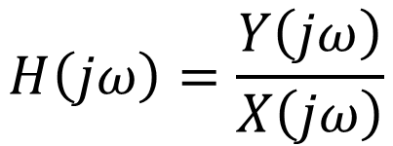
Determining the frequency response of a system
System
$$x(t)$$
$$y(t)$$
$$H\left(jω\right)=\frac{Y\left(jω\right)}{X\left(jω\right)}$$

