Slide 1
Transducers & Instrumentation
Module 03 - 01
Measuring Movements

Slide 2


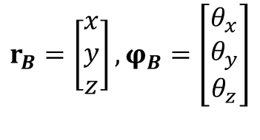


Kinematics
Study of motion without considering the forces/torques driving the motion.
$$r_{P}=\left[\begin{matrix}x \\ y \\ z\end{matrix}\right]$$
$$r_{B}=\left[\begin{matrix}x \\ y \\ z\end{matrix}\right],φ_{B}=\left[\begin{matrix}θ_{x} \\ θ_{y} \\ θ_{z}\end{matrix}\right]$$
Point
$$y$$
Rigid body
$$x$$
The number of components required depends on the number of degrees of freedom.
$$z$$

Slide 3
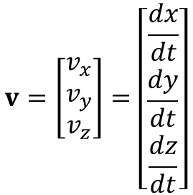
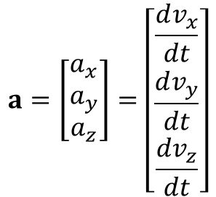
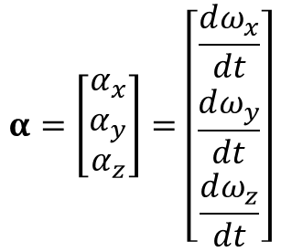
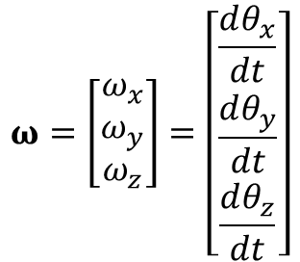
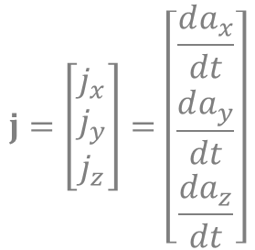
Kinematics
Derivatives of position and orientation measurements
$$v=\left[\begin{matrix}v_{x} \\ v_{y} \\ v_{z}\end{matrix}\right]=\left[\begin{matrix}\frac{dx}{dt} \\ \frac{dy}{dt} \\ \frac{dz}{dt}\end{matrix}\right]$$
$$a=\left[\begin{matrix}a_{x} \\ a_{y} \\ a_{z}\end{matrix}\right]=\left[\begin{matrix}\frac{dv_{x}}{dt} \\ \frac{dv_{y}}{dt} \\ \frac{dv_{z}}{dt}\end{matrix}\right]$$
$$j=\left[\begin{matrix}j_{x} \\ j_{y} \\ j_{z}\end{matrix}\right]=\left[\begin{matrix}\frac{da_{x}}{dt} \\ \frac{da_{y}}{dt} \\ \frac{da_{z}}{dt}\end{matrix}\right]$$
Linear velocity
Linear acceleration
Linear Jerk
$$ω=\left[\begin{matrix}ω_{x} \\ ω_{y} \\ ω_{z}\end{matrix}\right]=\left[\begin{matrix}\frac{dθ_{x}}{dt} \\ \frac{dθ_{y}}{dt} \\ \frac{dθ_{z}}{dt}\end{matrix}\right]$$
$$α=\left[\begin{matrix}α_{x} \\ α_{y} \\ α_{z}\end{matrix}\right]=\left[\begin{matrix}\frac{dω_{x}}{dt} \\ \frac{dω_{y}}{dt} \\ \frac{dω_{z}}{dt}\end{matrix}\right]$$
Angular velocity
Angular Acceleration

Slide 4
Position measurement
Measurement are made with respect to a reference.
Different approaches:
Resistive sensors
Inductive sensors
Capacitive sensors
Camera-based sensors

Slide 5
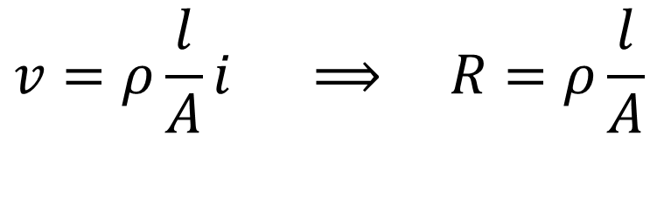



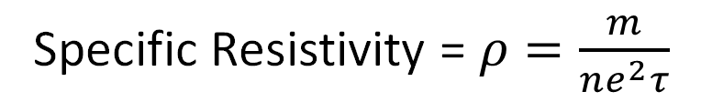
Resistance of a material
$$l$$
$$v=ρ\frac{l}{A}i ⟹ R=ρ\frac{l}{A}$$
$$A$$
Specific Resistivity = $ρ=\frac{m}{ne^{2}τ}$
$$v$$

Slide 6





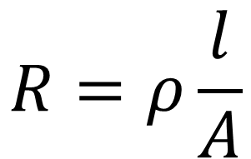






Potentiometer for measuring position
$$R=ρ\frac{l}{A}$$
Change in length leads to change in resistance.
$$θ$$
$$R_{x}$$
$$x$$
$$R−R_{θ}$$
$$x=0$$
$$x=L$$
$$R_{θ}$$
$$R_{x}$$
$$R−R_{x}$$
$$θ=0$$
$$θ=θ_{F}$$

Slide 7

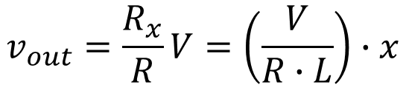

Potentiometer for measuring position
What happens when there is loading?
$${R−R}_{x}$$
$$v_{out}=\frac{R_{x}}{R}V=\left(\frac{V}{R∙L}\right)∙x$$
$$R_{x}$$
$$R_{x}$$

Slide 8

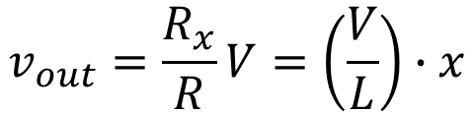


Potentiometer for measuring position
Interfering Inputs
Electrical noise in the circuit.
Noise due to changes in wiper contact resistance.
Wiper bounce over the resistor during movement.
$$R_{x}$$
$${R−R}_{x}$$
$$v_{out}=\frac{R_{x}}{R}V=\left(\frac{V}{L}\right)∙x$$
$$R_{x}$$
Modifying Inputs
Supply voltage $V.$

Slide 9
Potentiometer for measuring position
Problems:
Movement of the wiper against friction.
Mechanical wear
High frequency measurements are problematic (friction, slider bounce, etc.)

Slide 10
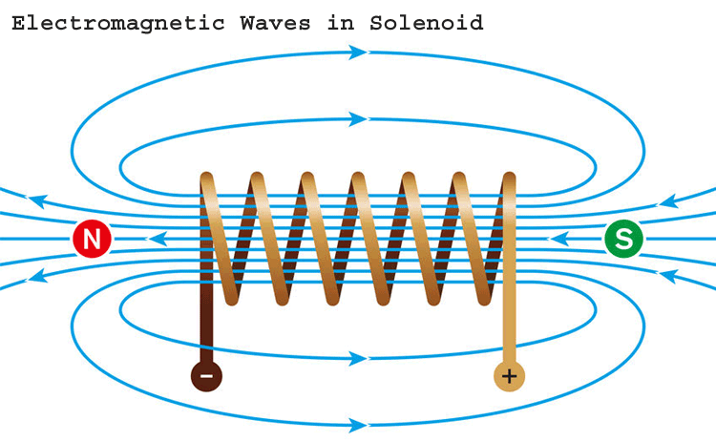


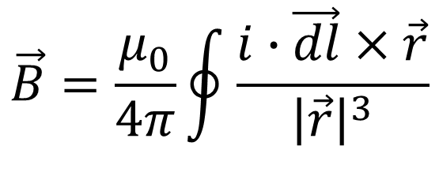
Inductance
Moving changes produce magnetic fields.
$$i$$
$$\vec{B}=\frac{μ_{0}}{4π}\oint{\frac{i∙\vec{dl}×\vec{r}}{{\left|\vec{r}\right|}^{3}}}$$
Source: https://circuitdigest.com/sites/default/files/field/image/What-is-Solenoid.png
$$B=μ_{0}∙i∙n$$

Slide 11



Inductance
Magnetic flux
Magnetic induction
$$φ=\int{\vec{B}∙\vec{dS}}$$
$$φ$$
$$e=−\frac{dφ}{dt}$$

Slide 12
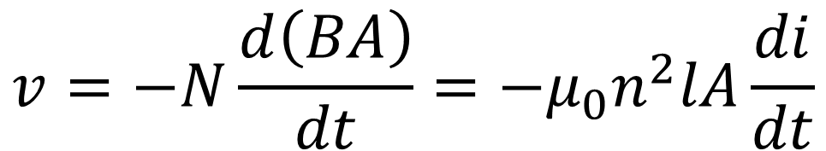
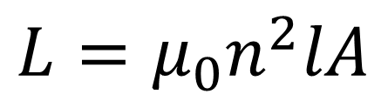
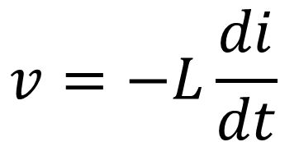
Inductance
$$v=−N\frac{d\left(BA\right)}{dt}=−μ_{0}n^{2}lA\frac{di}{dt}$$
$$v=−L\frac{di}{dt}$$
Source: https://circuitdigest.com/sites/default/files/field/image/What-is-Solenoid.png
$$L=μ_{0}n^{2}lA$$

Slide 13
Linear Variable Differential Transformer (LVDT)

Slide 14


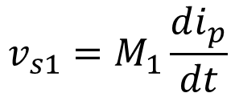






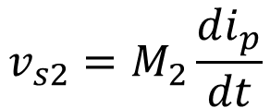

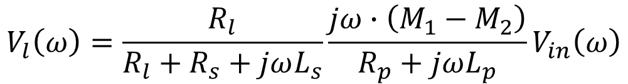


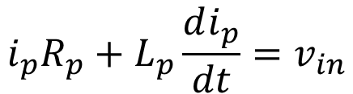

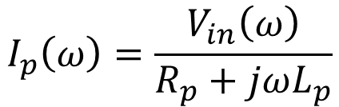
LVDT
$${L_{s}}/2$$
$${R_{s}}/2$$
$$i_{p}R_{p}+L_{p}\frac{di_{p}}{dt}=v_{in}$$
$$i_{p}$$
$$R_{p}$$
$$v_{s1}$$
$$v_{s1}=M_{1}\frac{di_{p}}{dt}$$
$$R_{l}$$
$$v_{l}$$
$$L_{p}$$
$$v_{s2}=M_{2}\frac{di_{p}}{dt}$$
$${L_{s}}/2$$
$${R_{s}}/2$$
$$v_{in}$$
$$v_{s2}$$
$$I_{p}\left(ω\right)=\frac{V_{in}\left(ω\right)}{R_{p}+jωL_{p}}$$
$$V_{l}\left(ω\right)=\frac{R_{l}}{R_{l}+R_{s}+jωL_{s}}\frac{jω∙\left(M_{1}−M_{2}\right)}{R_{p}+jωL_{p}}V_{in}\left(ω\right)$$

Slide 15








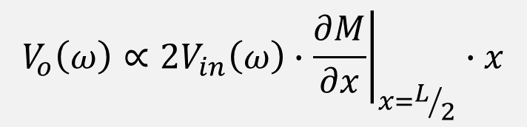

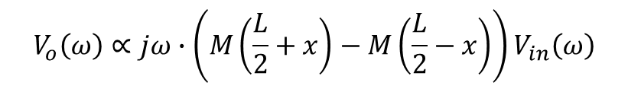


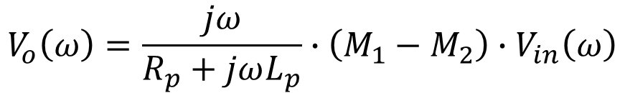



LVDT
$${L_{s}}/2$$
$${R_{s}}/2$$
$$V_{o}\left(ω\right)=\frac{jω}{R_{p}+jωL_{p}}∙\left(M_{1}−M_{2}\right)∙V_{in}\left(ω\right)$$
$$i_{p}$$
$$R_{p}$$
$$v_{s1}$$
$$v_{o}$$
Let’s assume the core is moved by $x$ units
$$L_{p}$$
$$V_{s1}\left(ω\right)={jω∙M}_{1}\left(x\right)V_{in}\left(ω\right)=jω∙M\left(\frac{L}{2}+x\right)V_{in}\left(ω\right)$$
$${L_{s}}/2$$
$${R_{s}}/2$$
$$v_{in}$$
$$V_{s2}\left(ω\right)=jω∙M_{2}\left(x\right)V_{in}\left(ω\right)=jω∙M\left(\frac{L}{2}−x\right)V_{in}\left(ω\right)$$
$$v_{s2}$$
$$V_{o}\left(ω\right)∝jω∙\left(M\left(\frac{L}{2}+x\right)−M\left(\frac{L}{2}−x\right)\right)V_{in}\left(ω\right)$$
$$V_{o}\left(ω\right)∝2V_{in}\left(ω\right)∙{\left.\frac{∂M}{∂x}\right|}_{x=L/2}∙x$$

Slide 16
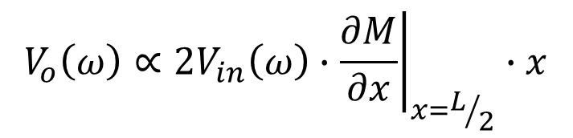


LVDT
$${L_{s}}/2$$
$${R_{s}}/2$$
$$i_{p}$$
$$R_{p}$$
$$\left|V_{o}\left(ω\right)\right|$$
$$v_{s1}$$
$$v_{o}$$
$$L_{p}$$
$${L_{s}}/2$$
$${R_{s}}/2$$
$$v_{in}$$
$$v_{s2}$$
$$x$$
$$V_{o}\left(ω\right)∝2V_{in}\left(ω\right)∙{\left.\frac{∂M}{∂x}\right|}_{x=L/2}∙x$$

Slide 17

Rotary Variable Differential Transformer
$$\left|V_{o}\left(ω\right)\right|$$
$$θ$$
$$θ$$

Slide 18

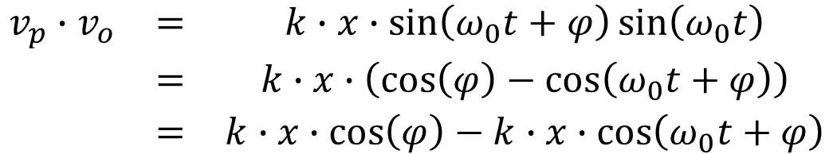

LVDT Demodulation
$$v_{p}=\sin\left(ω_{0}t\right)$$
LVDT
$$v_{o}=k∙x∙\sin\left(ω_{0}t+φ\right)$$
$$\begin{matrix}v_{p}∙v_{o} & = & k∙x∙\sin\left(ω_{0}t+φ\right)sin\left(ω_{0}t\right) \\ & = & k∙x∙\left(\cos\left(φ\right)−\cos\left(ω_{0}t+φ\right)\right) \\ & = & k∙x∙\cos\left(φ\right)−k∙x∙\cos\left(ω_{0}t+φ\right)\end{matrix}$$

Slide 19
LVDT: Interfering and Modifying Inputs
Interfering inputs
Electrical noise in the circuit.
External time-varying magnetic fields affecting the two secondary coils differently.
Modifying inputs
Primary voltage
Temperature dependence on magnetic permeability of the moving core.

Slide 20
LVDT
Advantages
Good for measuring sub-mm to a few cm displacement.
Reliable and durable; no direct surface contact with the sensing element.
Disadvantages
Not suitable for frequencies greater than 1/10 of the primary frequency.
Inertia of the core can be a problem for dynamic measurements.

Slide 21
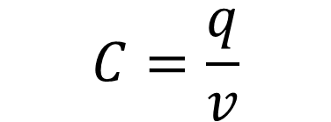

Capacitance
$$C=\frac{q}{v}$$
$$v$$

Slide 22
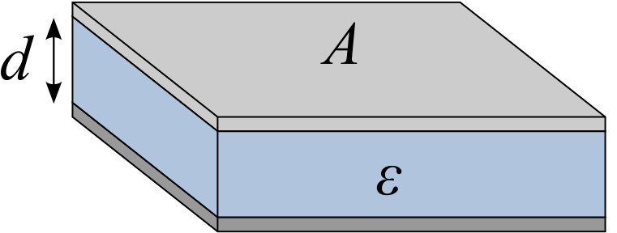
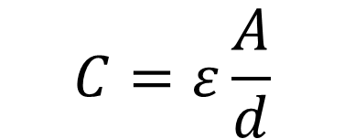
Capacitance
$$C=ε\frac{A}{d}$$
Source: https://tinyurl.com/2p9557bp

Slide 23











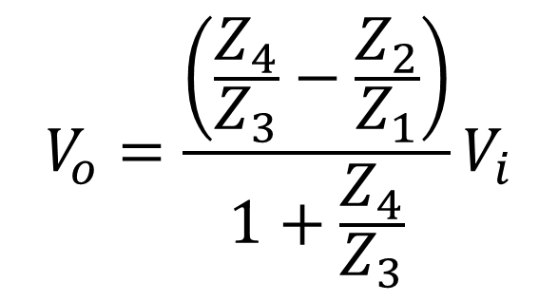





Capacitive sensors
Sensing rotational motion
$$C_{2}\left(θ\right)$$
$$C_{1}\left(θ\right)$$
$$C_{1}\left(θ\right)$$
$$C_{2}\left(θ\right)$$
$$C_{2}\left(θ\right)$$
$$C_{1}\left(θ\right)$$
$$C_{1}\left(θ\right)=C_{2}\left(θ\right)$$
$$C_{1}\left(θ\right)>C_{2}\left(θ\right)$$
$$C_{1}\left(θ\right)<C_{2}\left(θ\right)$$
$$Z_{2}$$
$$Z_{1}$$
$$V_{o}=\frac{\left(\frac{Z_{4}}{Z_{3}}−\frac{Z_{2}}{Z_{1}}\right)}{1+\frac{Z_{4}}{Z_{3}}}V_{i}$$
$$V_{o}$$
$$V_{i}$$
$$Z_{3}$$
$$Z_{4}$$
$$C_{1}\left(θ\right)$$

Slide 24



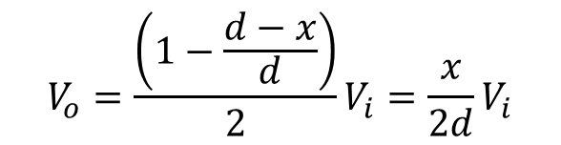

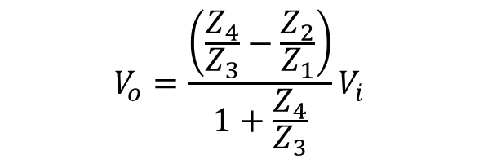

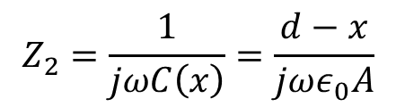




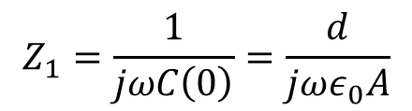


Capacitive sensors
$$Z_{2}$$
$$C\left(x\right)=\frac{ε_{0}A}{d−x}$$
$$Z_{1}$$
$$V_{o}=\frac{\left(\frac{Z_{4}}{Z_{3}}−\frac{Z_{2}}{Z_{1}}\right)}{1+\frac{Z_{4}}{Z_{3}}}V_{i}$$
$$V_{o}$$
$$V_{i}$$
$$Z_{3}$$
$$Z_{4}$$
$$A$$
$$Z_{4}=Z_{3}$$
$$V_{o}=\frac{\left(1−\frac{d−x}{d}\right)}{2}V_{i}=\frac{x}{2d}V_{i}$$
$$Z_{1}=\frac{1}{jωC\left(0\right)}=\frac{d}{jωε_{0}A}$$
$$x$$
$$Z_{2}=\frac{1}{jωC\left(x\right)}=\frac{d−x}{jωε_{0}A}$$
$$d$$

Slide 25
Capacitive sensors: Interfering and Modifying Inputs
Interfering inputs
Electrical noise.
Unwanted signal coupling through stray capacitance.
Modifying inputs
Primary voltage.
Temperature dependence of reluctance of the core.

Slide 26
Capacitive sensors
Advantages
For very small displacement in the order of sub-mm.
Reliable and durable; no direct surface contact with the sensing element.
Disadvantages
Sensitive to dust, and moisture.

Slide 27
Digital Encoder
Produce digital output for measuring translational and rotational motion.
Information produced is in the form of pulses or in coded form.
Interfaced to digital hardware for reading and further processing.

Slide 28
Shaft Encoder
Incremental Encoder
Incremental Encoder
Pulse output, which is counted to measure change in position (or) width is used to measure velocity.
Absolute Encoder
Absolute Encoder
.
.
.
Series of pulses where the position is already coded.

Slide 29
Shaft encoder
Four different ways of transducer signal generation:
Optical method
Sliding contact method
Magnetic saturation method
Proximity sensor method
Light source
Detector

Slide 30

Shaft Encoder: Incremental Encoder
Offset Sensor or Offset Track configurations.
Quadrature Output
Detector 1
Reference Window
Detector 2
$$θ,ω$$
Reference Detector

Slide 31

Shaft Encoder: Incremental Encoder
Resolution of the encoder:
Single Channel Output.
$$∆θ=\frac{360}{N}$$
Quadrature Output.
$$∆θ=\frac{360}{4N}$$

