Slide 1
Transducers & Instrumentation
Module 03 - 02
Measuring Movements

Slide 2
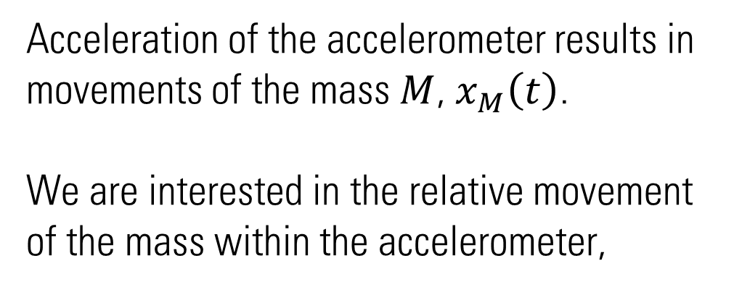

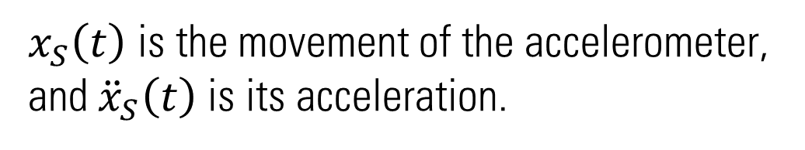





Accelerometers
$x_{S}\left(t\right)$ is the movement of the accelerometer, and ${\ddot{x}}_{S}\left(t\right)$ is its acceleration.
$$K$$
$$B$$
$$x_{M}\left(t\right)$$
$$x_{S}\left(t\right)$$
Acceleration of the accelerometer results in movements of the mass $M$, $x_{M}\left(t\right)$.
We are interested in the relative movement of the mass within the accelerometer,
$$M$$
$$y\left(t\right)=x_{S}\left(t\right)−x_{M}\left(t\right)$$
Accelerometer

Slide 3


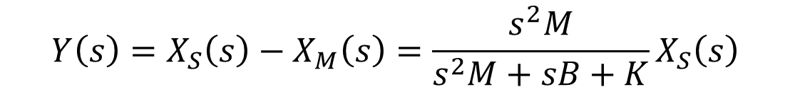
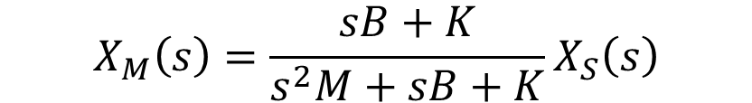
Accelerometers
$$M{\ddot{x}}_{M}\left(t\right)=K∙\left(x_{S}\left(t\right)−x_{M}\left(t\right)\right)+B∙\left({\dot{x}}_{S}\left(t\right)−{\dot{x}}_{M}\left(t\right)\right)$$
$$Ms^{2}X_{M}\left(s\right)=K∙\left(X_{S}\left(s\right)−X_{M}\left(s\right)\right)+sB∙\left(X_{S}\left(s\right)−X_{M}\left(s\right)\right)$$
$$K$$
$$B$$
$$x_{M}\left(t\right)$$
$$x_{S}\left(t\right)$$
$$X_{M}\left(s\right)=\frac{sB+K}{s^{2}M+sB+K}X_{S}\left(s\right)$$
$$M$$
$$Y\left(s\right)=X_{S}\left(s\right)−X_{M}\left(s\right)=\frac{s^{2}M}{s^{2}M+sB+K}X_{S}\left(s\right)$$
$$Y\left(s\right)=\frac{M}{s^{2}M+sB+K}A_{S}\left(s\right)$$
Accelerometer

Slide 4
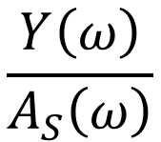


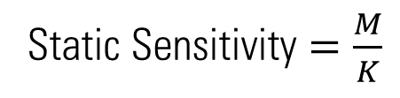

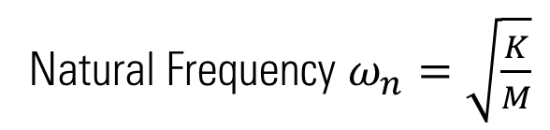

Accelerometers
$$Y\left(s\right)=\frac{1}{s^{2}+s\frac{B}{M}+\frac{K}{M}}A_{S}\left(s\right)$$
Natural Frequency $ω_{n}=\sqrt{\frac{K}{M}}$
Static Sensitivity $=\frac{M}{K}$
$$K$$
$$B$$
$$x_{M}\left(t\right)$$
$$x_{S}\left(t\right)$$
$$M$$
$$\frac{Y\left(ω\right)}{A_{S}\left(ω\right)}$$
$$ω$$

Slide 5




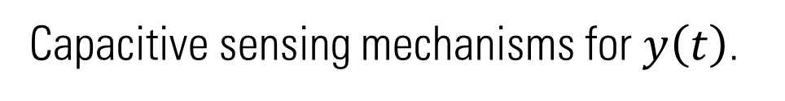

Accelerometers
$$Y\left(s\right)=\frac{1}{s^{2}+s\frac{B}{M}+\frac{K}{M}}A_{S}\left(s\right)$$
$$K$$
$$B$$
$$x_{M}\left(t\right)$$
$$x_{S}\left(t\right)$$
Capacitive sensing mechanisms for $y\left(t\right)$.
$$C_{1}$$
$$M$$
$$C_{2}$$

Slide 6









Multi-axis Accelerometers
Signal measured by the accelerometer will:
Contain acceleration due to gravity, and
Depend on the orientation of the accelerometer with respect to an inertial reference frame of interest.
$$y_{S}$$
$$a_{S}^{E}\left(t\right)$$
$$x_{S}$$
$$z_{S}$$
$$g^{E}$$
$$a_{S}^{S}\left(t\right)=R_{E}^{S}\left(t\right)∙\left(a_{S}^{E}\left(t\right)−g^{E}\right)$$
$$y_{E}$$
$$x_{E}$$
Earth reference frame
$$z_{E}$$

Slide 7














Two-axis Accelerometers
$$g^{E}=\left[\begin{matrix}0 \\ −9.81\end{matrix}\right]ms^{−2}$$
Sensor 1
Sensor 2
Sensor 3
Sensor 1
$$a_{S}^{S}=$$
$$y_{S}$$
$$y_{S}$$
$$x_{S}$$
$$θ$$
$$x_{S}$$
$$x_{S}$$
$$y_{S}$$
Sensor 2
$$a_{S}^{S}=$$
$$g^{E}$$
$$y_{E}$$
$$x_{E}$$
Sensor 3
$$a_{S}^{S}=$$
Earth reference frame

Slide 8








Gyroscope
$$y$$
$$v$$
$$ω$$
$$v$$
$$ω$$
Coriolis Force
$$f=2∙v×ω$$
$$x$$
$$z$$

Slide 9

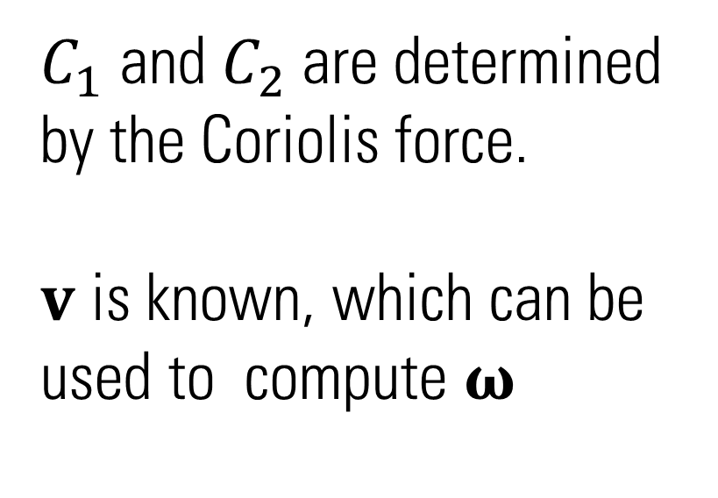




Gyroscopes
$$ω$$
$C_{1}$ and $C_{2}$ are determined by the Coriolis force.
$v$ is known, which can be used to compute $ω$
$$v$$
$$C_{1}$$
$$f$$
$$C_{2}$$

Slide 10





Multi-axis Gyroscopes
$$ω_{S}^{E}\left(t\right)$$
$$ω_{S}^{S}\left(t\right)=R_{E}^{S}\left(t\right)∙ω_{S}^{E}\left(t\right)$$
$$y_{S}$$
$$x_{S}$$
$$z_{S}$$
$$y_{E}$$
$$x_{E}$$
$$z_{E}$$

