Slide 1
Transducers & Instrumentation
Module 04
Measuring Forces and Torques

Slide 2


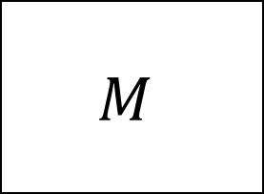
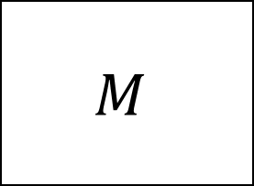
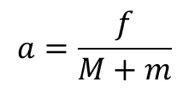

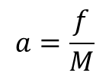

Forces and Torques
Forces and torques cause bodies to undergo linear or rotational acceleration.
Cause deformation.
$$a=\frac{f}{M}$$
$$a=\frac{f}{M+m}$$
$$M$$
$$M$$
$$f$$
$$f$$
$$f$$
$$f$$

Slide 3
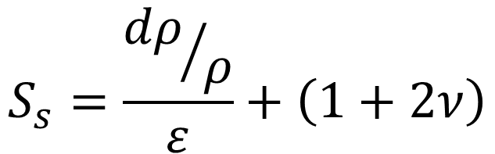

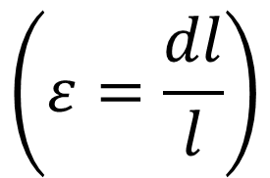

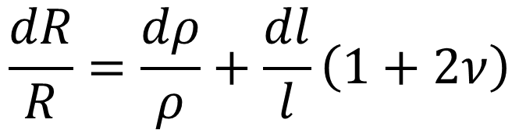
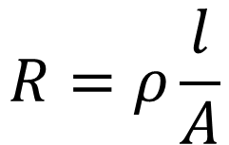
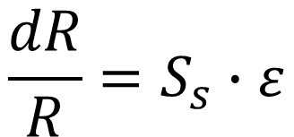
Resistance of a material
$$R=ρ\frac{l}{A}$$
$$l$$
$$A$$
$$\frac{dR}{R}=\frac{dρ}{ρ}+\frac{dl}{l}\left(1+2ν\right)$$
$$\frac{dR}{R}=S_{s}∙ε$$
Geometric factor
Piezoresistivity
$$S_{s}=\frac{{dρ}/ρ}{ε}+\left(1+2ν\right)$$
$$\left(ε=\frac{dl}{l}\right)$$
Gauge factor
Strain

Slide 4
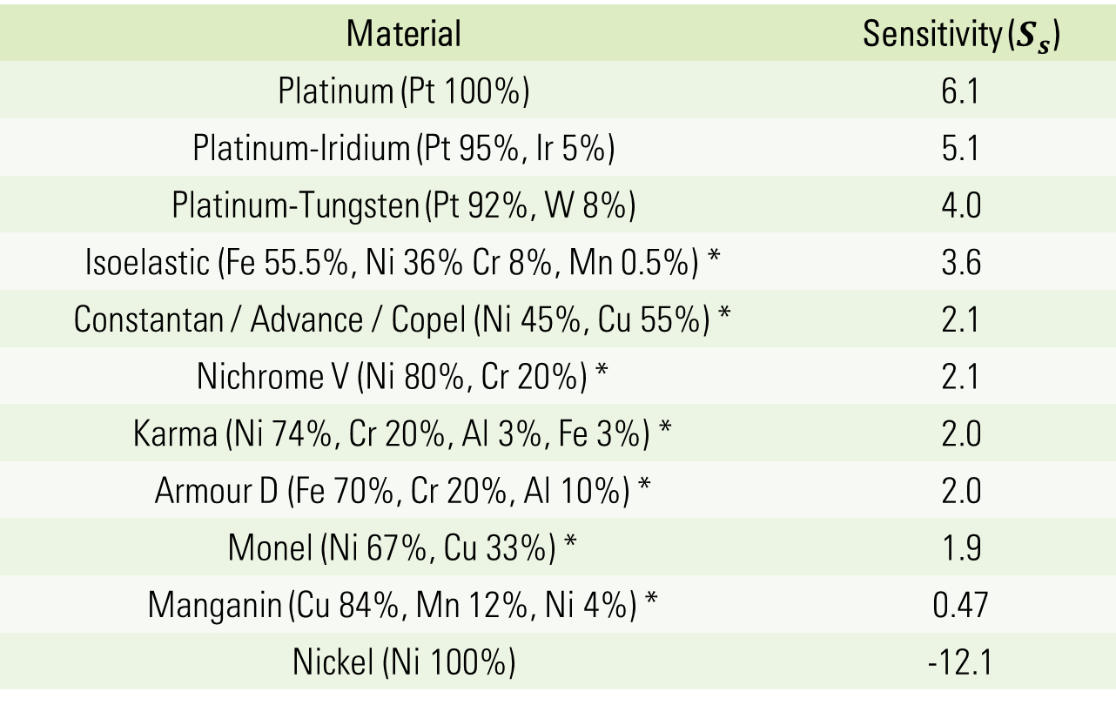
Gauge factors of common metals
Material | Sensitivity ($S_{s}$)
Platinum (Pt 100%) | 6.1
Platinum-Iridium (Pt 95%, Ir 5%) | 5.1
Platinum-Tungsten (Pt 92%, W 8%) | 4.0
Isoelastic (Fe 55.5%, Ni 36% Cr 8%, Mn 0.5%) * | 3.6
Constantan / Advance / Copel (Ni 45%, Cu 55%) * | 2.1
Nichrome V (Ni 80%, Cr 20%) * | 2.1
Karma (Ni 74%, Cr 20%, Al 3%, Fe 3%) * | 2.0
Armour D (Fe 70%, Cr 20%, Al 10%) * | 2.0
Monel (Ni 67%, Cu 33%) * | 1.9
Manganin (Cu 84%, Mn 12%, Ni 4%) * | 0.47
Nickel (Ni 100%) | -12.1
Source: https://www.efunda.com/designstandards/sensors/strain_gages/strain_gage_sensitivity.cfm

Slide 5
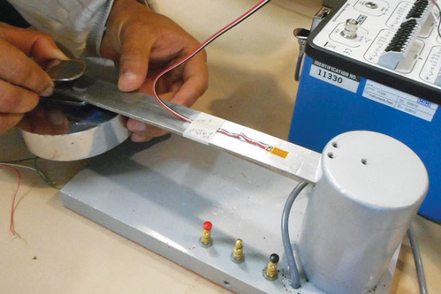
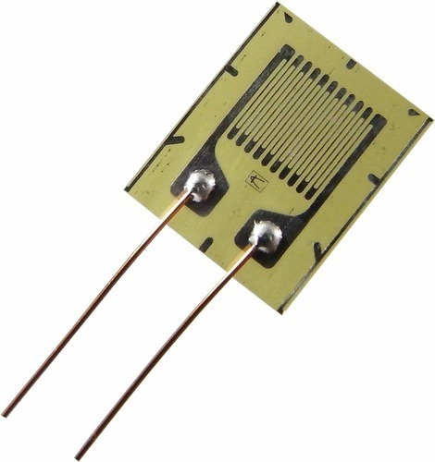
Strain gauges
Source: https://5.imimg.com/data5/BG/MR/MY-41643329/strain-gauge-500x500.jpg
Source: https://resourcespace-prod.s3.amazonaws.com/rs/filestore/1/1/6/3/9_981464e59f794c3/116391ai_b5fc4cbf03762f5.jpg
Strain gauge made from metal foil.
Backing film
Sensitive to length changes along this direction.
Strain gauge bonded to a cantilever.

Slide 6
Strain gauges
Source: https://5.imimg.com/data5/BG/MR/MY-41643329/strain-gauge-500x500.jpg
Problem:
Strain gauge with GF 2.5 and resistance 150 ohms.
Experiences a 400 micro-strain
Sensitive to length changes along this direction.
What is the change in resistance of the strain gauge?

Slide 7

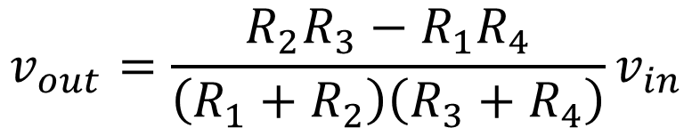

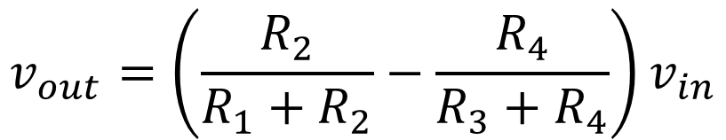



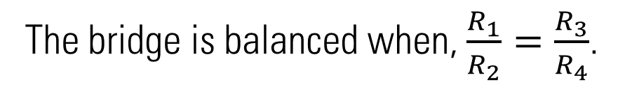

Measuring resistance change of strain gauges
Wheatstone Bridge
$$v_{in}$$
$$v_{out}=\left(\frac{R_{2}}{R_{1}+R_{2}}−\frac{R_{4}}{R_{3}+R_{4}}\right)v_{in}$$
$$R_{1}$$
$$R_{3}$$
$$v_{out}=\frac{R_{2}R_{3}−R_{1}R_{4}}{\left(R_{1}+R_{2}\right)\left(R_{3}+R_{4}\right)}v_{in}$$
$$v_{out}$$
The bridge is balanced when, $\frac{R_{1}}{R_{2}}=\frac{R_{3}}{R_{4}}$.
$$R_{2}$$
$$R_{4}$$

Slide 8



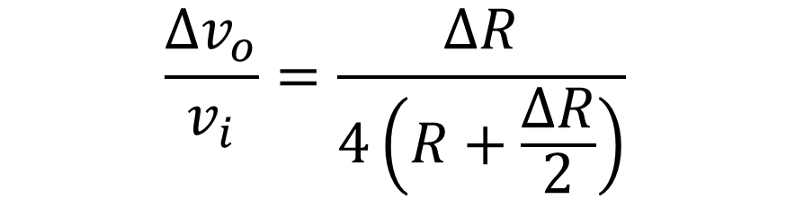

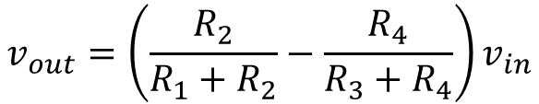


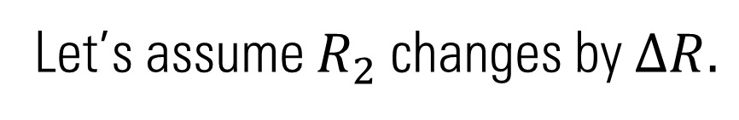

Wheatstone bridge with a single strain gauge
$$v_{in}$$
$$R_{1}=R_{2}=R_{3}=R_{4}=R$$
$$v_{out}=\left(\frac{R_{2}}{R_{1}+R_{2}}−\frac{R_{4}}{R_{3}+R_{4}}\right)v_{in}$$
Let’s assume $R_{2}$ changes by $ΔR.$
$$R_{1}$$
$$R_{3}$$
$$\frac{{Δv}_{o}}{v_{i}}=\frac{ΔR}{4\left(R+\frac{ΔR}{2}\right)}$$
$$v_{out}$$
$$R_{2}$$
$$R_{4}$$

Slide 9
Wheatstone bridge with a single strain gauge
$$v_{in}$$
$$R_{1}=R_{2}=R_{3}=R_{4}=R$$
$$v_{out}=\left(\frac{R_{2}}{R_{1}+R_{2}}−\frac{R_{4}}{R_{3}+R_{4}}\right)v_{in}$$
$$R_{1}$$
$$R_{3}$$
$$v_{out}$$
$$R_{2}$$
$$R_{4}$$

Slide 10

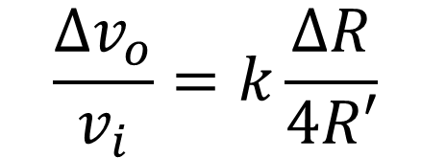



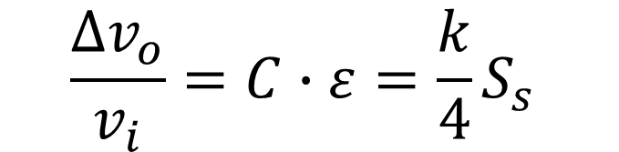


Bridge Constant $\left(k\right)$ & Calibration Constant $\left(C\right)$
$$v_{in}$$
$$\frac{{Δv}_{o}}{v_{i}}=k\frac{ΔR}{4R′}$$
$$R_{1}$$
$$R_{3}$$
$$v_{out}$$
$$\frac{{Δv}_{o}}{v_{i}}=C∙ε=\frac{k}{4}S_{s}$$
$$R_{2}$$
$$R_{4}$$

Slide 11



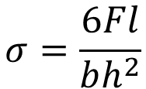


Some load-cell configurations
Single strain gauge
Cantilever based load-cell
$$F$$
Double strain gauges
$$b$$
$$h$$
Four strain gauges
$$l$$
$$σ=\frac{6Fl}{bh^{2}}$$
$$ε=Eσ$$

Slide 12


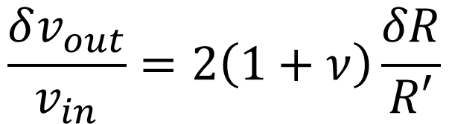
Some load-cell configurations
1
Tension/compression load-cell
1
2
$$f$$
3
2
4
3
$$v_{in}$$
$$f$$
4
$$R_{1}$$
$$R_{3}$$
$$v_{out}$$
$$\frac{δv_{out}}{v_{in}}=2\left(1+ν\right)\frac{δR}{R′}$$
$$R_{2}$$
$$R_{4}$$

Slide 13

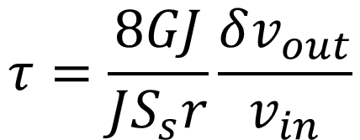
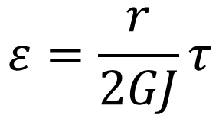
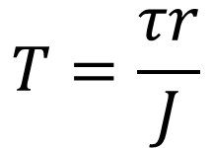

Strain gauge torque sensors
$$T=\frac{τr}{J}$$
$$ε=\frac{r}{2GJ}τ$$
$$τ$$
$$τ$$
Directions of maximum tensile stresses.
Torque computed from
$$τ=\frac{8GJ}{JS_{s}r}\frac{δv_{out}}{v_{in}}$$
4
1
4
2

Slide 14

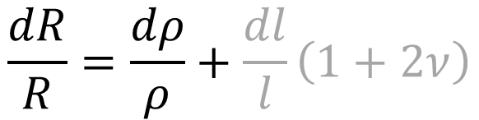
Semiconductor strain gauges
Highly sensitive to small strains compared to metallic foil strain gauges.
Change of resistivity due to a mechanical strain: Piezo-resistivity.
Gauge factor: 100 to 170 for p-type Silicon, -140 to -100 for n-type Silicon.
Higher resistivity, lower power consumption, lower heat dissipation.
Metal foil strain gauge: 150-350 ohms, SC strain gauge: 5000 ohms
$$\frac{dR}{R}=\frac{dρ}{ρ}+\frac{dl}{l}\left(1+2ν\right)$$
$$ρ_{ε}=\frac{{dρ}/ρ}{ε}$$

Slide 15
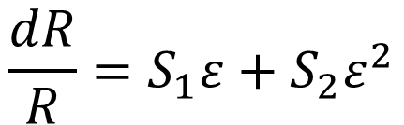
Semiconductor strain gauges
Some disadvantages:
Non-linear strain-resistance relationship.
Brittle and difficult to mount on curved surfaces.
Max. measurable strain is an order of magnitude lower.
Costly
More sensitive to temperature.
Normalized resistance change of SC strain gauges:
$$\frac{dR}{R}=S_{1}ε+S_{2}ε^{2}$$
Source: De Silva, C W, Sensors and Actuators, CRC Press (2007)

Slide 16

Temperature compensation
$$∆R=∆R_{s}+∆R_{T}$$
$$v_{in}$$
$$R_{1}$$
$$R_{3}$$
$$v_{out}$$
$$R_{2}$$
$$R_{4}$$

Slide 17
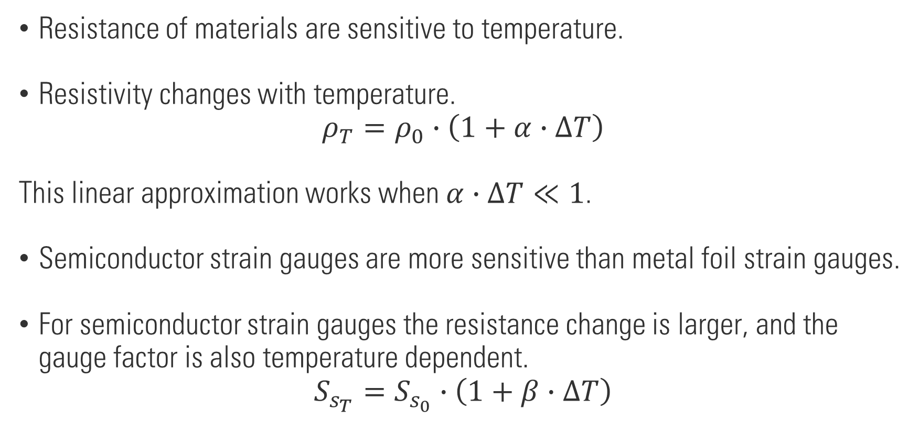
Temperature compensation
Resistance of materials are sensitive to temperature.
Resistivity changes with temperature.
$$ρ_{T}=ρ_{0}∙\left(1+α∙∆T\right)$$
This linear approximation works when $α∙∆T≪1$.
Semiconductor strain gauges are more sensitive than metal foil strain gauges.
For semiconductor strain gauges the resistance change is larger, and the gauge factor is also temperature dependent.
$$S_{s_{T}}=S_{s_{0}}∙\left(1+β∙∆T\right)$$

