Slide 1
Transducers & Instrumentation
Module 05 - 01
Measuring Pressure, Flow and Volume

Slide 2
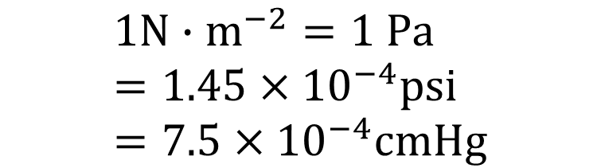
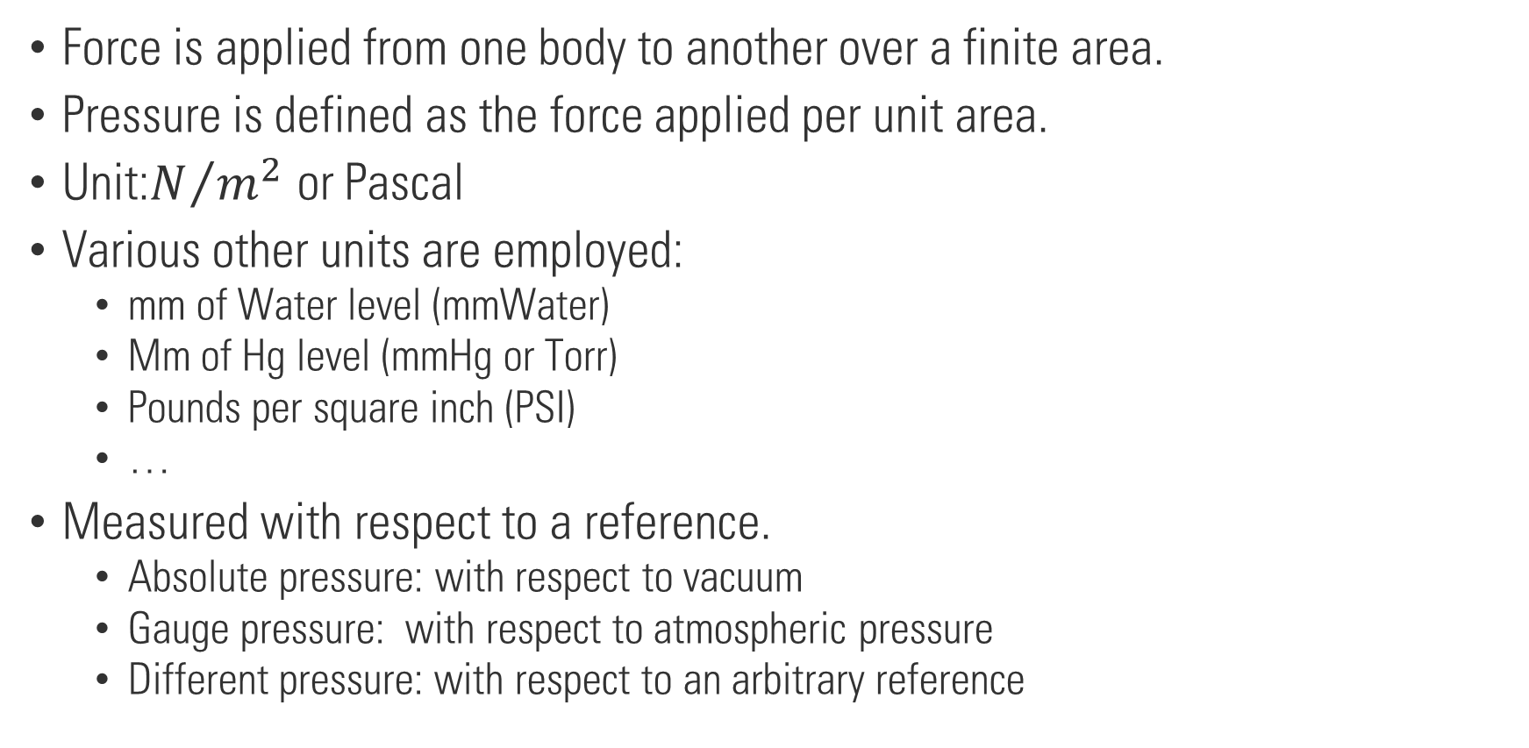
Pressure
Force is applied from one body to another over a finite area.
Pressure is defined as the force applied per unit area.
Unit:$N/{m^{2}}$ or Pascal
Various other units are employed:
mm of Water level (mmWater)
Mm of Hg level (mmHg or Torr)
Pounds per square inch (PSI)
…
Measured with respect to a reference.
Absolute pressure: with respect to vacuum
Gauge pressure: with respect to atmospheric pressure
Different pressure: with respect to an arbitrary reference
$$1N∙m^{−2}=1 Pa=1.45×{10}^{−4}psi=7.5×{10}^{−4}cmHg$$

Slide 3
Mercury pressure sensor
Source: Fraden, Jacob, and Jacob Fraden. Handbook of modern sensors: physics, designs, and applications. Vol. 3. New York: Springer, 2004.

Slide 4
Elastic pressure sensors
Eaton, William P., and James H. Smith. "Micromachined pressure sensors: review and recent developments." Smart Materials and Structures 6.5 (1997): 530.

Slide 5
Bellow based pressure sensors
Source: Fraden, Jacob, and Jacob Fraden. Handbook of modern sensors: physics, designs, and applications. Vol. 3. New York: Springer, 2004.

Slide 6
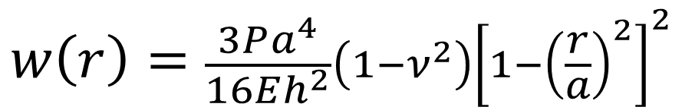
Diaphragm-based pressure sensors
$$w\left(r\right)=\frac{3Pa^{4}}{16Eh^{2}}\left(1−ν^{2}\right){\left[1−{\left(\frac{r}{a}\right)}^{2}\right]}^{2}$$
Tangential Strain
Radial Strain
Source: Fraden, Jacob, and Jacob Fraden. Handbook of modern sensors: physics, designs, and applications. Vol. 3. New York: Springer, 2004.

Slide 7
Diaphragm-based pressure sensors

Slide 8
Diaphragm-based pressure sensors
Micromachined diaphragms and piezoresistive strain gauges

Slide 9
Diaphragm-based pressure sensors
Have better sensitivity than piezoresistive sensors.
Can be affected by stray capacitances.
Requires complex signal conditioning circuity.

Slide 10
Piezoelectric Effect
Generation of electric charge by a crystalline material when subjected to a stress.
Examples of materials: quartz (SiO₂), poled man-made ceramics, and some polymers (PVDF).

Slide 11

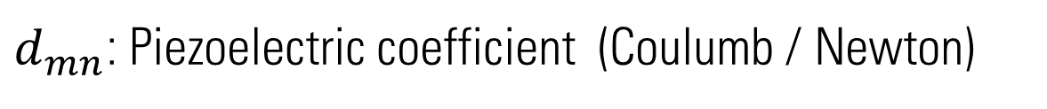
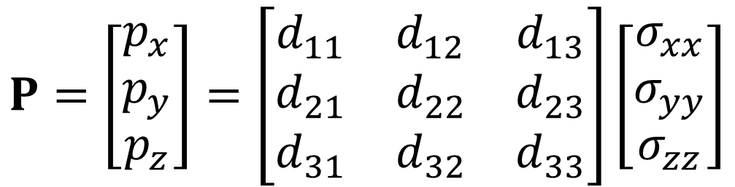


Piezoelectric effect
$$σ_{yy}$$
Polarization of the crystal due to stresses acting in different directions
$$P=\left[\begin{matrix}p_{x} \\ p_{y} \\ p_{z}\end{matrix}\right]=\left[\begin{matrix}d_{11} & d_{12} & d_{13} \\ d_{21} & d_{22} & d_{23} \\ d_{31} & d_{32} & d_{33}\end{matrix}\right]\left[\begin{matrix}σ_{xx} \\ σ_{yy} \\ σ_{zz}\end{matrix}\right]$$
$$σ_{xx}$$
$$σ_{zz}$$
$d_{mn}$: Piezoelectric coefficient (Coulumb / Newton)
In practice crystals are used in the directions where the coefficient is the largest.

Slide 12




Piezoelectric effect
+ + + + + + + + +
+ + + + + + + + +
$$f$$
$$f$$
$$f$$
$$f$$
- - - - - - - - -
- - - - - - - - -
Longitudinal effect
Transverse effect

Slide 13
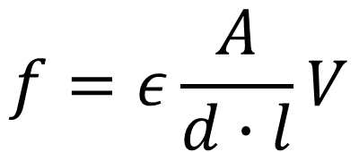
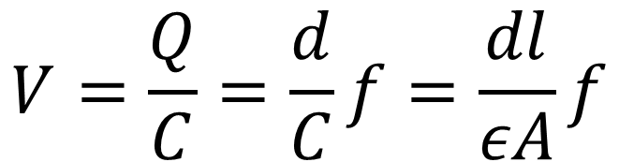
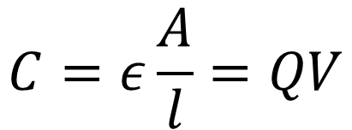

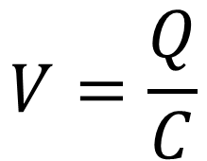
Piezoelectric effect
$$C=ε\frac{A}{l}=QV$$
$$Q=d∙f$$
$$V=\frac{Q}{C}=\frac{d}{C}f=\frac{dl}{εA}f$$
+ + + + + + + + +
$$V=\frac{Q}{C}$$
$$f$$
$$f$$
- - - - - - - - -
$$f=ε\frac{A}{d∙l}V$$

Slide 14






What is the output charge and voltage generated by this piezoelectric sensors if a force of 3N is applied on the sensor?
$b=w=1cm$ $t=0.5cm$
$$ε=2×{10}^{−10}F∙m^{−1}$$
$$d=1.8 pC∙N^{−1}$$
$$f$$
$$w$$
$$t$$
$$b$$
$$f$$

Slide 15
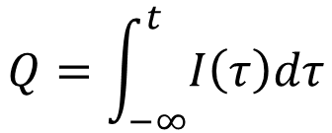
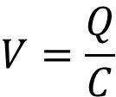
Piezoelectric sensor equivalent circuit
+ + + + + + +
$$V=\frac{Q}{C}$$
$$f$$
$$f$$
- - - - - - -
$$Q=\int_{−∞}^{t}{I\left(τ\right)dτ}$$

Slide 16




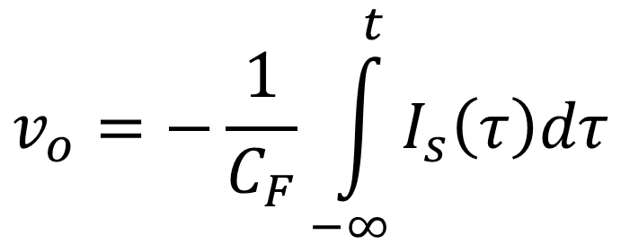
Charge amplifier
$$C_{F}$$
$$v_{o}=−\frac{1}{C_{F}}\int_{−∞}^{t}{I_{s}\left(τ\right)dτ}$$
$$v_{o}$$
$$C_{s}$$
$$I_{s}\left(t\right)$$

Slide 17
Piezoelectric sensors are not good for DC measurements

Slide 18
Piezoelectric pressure sensor

