Slide 1
Transducers & Instrumentation
Module 05 - 02
Measuring Pressure, Flow, and Volume

Slide 2
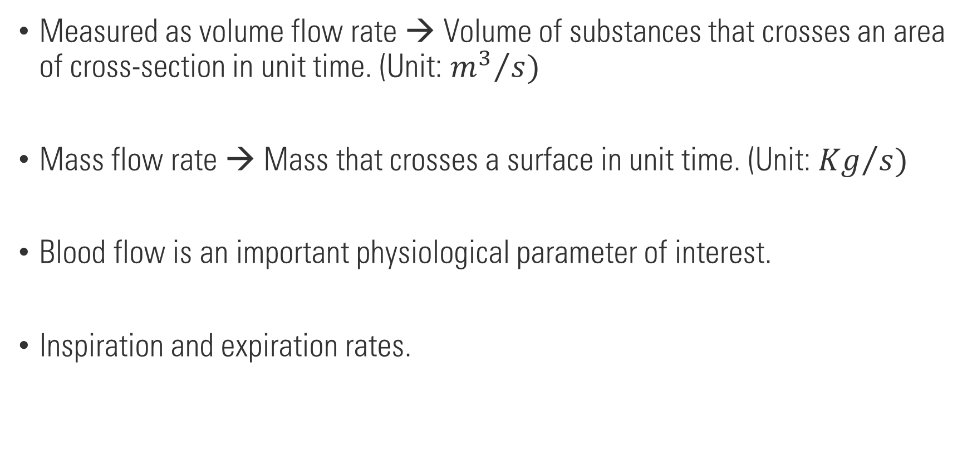
Flow rate
Measured as volume flow rate → Volume of substances that crosses an area of cross-section in unit time. (Unit: ${m^{3}}/s)$
Mass flow rate → Mass that crosses a surface in unit time. (Unit: ${Kg}/s)$
Blood flow is an important physiological parameter of interest.
Inspiration and expiration rates.

Slide 3
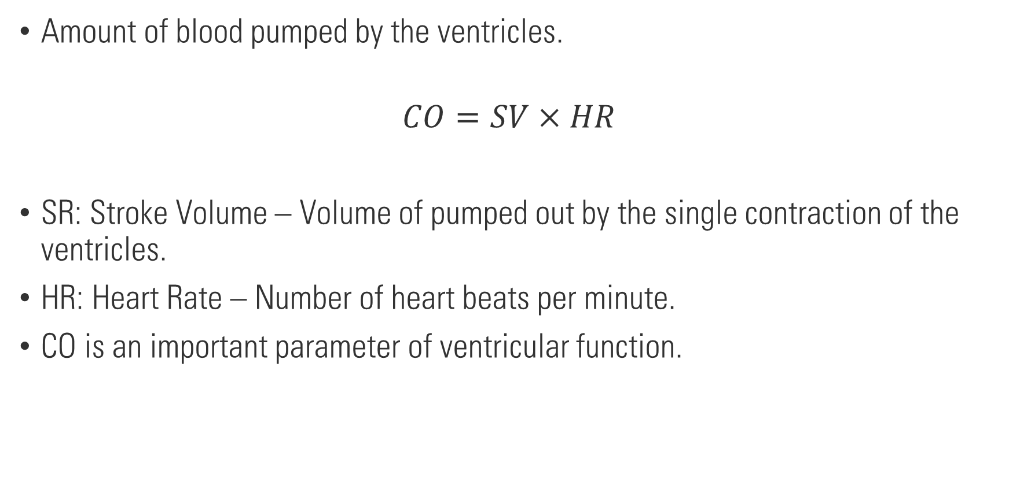
Cardiac Output (CO)
Amount of blood pumped by the ventricles.
$$CO=SV×HR$$
SR: Stroke Volume – Volume of pumped out by the single contraction of the ventricles.
HR: Heart Rate – Number of heart beats per minute.
CO is an important parameter of ventricular function.

Slide 4

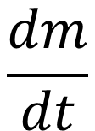


Fick’s method
Proposed by Adolf Fick in 1870.
$$CO=\frac{\frac{dm}{dt}}{C_{o}−C_{i}}$$
$$\frac{dm}{dt}$$
Lungs
$$C_{i}$$
$$C_{o}$$

Slide 5


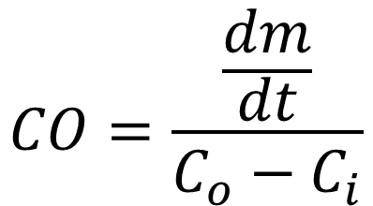

Fick’s method
$$\frac{dm}{dt}$$
Inspired oxygen = 210 mL/L
Expired oxygen = 160 mL/L
Total volume = 26L
Duration = 3min
Arterial oxygen concentration = 195 mL/L
Venous oxygen concentration = 132 mL/L
Lungs
$$C_{i}$$
$$C_{o}$$
What is the cardiac output?
$$CO=\frac{\frac{dm}{dt}}{C_{o}−C_{i}}$$

Slide 6


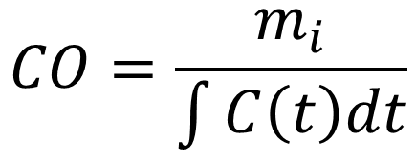


Indicator dilution method (Stewart-Hamilton Method)
$$m_{i}$$
$$CO=\frac{m_{i}}{\int{C\left(t\right)dt}}$$
Mixing chamber
$$F$$
$$F$$
$$C\left(t\right)$$
Sudden injection of indicator compound.

Slide 7

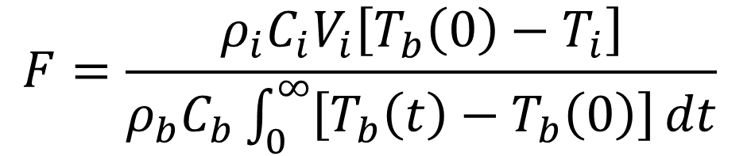



Thermodilution method
$ρ_{i}C_{i}V_{i}\left[T_{b}\left(0\right)−T_{i}\right]=$ $ρ_{b}C_{b}\int_{0}^{∞}{\left[T_{b}\left(t\right)−T_{b}\left(0\right)\right]}Fdt$
$$Q_{i}$$
Mixing chamber
$$F=\frac{ρ_{i}C_{i}V_{i}\left[T_{b}\left(0\right)−T_{i}\right]}{ρ_{b}C_{b}\int_{0}^{∞}{\left[T_{b}\left(t\right)−T_{b}\left(0\right)\right]}dt}$$
$$F$$
$$F$$
$$C\left(t\right)$$

Slide 8


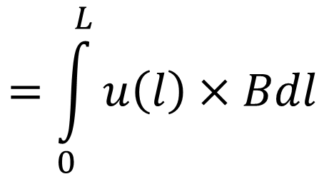

Electromagnetic flow meter
Blood is a conducting fluid.
Applying a magnetic field perpendicular to the flow will induce an EMG.
$$=\int_{0}^{L}{u\left(l\right)×Bdl}$$
$$u$$
$$e$$
$$B$$

Slide 9


Electromagnetic flow meter
+
$$u$$
-
$$B$$

Slide 10
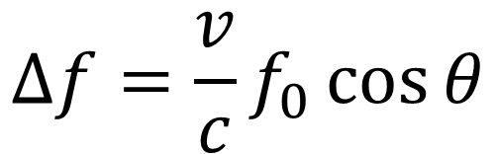





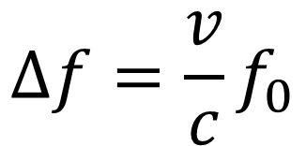
Ultrasound continuous Doppler flow sensing
Use the Doppler effect to determine flow rate.
Receiver
$$∆f=\frac{v}{c}f_{0}$$
$$c, f_{0}$$
Source
$$v$$
$$v$$
$$θ$$
$$∆f=\frac{v}{c}f_{0}\cos{θ}$$
$$c, f_{0}$$
Source
Receiver

Slide 11

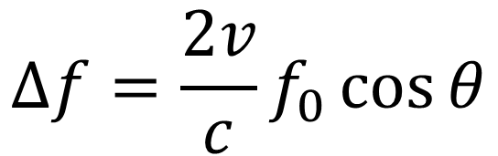

Ultrasound continuous Doppler flow sensing
Reflected wave
$$c, f_{0}$$
$$θ$$
$$∆f=\frac{2v}{c}f_{0}\cos{θ}$$
Source
&
Receiver

Slide 12

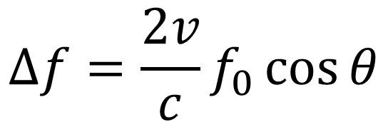

Ultrasound continuous Doppler flow sensing
Reflected wave
$$∆f=\frac{2v}{c}f_{0}\cos{θ}$$
$$c, f_{0}$$
$$θ$$
Source
&
Receiver
++

Slide 13
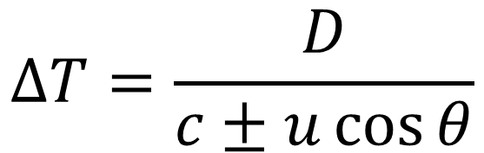

Ultrasound transit time flow sensing
$$θ$$
$$∆T=\frac{D}{c±u\cos{θ}}$$

Slide 14



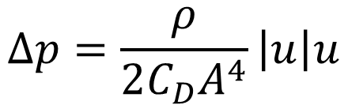
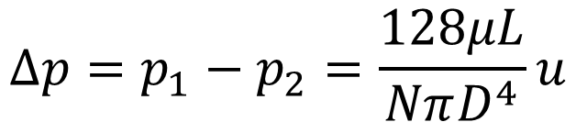

Pressure drop method – Pneumotachometer
There is a pressure drop when air flows through a path offering resistance to air flow.
Laminar Flow (through a set of capillaries)
$$p_{1}$$
$$p_{2}$$
$$∆p=p_{1}−p_{2}=\frac{128μL}{NπD^{4}}u$$
$$u$$
Turbulent Flow (with square edge orifice)
$$∆p=\frac{ρ}{2C_{D}A^{4}}\left|u\right|u$$
$$∆p=Ru+k\left|u\right|u$$

Slide 15
Venous occlusion plethysmography
Plethysmography is a technique of measuring volume change in a tissue.
From: Togawa, Tatsuo, Toshiyo Tamura, and P. Åke Öberg. "Biomedical sensors and instruments." (2011).

Slide 16



Impedance plethysmograph
Change in impedance due to a change in volume of a body segment.
$$∆A$$
$$A$$
$$L$$

Slide 17
Two vs. Four electrodes plethysmograph

Slide 18
Thoracic pneumography

