Slide 1
Transducers & Instrumentation
Module 06
Measuring Temperature

Slide 2
Temperature
A macroscopic property of a body → It’s a measure of the average kinetic energy of the molecules of an object.
Thermometer – Produces a physical response to the temperature of a body through physical contact or EM radiation.
Body

Slide 3
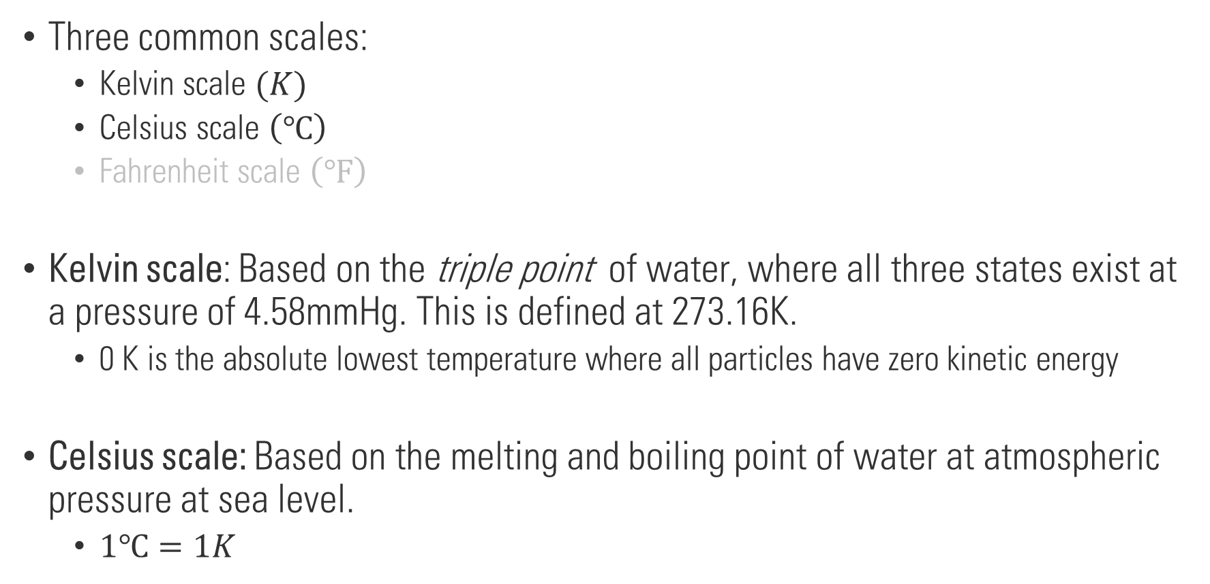
Temperature scales
Three common scales:
Kelvin scale $(K)$
Celsius scale $\left(℃\right)$
Fahrenheit scale $\left(℉\right)$
Kelvin scale: Based on the triple point of water, where all three states exist at a pressure of 4.58mmHg. This is defined at 273.16K.
0 K is the absolute lowest temperature where all particles have zero kinetic energy
Celsius scale: Based on the melting and boiling point of water at atmospheric pressure at sea level.
$1℃=1K$

Slide 4

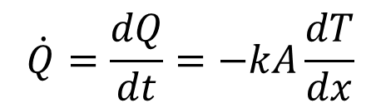
Modes of heat transfer
Conduction
Convection
Radiation
$$\dot{Q}=\frac{dQ}{dt}=−kA\frac{dT}{dx}$$
Requires and intermediate fluid to take heat from the warmer body to the cooler body.
Vibrating atoms and molecules generate electromagnetic radiation.
Temperature of the body determines the wavelength of the emitted radiation.
Total energy emitted will also depend on the emissivity.
$$k$$
: Thermal conductivity

Slide 5
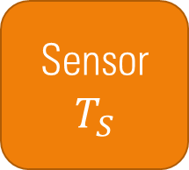


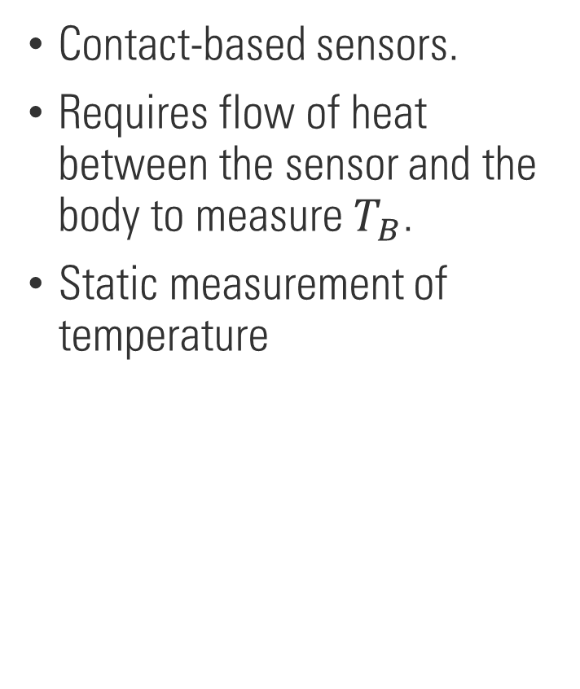

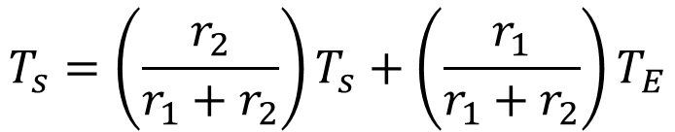


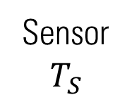

Temperature measurement – Static case
Environment
$$T_{E}$$
Contact-based sensors.
Requires flow of heat between the sensor and the body to measure $T_{B}$.
Static measurement of temperature
Sensor
$$T_{S}$$
Body
$$T_{B}$$
$$T_{s}=\left(\frac{r_{2}}{r_{1}+r_{2}}\right)T_{s}+\left(\frac{r_{1}}{r_{1}+r_{2}}\right)T_{E}$$
Body
$$T_{B}$$
Sensor
$$T_{S}$$
Env.
$$T_{E}$$
$$r_{1}=\frac{1}{k_{1}}$$
$$r_{2}=\frac{1}{k_{2}}$$

Slide 6
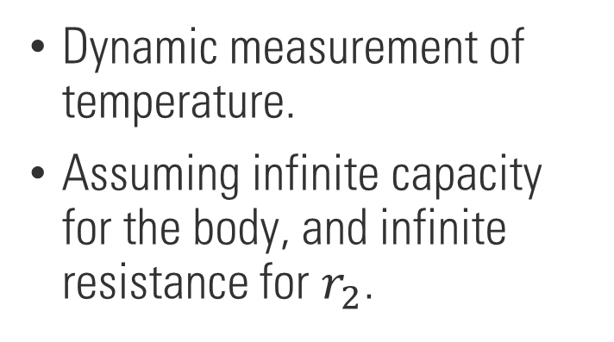

Temperature measurement – Dynamic case
Environment
$$T_{E}$$
Dynamic measurement of temperature.
Assuming infinite capacity for the body, and infinite resistance for $r_{2}$.
Sensor
$$T_{S}$$
Body
$$T_{B}$$
$$T_{s}\left(t\right)=T_{B}−\left(T_{B}−T_{S}\left(0\right)\right)e^{−t/τ}$$
Body
$$T_{B}$$
Sensor
$$T_{S}$$
Env.
$$T_{E}$$
$$r_{1}=\frac{1}{k_{1}}$$
$$r_{2}=\frac{1}{k_{2}}$$

Slide 7
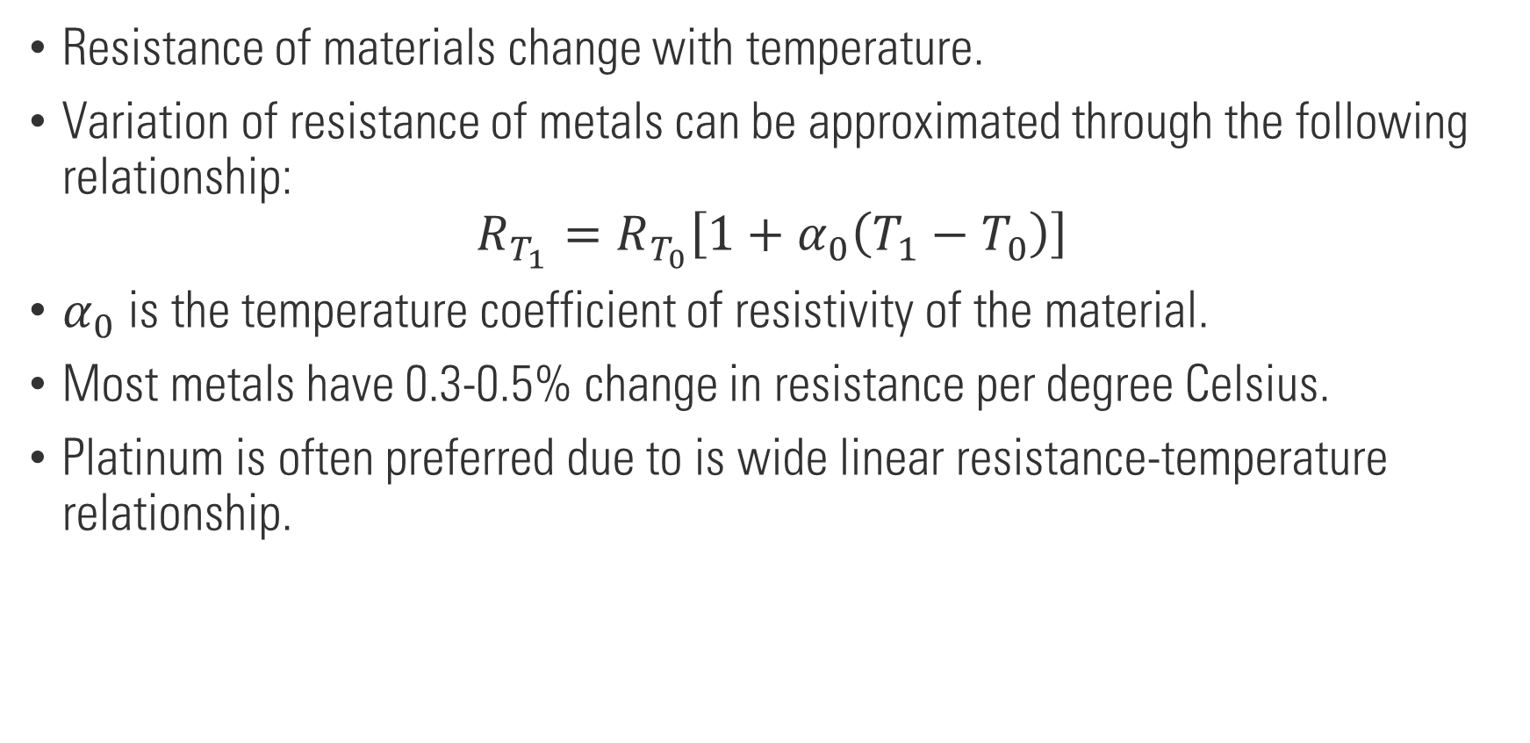
Resistance temperature detectors (RTD)
Resistance of materials change with temperature.
Variation of resistance of metals can be approximated through the following relationship:
$$R_{T_{1}}=R_{T_{0}}\left[1+α_{0}\left(T_{1}−T_{0}\right)\right]$$
$α_{0}$ is the temperature coefficient of resistivity of the material.
Most metals have 0.3-0.5% change in resistance per degree Celsius.
Platinum is often preferred due to is wide linear resistance-temperature relationship.

Slide 8
Resistance Temperature Detector (RTD)
Source: Wheeler, Anthony J., et al. Introduction to engineering experimentation. Vol. 480. Pearson, 2010.

Slide 9
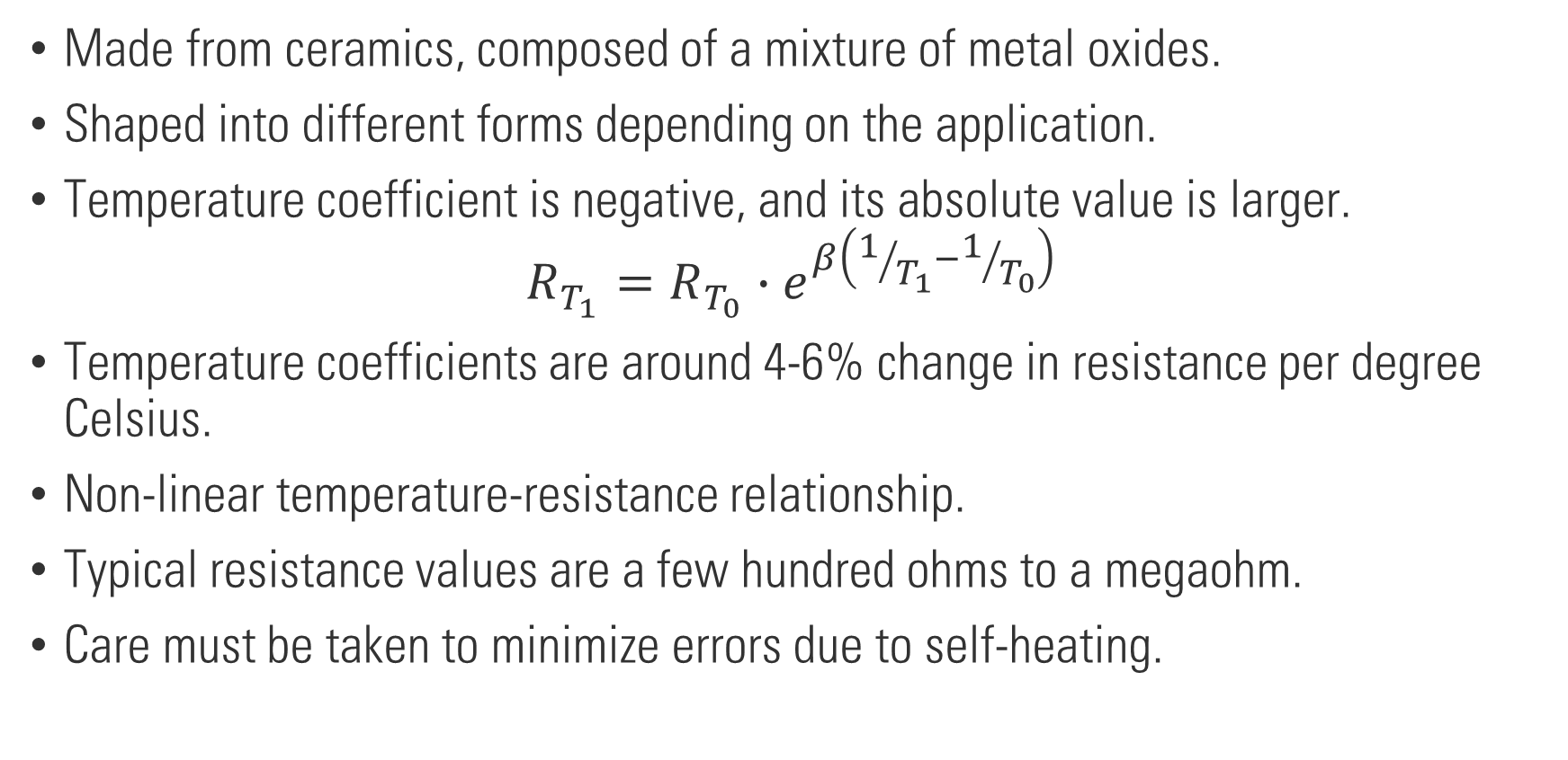
Thermistors
Made from ceramics, composed of a mixture of metal oxides.
Shaped into different forms depending on the application.
Temperature coefficient is negative, and its absolute value is larger.
$$R_{T_{1}}=R_{T_{0}}∙e^{β\left(1/{T_{1}}−1/{T_{0}}\right)}$$
Temperature coefficients are around 4-6% change in resistance per degree Celsius.
Non-linear temperature-resistance relationship.
Typical resistance values are a few hundred ohms to a megaohm.
Care must be taken to minimize errors due to self-heating.

Slide 10
Thermistor
Source: Wheeler, Anthony J., et al. Introduction to engineering experimentation. Vol. 480. Pearson, 2010.

Slide 11




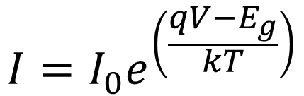

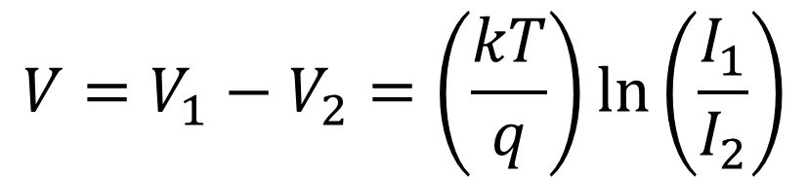
p-n Junction Temperature Sensor
$$I=I_{0}e^{\left(\frac{qV−E_{g}}{kT}\right)}$$
$$V$$
When the current I is kept constant, the voltage across the diode will be a function of the temperature
$$I$$
$$I$$
$$V$$
$$V=V_{1}−V_{2}=\left(\frac{kT}{q}\right)\ln\left(\frac{I_{1}}{I_{2}}\right)$$
$$I_{1}$$
$$I_{2}$$

Slide 12
Thermocouple
Seebeck Effect

Slide 13
Thermocouple

Slide 14
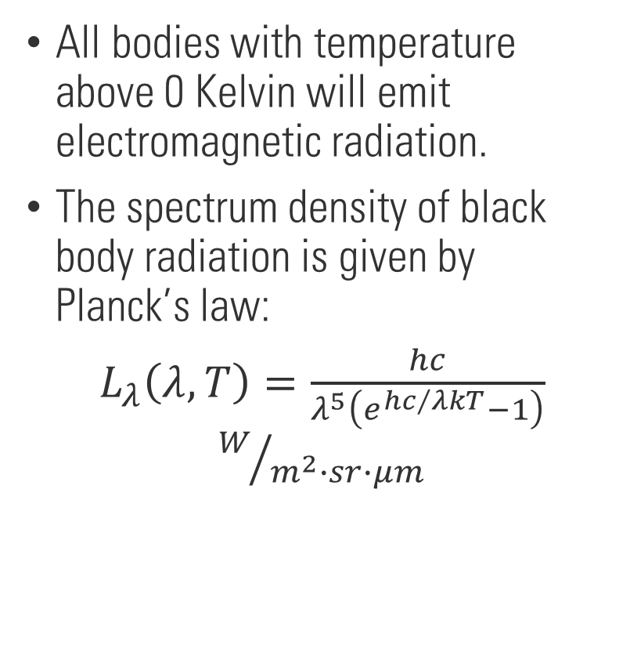
Radiation thermometry
All bodies with temperature above 0 Kelvin will emit electromagnetic radiation.
The spectrum density of black body radiation is given by Planck’s law:
$L_{λ}\left(λ,T\right)=\frac{hc}{λ^{5}\left(e^{{hc}/{λkT}}−1\right)}$ $W/{m^{2}∙sr∙μm}$

Slide 15

Radiation thermometry
Wein’s displacement law:
$$λ_{max}T=2897.77μm∙K$$
Stefan-Boltzmann law: Total thermal radiation power.
$$\int_{0}^{∞}{L_{λ}\left(λ,T\right)dλ}=\frac{σT^{4}}{π}=L_{b}$$
For a real body,
$$L_{r}=εL_{b}=ε\frac{σT^{4}}{π}$$

Slide 16
Radiation thermometry
Measurement system
$$L_{λ}\left(λ\right)=τ_{env}\left[ε_{λ}L_{b,λ}\left(λ,T_{b}\right)+L_{ref,λ}\left(λ\right)\right] + L_{em,λ}\left(λ,T_{env}\right)$$

Slide 17
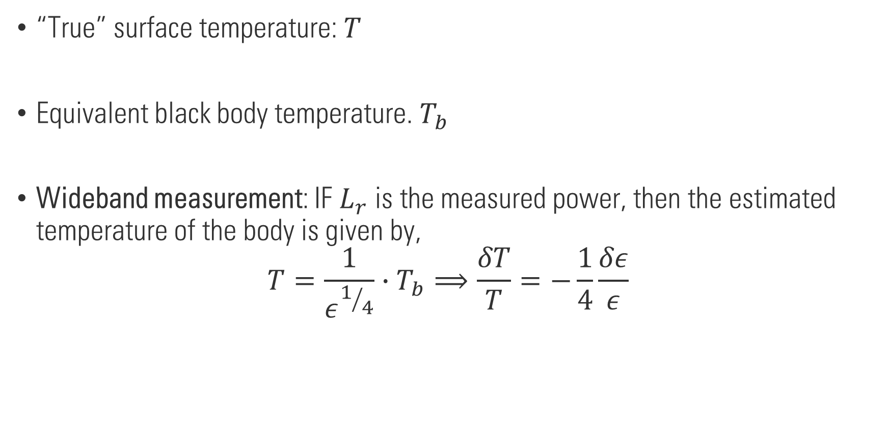
Radiation thermometry methods
“True” surface temperature: $T$
Equivalent black body temperature. $T_{b}$
Wideband measurement: IF $L_{r}$ is the measured power, then the estimated temperature of the body is given by,
$$T=\frac{1}{ε^{1/4}}∙T_{b}⟹\frac{δT}{T}=−\frac{1}{4}\frac{δε}{ε}$$

Slide 18

Radiation thermometry methods
Single wavelength measurement:
$$L_{λ}\left(λ,T\right)=ε\frac{hc}{λ^{5}\left(e^{{hc}/{λkT}}−1\right)}=\frac{hc}{λ^{5}\left(e^{{hc}/{λkT_{b}}}−1\right)}$$
$$\frac{1}{T}=\frac{1}{T_{b}}+\frac{λk}{hc}\ln\left(ε\right)$$

Slide 19
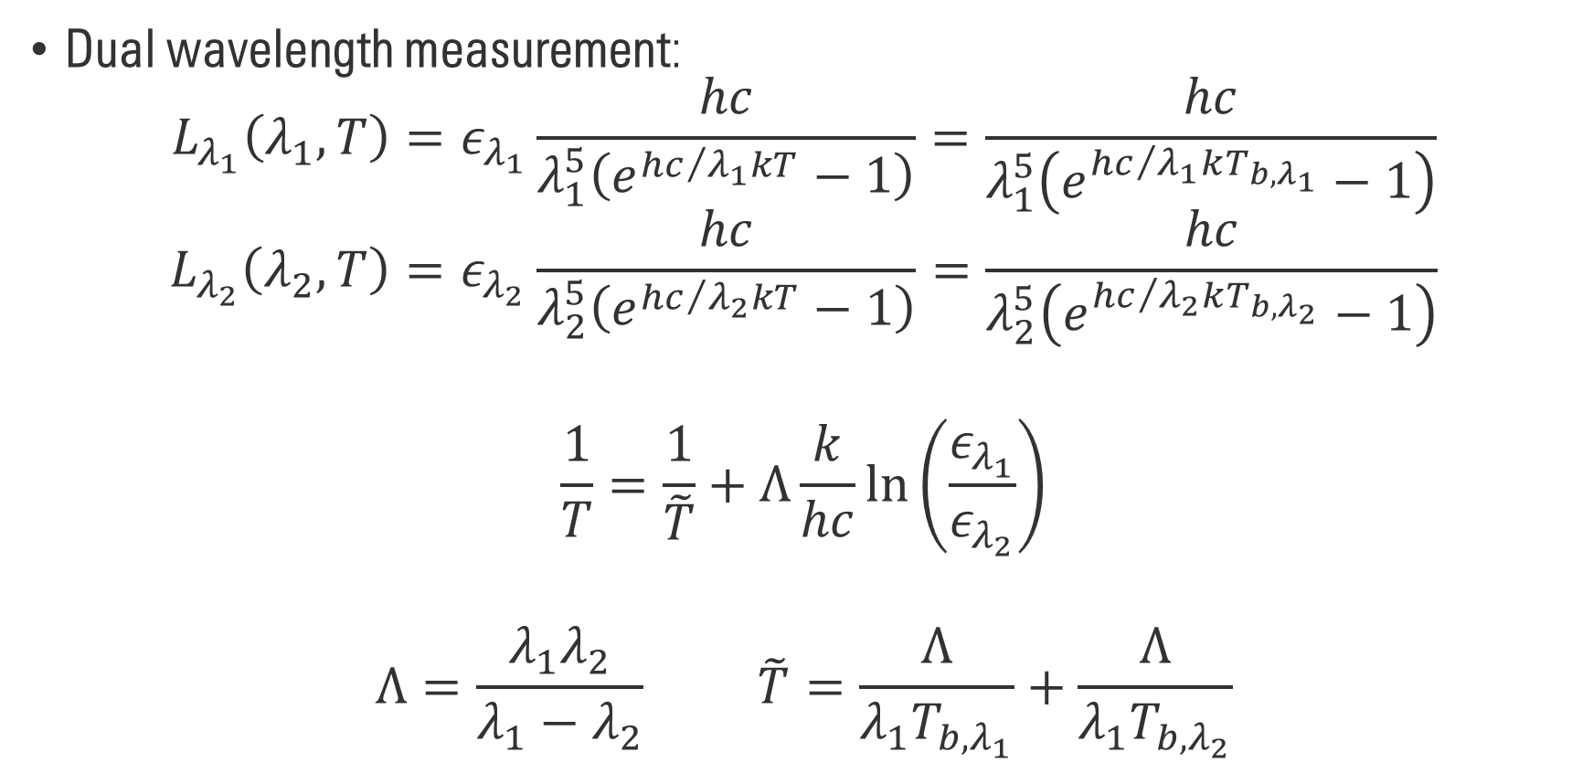
Radiation thermometry methods
Dual wavelength measurement:
$$L_{λ_{1}}\left(λ_{1},T\right)=ε_{λ_{1}}\frac{hc}{λ_{1}^{5}\left(e^{{hc}/{λ_{1}kT}}−1\right)}=\frac{hc}{λ_{1}^{5}\left(e^{{hc}/{λ_{1}kT_{b,λ_{1}}}}−1\right)}$$
$$L_{λ_{2}}\left(λ_{2},T\right)=ε_{λ_{2}}\frac{hc}{λ_{2}^{5}\left(e^{{hc}/{λ_{2}kT}}−1\right)}=\frac{hc}{λ_{2}^{5}\left(e^{{hc}/{λ_{2}kT_{b,λ_{2}}}}−1\right)}$$
$$\frac{1}{T}=\frac{1}{\tilde{T}}+Λ\frac{k}{hc}\ln\left(\frac{ε_{λ_{1}}}{ε_{λ_{2}}}\right)$$
$$Λ=\frac{λ_{1}λ_{2}}{λ_{1}−λ_{2}} \tilde{T}=\frac{Λ}{λ_{1}T_{b,λ_{1}}}+\frac{Λ}{λ_{1}T_{b,λ_{2}}}$$

Slide 20
Radiation thermometry methods
Multiwavelength measurement:
A functional form is assumed for emissivity as a function of wavelength.
Measurement at N different wavelengths can is used to estimate emissivity function and the unknown temperature.

