Slide 1
Introduction to Physiological Measurement
Transducers and Instrumentation for Physiological Measurement

Slide 2

Outline
General Principles of measurement
Examples of measurement
Sensors for measurement
Unobtrusive measurement: non-invasive

Slide 3
Why Measure?
To define normal physiology
To classify deviations from normal physiology – i.e., pathophysiology
To understand processes and systems
N.B. Physiology is the study of processes and systems that enable homeostasis

Slide 4
The Measurement Process

Slide 5
Examples of Measurement
Measurement of chemical and gas concentrations
Measurement of structure - imaging
Electrophysiological Measurement
Cardiovascular Fluid Mechanics Measurement
Musculoskeletal Mechanical Measurement

Slide 6
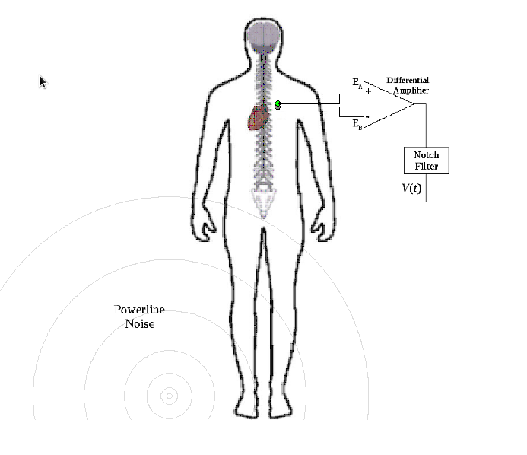
Biopotential Measurement – ECG and Nerve Activity

Slide 7
Concepts for Measurement
A signal is a physical quantity – typically it varies with time (but it can vary with length, space, etc.)
A system is a process that can modify a signal

Slide 8

Transduction of Signals
Transducer converts one kind of physical energy into another form
  e.g., pressure to resistance, temperature to voltage
Therefore, a transducer is also a system that modifies the signal

Slide 9
Characteristics of signals
Steady state value – single value measurement, slow measurement
Transient measurement – time-varying measurement

Slide 10
Characteristics of Systems
Predictable behaviour – i.e., stationary over time
Linear – acts the same way on small signals and as well as larger signals

Slide 11
Review Questions
In each of the following transducers, what is the input and output?
  Manometer
  Weighing scale
  Load cell
  Accelerometer
A piston in a cylinder (like a syringe), and a displacement sensor, can be used as a pressure sensor. What are the potential difficulties with this arrangement? Is any additional element to be added? What is the zero reading of such a transducer?
When is an electrical pressure transducer better than a mercury manometer?

Slide 12
Characterization of measurement systems
Static calibration
Dynamic calibration

Slide 13

Static calibration of transducers
Input-output relationship
Linearity
  Linear: y = m x+c
  Compensating for non-linearity
Offset
Calibration and curve fitting

Slide 14

Dynamic calibration
Transient behaviour of physiological systems
  Changes in system output with time
Dynamic response = response of a transducer or recording system to a changing signal
Dynamic characterization
  Time constant
  Step response
  Frequency response
  Transfer function

Slide 15
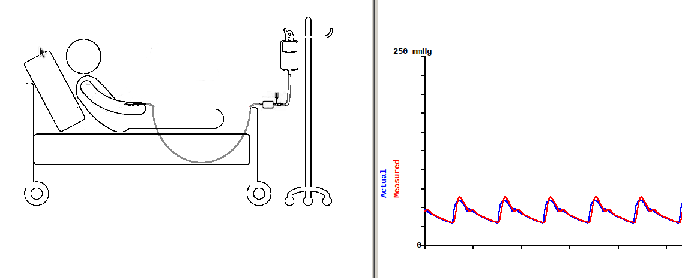
Dynamic Measurement – Intra Arterial Blood Pressure

Slide 16
Digitization of Signals
Sampling and Quantization
Analog-to-Digital Converters
The Sampling Theorem
  If the signal is sampled at a rate which is at least twice the highest frequency contained in the signal, then the original signal can always be recovered

Slide 17
Characterizing signals
Decomposing signals
Identifying contamination of signals
---> Next lecture

