Slide 1
Analog Processing of Signals
Suresh Devasahayam
Department of Bioengineering
Christian Medical College, Vellore

Slide 2
Outline
Sensors for physiological data
Amplification, linearity, offset
Concepts of Filtering
Frequency filtering
Frequency content of signals
Conclusions

Slide 3


Transducers for Physiological Signals
Mechanical measurement
  Strain gauges and bridge measurement
  Piezoelectric sensors
  Electromagnetic sensors
Electrophysiological measurement
  Biopotential electrodes
Displacement or length measurement
  Camera based measurement
  Resistive, capacitive, inductive sensors
Optical measurement
  Spectral measurement - spectrophotometry
Actuators
  Electromagnetic actuators
  Piezoelectric actuators

Slide 4
Measurement System - I

Slide 5
Particle Filtering by Size

Slide 6
Filtered Particle Size Distribution
Driving forces:
P₁-P₂, and P₁-P₃
Separation is not perfect, some small particles miss the filter
Quality of filtering depends on filter pore size accuracy and driving forces
Filter is described by:
  Pore size (size threshold)
  Small-pass or Large-pass

Slide 7
Combination of filters I – cascading filters

Slide 8
Combination of filters II – adding filters

Slide 9
Summary of Particle-Size Filter
Size filtering is imperfect, but can be improved by using multiple screens one after the other (cascade)
Combinations of filters can be used to produce complex size filtering. The basic combinations are:
  Cascading: this is equivalent to multiplying size distribution function
  Adding: this is equivalent to adding size distribution function
Filtering quality depends on accuracy of pore-size and pressure differences
  Pressure differences can be controlled using fluid pumps

Slide 10
The use of analogies
Analogies are useful to extend intuition to an unusual or unaccustomed situation
Analogies are imperfect
The particle filter analogy has some important limitations
  The temporal and spatial relation between particles is not preserved during flow
  In the case of most time signals in physiology, the temporal relation between components of the signal is very important

Slide 11
Electrical Filters – the basic RC filter

Slide 12
Filtered Signal Frequency Distribution
Cutoff frequency:
Cutoff freq is half-power freq, or -3dB freq
Separation is not perfect, there is a transition region
Quality of filtering depends on source current, load currents. These depend on source impedance and load impedances
Quality of filtering can be improved using active components

Slide 13
Summary of Frequency Filtering
Frequency filtering is imperfect, but can be improved by using multiple filters one after the other (cascade)
Combinations of filters can be used to produce complex frequency filtering. Basic combinations are:
  Cascading: this is equivalent to multiplying frequency distrbution functions
  Adding: this is equivalent to adding frequency distrbution functions
Filtering quality depends on accuracy of resistor & capacitor values and source and load impedances
Using active components (transistors, integrated circuits), the effect of source and load impedances can be greatly reduced

Slide 14
Frequency content of a time-varying signal
Preface: Any composite fluid (like blood) can be regarded as a mixture of particles of different sizes
Any composite signal (any general time varying signal) can be regarded as a mixture of pure frequencies
[Note: Here, “pure frequency” means a signal whose shape doesn't change with differentiation or integration. Sines and cosines (sinusoids) are such functions]
Fourier decomposition is a mathematical process of identifying the component frequencies in a signal

Slide 15

Basic Filter Characteristics
The basic RC filter is a first order filter (described by a first order differential equation)
Cascading two filters will result in multiplication of the frequency selectivity. This makes a second order filter.
Adding two filters in parallel will add the frequency selectivity. This usually results in a 2nd order system.
The basic filter types are:
  Low-pass filter
  High-pass filter
  Bandpass filter
    cascade HPF (f_{H}) and LPF (f_{L}), with f_{H}< f_{L}
  Bandstop filter
    add LPF (f_{L}) and HPF (f_{H}), with f_{L}< f_{H}

Slide 16
What is frequency analysis of signals and systems
Fourier series: Any periodic signal can be described by a set of sine waves
Fourier transform: Any arbitrary signal can be described by a continuum of sine waves
Illustration: simulation from Signals & Systems book
Freq spectrum=Freq distribution of signal power
Freq response=Freq distribution of system response

Slide 17
Frequency distribution graphs
Linear plots – linear frequency and linear amplitude
  Graphs are complex curves
  Combining graphs is tedious
Log-Log plots – logarithm of frequency and logarithm
  Graphs can be approximated by a few straight lines
  Combining graphs is easy – can usually be added
  Log of frequency – shows small frequencies with high resolution and high frequencies with large range

Slide 18
More complex filters
Filters can be combined by cascading or addition to make more complex filters
Higher order filters
  Better stopping of unwanted frequencies
  Transition region between passband and stopband can be designed
    Butterworth, Bessel, Chebyshev, Elliptic, etc.
Higher order filters can be unstable – producing artificial oscillations

Slide 19
Part II ...
Noise Removal

Slide 20
What is “noise”?
Contamination by unwanted signals
  Usually of external origin
  Could also be of biological origin
Noise can be periodic or it can be random
  Electrical mains – caveat: SMPS
  Radio waves, thermal noise

Slide 21
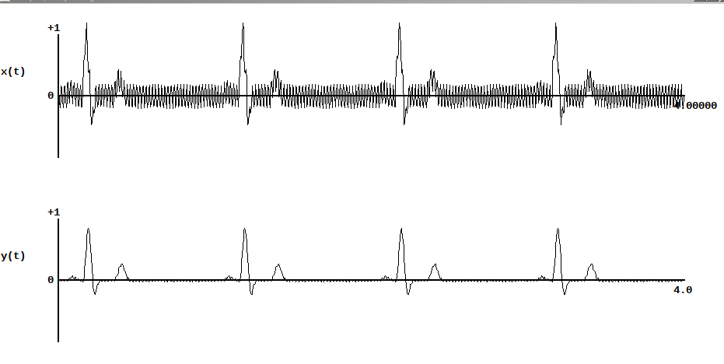
Filtering Noise

Slide 22
Frequency composition of Signal
Every signal can be described in terms of a set of sinusoids
Conversely, any signal can be constructed from a suitable set of sinusoids
This is the Fourier Transform

Slide 23
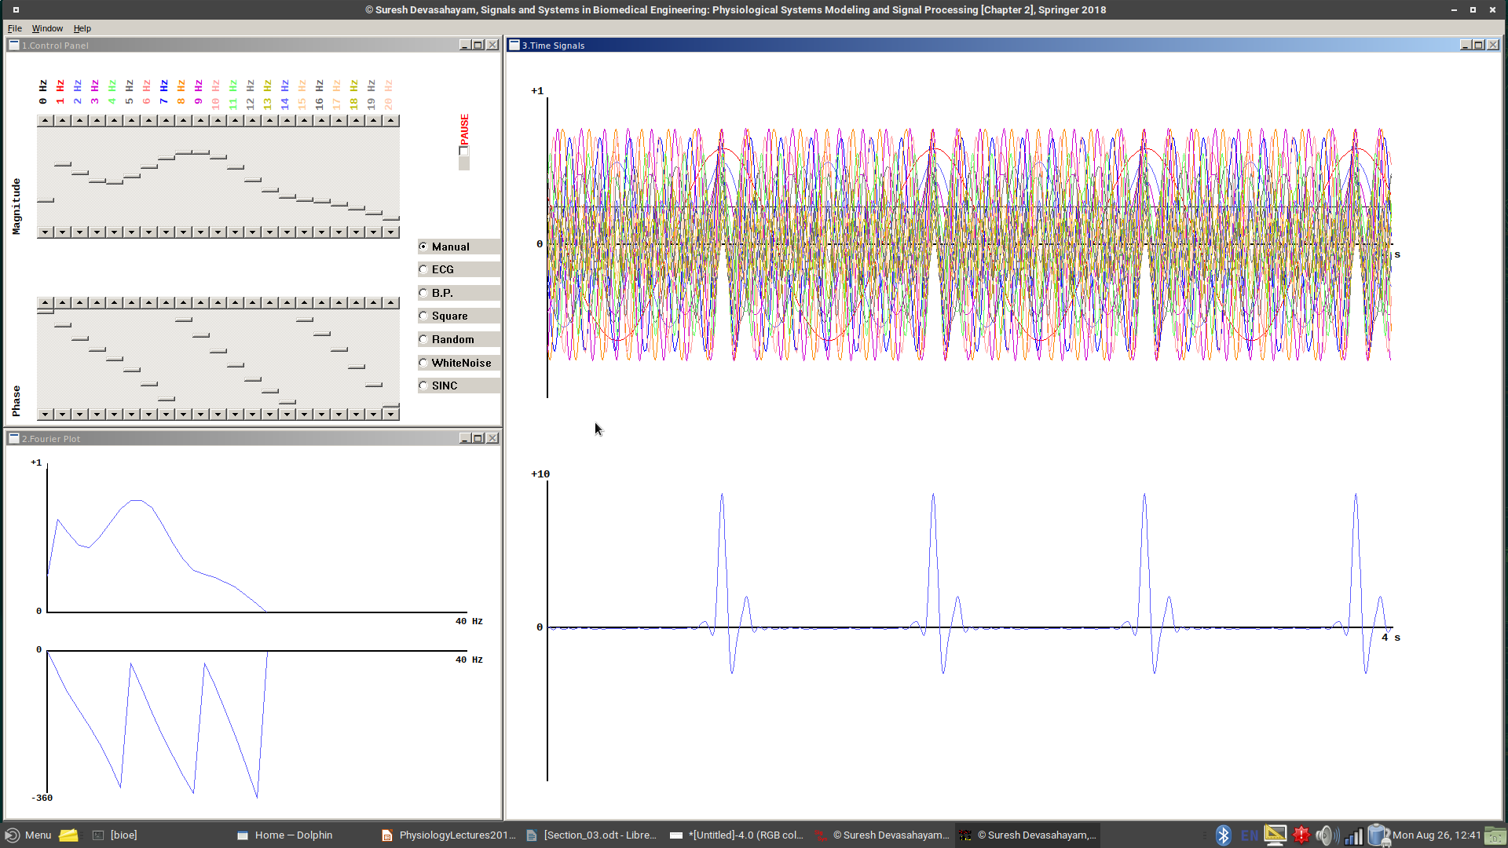
Fourier Decomposition

Slide 24
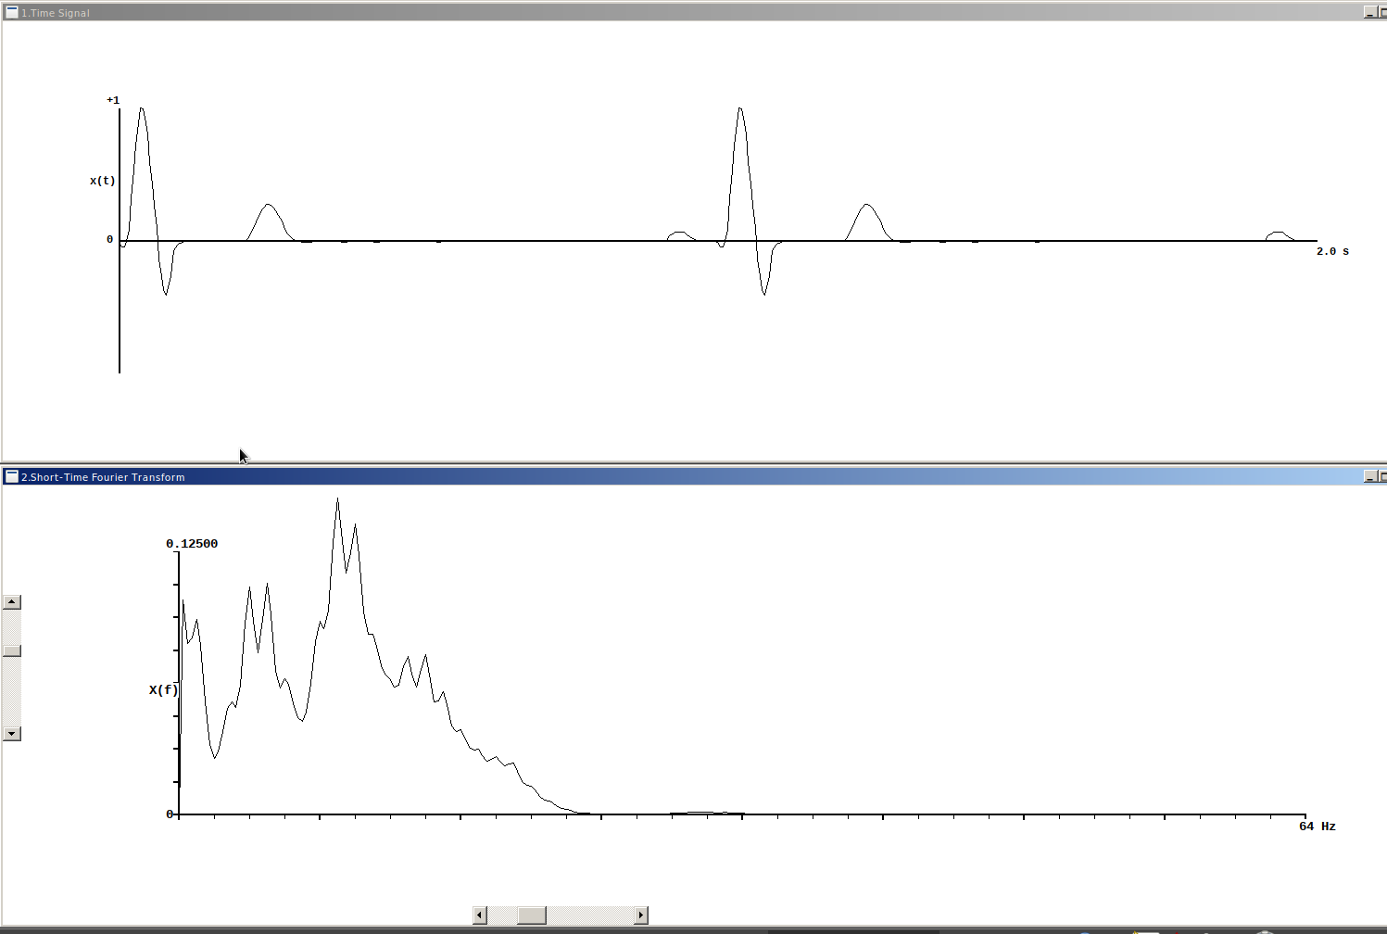
Spectrum Analysis

Slide 25
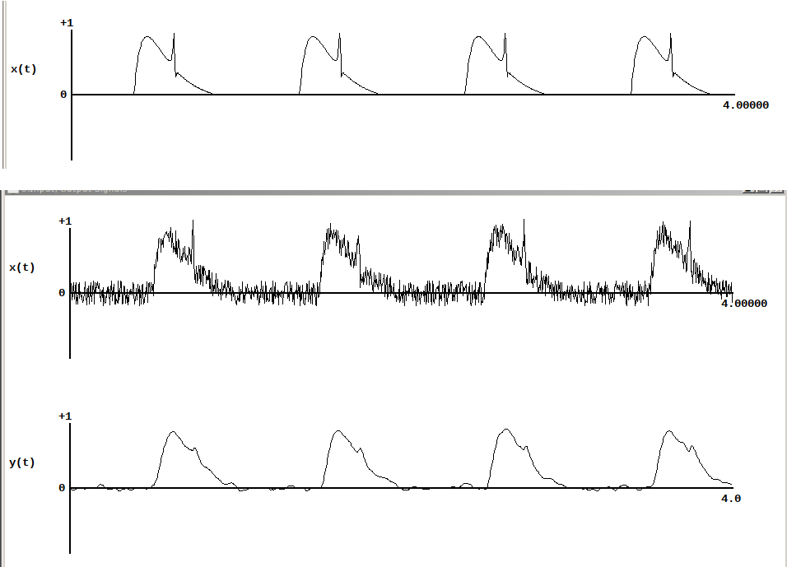
Filtering: 1st and 2nd Order filters

Slide 26
How to select the cutoff freq: The Optimal Filter

Slide 27
The Optimal Filter
Keep as much of the signal as possible
Remove as much of the signal as possible
Decide on a compromise between these two

Slide 28
Other Techniques
Noise removal:
  Ensemble Averaging
  Adaptive filtering
Signal Decomposition
  Wavelet transforms

