Slide 1
Analog Processing
Suresh Devasahayam
Department of Bioengineering
Christian Medical College, Vellore

Slide 2

Lecture - Outline
Amplifiers
Frequency filtering
Filter Characteristics – Gain and Phase
Phase Distortion in Biological Signals
Offline Filtering

Slide 3
Measurement schematic

Slide 4

Considerations in Designing Sub-systems (i.e.,Transducers, Amplifiers, Filters)
The subsystem must draw very little power from the preceding subsystem
  In the case of voltage signals, the subsystem must draw as little current as possible
  This means the input impedance must be very high
The subsystem must be capable of delivering as much power as the following or next subsystem requires
  In the case of voltage signals, the subsystem must be able to deliver as much current as required
  This means the output impedance must be very small

Slide 5

Thevenin and Norton equivalent for any voltage or current source
Any voltage or current source can be represented by:
  A perfect voltage source with a series impedance
    (Thevenin equivalent)
  A perfect current source with a shunt impedance
    (Norton equivalent)

Slide 6
Attenuators and Amplifiers

Slide 7
Difference or Differential Amplifier

Slide 8
Operational Amplifiers
Amplifier with differential inputs suitable for feedback circuits
Very high gain
Very high input impedance
Low output impedance

Slide 9
Feedback Control System

Slide 10
Basic Amplifier with Adjustable Gain

Slide 11
Simple Analysis of Op-Amp Circuits
Due to high input impedance the current into amplifier at the two inputs is zero
From the above point, the effective potential difference between the two inputs is zero (“virtually connected” or concept of “virtual ground”)
The output is: V_{o}=(V_{a}-V_{b})G, with G→ very large

Slide 12
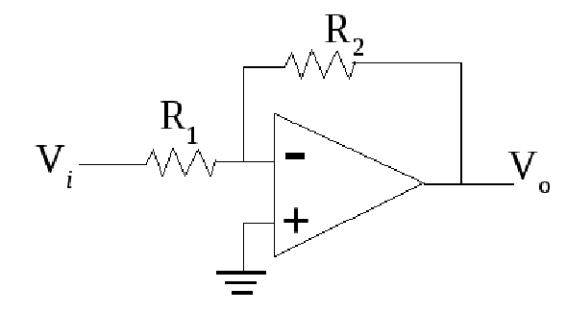
Inverting Amplifier

Slide 13
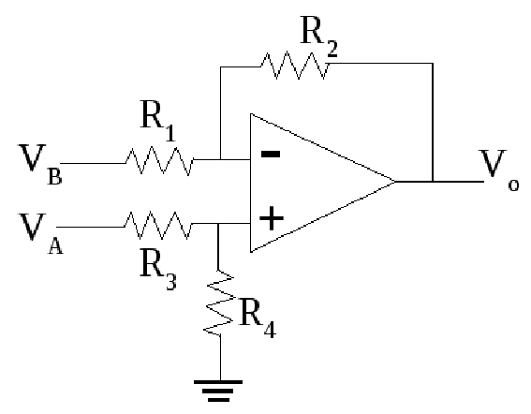
Differential Amplifier

Slide 14
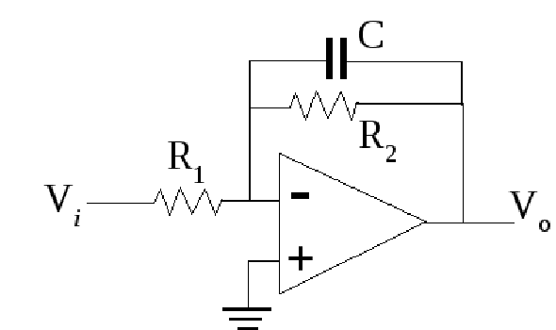
Low-Pass Filter

Slide 15
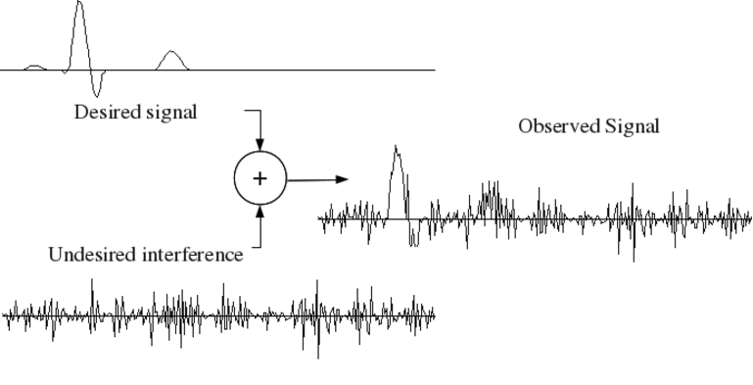
Signal contaminated by noise distinctly separated in frequency

Slide 16
Lowpass filtering of distinct high frequency noise

Slide 17
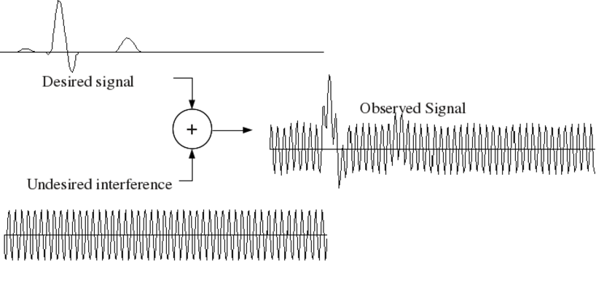
Signal contaminated by noise overlapping in frequency

Slide 18
Filtering Overlapping Noise

Slide 19
Optimal Filter - I
Keep as much of the signal as possible
Remove as much of the noise as possible
This means:
  In the frequencies where the signal and noise overlap, the filter attenuation is proportional to the ratio of signal to noise
  In the frequencies where they don't overlap, keep all the signal and remove all the noise

Slide 20
Optimal Filter - II
Consider the EMG and ECG both of which can be picked up simultaneously by electrodes on the chest
  ECG spectrum: 0.05Hz-80Hz
  EMG spectrum: 15Hz-300Hz

Slide 21
Cascading Filters
The Laplace Transform converts the input-output relation in simple algebraic terms – i.e., only multiplications and divisions
Multiple filters can be cascaded, and the cumulative effect is a multiplication of the individual input-output relations

Slide 22
Real Filters
Real-time and offline filtering
Implementation
  Physical filters/Electrical – online/realtime
Physical filters and online filters
  Causal , cannot use future data
  Have finite phase shift or time lag
Offline filters (Digital Filters)
  Can use “virtual future” data that has been stored

Slide 23
Phase shift in filters
Phase shift can disrupt time relations in waveforms
Phase shift can introduce lag between synchronous signals
Linear phase filters introduce constant time lag to all frequencies

Slide 24
Characterizing Filters
Frequency response
Step response

