Slide 1
System Characterization
Suresh Devasahayam
Department of Bioengineering
Christian Medical College, Vellore

Slide 2


Lecture - Outline
System Transfer Function
System Frequency response
Testing Methods
  Frequency testing
  Step response
  Fourier transform methods

Slide 3
Measurement schematic

Slide 4
Transfer function estimation-I
Sinusoids are Eigen functions of linear systems – function does not change
When a sinusoid is input, the output is also a sinusoid

Slide 5
Using Sinusoidal testing for systems
Electronic circuit sub-systems – sinusoidal voltage
  Amplifiers
  Filters
Transducers – use known or calibrated sinsoidal input
  Force and pressure transducers
  Audio transducers
Important consideration
  Requirement of a known or calibrated input signal that can be controlled to have a sinusoidal time variation

Slide 6
Transfer function estimation – IIa
White noise as input signal

Slide 7
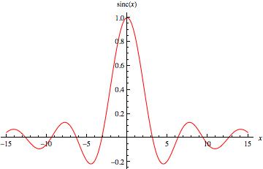
Transfer Function Estimation - IIb
Simultaneous application of multiple sinusoids
  Sinc function
Sinc test function

Slide 8
Transfer function estimation - III
Step input signal
  Easy to apply
Assume or guess the order of the system
Step response is the solution of the system differential equation
First order system:
Second order system

