Slide 1
Resistive Displacement & Force Sensors
Strain Gauges
Suresh Devasahayam
Department of Bioengineering
Christian Medical College, Vellore

Slide 2


Lecture - Outline
Strain gauges
  Load cells
  Force measurement
  Pressure measurement
Thermistors
  Temperature measurement
  Self-heating

Slide 3
Strain Gauge
Resistance
Taking log
Differentiating
Fractional change of resistance
Can calculate for a cylinder, A=πr²
Poisson’s ratio σ is 0.5 for incompressible solids (constant volume), 0.3 for metals

Slide 4
Strain Gauge (contd)
Temperature dependence of resistivity
Temperature dependence of length

Slide 5
Strain Gauge Examples
Material | Temperature Coeff α_{E} | Maximum strain Δl/l | Modulus of Elasticity Y | Gauge factor G
Platinum | 0.0038 | 0.0023 | 1.5 x 1010 | 6
Nichrome | 0.0004 | 0.0036 | 19 x 1010 | 2.5
Silicon | 0.007 | 0.0033 | 19 x 1010 | 170

Slide 6
Load Cell

Slide 7
Load Cell – cantilever beam

Slide 8
Bending of the cantilever beam
Deflection of beam
Horizontal distance:
Similar Sectors:
Substiting for r:
Strain in surface fibres:

Slide 9
Mechanical Equivalent

Slide 10
Pressure Transducer

Slide 11
Pressure Measurement

Slide 12
Equivalent of catheter fluid system

Slide 13
Thermistors – negative temperature coefficient sensors

Slide 14
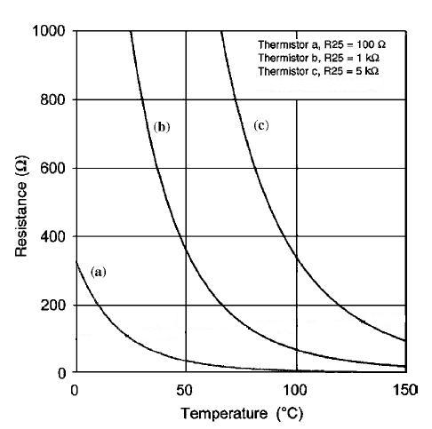
Thermistors

Slide 15
Thermistors
Thermistor characteristics
Sensitivity:
Non-linear sensitivity:

Slide 16
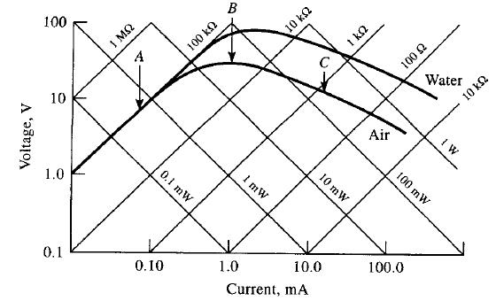
Voltage-Current characteristics

Slide 17
Thermistor self-heating
Power dissipation (due to electric current) results in heating of thermistor
As temperature changes, resistance decreases
Equilibrium is reached when the electrical power is equal to the thermal power dissipated

Slide 18
Application of Thermistor in Self-Heating
Measurement of fluid flow – changing dissipation constant
Mass flow meters
  gas and liquid flow sensors

