Slide 1
Sensors with Feedback Correction
Suresh Devasahayam
Department of Bioengineering
Christian Medical College, Vellore

Slide 2

Lecture - Outline
Force and Pressure Transducers as Second Order Systems
Force Actuators
Force Balance with Feedback

Slide 3
Force and Pressure measurement

Slide 4
Add actuator to force/pressure transducer

Slide 5
Feedback compensation for force sensor

Slide 6
Overall Transfer Function

Slide 7
Opamp circuit for Proportional+Differentiator

Slide 8
Standard form for second order system

Slide 9
Why closed loop?
Open-loop case
Closed-loop case

Slide 10
Force Actuators - Electromagnetic actuator
EMF in a coil
EMF in a moving conductor
Force on a conductor
Magnetomotive force

Slide 11
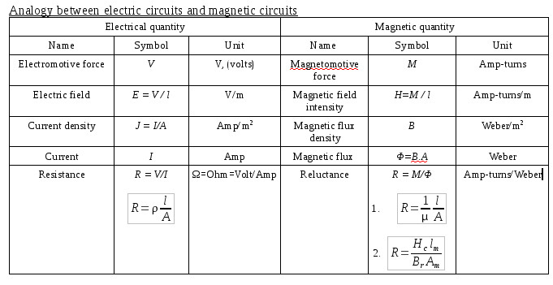
Magnetic Circuit equivalent

Slide 12
Magnetic circuits

Slide 13
Voice coil - actuator

