Slide 1
Voice Coil Actuator
Suresh Devasahayam
Department of Bioengineering
Christian Medical College, Vellore

Slide 2

Lecture - Outline
Magnetic Circuits
Voice Coil

Slide 3
Force Actuators - Electromagnetic actuator
EMF in a coil
EMF in a moving conductor
Force on a conductor
Magnetomotive force

Slide 4
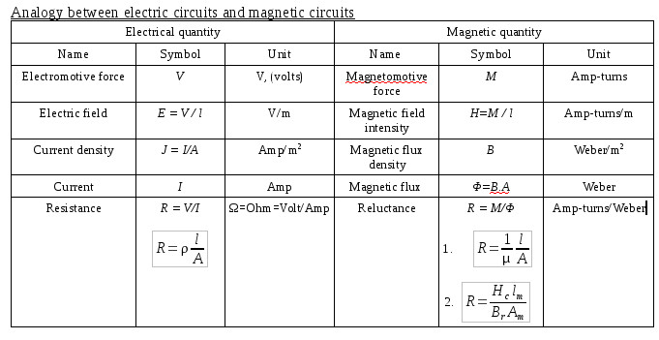
Magnetic Circuit equivalent

Slide 5

Field-Flux characteristics of a permanent magnet
Permanent magnets B_{r}H_{C} =figure of merit (is large)
  Steel, Ferrite: B_{r}H_{C}=9
  Alnico: B_{r}H_{C} = 62400
  Ne-Fe-B: B_{r}H_{C}=240000
For electromagnets hysteresis (B_{r}H_{C}) should be small

Slide 6
Magnetic circuits

Slide 7
Voice coil - actuator

Slide 8
Magnetic circuit of voice coil
Reluctance of magnet
Reluctance of pole piece
Reluctance of air gap
Flux in air gap
Flux density in air gap

Slide 9
Force developed by the voice coil
Force on the coil
Laplace transform
Length of conductor in coil

Slide 10
Electrical Excitation of voice coil
Excitation voltage
Back emf due to movement
Total Applied Voltage

Slide 11
Electrical Equivalent

Slide 12
Equivalent Electrical Impedance due to mechanical components

Slide 13
Using a transformer representation

Slide 14
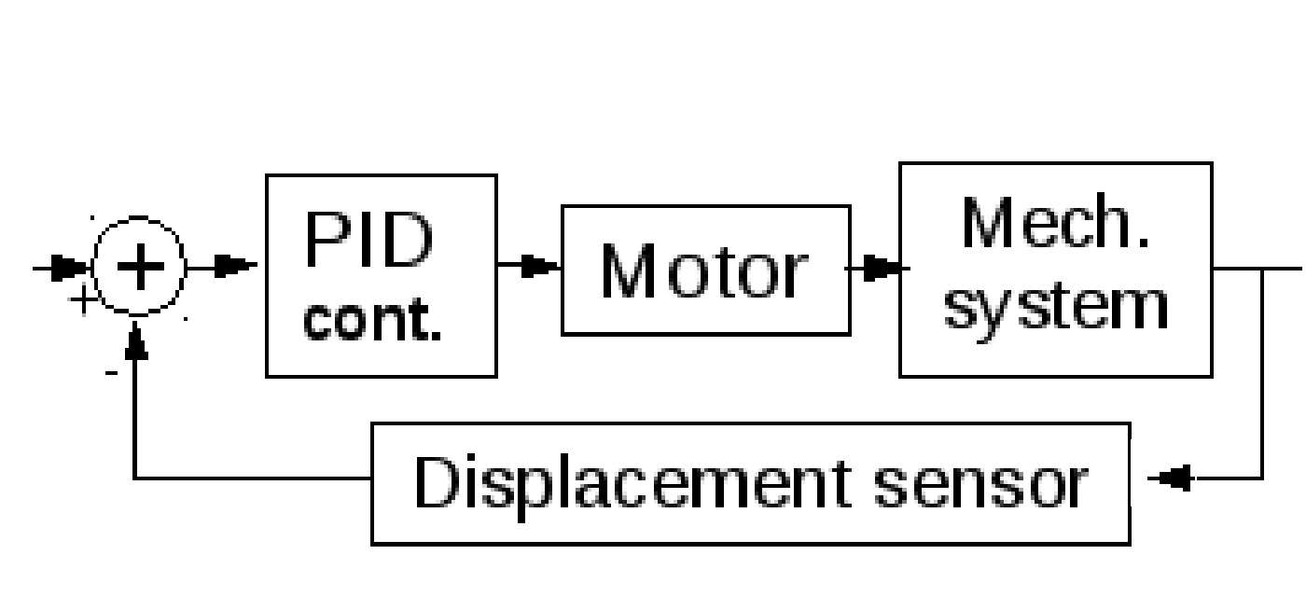
Servo Motor

Slide 15
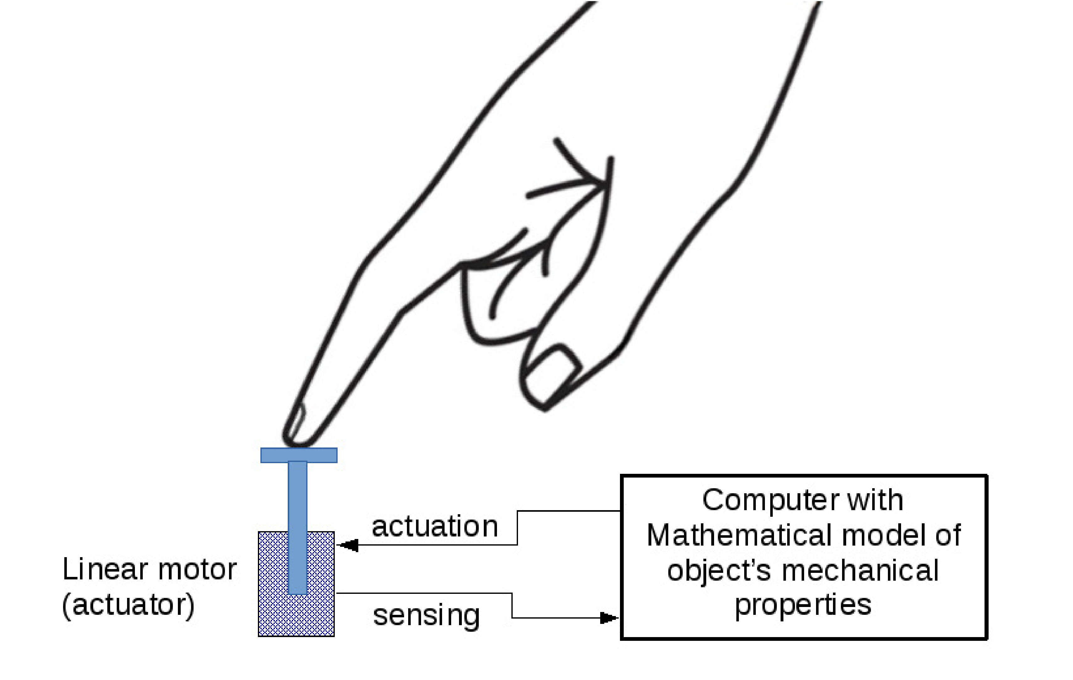
Application of Servo motor in Haptics

Slide 16
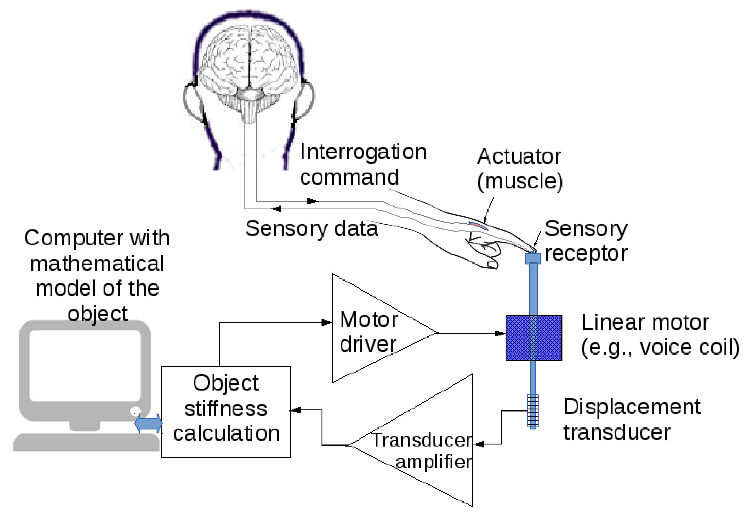
Haptics – Feeling in Medical Devices

Slide 17
End of Lecture

