Slide 1
Sample Problems
Suresh Devasahayam
Department of Bioengineering
Christian Medical College, Vellore

Slide 2


Lecture - Outline
Operational Amplifier Circuits
  Sum and difference amplifier
  Low-pass and high-pass filters
Sensors with feedback compensation
  Force sensor dynamic characteristics
  Feedback compensation

Slide 3
Problem 1: Sum and Difference Amplifier

Slide 4
P1: Output of the sum-and-difference amplifier

Slide 5
Problem 2: Low-pass filter

Slide 6
P2: Design the filter for a cutoff of 20Hz

Slide 7
P2:
f | ω | Magnitude | Magnitude (dB) | Phase
0.2 | 1.25 | 1 | 0 | 0
2.0 | 12.5 | 1 | 0
20 | 125 | 0.707 | -3 | 45
200 | 1250 | 0.1 | -20
2000 | 12500 | 0.01 | -40 | 90

Slide 8
Problem 3: High-pass filter

Slide 9
P3: Design the HPF with cutoff freq of 20Hz

Slide 10
P3:
f | ω | Magnitude | Magnitude (dB) | Phase
0.2 | 1.25 | 0.01 | -40
2.0 | 12.5 | 0.1 | -20
20 | 125 | 0.707 | -3
200 | 1250 | 1 | 0
2000 | 12500 | 1 | 0

Slide 11
P4: Force sensor
Mass: m=100g,
spring constant: K=25.6 N/m
viscous damping B=0.8 N.s/m

Slide 12
P4:

Slide 13
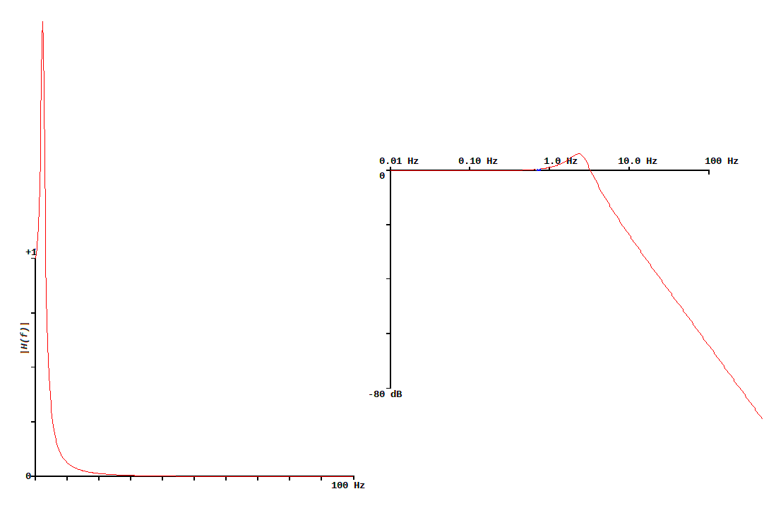
P4: Sensor Frequency response

Slide 14
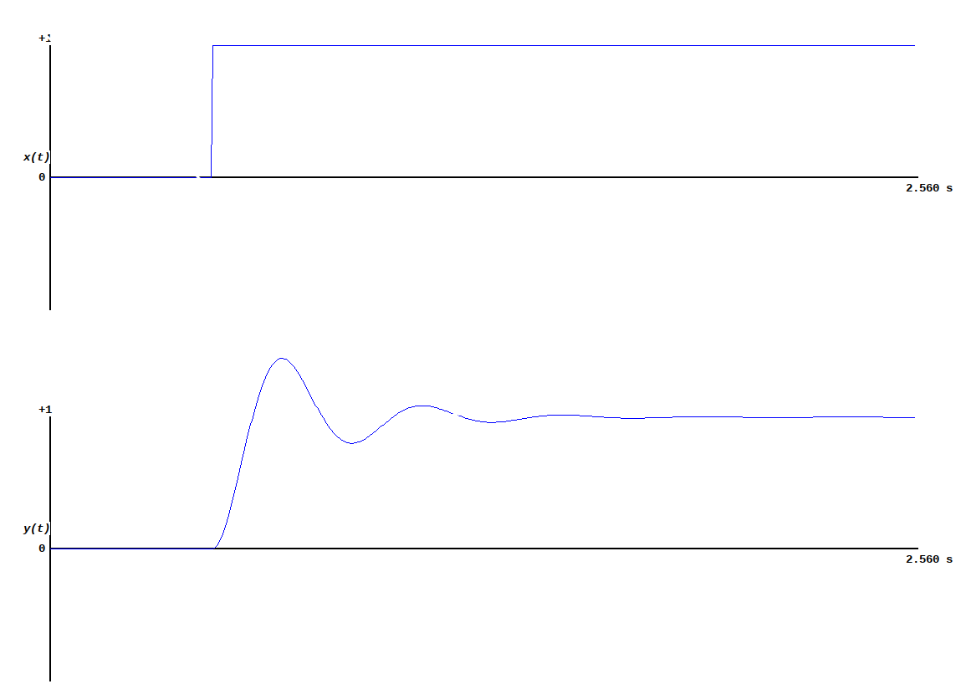
P4: Sensor Step response

Slide 15
P4: Sensor with feedback compensation

Slide 16
P4: Feedback compensation

Slide 17
P4: Transfer function of sensor with feedback compensation

Slide 18
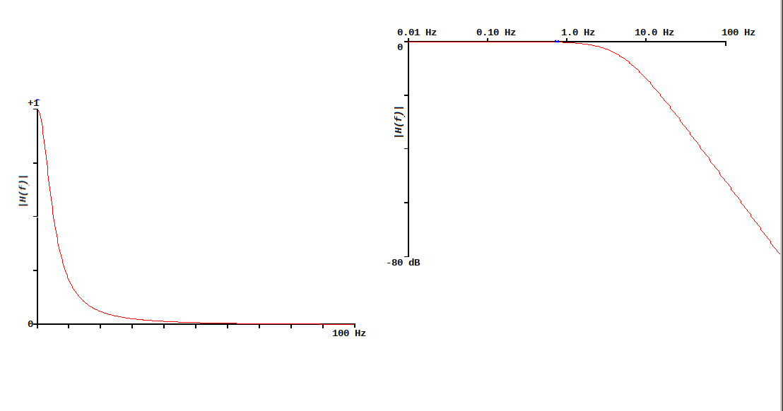
P4: Compensated Sensor Freq Response

Slide 19
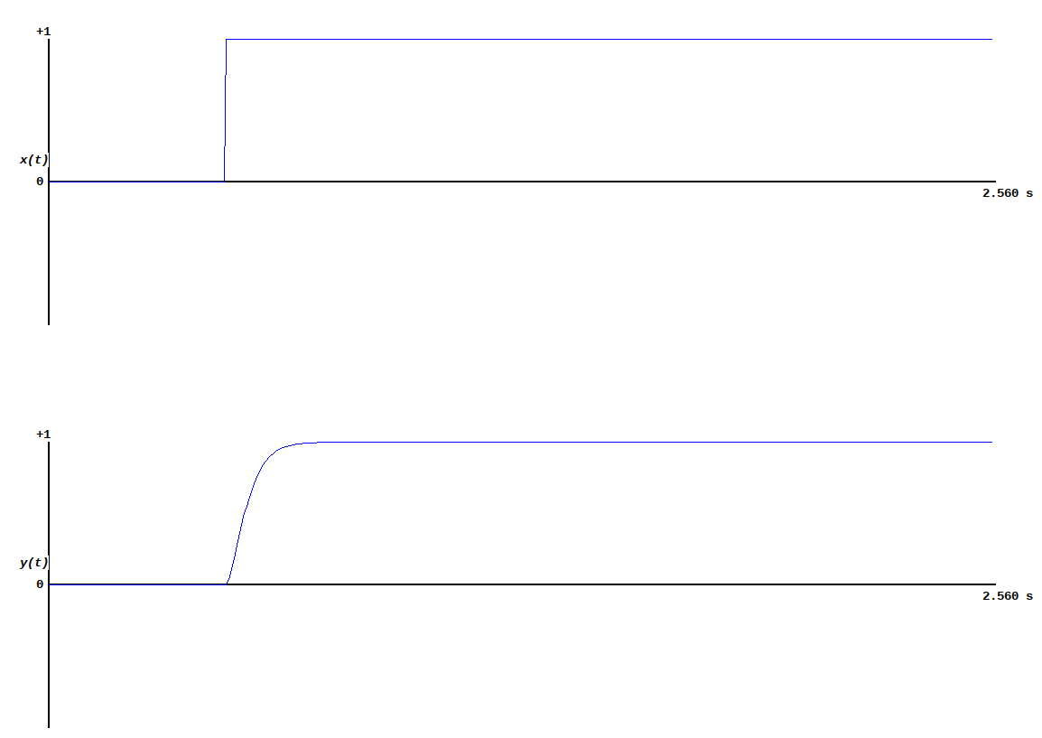
P4: Compensated Sensor Step Response

Slide 20
End of Lecture

