Slide 1
Voice Coil Example
Suresh Devasahayam
Department of Bioengineering
Christian Medical College, Vellore

Slide 2


Lecture - Outline
Voice Coil
  Ring magnet
  Centre pole piece
  Air gap
  Coil in air gap
  Spring to position coil

Slide 3
Voice coil - actuator

Slide 4
Ring magnet
Ferrite ring
Length=20mm
outer diameter=20mm, inner diameter=15mm.
Place it in a coil of wire (e.g.,20 turns; current 1A)
Ferrite => H_{c}=60 Amp-turn/m, B_{r} = 0.15 Weber/sq.m
Ferrite ring is saturated and fully magnetized.

Slide 5
Permanent Magnet

Slide 6
Magnetic circuit
Iron Pole piece: length = 20mm, diameter = 13mm.
Fe permeability:

Slide 7
Coil
Coil: 40 gauge (diameter 0.08 mm), 125 turns. Length of coil=10mm.
Diameter of coil = 14 x 10⁻³ m. Length of wire=1.75 m
Resistance of coil = 5.8 Ω
Inductance (iron core inductor):

Slide 8
Static case
Excitation voltage = 6V
Current = 1.03 A
Force:

Slide 9
Dynamic case
Excitation voltage is time varying: V(t)

Slide 10

Mechanical Aspect
When coil is moving, EMF due to moving conductor in magnetic field:
  Back EMF
  Velocity determined by mechanics

Slide 11
Equivalent Electrical Impedance due to mechanical components

Slide 12
Using a transformer representation

Slide 13
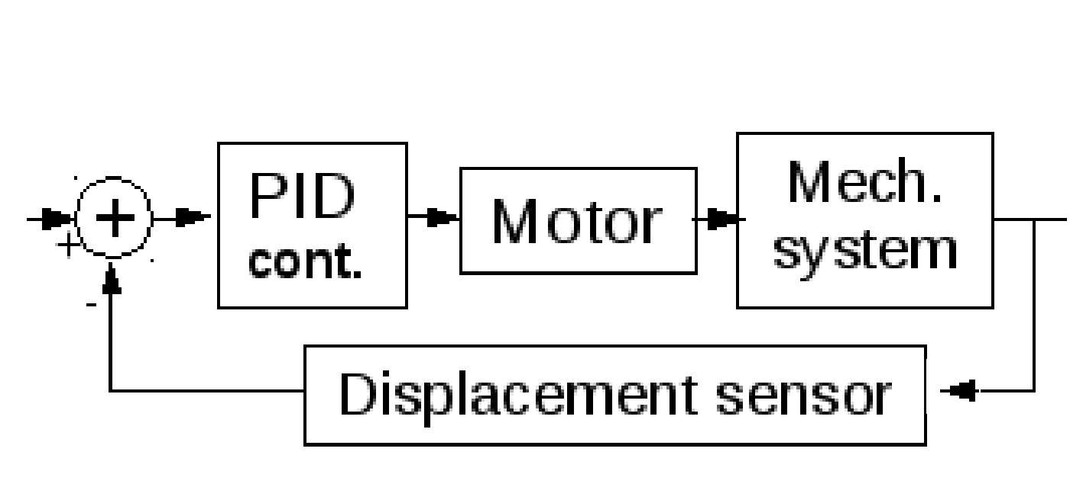
Servo Motor

Slide 14
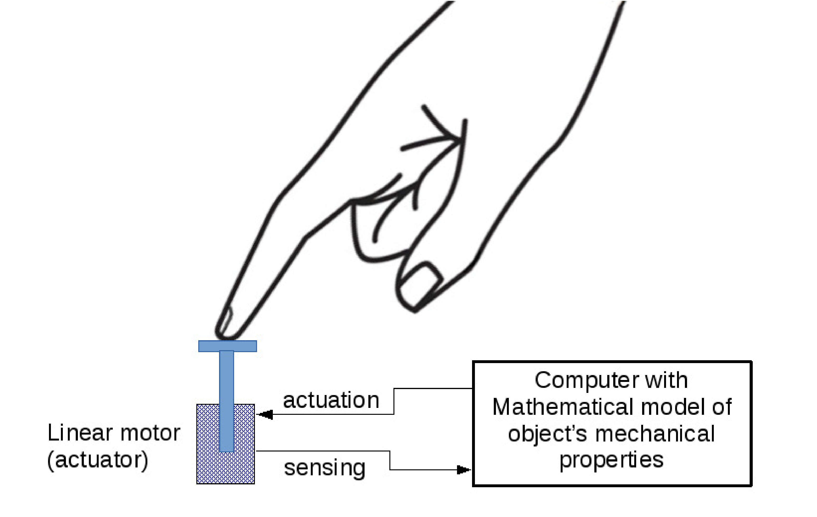
Application of Servo motor in Haptics

Slide 15
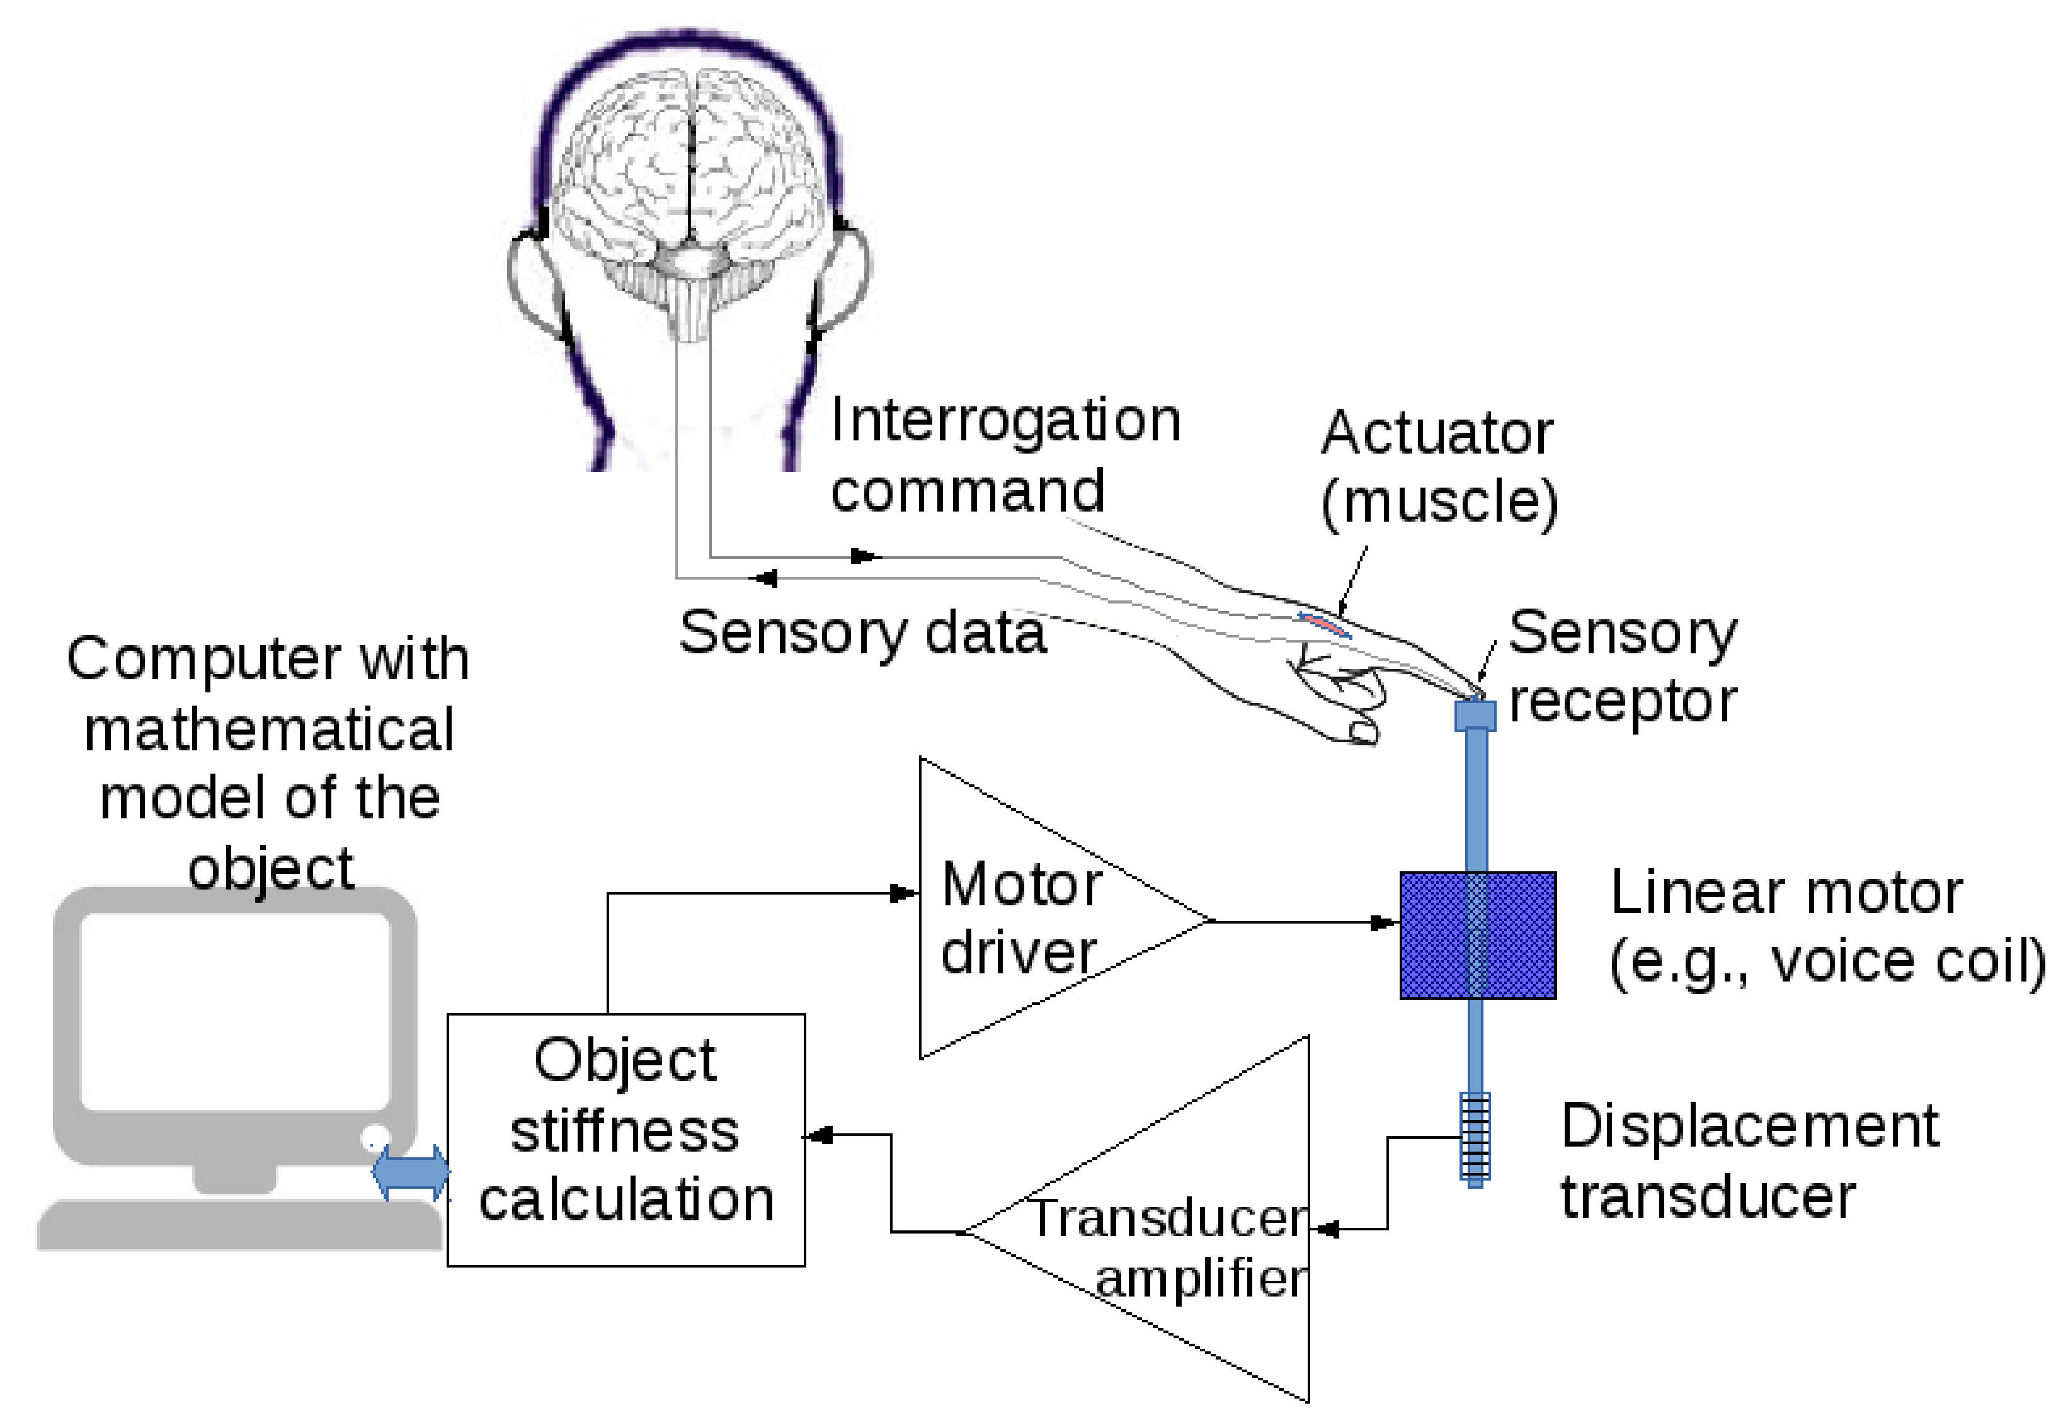
Haptics – Feeling in Medical Devices

Slide 16
End of Lecture

