Slide 1
Displacement Sensors
Suresh Devasahayam
Department of Bioengineering
Christian Medical College, Vellore

Slide 2


Lecture - Outline
Inductive Sensors
  Measuring Inductance
Capacitive Sensors
  Measuring Capacitance

Slide 3
Inductance
Inductance
With constant permeability
Reluctance of coil is R:
If l_{c} is coil length and l_{a} is length of air, Reluctance:

Slide 4
Variable Inductance Transducer
Relative permeability:
  Steel = 30000
  Ferrite=2500
(Note: Weber/Ampere=Henry)

Slide 5
Measuring Inductance using simple V-I

Slide 6
Differential Inductance Sensor – bridge measurement

Slide 7
Linear Variable Differential Transformer (LVDT)

Slide 8
Capacitive transducers
Capacitor
Microphone

Slide 9
Capacitance measurement
Simple V-I measurement
Bridge measurement
Oscillator measurement
Charge transfer or switched capacitor measurement

Slide 10
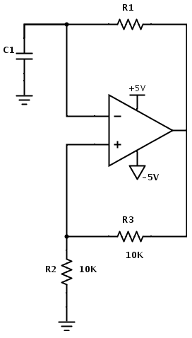
Relaxation Oscillator for capacitance measurement

Slide 11
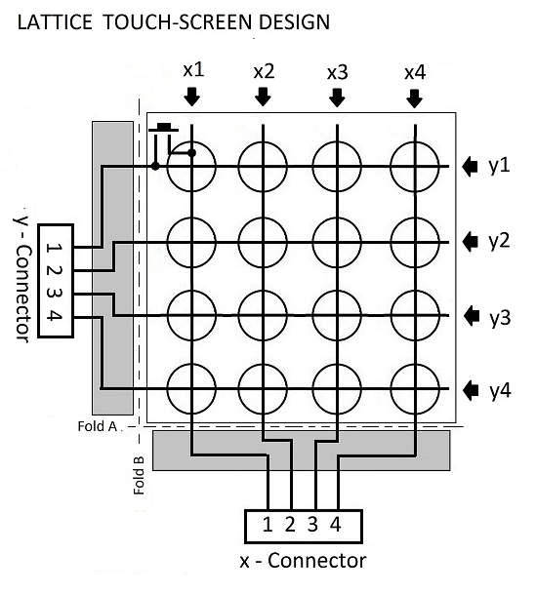
Capacitive grid sensor

Slide 12
End of Lecture

