Slide 1
Volume Measurement and
Concentration Measurement
Suresh Devasahayam
Department of Bioengineering
Christian Medical College, Vellore

Slide 2


Lecture - Outline
Volume –
  Electrical Impedance
  Optical Absorption
Optical density measurement
  Absorption by chemicals
Characteristics of Spatial Sensors
  Spatial Transmission/Reception Pattern
Chromatic measurement - spectrometry
  Electrical
  Optical
Spectrophotometric oximetry

Slide 3
Electrical Impedance Plethysmography

Slide 4

Impedance Measurement – 2 electrode, 4 electrode
Constant current source
Voltage measurement across electrodes
2 electrode method
  Electrode-tissue impedance is included
4 electrode method
  Inject current across outer 2 electrodes
  Measure voltage across inner 2 electrodes
  If amplifier has high input impedance
    Electrode impedance is excluded

Slide 5
Optical Emitters, Filters, Detectors
Intensity is a function of frequency
  Spectrum
Spatial radiation, reception pattern
  Angle dependent
  Lenses and collimators
Light transmission:
  Incident energy = Transmitted+Scattered/reflected
Transmission through multiple media
  Snell’s law:

Slide 6
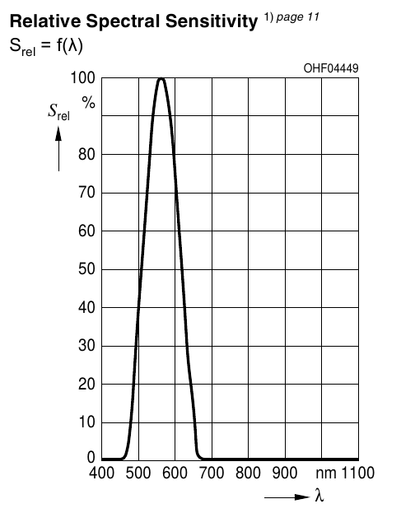
Spectral characterisitics of Photodiode (SFH2270)

Slide 7
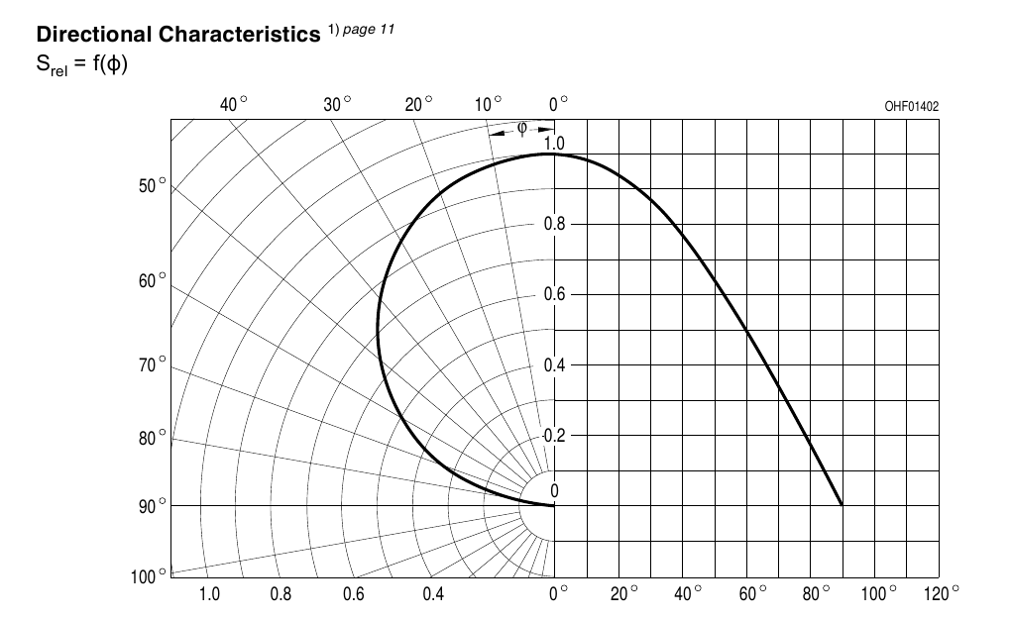
Directional Characteristics

Slide 8
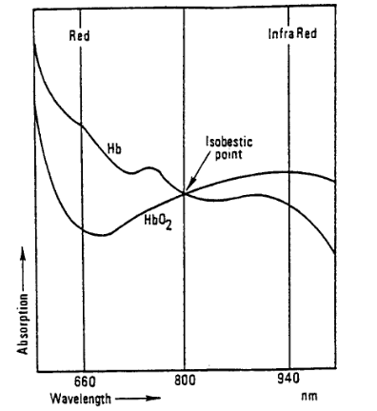
Spectrophotometry for Blood Oximetry

Slide 9
Electrical Impedance Spectrometry

Slide 10
End of Lecture

