Slide 1
Digital Sensors:
Digitization &
Data Communication
Suresh Devasahayam
Department of Bioengineering
Christian Medical College, Vellore

Slide 2

Lecture - Outline
Digital Sensors
Digitization
Numerical data representation
Data transfer
Packet data
Wireless and network data transfer
Digital to Analog - Pulse width modulation (PWM)

Slide 3
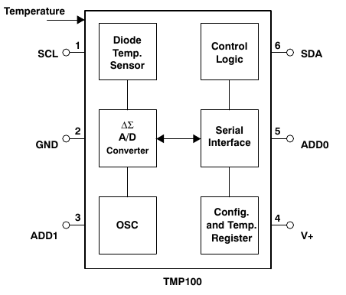
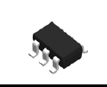
Digital Temperature sensor - TMP100

Slide 4
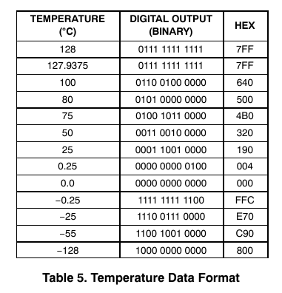
TMP100 – Data format

Slide 5
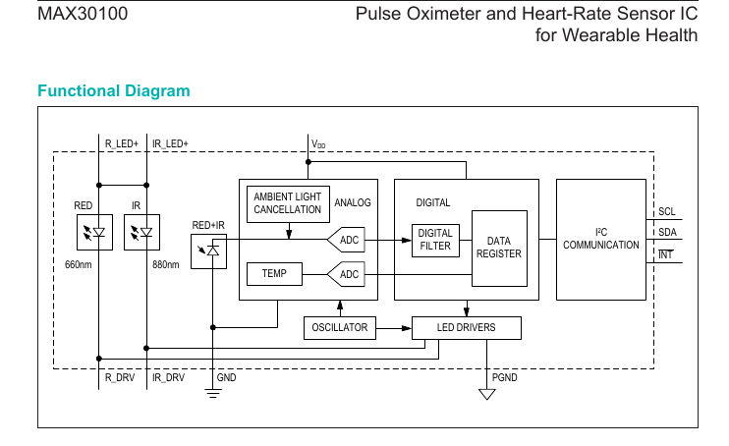
MAX30100 – Photoplethysmograph Sensor

Slide 6
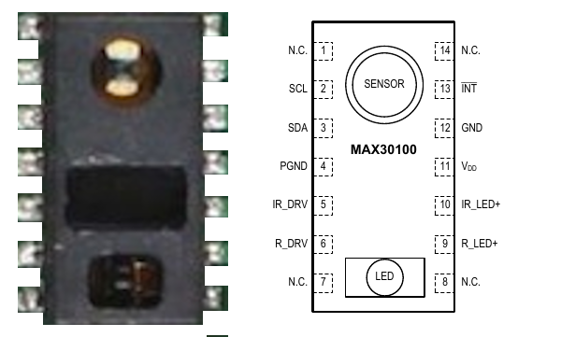
MAX30100 - IC

Slide 7
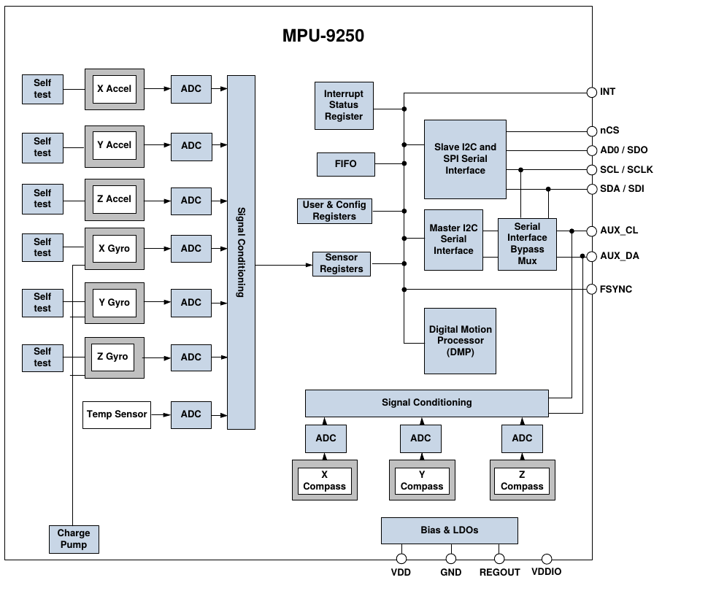
Inertial Motion Sensor - MPU9250

Slide 8
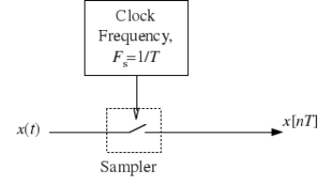
Digitization

Slide 9
Sampling Theorem
If a signal is sampled at a rate of at least twice the highest frequency contained in the signal, then the original signal can be reconstructed from the samples.

Slide 10

Reconstruction of original signal from the samples
The original signal contains frequencies less than half the sampling rate.
If the sampled signal is low-pass filtered with a cutoff of exactly half of the sampling rate, then the original signal will be recovered.
Practically, this method is difficult and expensive
Approximate methods:
  Zero-order hold
  First order interpolation
  Analog low-pass filter

Slide 11
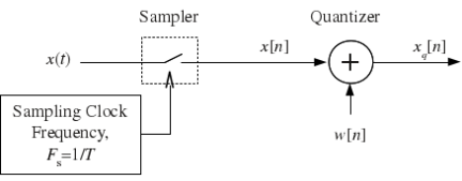
Digitization and Quantization

Slide 12
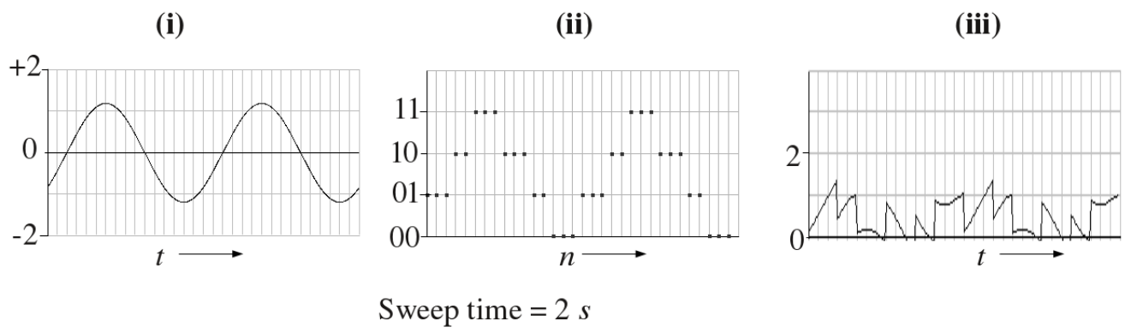
Quantization “Noise”

Slide 13
Number representation
Straight binary – only positive numbers
For both positive and negative numbers
  First half of numbers → same as straight binary
  Second half → negative numbers
Floating point numbers
  Significand (fraction) and exponent

Slide 14
Parallel Data Transfer
One wire per bit
Plus ground wire
Data updated when available
Data read when desired

Slide 15
Serial Data Transfer
Sequential transfer of bits
  Big endian, little endian
Synchronous
  Requires a separate clock line
  Clock rate determined by one Master clock
Asynchronous
  Each devices has Independent clocks
  Clock rate needs to be same on all devices

Slide 16
Data lines – electrical connection
Low voltage and high voltage data lines
Ground referenced data line
Differential data lines
  USB, CAN
  Immunity to electrical noise

Slide 17
Individual Bytes versus Packet data transfer
Individual bytes
  Simple universal protocol
  Well established standard
Packet data
  Packet contains header and data
  Header can contain source and destination information, other information
Packet identifier and delimiters
  Start of packet
  Packet length

Slide 18
Network and wireless data transfer
Network topologies
Formation of networks
Packet data transfer

Slide 19

Network Topology
Network topologies
  Star
  Peer-to-peer
  Mesh
Co-ordinator devices
  Terminal node Input/Output devices

Slide 20


Example wireless network
IEEE 802.15 for Wireless Personal Area Networks - ad hoc networks
Frequency band is 2.4GHz, 16 channels (channels 11-26), license free.
Uses carrier sense multiple access (CSMA) with collision avoidance (CA)
Zigbee protocol is one realization of the IEEE 802.15.4 specification
Physical layer (PHY), & part of MAC (media access control) with AES (advanced encryption standard) are incorporated in hardware.
Globally unique address
  64 bit MAC address
  24 bit OUI, and 40 bit manufacturer assigned
  additional 16 bit network address designating the current network

Slide 21
Wireless network - star

Slide 22
Node software
At node power up
  searches the medium for the presence of a network
  if a network is found, the node checks the network identity
  if it is a recognizable network, makes a request to join
Micrcontrollers of the netowkr nodes have digitized sensor data
  e.g., data is sampled at 1000 samples/second
  Node uses a timer interrupt for ADC
  Data packets size 80 bytes
  16 bytes are for a header specifying the type of data
  64 bytes of data

Slide 23
Co-ordinator software
coordinator power up
  checks the medium for networks
  if its own network identity does not already exist, starts own network
  after network has been started any recognizable node is allowed to join
Coordinator is a state machine
  States set by Software (Bluetooth/Zigbee) stack (interrupt driven)
  States are polled for priority of action
  Coordinator can also send data packets to the nodes

Slide 24
Pulse width modulation (PWM)
Fixed clock rate, variable pulse width
  Information encoded as pulse width
Easy to decode
  Estimate pulse width
  Lowpass filter
Poor error correction capability

Slide 25
End of Lecture

