Slide 1
Radiation Thermometry
Suresh Devasahayam
Department of Bioengineering
Christian Medical College, Vellore

Slide 2


Lecture - Outline
Radiation Thermometry
Non-linear sensors
  Radiation Thermometer Example
Digitization and digital sensors

Slide 3
Thermometry – thermal radiation
Non-contact measurement - necessity and advantages
Thermal radiation and temperature (steel)
  Bright yellow: 2000 C
  Bright red: 1500 C
  Red-gray: 1000 C
  Gray: 800 C
  Blue: 575 C
  Purple: 520 C
  Brown: 480 C

Slide 4
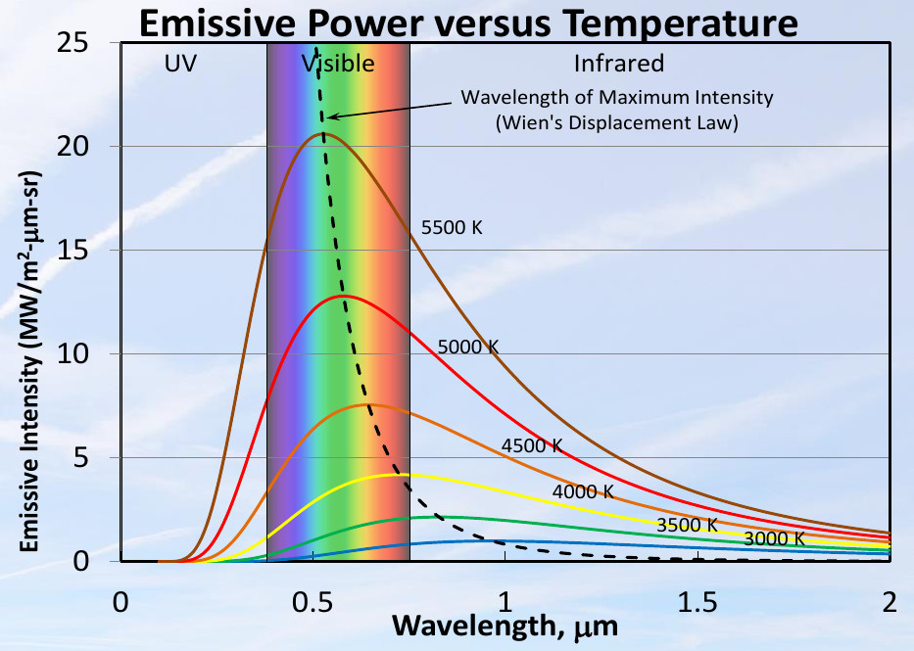
Thermal Emission and Temperature – Planck’s Law
Ref for graphs: T.K.Risch, 2015

Slide 5
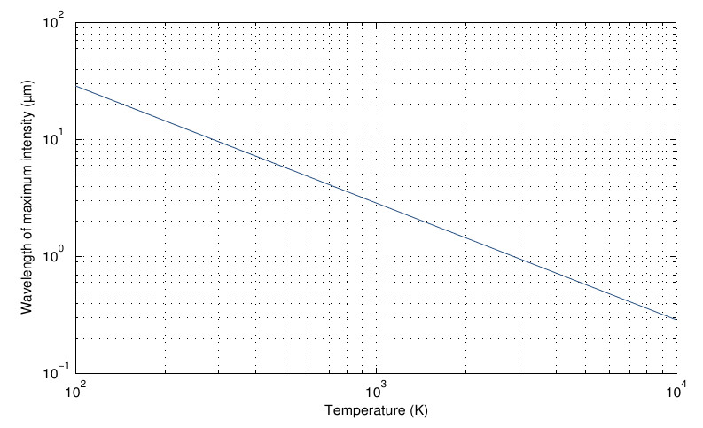
Thermal Radiation – Wien’s law → peak radiation

Slide 6
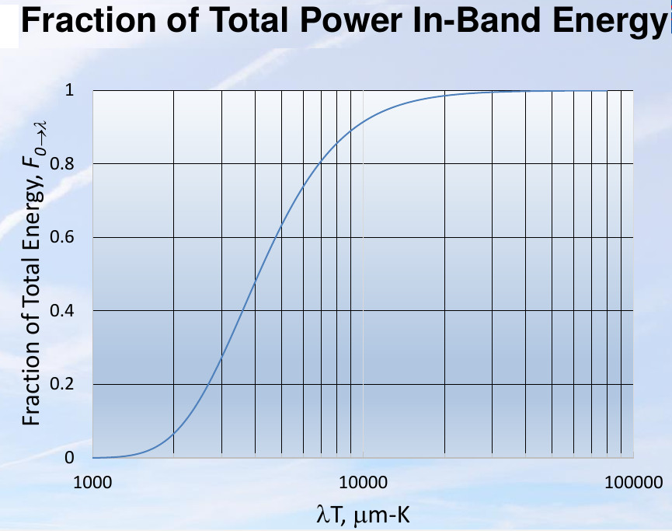
Fractional Thermal Power

Slide 7
Stefan-Boltzman Law – radiation (absorbed/emitted)
Integrating Wien’s equation can get total thermal power
  integrate numerically
Empirical formula by Stefan and Boltzman
For black body, the emissivity is 1
‘A’ is a geometry factor

Slide 8
Emissivity
Radiated energy depends on surface properties, reflectivity
Emissivity = Ratio of power emitted by a material to the power emitted by a perfect radiator (black body)
Emissivity ranges from 0 to 1

Slide 9
Measuring thermal radiation
Single wavelength measurement
Two point measurement
Multi-point spectrum measurement
  Can estimate emissivity
Measure Temperature rise due to absorbed energy
  Thermocouple (thermopile)

Slide 10
Thermal Energy Measurement – PN jn voltage PTAT

Slide 11
Thermal Energy Measurement – PN jn voltage PTAT
(Proportional To Absolute Temperature)
Semiconductor PN junction voltage depends on temperature (T) and current (I)
Using a transistor with controlled collector current, and measuring the Base-Emitter voltage, we can calculate the junction temperature
Sometimes, two transistors with I_{c} in a fixed ratio is used. The difference in V_{BE} can be used.

Slide 12
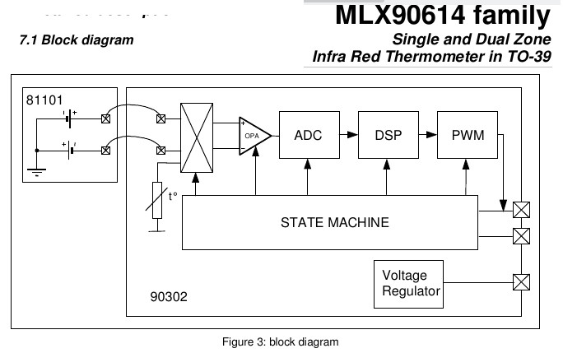
Example of radiation thermometer

Slide 13
Calibration of temperature sensors
Calibrate against a known sensor
Calibration of conductive and radiative sensors
Standard Black-body - cavity

Slide 14
Applications of radiation thermal sensors
Single point measurement
Infrared arrays/scanners for thermal photography
Superimposition of thermal and visible light images
Insulation testing of thermal vessels in power plants
Insulation testing of buildings
Mapping Heating and Energy loss in electronic and mechanical systems
Human body temperature measurement
  Use laser beam to show area of measurement

Slide 15
Measuring Human temperature
Thermoregulation in animals and humans
  Maintenance of core temperature
  controlled by the hypothalamus
Alteration in thermoregulation – fever
Estimation of core body temperature
  Sub-lingual, axillary fossa
  Forehead – convenience
Mass screening for individuals with fever

Slide 16
End of Lecture

