Slide 1
Digital Sensors
Distance Sensing
Suresh Devasahayam
Department of Bioengineering
Christian Medical College, Vellore

Slide 2

Lecture - Outline
Distance sensing
Magnetic sensing

Slide 3

Non-contact Distance Measurement - Optical
Triangulation method
Time of Flight (ToF) methods
  Transit time measurement
  Phase difference measurement

Slide 4
Triangulation method

Slide 5
Triangulation calculation

Slide 6
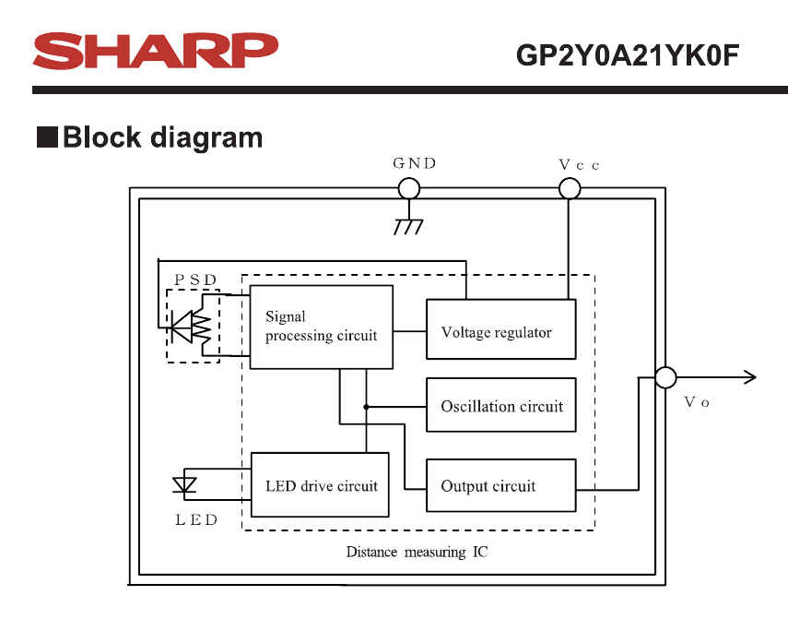

Sharp Sensor GP2Y0A21YK0F

Slide 7
Time of Flight methods
Time difference between two pulses – transmitted and received
Time-to-digital converters (TDC7201 )
  Start and stop signals
  Resolution 55 ps (0.000055 us)
Time for light: 33 ps / cm

Slide 8
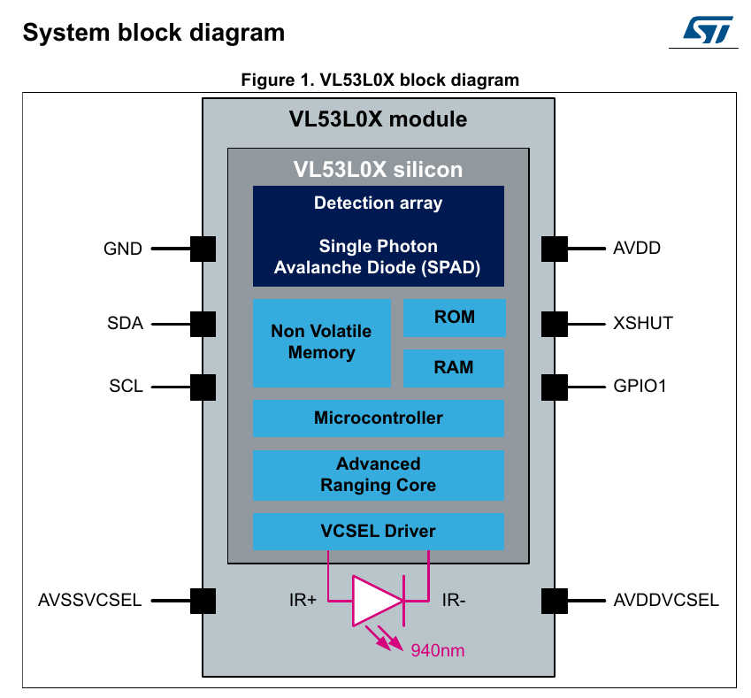
ToF LiDAR

Slide 9
Phase-change measurement
Modulated light signal
Phase difference between transmitted and received
Example:
  Frequency=60MHz
  One cycle = 16.6 ns

Slide 10
Computational Delays in Digital Sensors
Actual delay due to A/D and numerical calculations
Repetition interval of calculations
  Clock driven repetition
  Take measurement
  Perform calculation
  Output numerical data
  Repeat

Slide 11
Note on safety with lasers
Lasers cause damage by heating
NOHD=Nominal Ocular Hazard Distance
Class 1: less than 39μW and/or enclosed
Class 2: 0.99mW NOHD=7m
Class 2M: safe up to 0.25s
Class 3R: 4.99mW NOHD=16m
Class 3B: 499.9mW NOHD=160m
Class 4: over 500mW
  1W NOHD=224m
  10W NOHD=710m

Slide 12
Magnetic Sensing
Hall effect: Potential difference in a current carrying conductor in a magnetic field
  Electric potential is normal to Current and magnetic field
Hall sensing is possible in three directions
Applications
  Rotation sensing
  Magnetic field measurement

Slide 13
End of Lecture

