Slide 1
Measurement of Human Movement

Slide 2

Outline
Need for measuring human movement
Non-contact measurement
Camera based measurement

Slide 3

The forward problem
Given:
  the geometry of the skeletal system
  Force from the muscles
Calculate the movement of limb segements
Calculate external forces on the body

Slide 4
The inverse problem: movement analysis
Determining the physiological properties from the observed movement:
What are the control signals from the nervous system?
What are the characteristics of the musculoskeletal system?

Slide 5
Analysis of gait
Observe
Limb movement
Ground reaction forces
Muscle activity
Determine:
joint kinematics
Net moments
Power
Energy expenditure

Slide 6
Three parts of gait analysis
Kinematics
Kinetics
EMG

Slide 7
Limb movement in space
Positions determined every 0.01 second:
Foot
Shank
Thigh
Pelvis

Slide 8
Kinematics
Get joint positions at successive time intervals
Calculate position changes of limb segments:
Translation
Rotation
Calculate translational velocities, V_{x}, V_{y}, V_{z}
Calculate rotational velocities, ρ_{x}, ρ_{y}, ρ_{z}
Similarly, calculate accelerations

Slide 9
Segment movement forces
Estimate mass & moment of inertia for each segment (foot, shank, thigh) from anthropometric data
Using the acceleration calculated from the motion data, calculate the forces effected on these body segments

Slide 10
External forces on the body
Normal walking – only ground reaction forces
Sports – forces due to ball on limb/bat
Assisted walking – crutch, walker, etc.

Slide 11
Muscles involved in normal walking
Ankle flexion/extension
Tibialis Anterior
Gastrocnemius
Knee flexion/extension
Medial Hamstrings
Vastus Lateralis
Hip flexion/extension
Rectus Femoris
Gluteus maximus
Hip adduction/abduction
Adductor Longus
Tensor Fascia Lata

Slide 12
EMG measurement locations
8
7
6
5
Tibialis Anterior
Gastrocnemius
Vastus lateralis
Medial Hamstrings
Adductor Longus
Tensor Fascia Lata
Rectus Femoris
Gluteus Maximus
4
3
2
1
Lateral View
Anteromedial
View

Slide 13
Three points on a limb and angle of joint

Slide 14
Camera placement

Slide 15
Room co-ordinates to camera image co-ordinates

Slide 16
Camera images

Slide 17
Camera image co-ordinates

Slide 18
Room co-ordinate system

Slide 19
Magnification and depth dependent scale factor

Slide 20
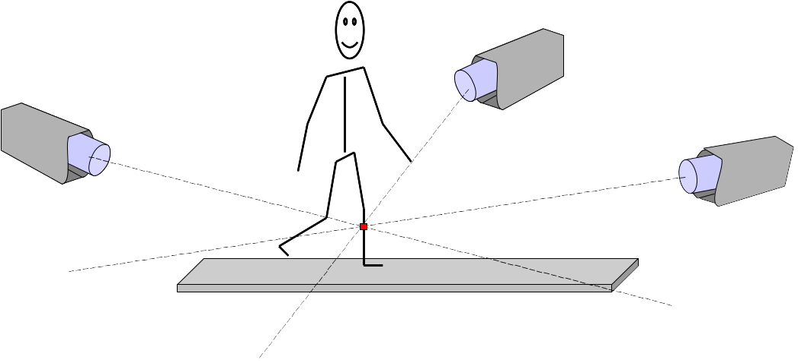
Multiple camera systems

Slide 21
3D reconstruction

Slide 22
3D reconstruction from cameras
Image of Marker A in camera I co-ords: x'_{A}, y'_{A}
Image of Marker A in camera II co-ords:x''_{A}, y''_{A}
Knowing positions of cameras I & II in room co-ordinates, we can calculate, x, y, z in room co-ordinates

Slide 23
How many cameras ?
Theoretical minimum number of cameras is 2
The theoretical minimum assumes infinite spatial resolution for the imaging system, no distortion, visibility of all markers always, by each camera, etc.
In practice these assumptions are not true
The 3D reconstruction is done by SVD (i.e., not by direct solution) and the accuracy improves with more cameras

Slide 24
Measurement of ground forces
Force vector: direction and magnitude of force by foot on the ground
Centre of pressure determines the position of the force vector (i.e., whether at the heel, toe, or in-between)

Slide 25
Force plate recording
Force plate
Floor
Force plate
3 axes of measurement
Force transducer pillars

Slide 26
Force plate measurement
Horizontal forces in forward-backward direction and lateral (left-right) direction are measured by all four pillars
Centre of pressure is calculated from the relative vertical force on each pillar

