Slide 1
Blood Chemistry Sensors
Suresh Devasahayam
Department of Bioengineering
Christian Medical College, Vellore

Slide 2

Outline
pH sensors
Oxygen sensors
Glucose sensors
CO2 sensors

Slide 3
Normal Ranges
PO₂: 80-104 mmHg
PCO₂: 33-48 mmHg
pH : 7.31-7.45
Glucose: 70-110

Slide 4
Photospectrometry
Estimate the spectrum of optical properties of a sample
Measure intensity of light at few selected wavelengths

Slide 5
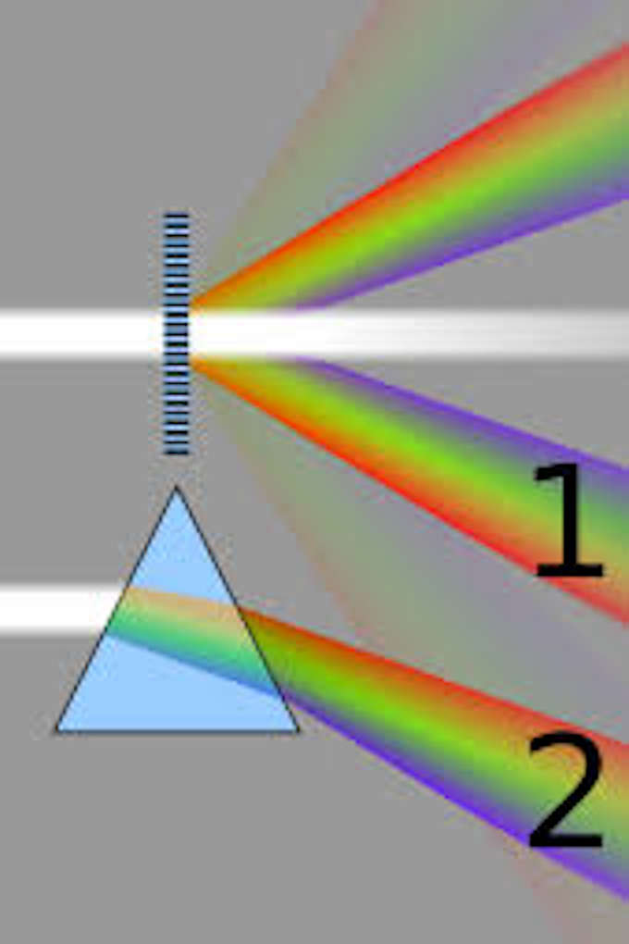
Optical Spectrum estimation

Slide 6
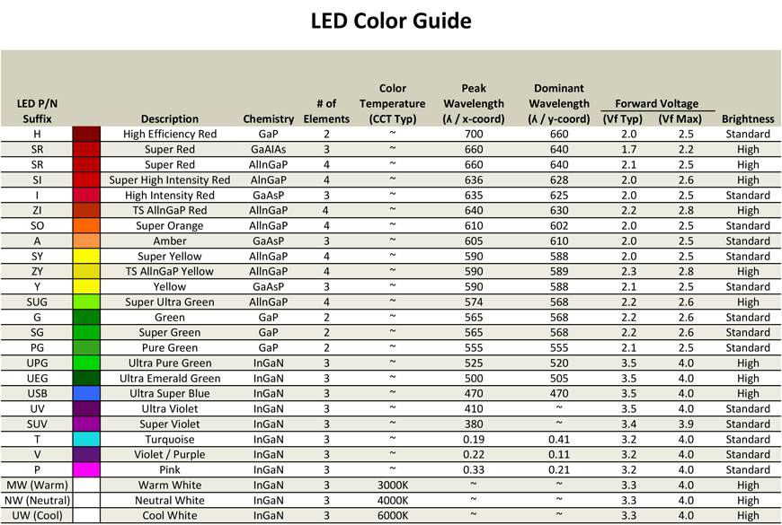
LED colours

Slide 7
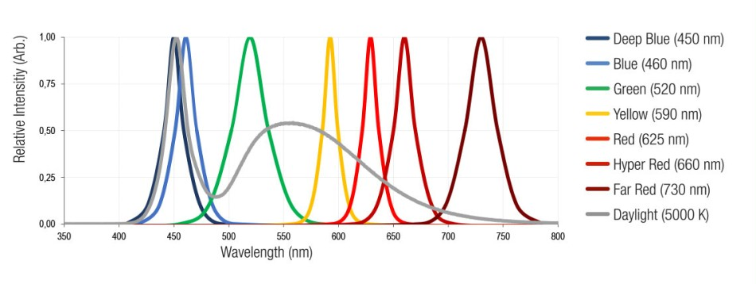
LED spectra

Slide 8
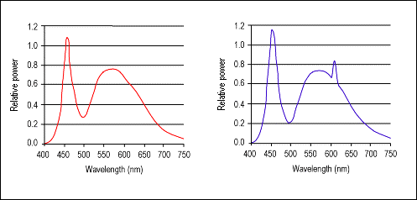
White light using phosphor coated blue LEDs

Slide 9
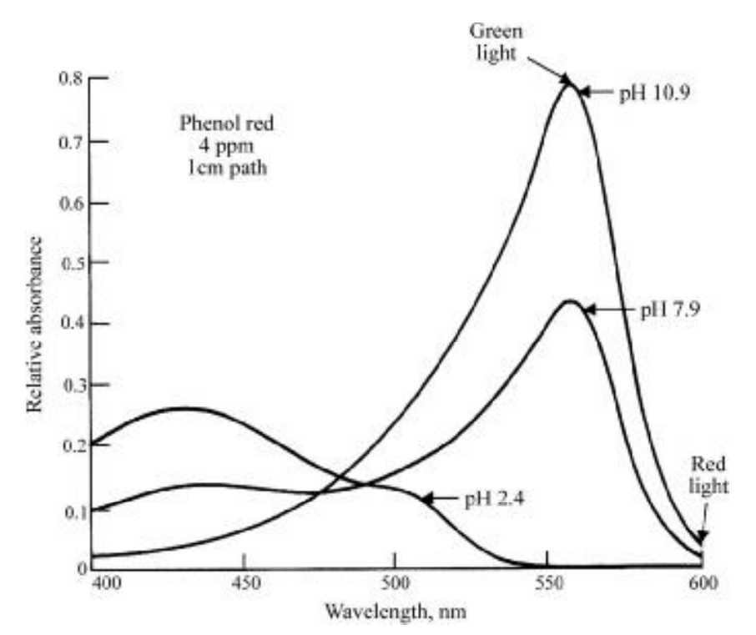
Absorption spectrum change of phenol red with pH

Slide 10
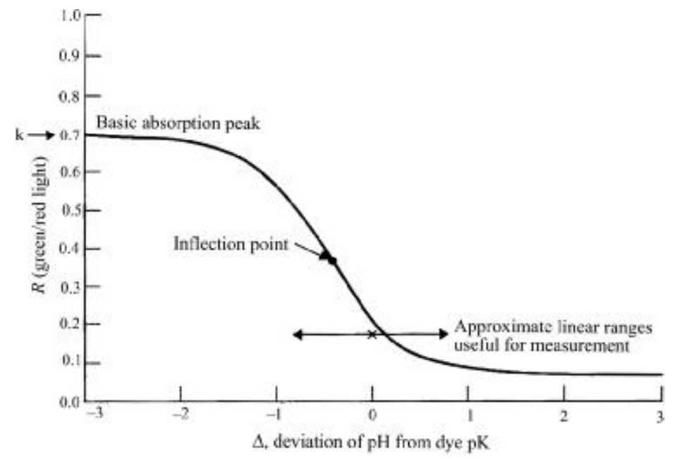
Peak spectrum shift of phenol red with pH

Slide 11
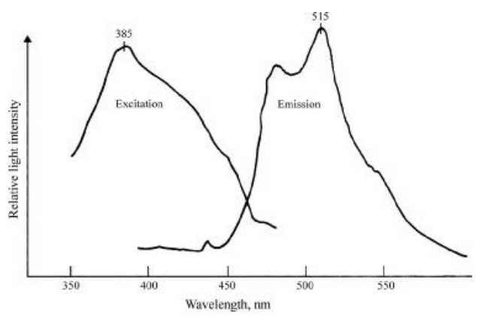
O₂ fluorescence dye (e.g., Anthracenecarboxaldehyde, C₁₅H₁₀O)

Slide 12
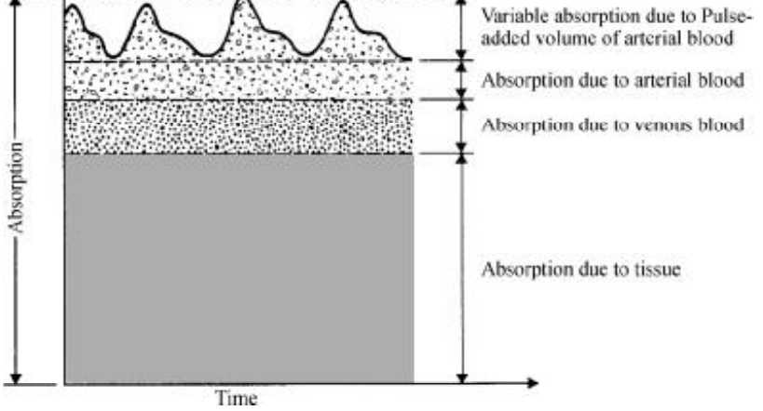
Light absorption by tissue

Slide 13
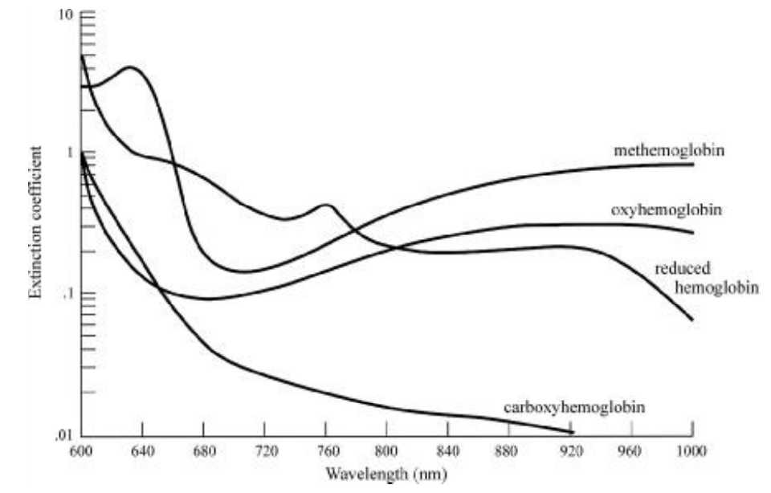
Light absorption and oxygenated haemoglobin

Slide 14
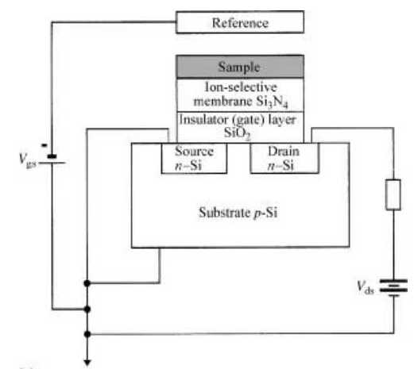
Ion-sensitive Field Effect Transistors

Slide 15
ISFET with sample holder

Slide 16
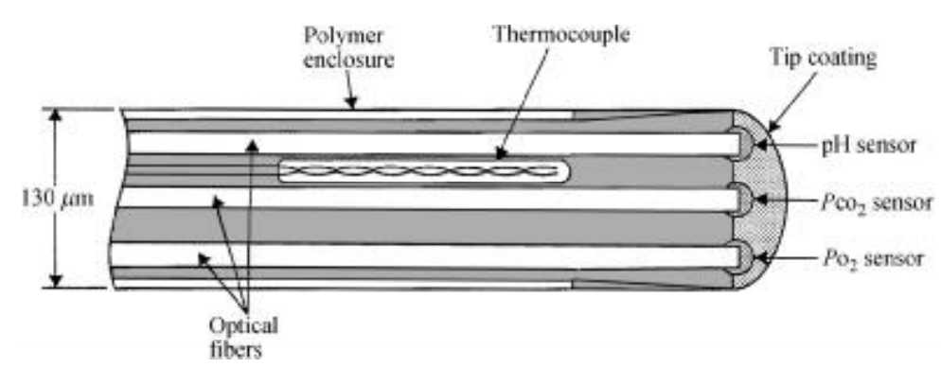
Intravascular sensor

