Slide 1
Review
Suresh Devasahayam
Department of Bioengineering
Christian Medical College, Vellore

Slide 2
Ultrasound Measurement

Slide 3
Ultrasound Reflection Measurement

Slide 4

Ultrasound Instruments
Time of echo:
Attenuation:
Automatic depth dependent gain compensation

Slide 5
Flow measurement
Transit time =
distance / (effective velocity in medium)

Slide 6
Doppler shift
Source frequency f_{o}
Source-target velocity u
Propagation in medium with velocity c
Dopplet shift f_{d}

Slide 7
Flow Measurement

Slide 8
Dilution methods

Slide 9
Digital Measurement

Slide 10
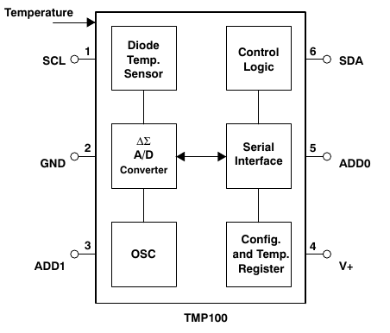
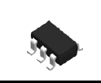
Digital Temperature sensor - TMP100

Slide 11
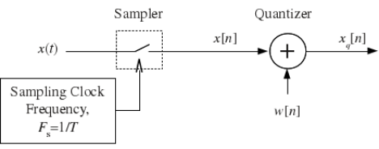
Digitization and Quantization

Slide 12
Inertial Sensors

Slide 13
Measurement of Acceleration

Slide 14
Gyroscope Principle

Slide 15
Disc gyroscope
Mass, m
Radius of disc, r
Spin angular vel
Precession angular vel
Spin moment of inertia

Slide 16
Vibrating gyroscope – Coriolis force
Force, F
Angular Velocity of rotation/precession
Linear velocity of oscillation
Mass, m

Slide 17
Distance Measurement

Slide 18
Triangulation calculation

Slide 19
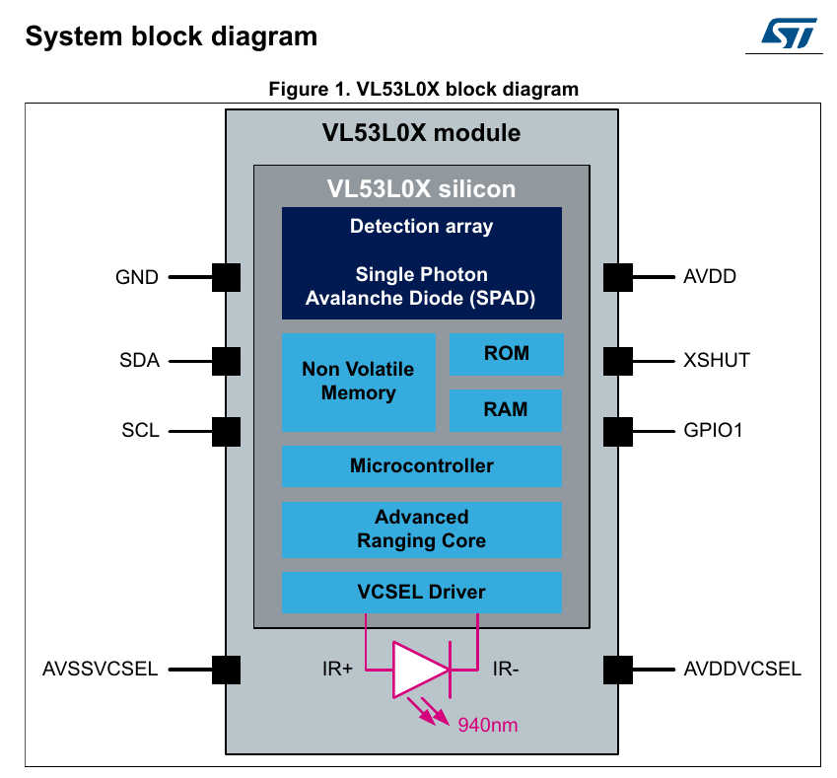
ToF LiDAR

Slide 20
Radiation Thermometry

Slide 21

Stefan-Boltzman Law – radiation (absorbed/emitted)
Integrating Wien’s equation can get total thermal power
  integrate numerically
Empirical formula by Stefan and Boltzman
For black body, the emissivity is 1
‘A’ is a geometry factor

Slide 22
Biopotential Electrodes

Slide 23
Measurement model

Slide 24
Photospectrometry

Slide 25
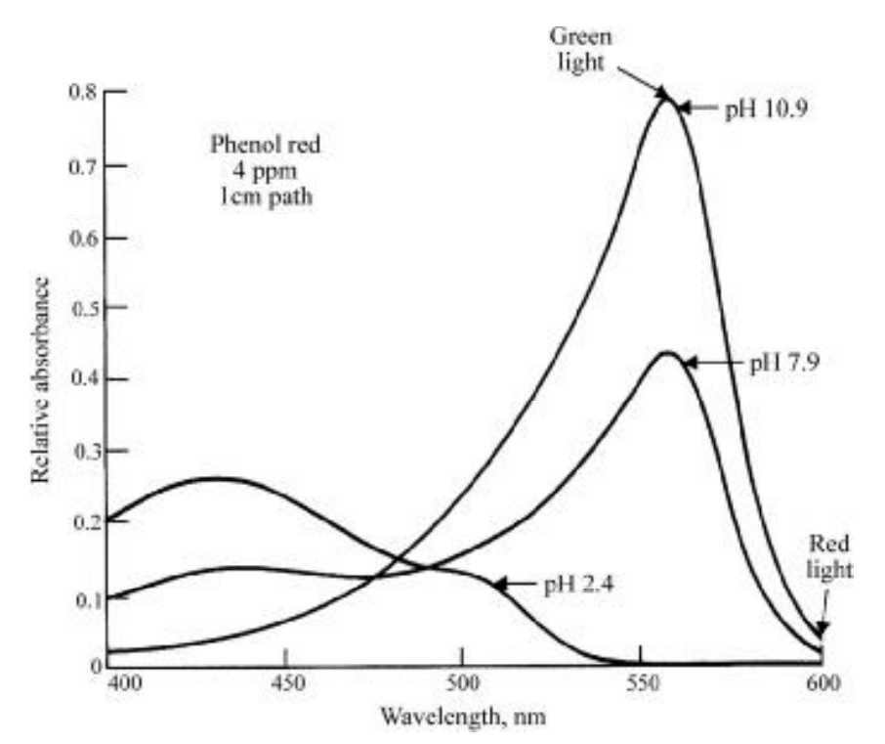
Absorption spectrum change of phenol red with pH

Slide 26
Examples requiring Design

Slide 27
1. Measuring eye-blink for noise removal
Noise in EEG recording
Remove noise by subtracting blink event-related potential
Determine transfer relation between blink measurement and EEG measurement

Slide 28
2. Measuring eye-blink to use as control signal
Locked-in patients – eye-blink under voluntary control
Encode intention as sequence of eye-blinks

Slide 29
3. Electrogastrography
Measure peristalsis
Distinguish signal from movement noise

Slide 30
4. Measuring Blood flow in tissue
Photoplethysmography
Impedance plethysmography

Slide 31
5. Separating signal from noise
Similar characteristics
  ECG/EMG
  EEG/EMG
Different characteristics
  ECG/respiration

Slide 32
Designing Measurement Systems
Sensitivity
Selectivity
  Noise immunity
Linearity
Dynamic response
Non-invasive
Portability
  Battery operation
  Wireless data transfer

