Slide 1
Natural Language Processing Project Work
By
Siva Gogineni

Slide 2
Outline for the project
DataSet
NLP Network
Preprocessing
Conversion
Model

Slide 3
DataSet
Selected IMDB Dataset.csv dataset from the Kaggle website and it has about 50,000 records.

Slide 4
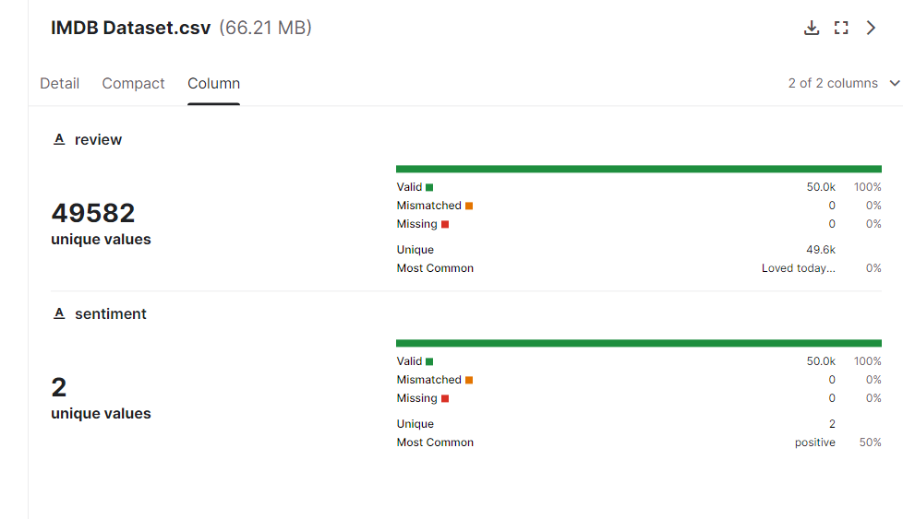
DataSet
Sample Data

Slide 5
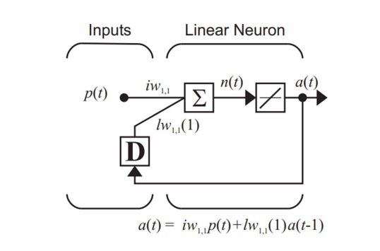
NLP Network
Selected the NLP RNN network for project work.

Slide 6
Preprocessing
Prepared dataset by cleaning and preprocessing the text data. This includes steps such as removing stop words, and converting the text data into numerical representations that can be fed into the neural network.
def preprocess_string(s): s = re.sub(r"[^\w\s]", '', s) s = re.sub(r"\s+", '', s = re.sub(r"\d", '', s) return s

Slide 7
Conversion
Covert the Text format of data into numerical format.
onehot_dict = {w: i + 1 for i, w in enumerate(corpus_)}

Slide 8
Model
Train the Model N number of Epochs
Stop at highest model performance
Start using the Model

Slide 9
Summary
In conclusion, we have learned that RNN models can be very effective in text classification tasks, and the preprocessing steps are crucial in ensuring that the data is suitable for training the model. We suggest further improvements in the future, such as experimenting with different hyperparameters, using more advanced preprocessing techniques, and exploring other neural network architectures, such as transformers.

Slide 10
References
Kaggle website.
Lecture notes.
chatGPT

