Slide 1
What five QUIC implementations actually do
when your phone changes network
Phase 2 review — the cross-implementation survey
Capstone research · Computer Networks
sivaahari · cb.sc.u4cys24055@cb.students.amrita.edu

Slide 2
WHERE WE LEFT OFF
Last phase we found one implementation ignoring a rule it must follow.
The standard says an endpoint MUST reset its speed estimate when a connection moves to a new network. Forget what you learned about the old one; start over.
We checked picoquic. It doesn't. The function that performs the reset exists, is implemented for all seven of its congestion-control algorithms, and is called by nothing.
Then we implemented the rule ourselves — and transfers stopped completing entirely, because the rule has a second half that is easy to miss.
Which left an obvious question.

Slide 3
THE QUESTION
Does anyone else get this right?
We took the five QUIC implementations that carry most of the internet's traffic, in three different languages, and asked each of them the same three questions.
Resets congestion control on migration?
MUST — RFC 9000 §9.4 (2nd paragraph)
Uses path-validation RTT as the new path's initial RTT?
MAY — RFC 9002 §6.2.2
Excludes old-path ACKs from new-path state?
MUST — RFC 9000 §9.4 (1st paragraph)
Every answer twice: once by reading the source, once by measuring the running program. If they disagreed, we had made a mistake and went to find it.

Slide 4
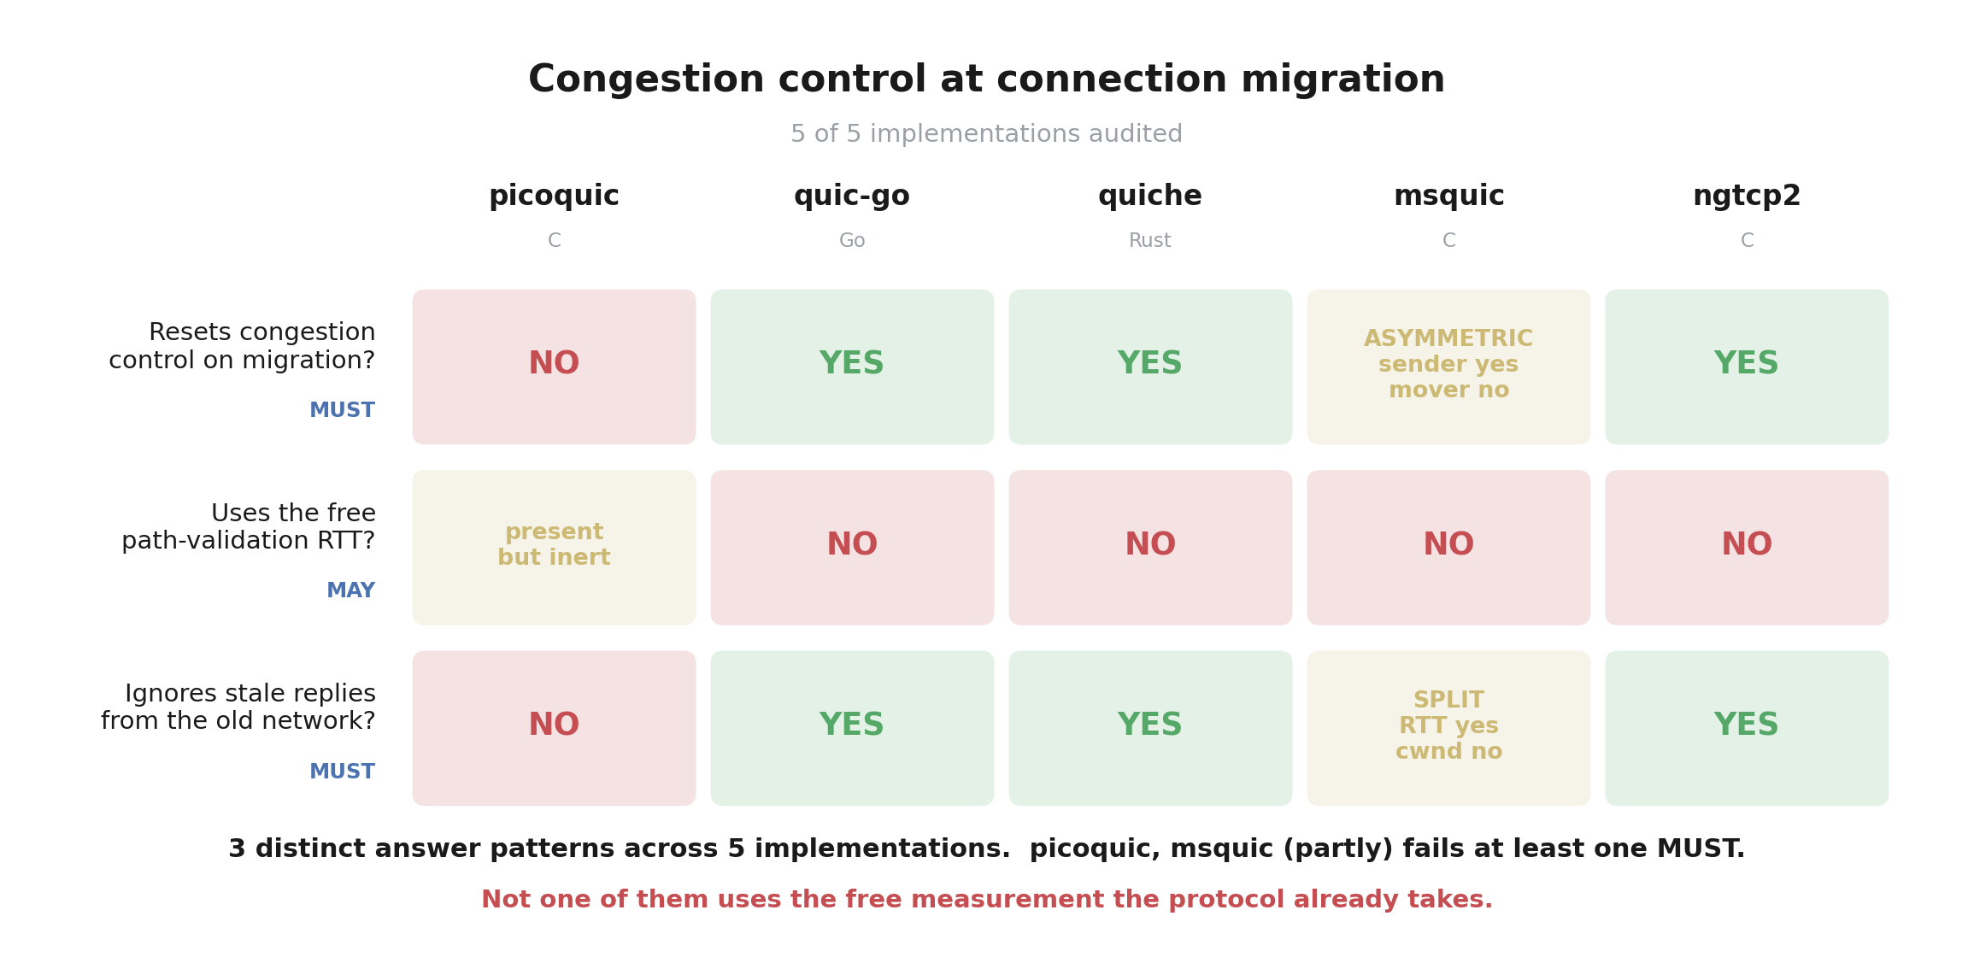
THE RESULT
No two of them behave the same way.
5 implementations audited from source; 5 of them also measured live in our testbed. Every cell is backed by both.

Slide 5
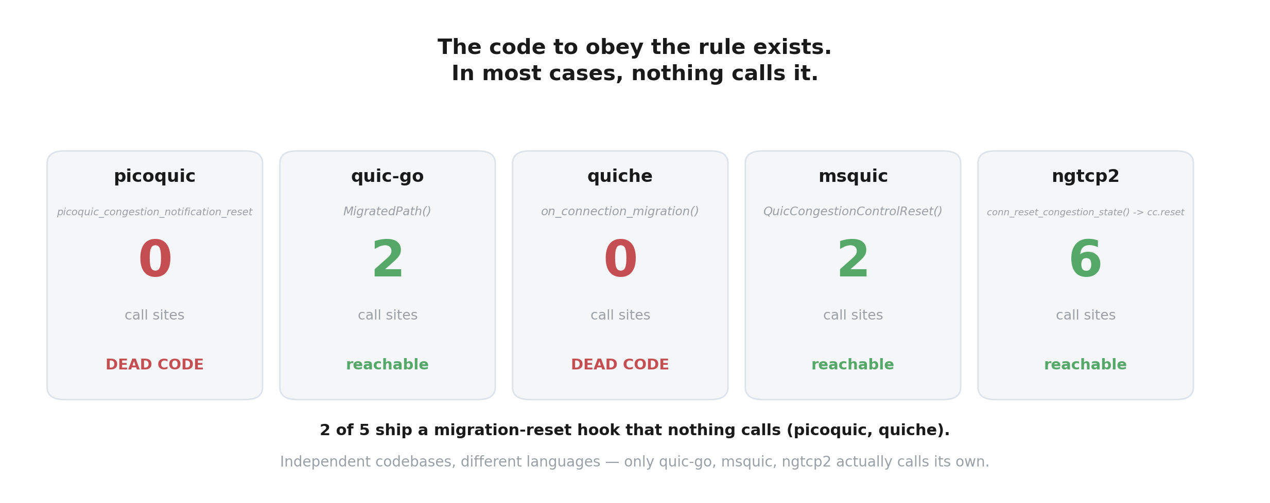
FINDING 1
Two of them ship the code to obey the rule — and never call it.
quiche's dead function even carries the comment “Called when connection migrates and cwnd needs to be reset”. Independent codebases, different languages, the same dead hook.

Slide 6
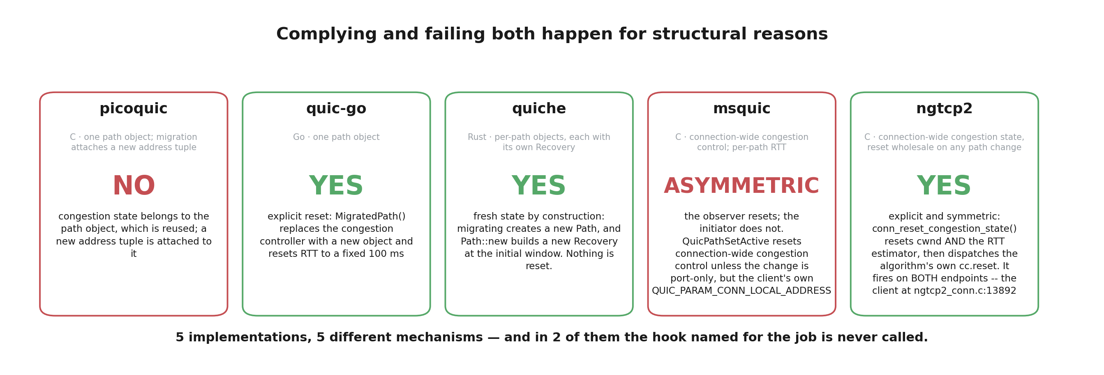
FINDING 2
Where they do comply, they get there five different ways.
One replaces its controller outright. One is compliant by accident of architecture. One uses a packet-number watermark. One resets at only one end. One doesn't reset at all.

Slide 7
FINDING 3
Not one of them uses the free measurement the protocol already takes.
Before a connection trusts a new network it must run a security check — send a random number, require it echoed back. That is a compulsory round trip on the new network, so it measures that network's speed for free.
The standard explicitly permits using it. All five decline.
Two of them we caught in the act, in consecutive log lines: measure the new network at roughly 40 milliseconds, then throw it away and seed a fixed default instead — 100 milliseconds in one, 333 in the other.
This is the one finding that is unanimous across every major implementation.
RFC 9002 §6.2.2 — a MAY, not a MUST. Nobody is breaking a rule here. But nobody is taking the free measurement either.

Slide 8
FINDING 4
One of them cannot be scored yes or no at all.
msquic splits its state: congestion control is shared across the whole connection, but round-trip time is tracked per network path. That produces two answers no yes/no column can hold.
On the first question the answer is ASYMMETRIC. The endpoint that OBSERVES the move resets. The endpoint that MAKES the move does not. The same connection is compliant at one end and not at the other.
On the third the answer is SPLIT. Round-trip measurements from the old network are correctly ignored. Acknowledged byte counts are not.
We are not the first to notice the second one. msquic's own source says, at the exact line responsible:
const QUIC_PATH* Path = &Connection->Paths[0]; // TODO - Correct?

Slide 9
FINDING 5
And in that implementation, the sender never recovers its sense of the new network.
After migrating, msquic's server holds its round-trip estimate at exactly its starting default — 333 milliseconds — and its minimum-RTT field at the “no measurement yet” marker.
For every one of roughly 3,800 samples per run. For twenty seconds. In five runs out of five. The real network delay was 40 milliseconds.
The cost is visible: about 13 Mbit/s where another implementation reached about 19 on the same link.
The irony is the finding. The endpoint that follows the rule ends up with a permanently broken estimate; the endpoint that ignores it keeps a working one.
Reported as an observation, not a diagnosis. We have not yet built an instrumented version to prove the mechanism, and we say so.

Slide 10
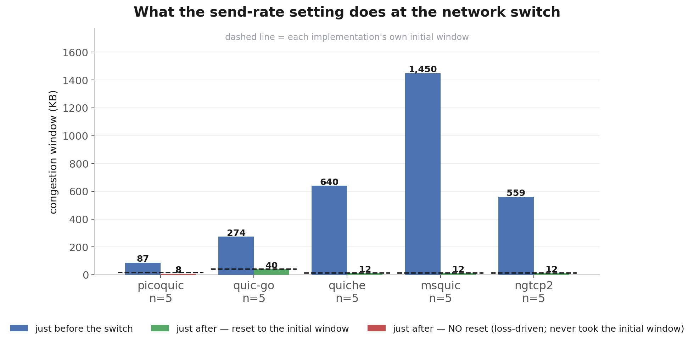
THE EVIDENCE
What the measurements actually look like.
Each implementation's own initial window is the dashed line. A drop to EXACTLY that value can only be a reset — we checked each one's loss arithmetic to be sure an ordinary loss event could not produce the same number. A bar BELOW the line is therefore not a deeper reset but the opposite: loss carried it past the value a reset would have set.

Slide 11
METHOD
How we know we are not fooling ourselves.
Every claim was answered twice — from source and from measurement — and they had to agree.
Before trusting any drop in the send rate, we looked up each implementation's initial window, its loss floor, and its loss reduction factor, and confirmed the number we saw could only be a reset. In quic-go that revealed TWO events where we would have reported one — in 5/5 runs an ordinary loss backoff to exactly 0.7× the peak, then the real reset 0.44–1.96 milliseconds later.
Then we wrote a second validator from scratch, sharing no code with the first, which re-derives every claim from git object storage and raw traces. 30 checks, 30 pass.
It found seven things we had got wrong along the way — a window described as flat when it had declined, a repetition count of four that was really three, a path delay recorded as sixty milliseconds that was really forty, and — the one that stings — a verdict line in our own parser that would have called a loss event a reset. All seven are corrected and recorded.

Slide 12
HONESTY
What we are deliberately not claiming.
We have not shown that any of this harms real users. We measured what implementations do, and what it costs in our testbed.
Everything is emulation. No real phones, no real cellular networks.
Each implementation was tested at one commit, in one configuration, in one direction of transfer.
The stuck-estimate result is an observation. We have not proven its cause.
We would rather state these than have a reviewer find them.

Slide 13
NEXT
Where this goes.
The survey is complete: five implementations, three questions, source and measurement for every cell.
Next is the cost — how much each of these behaviours actually loses, across a range of network conditions rather than the single pair we used here.
Then the paper. And the findings go back to the projects: two of them ship a reset that never runs, and one has a comment in its own source asking whether the line we identified is correct.
Nobody had measured this. Now it is measured.

