Slide 1
Turning QUIC's Path Validation into a
Congestion-Control Measurement Primitive
Phase 1 review — establishing that the gap is real
Capstone research project · Computer Networks
sivaahari · cb.sc.u4cys24055@cb.students.amrita.edu

Slide 2
ORIENTATION
The thirty-second version
When your phone switches from Wi-Fi to mobile data, the connection survives — QUIC identifies you by a Connection ID, not an address.
But the connection still has to relearn how fast the new network is. It starts from a crawl and ramps up. You feel that as a stall.
It turns out the protocol already runs a compulsory speed test on the new network a moment earlier — for security reasons — and then the rulebook requires it to throw the result away.
Phase 1 asks one question: is that real?
Answer: yes — on paper, in deployed code, and in measurement.

Slide 3
BLOCK A · THE GAP ON PAPER
How QUIC migration works
The badge, and the sealed envelope
1. The client changes address. It keeps its Connection ID — the badge.
2. The server cannot simply trust the badge; anyone could steal one. So it sends a PATH_CHALLENGE containing random bytes, and the client must echo them back in a PATH_RESPONSE.
3. Only then does the server accept the new address.
That exchange is compulsory, happens at every handover, and is a full round trip down the exact path about to be used.
RFC 9000 §8.2 additionally requires BOTH the challenge and the response datagrams to be padded to at least 1200 bytes. So it is a full-size packet, making a full round trip, on the new path — before any application data is risked.
RFC 9000 §8.2.1, §8.2.2 — verified verbatim against the RFC text

Slide 4
BLOCK A · THE GAP ON PAPER
…and the rulebook requires the result to be discarded
“On confirming a peer's ownership of its new address, an endpoint MUST immediately reset the congestion controller and round-trip time estimator for the new path to initial values … unless the only change in the peer's address is its port number.”
— RFC 9000 §9.4
It is a MUST, not a SHOULD. The amnesia is specified, not an oversight.
The normative object is the phrase “initial values”. The RFC fixes THAT the controller is reset — it does not fix what those initial values must numerically be for a path about which evidence exists.
This is the seam the entire project works in.

Slide 5
BLOCK A · THE GAP ON PAPER
The state of the art refuses to help here
Careful Resume — IETF Proposed Standard for jump-starting congestion control
“…or the sender receives a signal from the local stack indicating that the path is now different to the observed path, the sender MUST stop using Careful Resume.”
— draft-ietf-tsvwg-careful-resume
Careful Resume switches itself OFF the moment the path changes — which is reasonable, because it seeds from REMEMBERED state, and on a new path an old memory is a guess, not knowledge.
It seeds across TIME (previous connection → new connection, same path).
Nothing seeds across SPACE (same connection, new path).
Our answer is not to remember. It is to MEASURE — using evidence the protocol is already compelled to generate.

Slide 6
BLOCK B · THE GAP IN CODE
Does deployed code actually do this?
picoquic — a widely used reference implementation, 548 tests passing
Finding: picoquic does NOT implement the §9.4 MUST-reset. Verified four independent ways:
1. The reset hook is dead. picoquic_congestion_notification_reset has handlers in newreno, cubic, bbr, bbr1, c4, fastcc and prague — and ZERO callers.
2. On path validation it updates RTT, promotes the tuple, and resets the MTU. Congestion control is never touched.
3. cwnd is re-initialised only in CC-init and picoquic_create_path — neither on the migration route. Migration creates a new tuple on the EXISTING path object, so the window survives by construction.
4. Live qlog across a real IP-changing migration: cwnd flat at 241,174 bytes, never near the 15,360-byte initial window.
So deployed reality is blind CARRY-OVER — precisely what RFC 9000 §9.4 warns “could transmit too aggressively”.
picoquic 0dc8ba8b · static analysis and live measurement agree

Slide 7
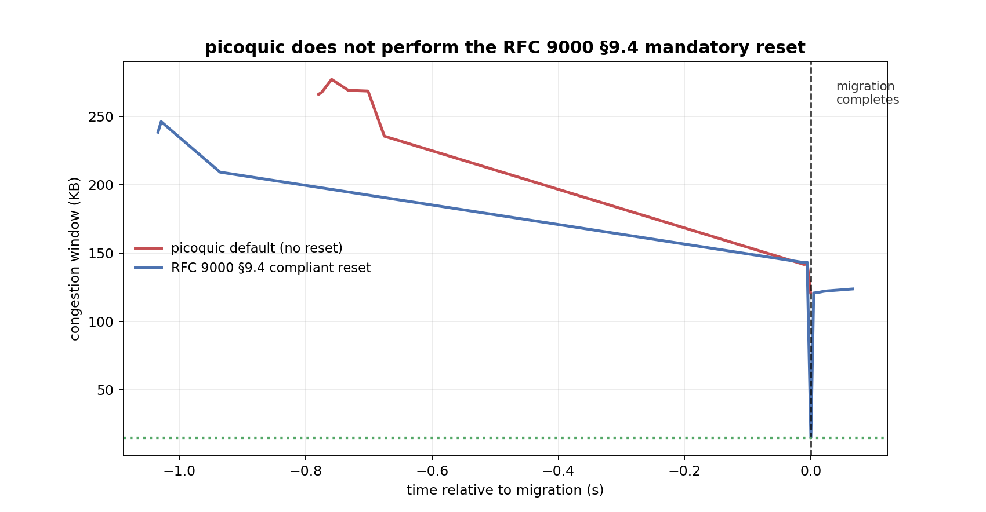
BLOCK B · THE GAP IN CODE
Both behaviours, measured
We implemented the compliant reset ourselves (runtime-gated, default off; 548/548 tests still pass with it disabled) — because the stack does not provide one.

Slide 8
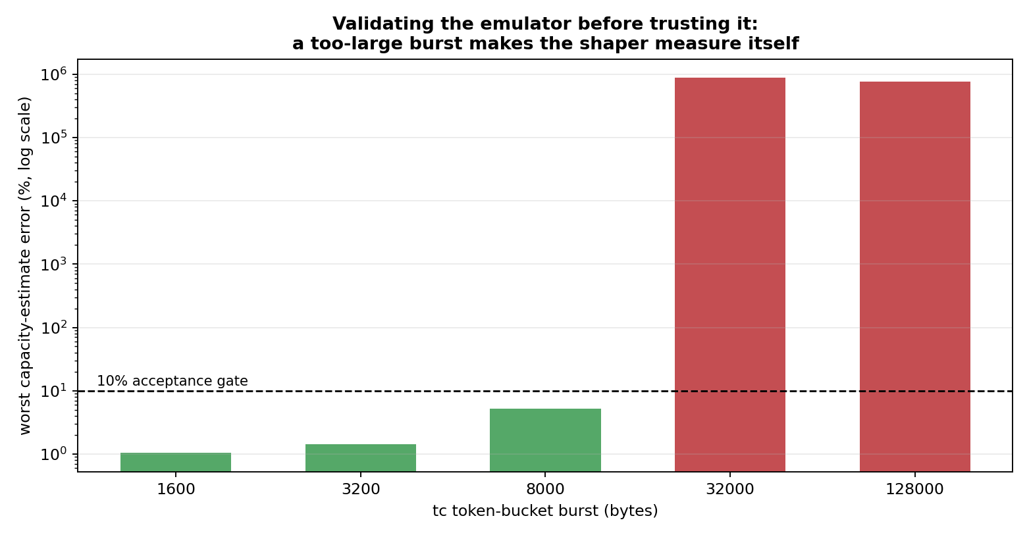
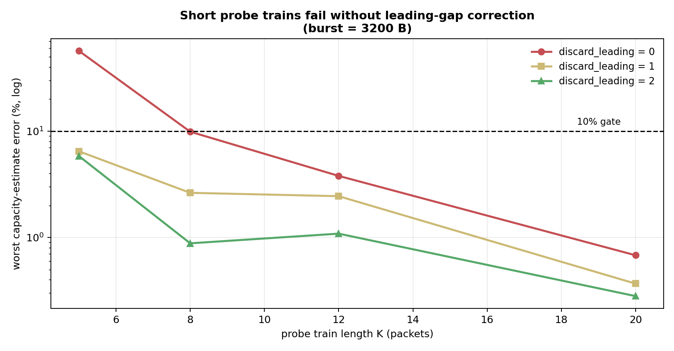
METHODOLOGY
Validating the instrument before trusting it
Two artefacts found that would have silently invalidated every downstream number
Left: a too-large token bucket lets a probe train through unshaped — you then measure the emulator, not the link. Right: short probe trains fail without leading-gap correction. Operating point: burst 3200 B, K ≥ 8, discard 2.

Slide 9
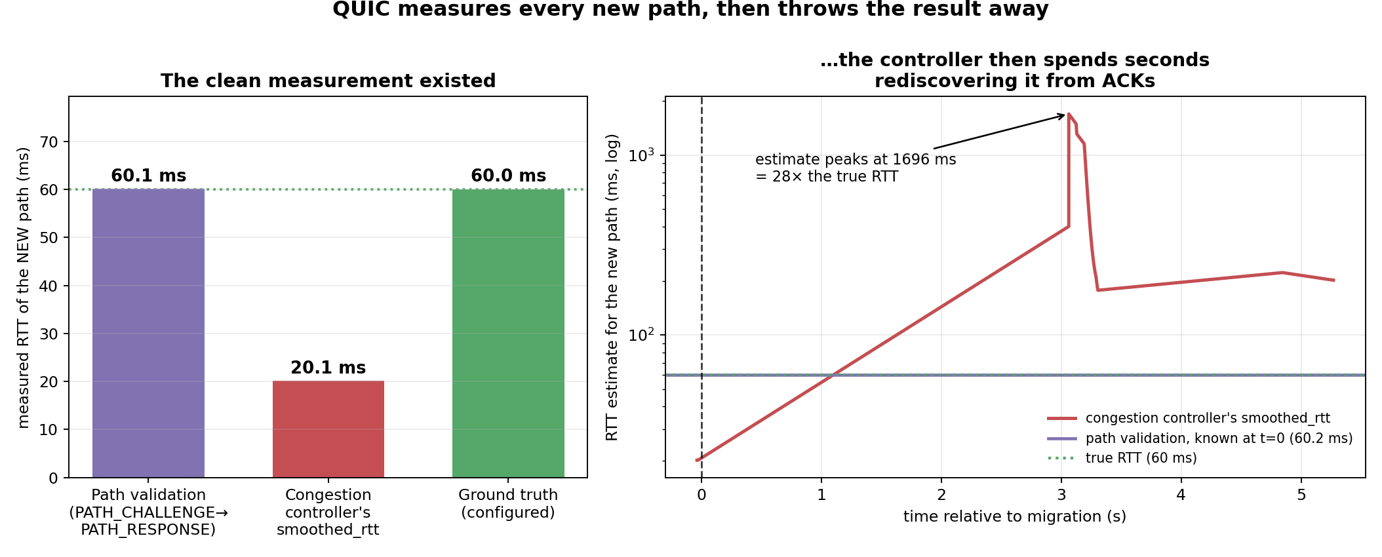
BLOCK C/D · THE PAYOFF
The measurement was there all along
Same trace. Same instant. Two numbers.
Path validation measured the new path to within 0.2% of ground truth — and the stack discarded it, while its congestion controller believed a 3× wrong value carried over from the old path.

Slide 10
BLOCK C/D · THE PAYOFF
The headline numbers
What path validation measured on the new path
60.1 ms
Ground truth (configured)
60.0 ms
Error of the discarded measurement
0.2 %
What the congestion controller believed instead
20.1 ms
Peak error of the estimator while relearning
1696 ms (28× truth)
The clean measurement is not hypothetical, not expensive, and not new work — the protocol is already required to perform it.

Slide 11
HONEST REPORTING
What went wrong, and what it taught us
Our first spec-compliant reset made things WORSE — transfers stopped completing entirely.
Cause: we implemented §9.4's second paragraph (reset to initial values) and missed its first — “Packets sent on the old path MUST NOT contribute to congestion control or RTT estimation for the new path.”
Clearing the estimator let the very next in-flight OLD-path ACK re-seed it: 1.8 ms after resetting, smoothed_rtt read 20.3 ms on a path whose true RTT is 60 ms. Slow start then paced 3× too fast and destroyed the connection.
Two things follow:
• Partial §9.4 compliance is worse than none — a finding worth reporting in its own right.
• It sharpens the motivation: after migration, EVERY ordinary RTT sample is polluted by in-flight old-path packets. The path-validation exchange is, by construction, the only clean one — sent on the new path, answered on the new path.

Slide 12
THE PLAN
What Phase 2 builds
PV-Seed — five steps
1. PROBE
send a short train of the padded challenges the protocol already sends
2. MEASURE
round-trip time gives the path's length; spacing between replies gives its width
3. CHECK
do the estimates agree? if they scatter, discard them and fall back
4. SEED
initialise the congestion controller from the measurement instead of from nothing
5. WATCH
send paced, and retreat to the specification's behaviour at the first sign of trouble
Follow the fallbacks down and you land exactly on what the RFC already demands. The worst case of PV-Seed is the status quo.
picoquic already contains a live congestion-window seeding pathway (used by Careful Resume). We re-source it from measurement rather than memory — we are not adding new plumbing.

Slide 13
THE PLAN
What could still sink this, and how we would know early
• The reflected reply train may only reveal the NARROWER direction of the path
→ proved analytically; drives a one-frame extension for the download case
• Receiver batching may destroy the reply spacing we measure
→ dedicated experiment; a negative result here is publishable and motivates the extension
• Anti-amplification limits how many probes a server may send
→ K ≥ 8 needs client-side priming — Phase 0 already made this mandatory, not optional
• The benefit may be small for short transfers or low-bandwidth paths
→ we will state the regime where it matters, and the regime where it does not
Kill criterion: if the estimator cannot reach usable accuracy on clean emulated links, we pivot to a measurement paper and keep every hour invested.

Slide 14
SUMMARY
Phase 1 verdict
✓ The gap exists on paper
RFC 9000 §9.4 mandates the discard; Careful Resume explicitly refuses to help at a path change
✓ The gap exists in code
picoquic does not implement the MUST — verified four ways
✓ The discarded measurement is accurate
60.1 ms vs 60.0 ms ground truth — 0.2% error
✓ The controller's alternative is bad
believed 20.1 ms; peaked at 28× the truth while relearning
Phase 2 begins: build the estimator, seed the controller, keep it safe.

