Slide 1
What QUIC implementations actually do
when your phone changes network
Phase 1 review
Sivaa S Hari Charan J Kenin Franson Krithikk T Shafeeq Umar

Slide 2
THE SETTING
When you walk out of your house, your connection has to relearn how fast the network is.
QUIC keeps the connection alive when your phone switches from Wi-Fi to mobile data. That part works — it identifies you by an ID, not by your address.
But it still has to work out how fast to send on the new network. It cannot see the road. So it starts slow and speeds up until something breaks.
That relearning is what you feel as a stall.

Slide 3
THE RULE
The rulebook is explicit about what should happen.
“…an endpoint MUST immediately reset the congestion controller and round-trip time estimator for the new path to initial values.”
In plain terms: forget how fast the old network was. Start over.
MUST — not “should”, not “may”. This is the strongest word the standard has.
RFC 9000 §9.4 — quoted verbatim

Slide 4
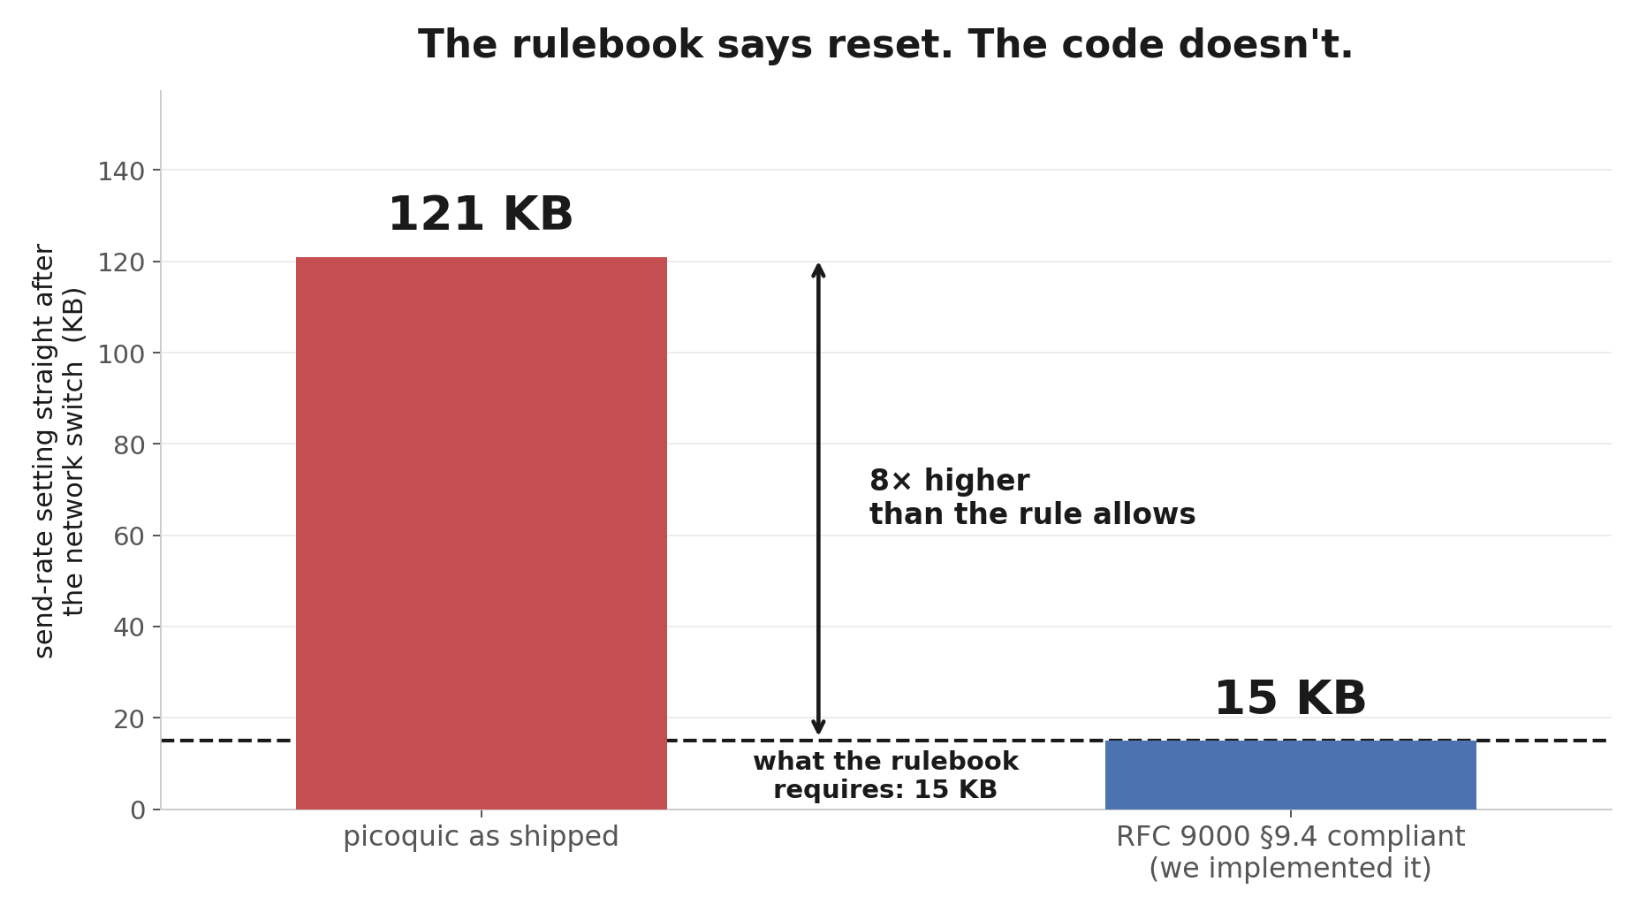
WHAT WE FOUND · 1
We checked a widely-used implementation. It doesn't do this.
picoquic — a reference QUIC implementation, 548 of its own tests passing. Verified four independent ways: the reset function exists in seven congestion-control algorithms and is called by none of them.

Slide 5
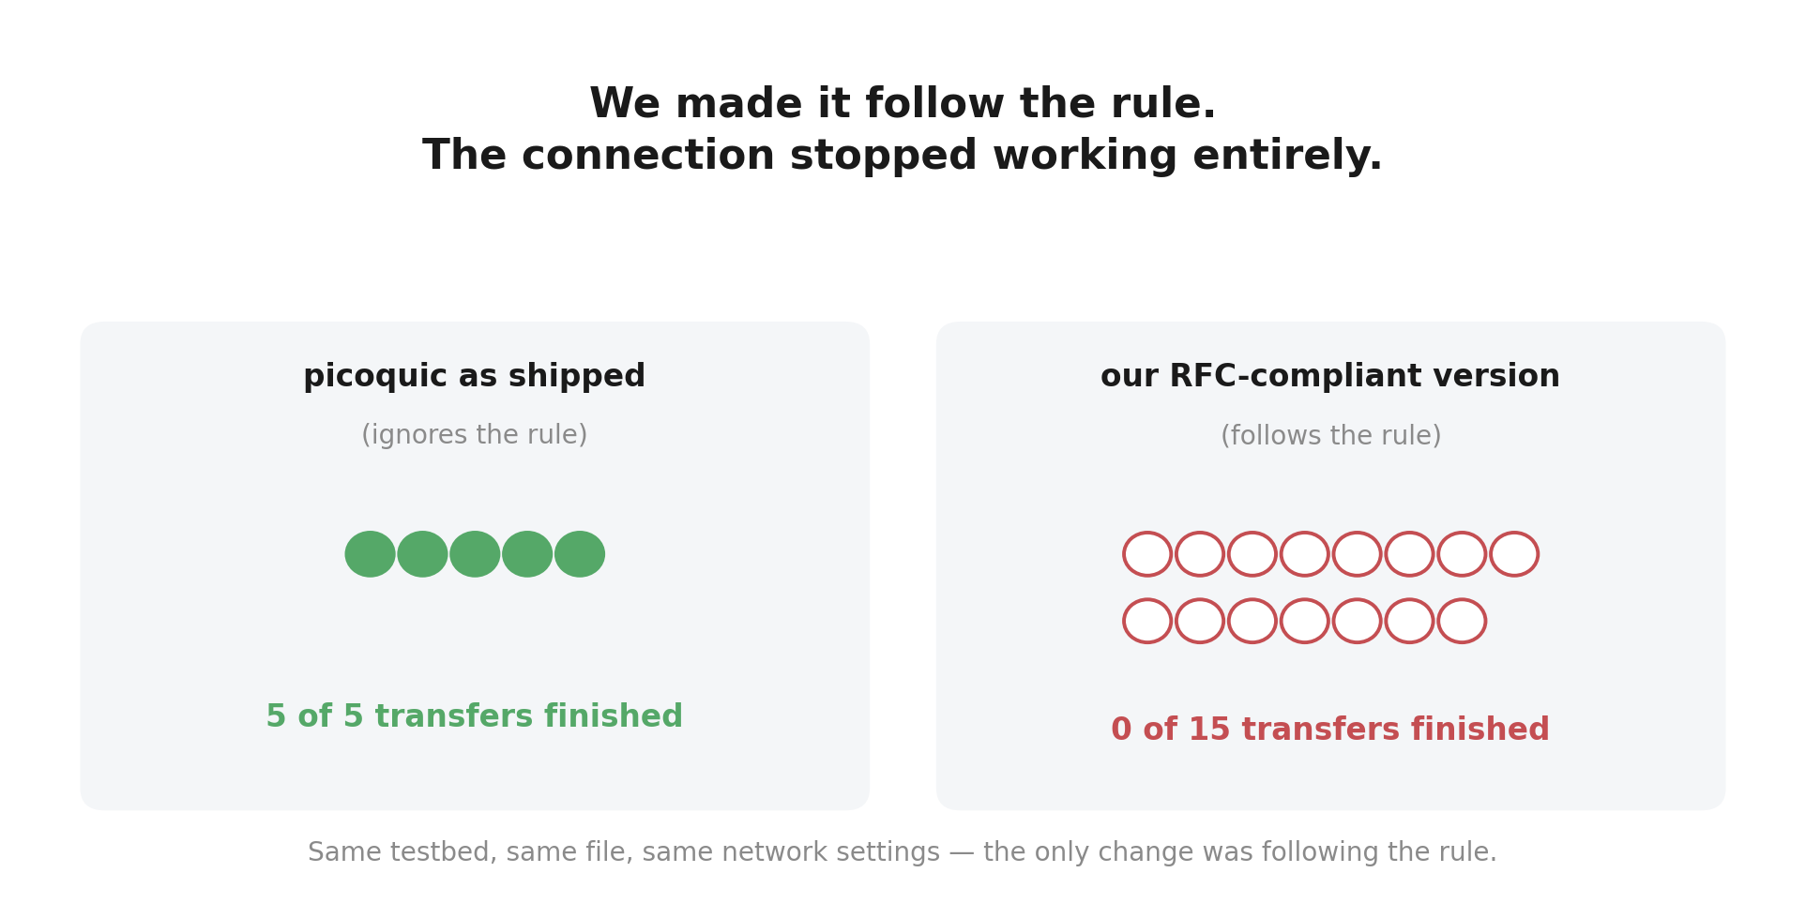
WHAT WE FOUND · 2
So we implemented the rule ourselves — and the connection stopped working.
Same testbed, same file, same network settings. The only change was following the rule.

Slide 6
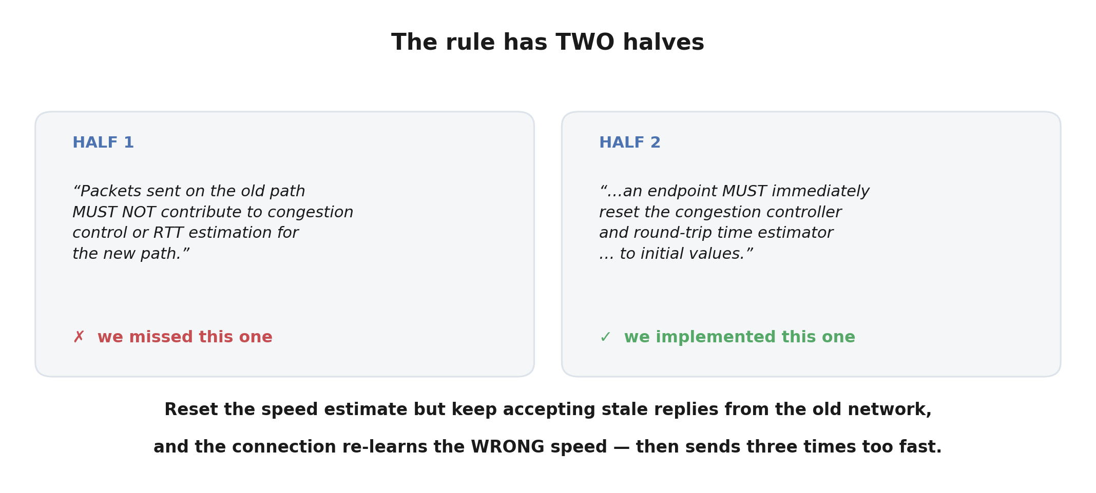
WHY IT BROKE
Because the rule has two halves, and we had only followed one.
This is the finding: following the rule PARTLY is worse than ignoring it entirely.

Slide 7
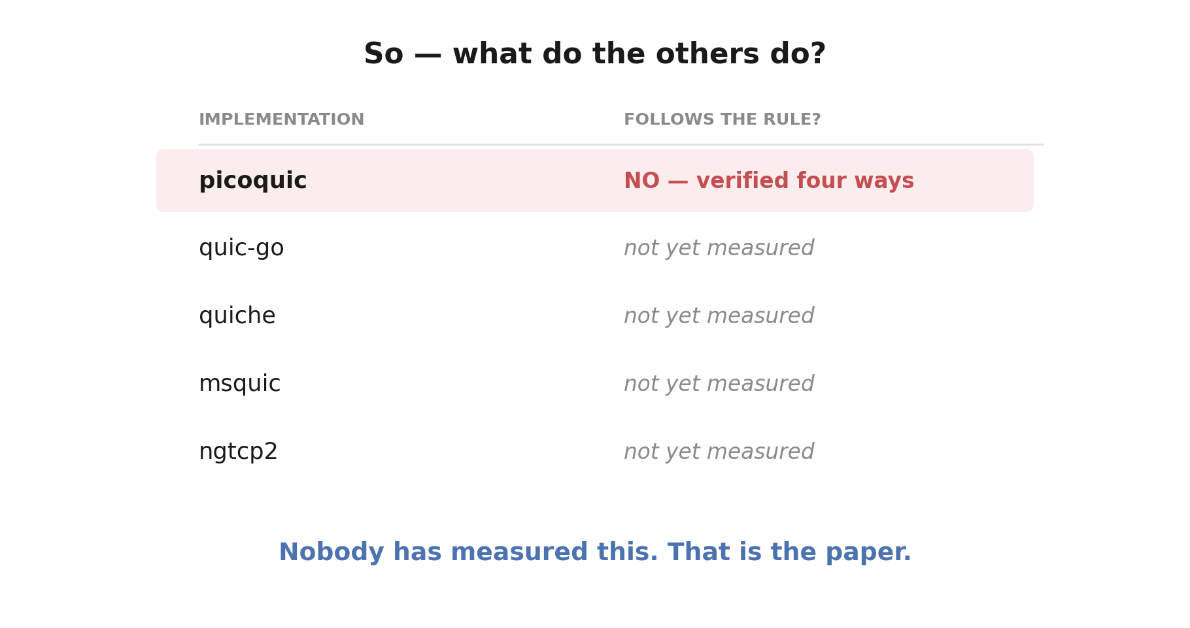
THE GAP
Which raises the question nobody has answered.
A 2025 study measured whether servers SUPPORT migration at all. Nobody has measured what they DO to congestion control once they accept one.

Slide 8
WHAT WE PROPOSE
That is the paper.
Take five QUIC implementations and answer three questions for each:
1. Does it reset the speed estimate when the network changes, as required?
2. Does it use the free measurement the protocol already takes of the new network?
3. Does it correctly ignore leftover replies from the old network?
Then measure, in our testbed, what each choice costs.
We already have the testbed, the measurement tools, and the first implementation's answer.

Slide 9
A LEAD FOR LATER
One more thing we noticed along the way.
Before a connection trusts a new network, it must run a small security check — send a random number, get it echoed back.
That check is a round trip on the new network. It measures the network's speed for free.
In our traces it measured the new network to within 0.2% of the true value — while the connection's own estimate was three times wrong.
The standard already allows using this for one purpose. Extending it further is a natural follow-on — but it is a section of the paper, not the paper.
60.1 ms measured vs 60.0 ms ground truth, in the same trace where the connection believed 20.1 ms.

Slide 10
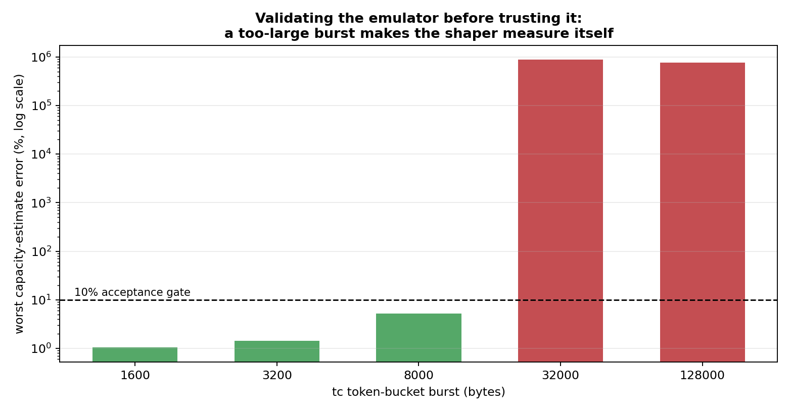
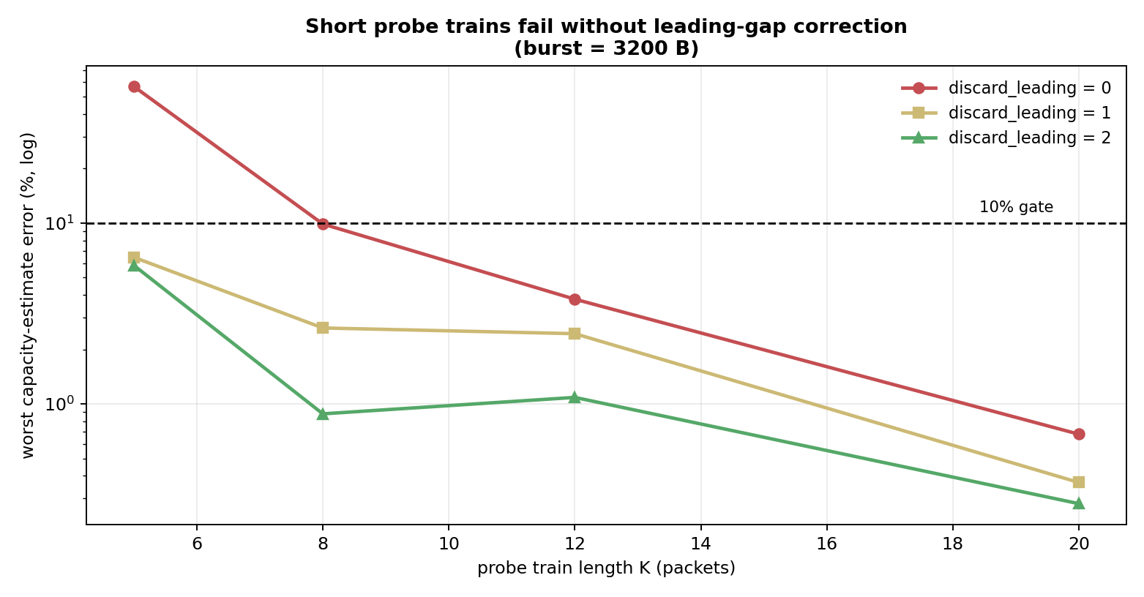
METHOD
We checked our instruments before trusting them.
Two flaws in the emulator found and fixed before any measurement was taken. Left: a mis-set shaper lets test traffic through untouched, so you measure your own simulator. Right: short measurement bursts break without correction.

Slide 11
STATUS
Where we are.
✓ Testbed built, calibrated, and validated
✓ First implementation surveyed — does not follow the rule
✓ Discovered that partial compliance is worse than none
✓ Measurement and analysis tooling complete
◦ Four more implementations to survey
◦ Cost of each behaviour to quantify
Nothing in this deck is projected. Every number is measured.

Slide 12
HONESTY
What we are deliberately not claiming.
• We have not shown that any particular fix is worth deploying.
• We have not tested on real phones or real cellular networks — this is emulation.
• Our own compliant implementation still fails in one scenario; one cause is diagnosed, a second is not.
• One implementation is not a survey. Four more to go before we can generalise.
We would rather state the limits than have a reviewer find them.

