Slide 1
Assignment Title
Data Analysis and Insights for different page Optimization & How to get more user install & Engagement from the App & Website
SIVA SHANKAR B.tech,

Slide 2
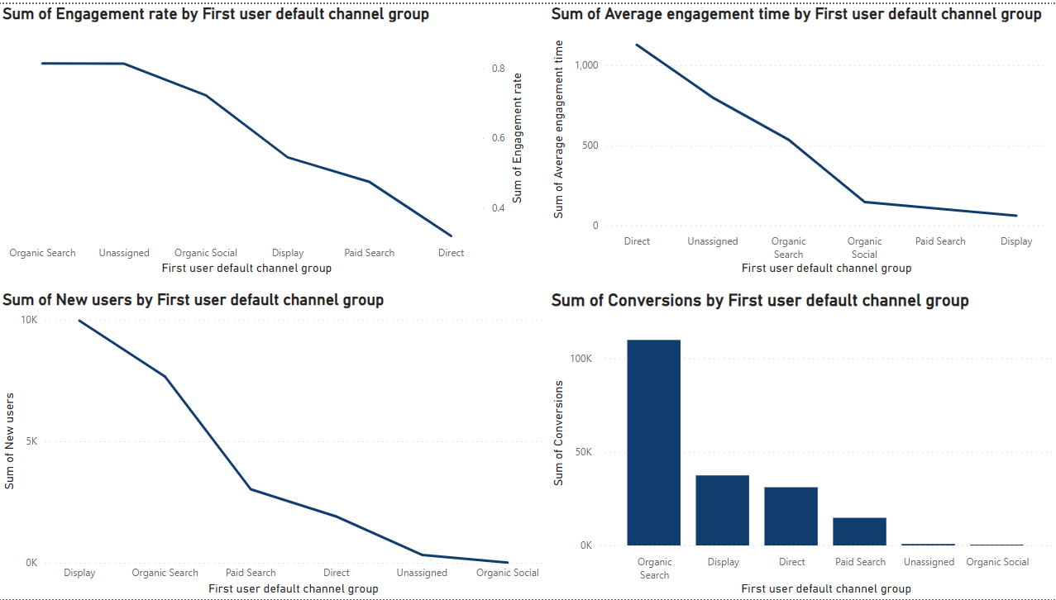
User Acquisition
From User Acquisition Data we can Infer that More New Users reaching the app via Display channel,
But in the view of Engagement rate, Conversion, Engaged sessions, Event Count we can see that the people from channel via organic search is more interested to spent time on the app than Users via Display channel.
If we improve the quality of Organic Search we can gain more New Users to our app.
Some ways to improve Organic Search are :
1. Keyword Research
2. Content Optimization
3. On page SEO
4. Page speed Optimization
5. Social Signals
6. User Experience (UX)
7. Technical SEO
8. Backlink Building
9.Monitor and Analyze.
10.Structure Data Markup
11. Competitor Analyze.

Slide 3
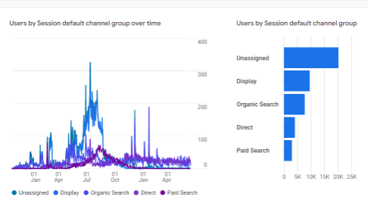
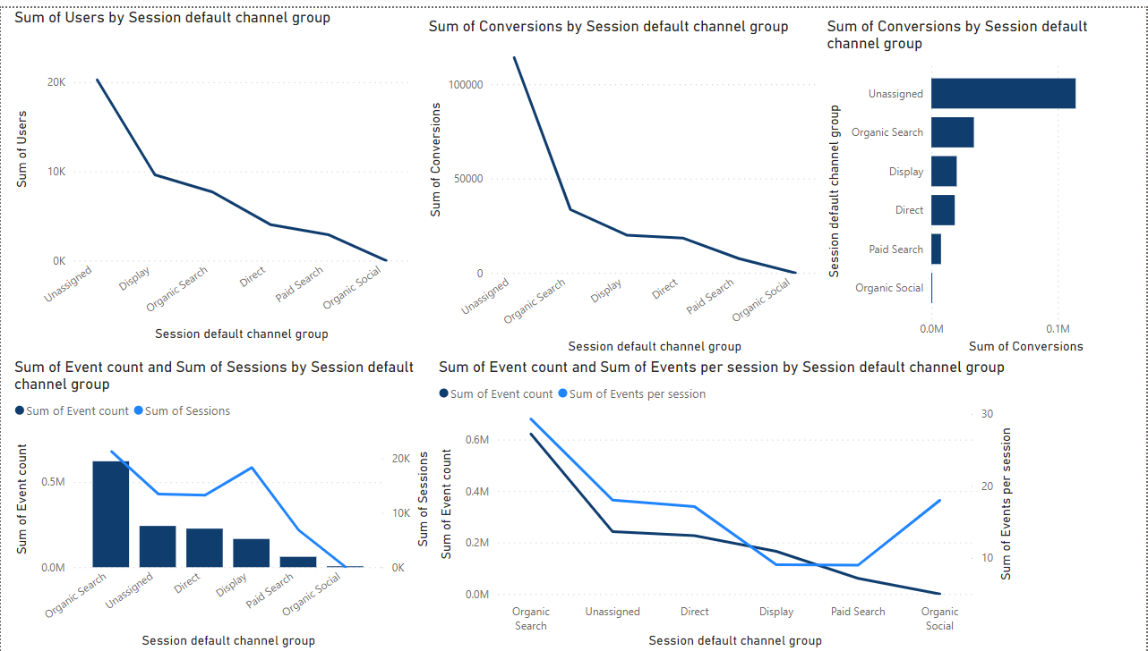
Traffic Aquisition
From the data we can see that there are more Unassigned channels which leads to misleading Analysis of traffic of our app. So we need to take an effort on fixing those issues
On the other hand Next to unassigned channels the existing users still reach our app via Display and Organic Search .So we have to minimize the paid search and try to make steps to improve Organic social ,Organic search channels to reach more New user to our site.
Next form the time Series Chart we can make user that our app is in max usage during the month of May to July(Since it is an end academic . So we can take some efforts to advertise(Campaigns) our app via various Study related websites like W3 Schools, Javatpoint, Tutorials Point, Hacker Rank, Hacker Earth, Byju`s etc. and Social Media like Instagram, Facebook Messenger, Threads etc. So that we can increase More users.
Some ways to reduce Unassigned channel Traffic are Review Default Channel Grouping, Implement UTM Parameters, Use Google Tag Manager, Check Campaign Tagging Accuracy, Cross-Domain Tracking, Analyze Landing Pages etc,

Slide 4
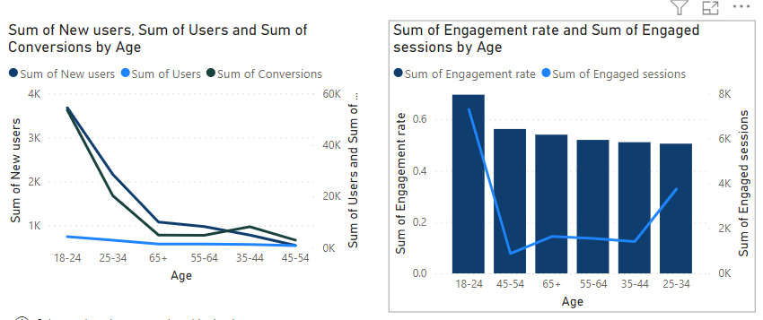
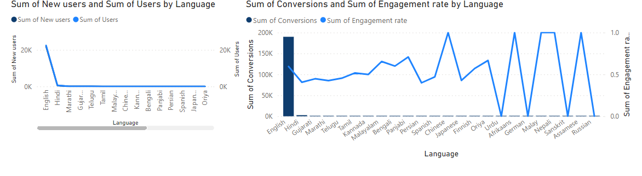
User BY age
User BY Language
In the view of Customers age, people in the age category between 18-24 are more users who are in the category of students , Job seekers.
New users, Engagement rate, Engaged session,Conversiona there are more New users in this age category who reach our App are more.
From Users Language preference we can infer that there are more New and Existing users use English as a major language for usage we can improve its efficiency we can reach more users.
Other than English Hindi,Tamil,Chinese,Nepal,Assame,Malayalam languages have high engagement rate if we improve those languages too will help us to reach more new user form these Areas

Slide 5
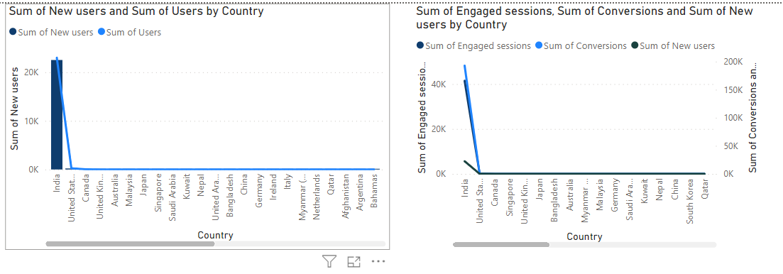
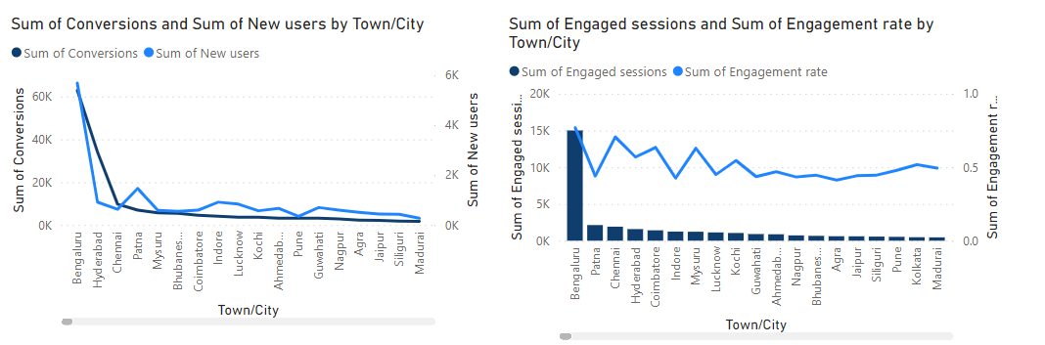
DEMOGRAPHICS
Cite-Wise Report
From Demographics data’s we can see that More New users, Existing Users, Engagement rate ,Conversion are in India whom uses our app.
Next to India,United States,Canada ,Uk and Singapore are some prominent users who shows some interest in using our services so we can improve our services in that country to take the business internationaly
From cite wise(Town/city) data we can see the More New users reach our app are from Bengaluru,Hydreabad,Chennai where are more IT companies and colleges are located so we can made Advertisements in these areas we can reach more customers to our app.
In addition to that some of the areas in central states also have more Engagement rate if we made campaign is those areas also really helpful to improve the Users count

Slide 6
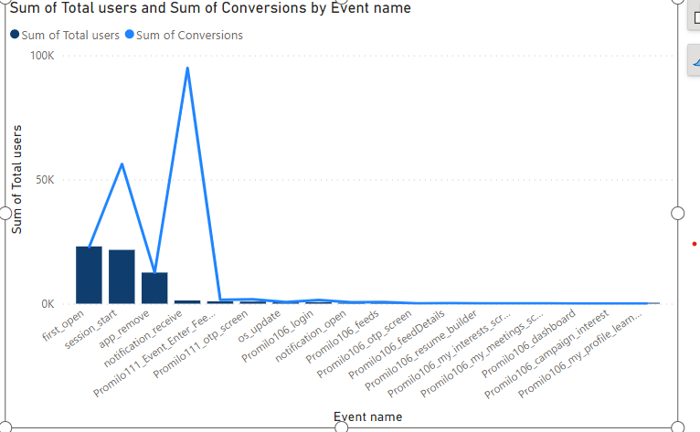
CONVERSION REPORT
From conversion report we can see that maximum users are interested in opening the app for first time which is seen as first-open event ,with that we can say that more New users are trying to use our app
In view of conversions the event notification-receive have maximum conversion so we can use this area to deliver more services to the users like notifying the user about new job opportunities, About the informations about college events like admissions, Internships, Entrance Exams with which user can spend more time in our app based on the information we provide.
We can see that events like promilo-login, feeds, dashboard, resume builder have very less conversions so we have to improve the styles,designs of pages to attract users and improve user experience to increase conversions in these events

Slide 7
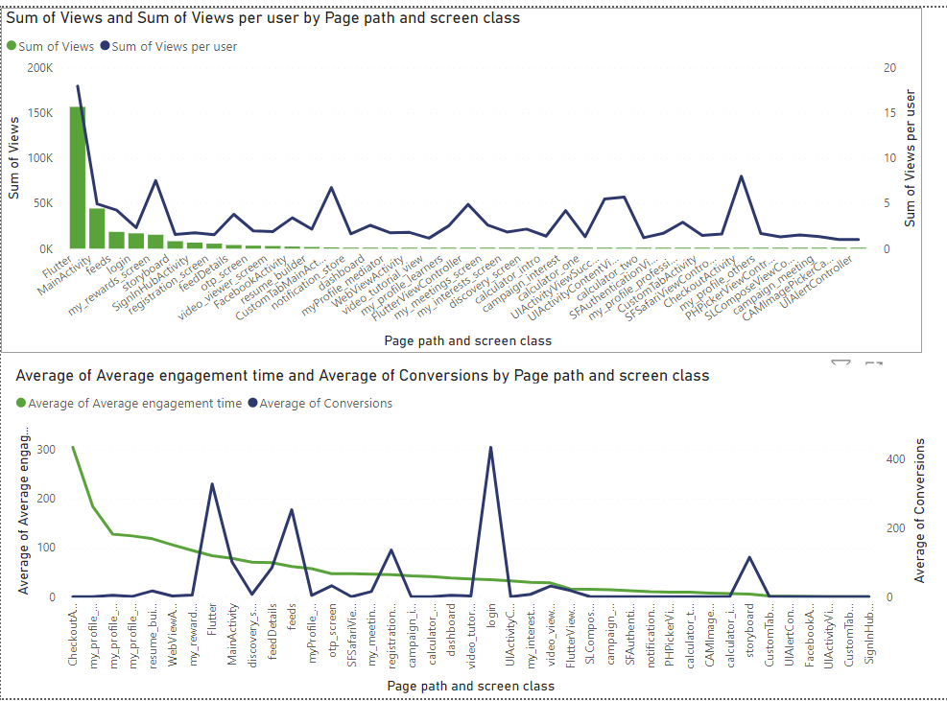
SCREENS AND PAGES REPORT
From Screens and Pages Report we can see that in the terms of Views the total views and views per user are high in flutter Page screen.In terms of single user the views are also more in areas like Login,My Screen Rewards,UIActivity and checkout Activity.
In other pages the views are low so we have to improve the quality and UI in that pages to engage users and spent time on the main screens of the app .
In terms of conversions Many users makes an attempt to login to the app and also spend saw our feeds page,story board and registration page which are some main pages of the app.If we make an attempt to improve all pages like this we can even attract more users to install our app.If we increase UX designs in this pages like dashboards,feed pages we can also increase the engage time of the users

Slide 8
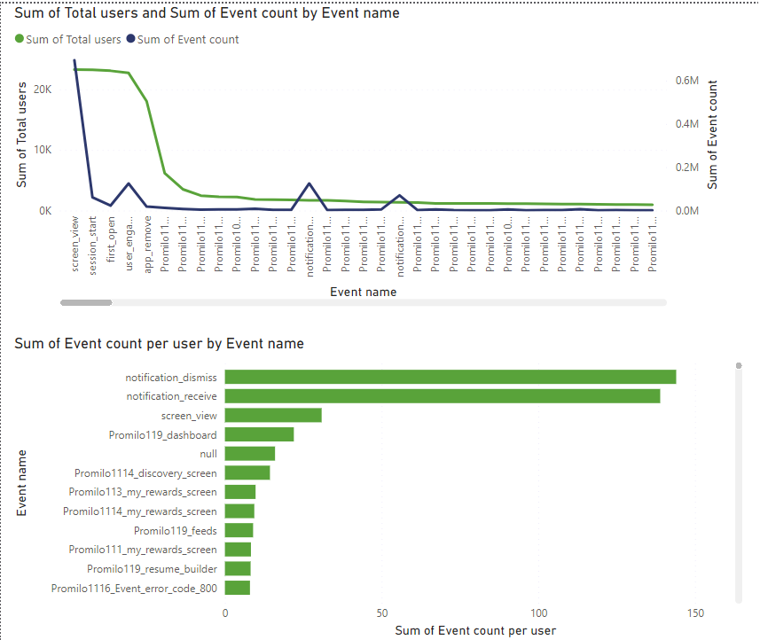
EVENT REPORT
From the Event Report, with features like event name, event count ,Total Users, Event count per user we can infer that screen_view,notification receive,notification dismiss events are done by more users and other than that we have to make improvement on others too.
In the view of single use promilo 119_dashboard event is also use more so if we improve the dashboard contents and styles more users will explore the contents from the dashboard to other services quickly and easily.

Slide 9
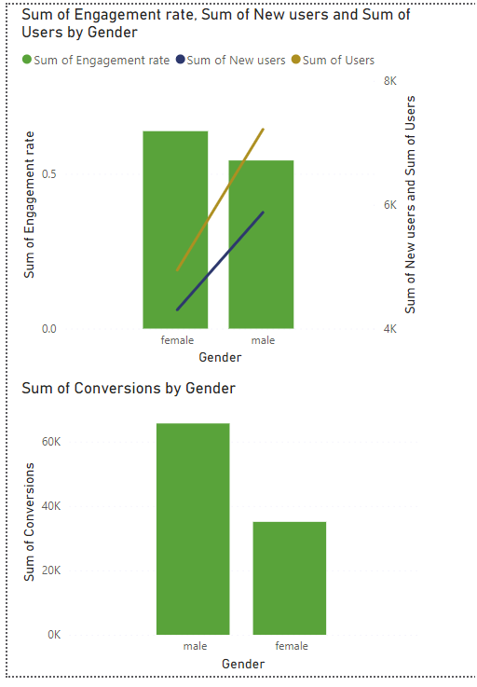
GENDER REPORT
In the view of gender New users, Existing users, Conversions are more in Male category than female.
But Female users use the app more time than Male.
So we can make an effort to attract more Female Users via some webistes through which we can reach them more like pets website, beauty products related website like diplay ads,beauty pages in Instagram site etc

Slide 10
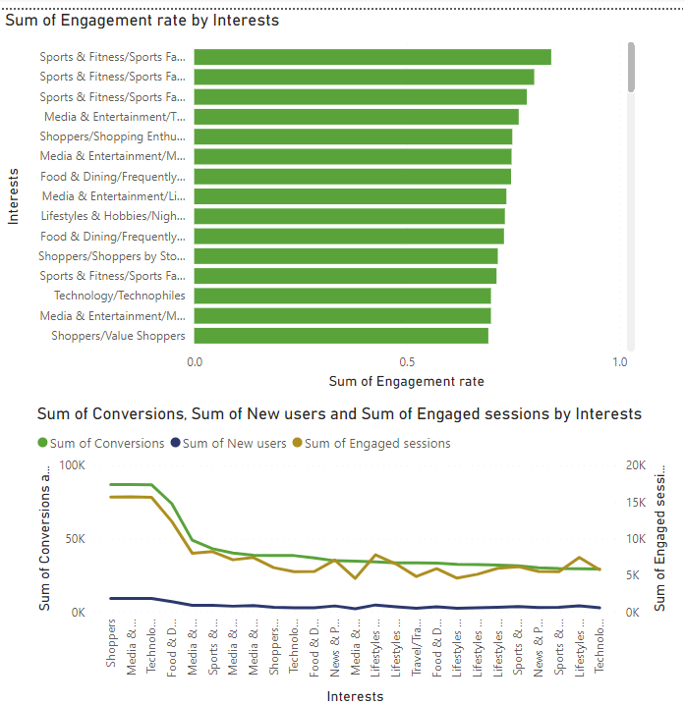
BY INTEREST
From the Interest data we can see that New users who visit the app are interested in searching for shopping ,Media and Entertainment, Technology and Mobile Enthusiasts.
But In the view of engagement rate sports and fitness ranks first that more users spend time more on sports related information so we can improve and give more details related to sports ,Media,Technology,Food related concepts to attract more users.

Slide 11
KPIS OF these Data Analysis are
New User
Exisisting User.
Engagement Rate
Conversion
Engaged Sessions.
Event and Event count
These Features tells more about data and gives Information about how to improve users attraction more and helped to establish the app more efficiently.

Slide 12
CONCLUSION
From all the above analysis done we can conclude that inspite of spending money in unwanted advertising we can improve our site towards Oragnic searches where more users are come to know about the app so we can improve those areas to establish our app.
From pages report we can see that our app need some designs and styles changes to attract more people to use our app and keep engage our app

