Slide 1
SALESTORM — Flash Sale at 500k req/s
• 100 units, 10,000 concurrent Buy clicks, 500k req/s peak
• Goals: zero overselling, exactly-once charge, orders survive a 30 s outage
• Our unique factor: the Cache-Hit Ladder
• “Caches can say NO. Only the database can say YES.”

Slide 2
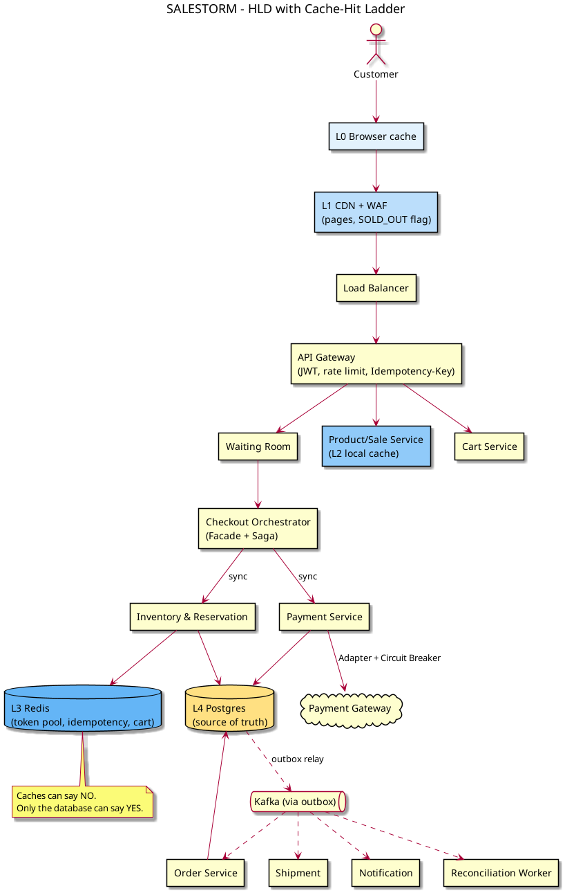
The Cache-Hit Ladder
• L0 Browser: debounce Buy, cache static assets
• L1 CDN: serves pages + SOLD_OUT flag at the edge
• L2 In-process cache: product + sold-out flag per pod
• L3 Redis: 100 admission tokens + idempotency records
• L4 Postgres: the only place a unit is actually sold

Slide 3
Concurrency: no overselling
• Redis pool of 100 tokens admits at most 100 buyers to the DB
• Each unit is a row; claim with SELECT … FOR UPDATE SKIP LOCKED
• UNIQUE(sale_id, customer_id) = one unit per customer
• 5-min reservation TTL, fencing version beats late-payment races
• Pessimistic on the hot rows, optimistic elsewhere (ADR-008)

Slide 4
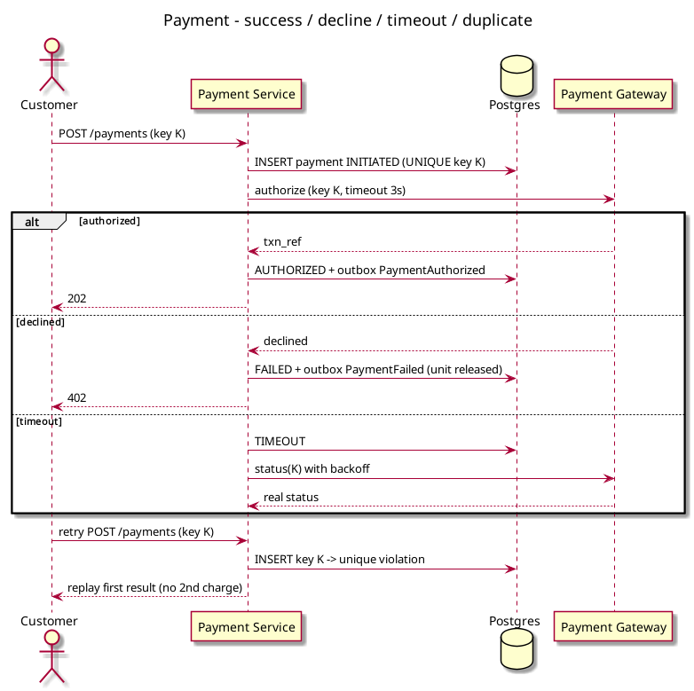
Payment & Order reliability
• Idempotency-Key + business key: duplicates replay the same result
• Authorize at checkout, capture only after the order is safe
• Transactional outbox → Kafka → Order Service (saga)
• Order Service down 30 s: events wait in outbox, retried, none lost
• Payment failure: release unit back to pool, void auth

Slide 5
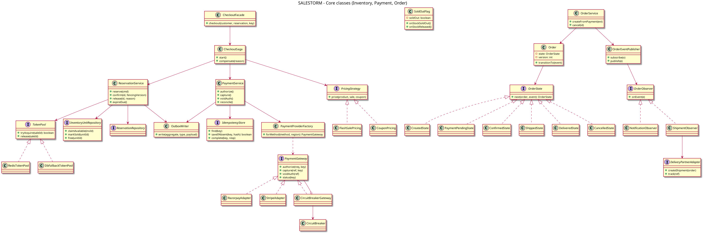
LLD & SOLID
• Facade: Checkout Orchestrator; Strategy: allocation; Adapter: payment gateway
• State pattern for Reservation and Order lifecycles
• Repository + Unit of Work around Postgres
• Circuit Breaker + Retry with backoff on gateway
• Each service depends on interfaces (DIP), one reason to change (SRP)

Slide 6
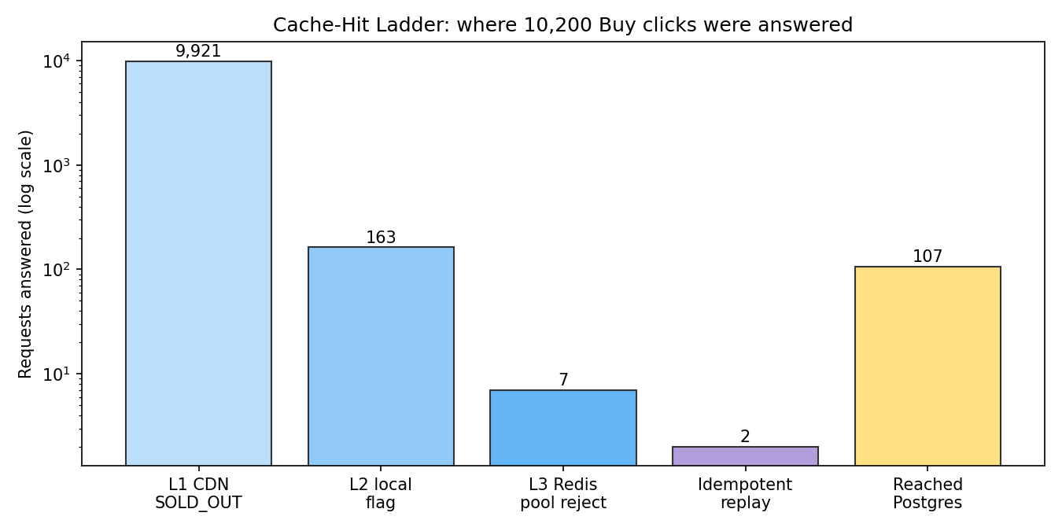
Proof: we simulated the test case
• 10,200 requests incl. 200 duplicates, 5% payment failures, 30 s Order outage
• Sold exactly 100, max 1 charge per customer
• 7 failed payments → 6 units resold to others
• 100 orders created after outage recovered
• 415 invariant checks, 0 violations

Slide 7
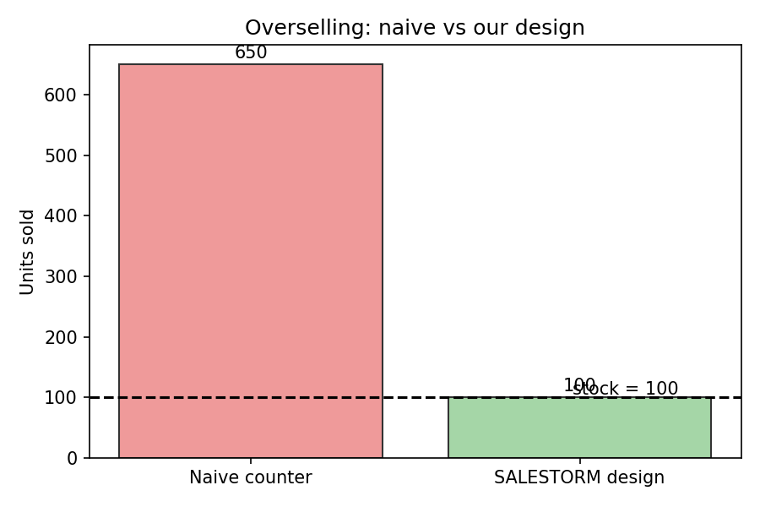
Naive vs our design
• Naive stock counter under the same load: sold 650 (oversold by 550)
• Our design: sold exactly 100
• Only 107 of 10,200 requests ever touched the database

Slide 8
Scale & stress scenarios
• 500k req/s absorbed mostly at CDN; DB sees ~100s of writes
• Redis down → fall back to DB SKIP LOCKED with stricter rate limit
• Gateway slow → circuit breaker, queue in waiting room
• Order Service down → outbox buffers; reconciliation worker heals
• Observability: tier hit-rate, oversell invariant alarm, payment lag

Slide 9
Thank you
• Repo: github.com/sivaangayarkanni/SalesStrom-Ecommerce-platform
• HLD, LLD, DB, API, ADRs, simulation and load tests all included
• Questions?

