Slide 1
Virtual Hackathon-AI for All
Team No: HT104
Domain Name: Artificial Intelligence and Machine Learning
SDG Goal: 2
Title: Liver disease prediction using web app
Team Name: Janus
HACK@SRET 2022

Slide 2
Idea/Approach Details
Describe your Problem Statement:
Now a days there are so many peoples were affected by kidney disease. Due to over consumption of alcohol in young age may affect them to severe kidney failure and they affected with disease The main goal is to predict the disease by getting the details of the patient

Slide 3
Idea/Approach Details
Describe your Objectives:
This web app is to help the people to predict whether they affected with liver disease by getting some details from the reports

Slide 4
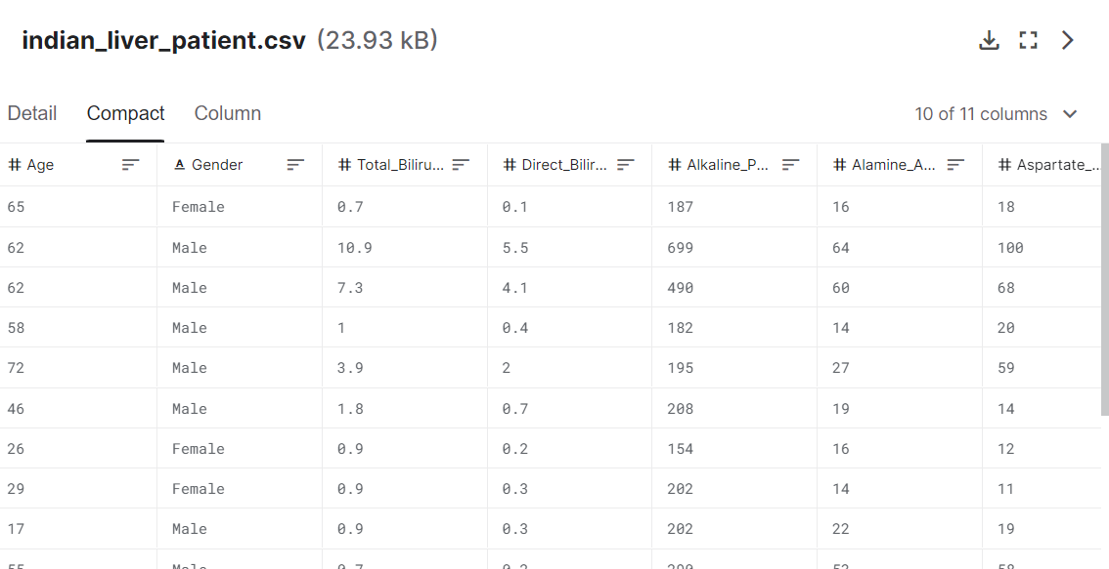
Idea/Approach Details
The dataset which I have used for the prediction is took from Kaggle:
https://www.kaggle.com/datasets/uciml/indian-liver-patient-records
Total columns: 11
Total Row: 583

Slide 5
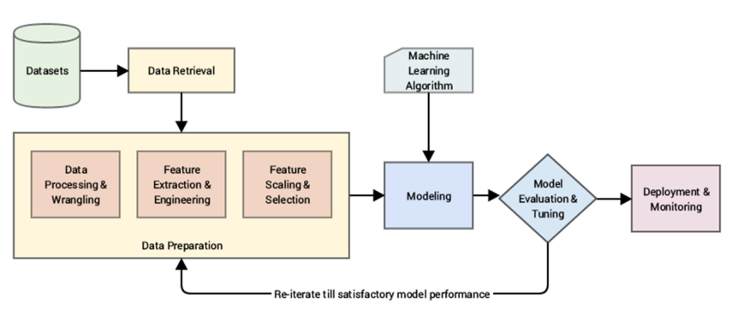
Idea/Approach Details
Workflow

Slide 6



Idea/Approach Details
Tools & Technology used:
Jupyter Notebook
React Native
Visual Studio Code
LANGUAGE USED:
Python

Slide 7
Demonstration Video
Insert link here to a short 3 minute demonstration video of the working prototype, app, work flow or
analytical model
The complete demonstration of the project with code
https://drive.google.com/file/d/131FBfb1d9g0IsTPHwksKylxgFjpHDJ5c/view?usp=sharing

Slide 8
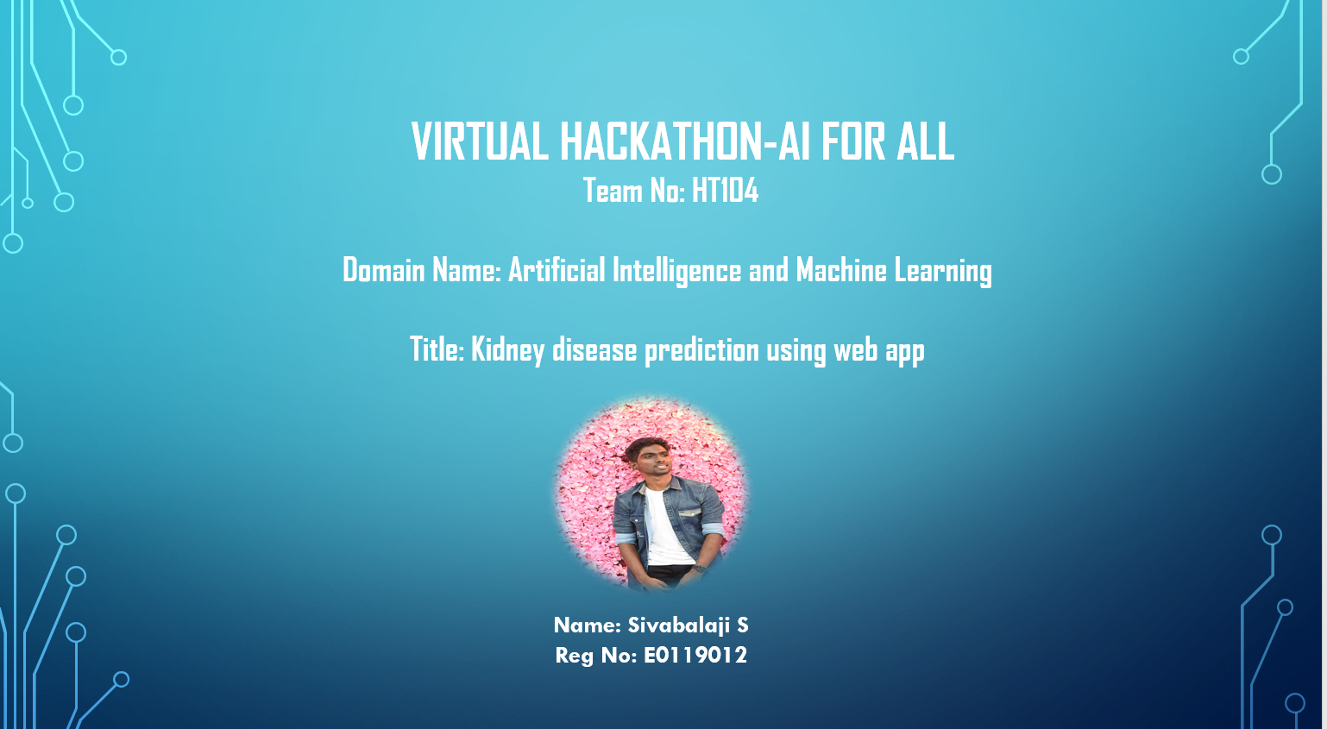
Team members details:

