Slide 1

Car Market Trends Analysis with Car Dekho Data
SIVA BALA KEERTHICK G
RMK Engineering College,Tamilnadu
sivabalakeerthick@gmail.com
STUDENT ID:STU6670463dd7a3d1718634045

Slide 2

PROBLEM STATEMENT
To analyze the Car Dekho dataset to uncover trends and patterns in the car market. The goal is to identify key factors influencing car sales, understand consumer preferences, and predict future trends. This analysis will support car manufacturers, dealers, and potential buyers in making data-driven decisions.

Slide 3
Project Description:
This project aims to leverage this data to analyze current market trends, identify consumer preferences, and predict future trends.
Objectives:
Analyze car sales trends to identify popular brands and models.
Understand consumer preferences and how they vary by demographics.
Examine pricing trends and factors influencing car prices.
Segment the car market based on various factors.
Predict future trends in the car market.

Slide 4

WHO ARE THE END USERS?
1.Car Manufacturers
2. Car Dealers
3. Car Buyers
4. Marketing and Sales Teams
5. Automotive Parts and Accessories Suppliers

Slide 5

Technology Used
Numpy
Pandas
Matplotlib
Python
Power BI

Slide 6
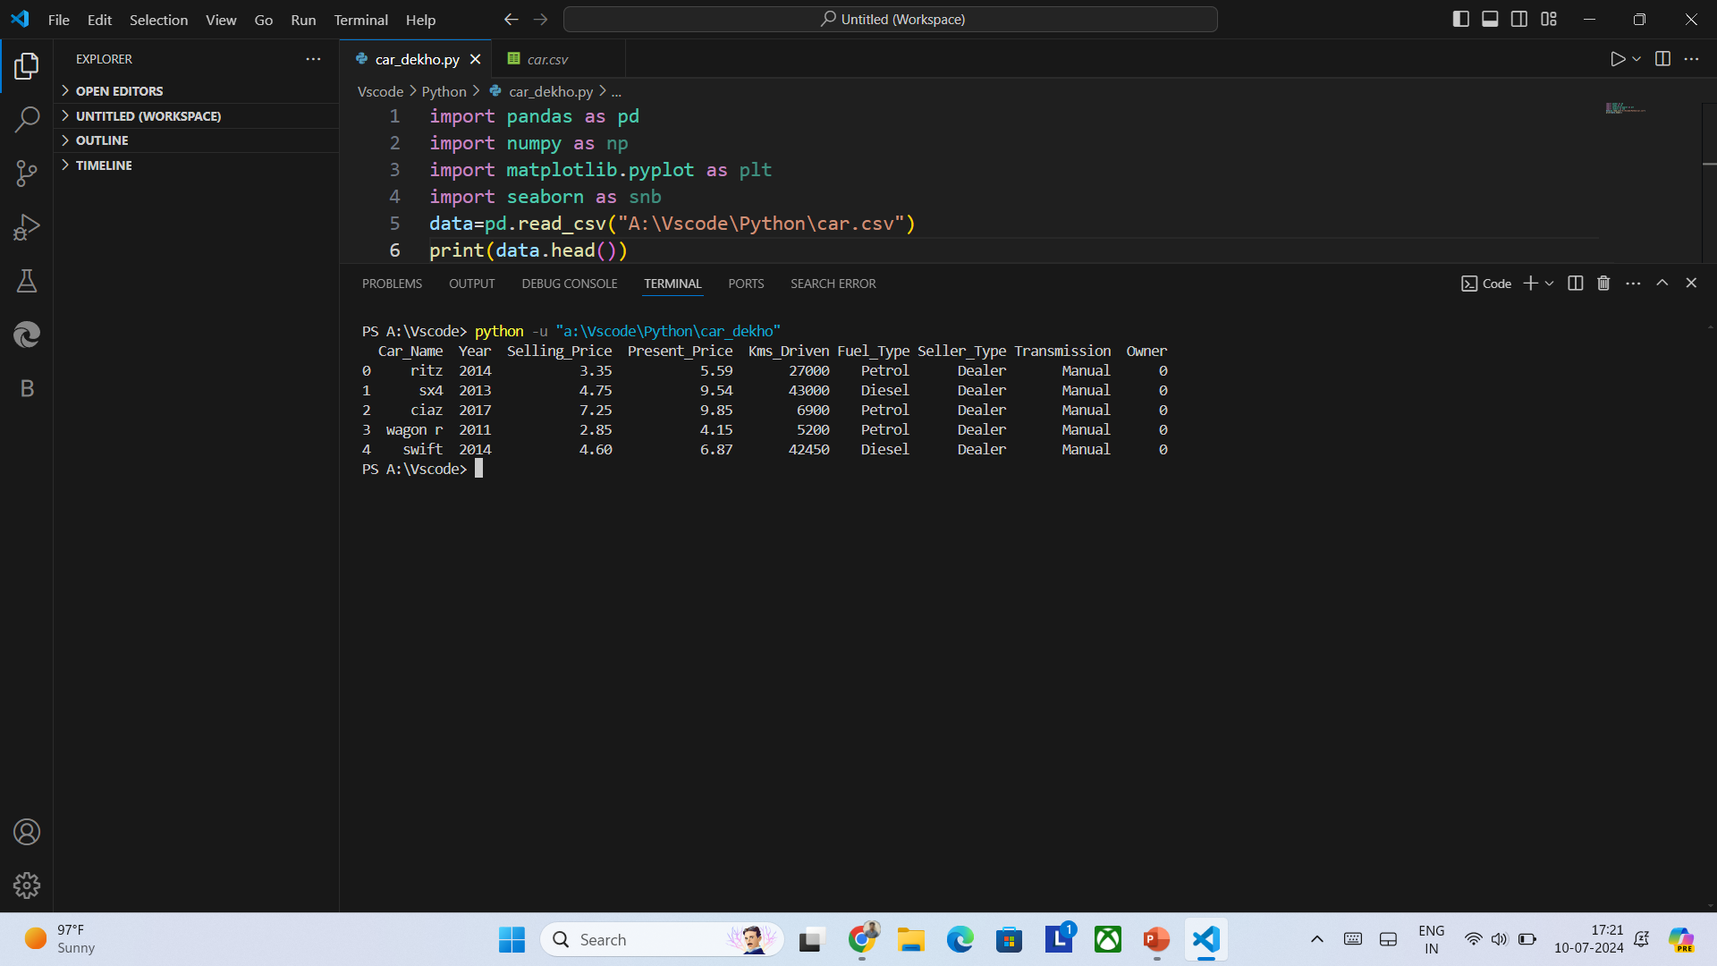
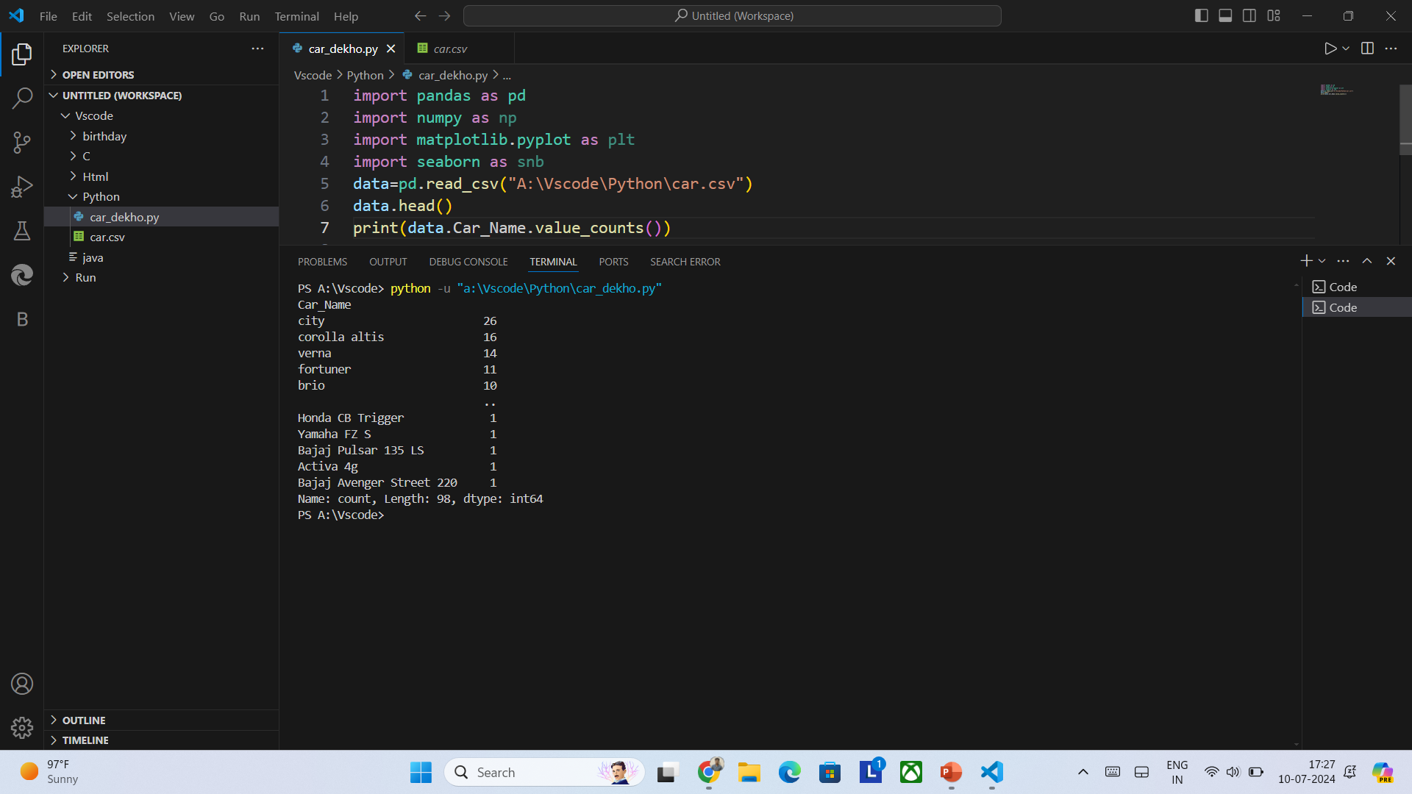
RESULTS
Demo link:Touch here

Slide 7
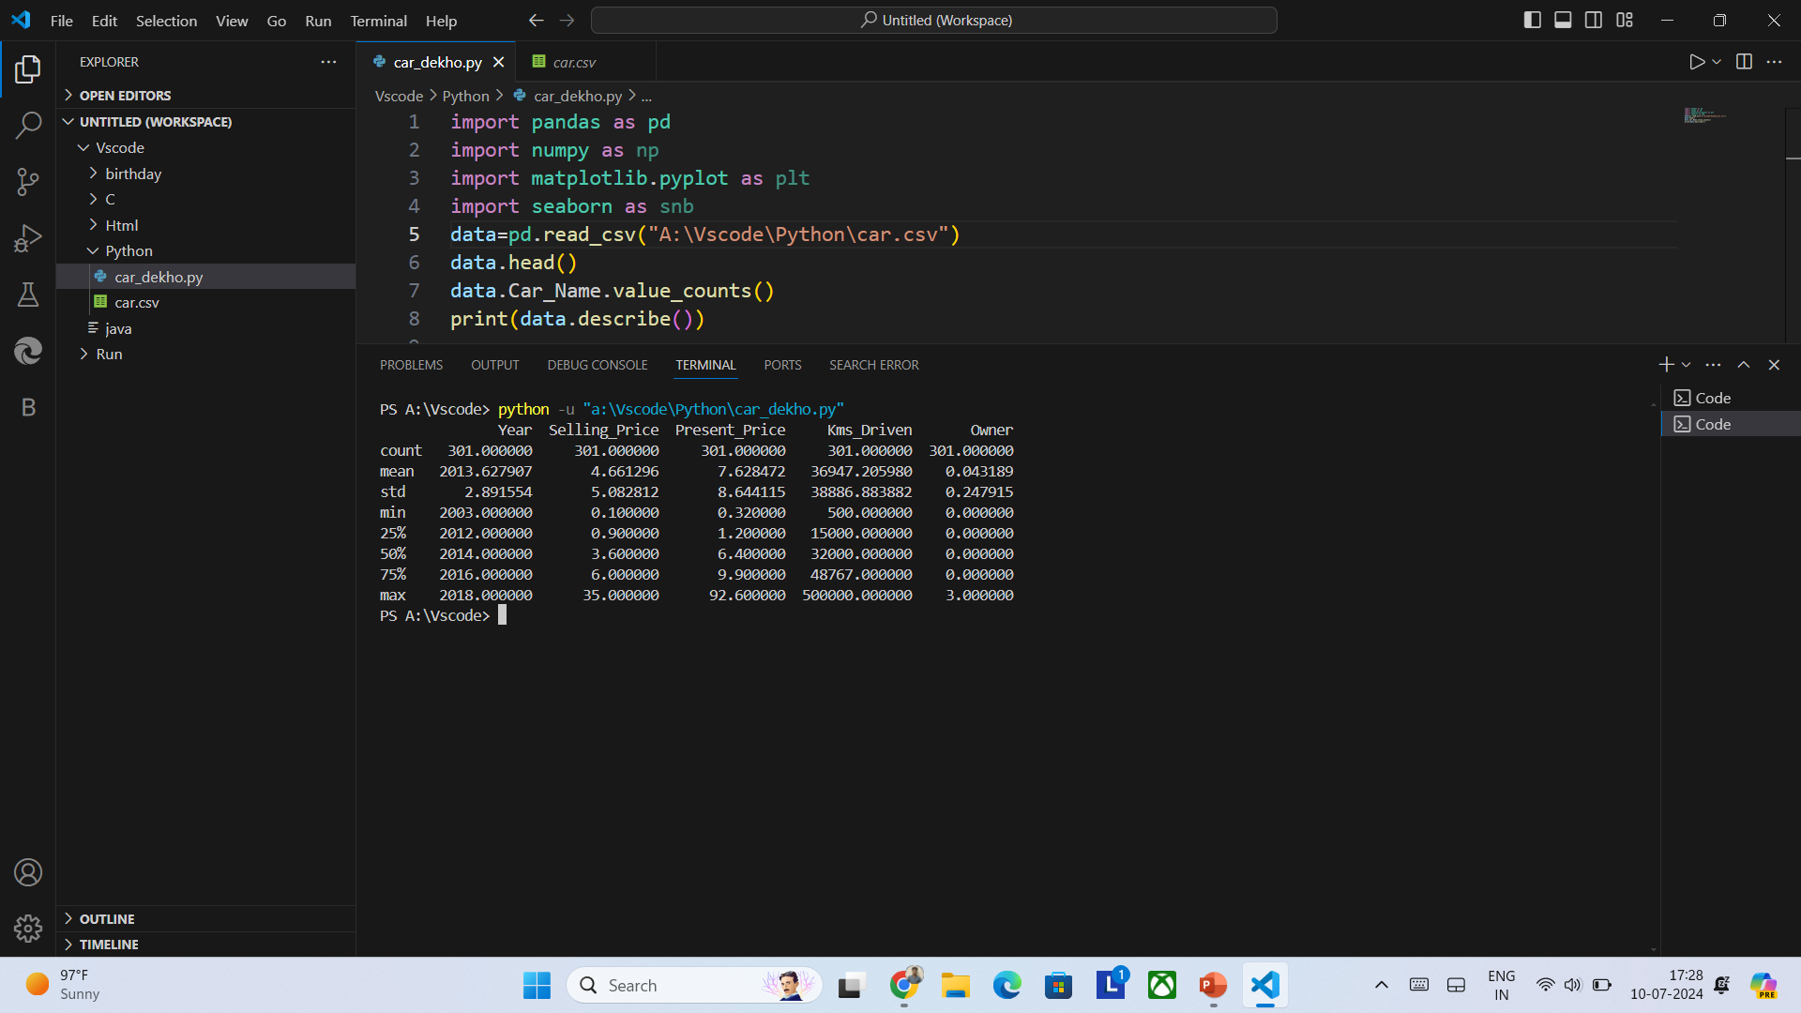

Slide 8
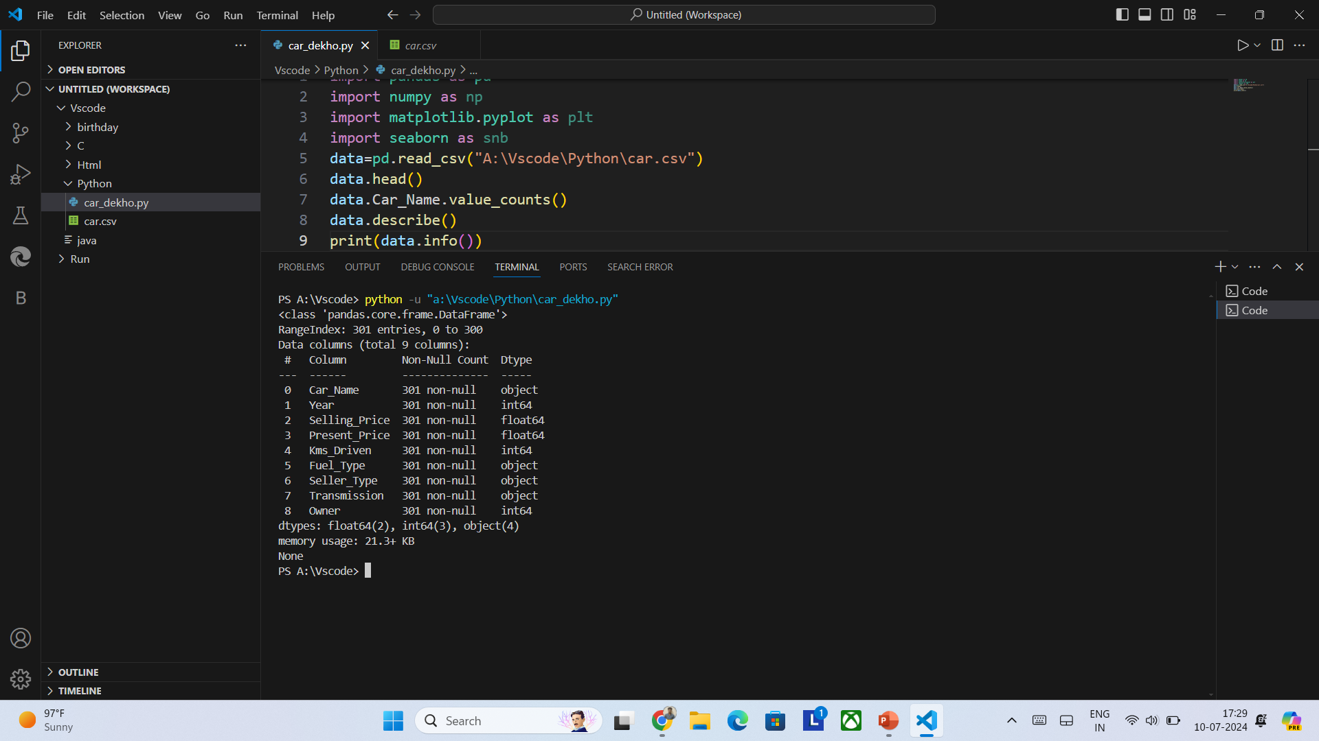

Slide 9
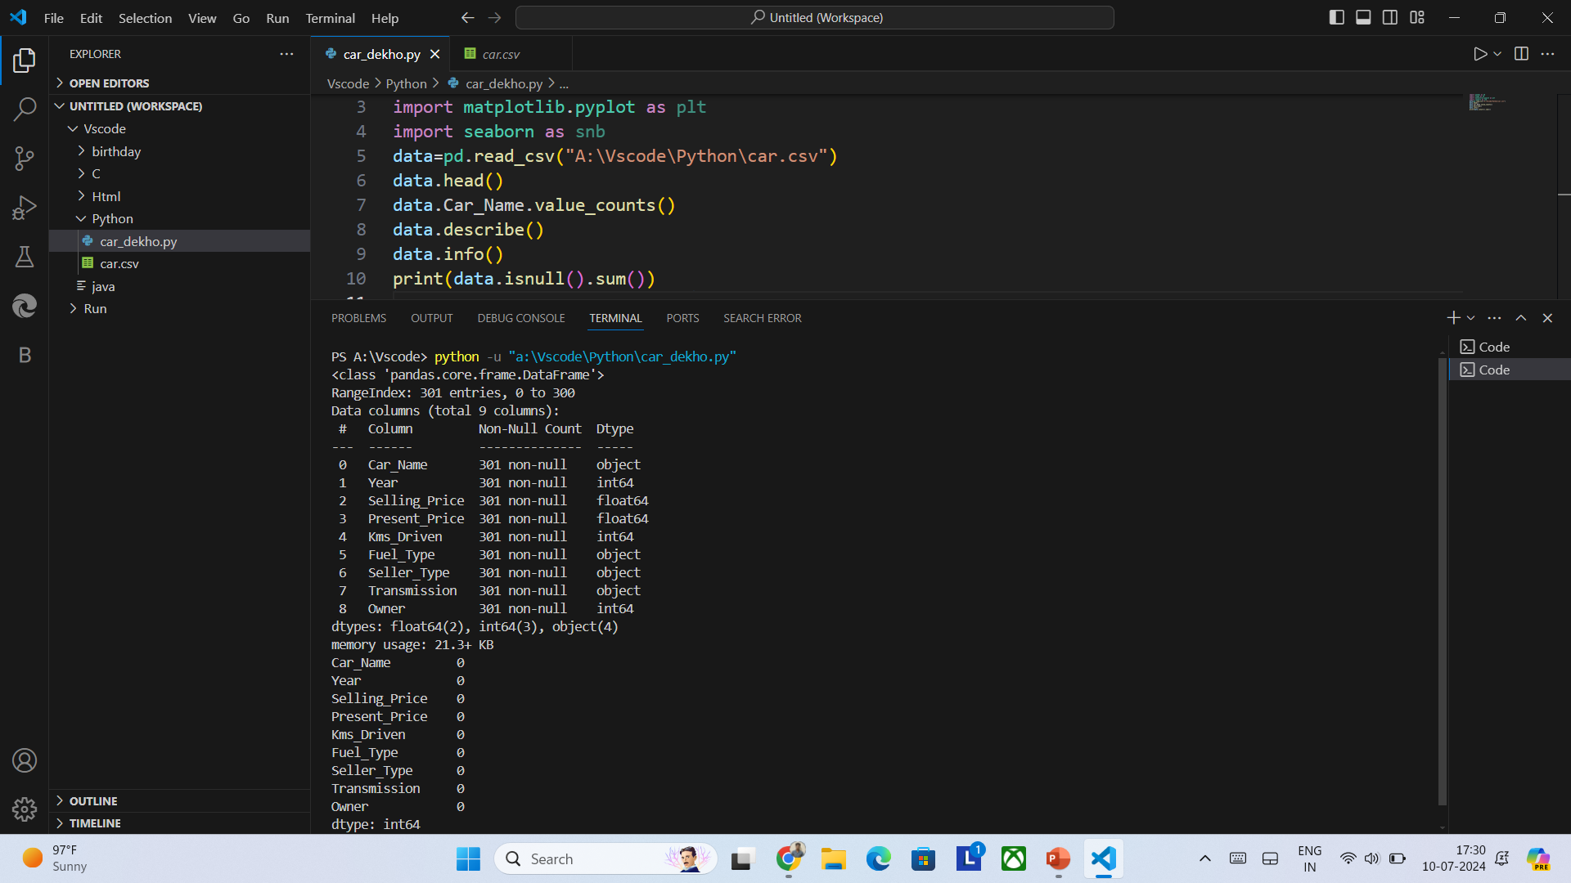

Slide 10
Analysis:
The data of manufacturing vehicle is available from 2003 to 2018.
The lowest selling price is 1lakhs.
The highest selling price is 35lakhs.
There is no missing data in the dataset.
Totally there are 301 vehicles in this dataset.
There are 239 petrol,60 diesel and 2 CNG vehicles respectively.
Maximum vehicles is sold in 2015 and minimum vehicles is sold in 2004 and 2018.

Slide 11
Thank you

