Slide 1

FIRST Sight
Problem Statement 1 · Digital property valuation for Loan Against Property
Check the property file before anyone travels

Slide 2







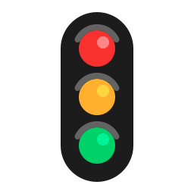






FIRST Sight: LAP Property Checks in 2.6 Days, Not 7
The delay is in paperwork, not visits: we check each file on day one and send a valuer only where risk needs one
THE PROBLEM
THE SOLUTION
THE OUTCOME
5-7 days, ≈₹5,500
Check papers first
2.6 days, ≈₹2,860
per property check today; in IDFC's sample the visit took 1 day and signing 9 more
AI reads each paper on day one, written rules pick 1 of 3 visit lanes, a valuer signs
per check (estimate); ≈₹16.7 Cr a year in savings and interest; payback ≈20 months
HOW ONE LAP FILE MOVES THROUGH FIRST SIGHT
Five S.I.G.H.T. steps run on every file; the Grade step then sends it down one of three lanes, so only risky files get a full visit
S
I
G
H
T
Sight 24
35% · 24 h · video
Valuer signs
Sight 72
35% · 72 h · short visit
Each lane ends in a valuer's signature and a 1-page card
LAP file
Source
Inspect
Grade
Human
Track
Asked once, on WhatsApp
Checked vs land records
Rules pick the lane
Valuer checks, signs
Watch after the loan
Sight Full
30% · ≤4 days · full visit
PROVEN IN TESTS
WHAT IDFC GAINS (ESTIMATES)
THE ASK
69/69
31/31
0
Cost / check
₹5,500
₹2,860
1
Approve a 1,000-file shadow pilot in Dehradun and Coimbatore
Days to clear
7 days
2.6 days
2
Run Second Sight on every agency report from day one
problems caught
report errors
false alarms
Report pages
10-13
1 page
Board approves the lane policy after the pilot gate
64 blind test files; < 1 US cent to read a real report
3
Plus ≈₹7.7 Cr a year of extra interest
Check the property file before anyone travels: faster LAP decisions with every risk control intact

Slide 3








The Delay and the Risk Hide in the Paperwork
Our audit of IDFC's 3 sample reports: the visit takes a day, while papers that disagree surface late and get typed wrong
PRIMARY RESEARCH: IDFC'S 3 SAMPLE REPORTS, FIELD BY FIELD
WHERE THE DAYS GO: REPORT 1
We read every field of IDFC's three sample appraisals; each finding below cut the value IDFC could lend against, or the trust in the report
Dates printed on IDFC's own report
25 May · visit
4 Jun · signed
01
Dehradun
02
Dehradun
03
Coimbatore
26 May · draft
9 more days to write, check, sign
House · ₹3.19 Cr (land only)
Commercial · ₹20.11 Cr
House · ₹3.40 Cr · 14 years
10 days
visit to signature
82%
over approved size
1 vs 3
survey numbers
Report 3 is worse: its header, remarks and signature carry three different dates, so the real gap cannot even be measured
Time: signed 10 days after a 1-day visit
Time: visit 12 June, report 13 June
Time: two inspection dates, 4 July and 7 August
Size: built 15% over the approved plan
Size: built 82% bigger than approved
Size: no approved building plan given
Why it matters: LAP is 11% of IDFC's ₹3.47 lakh Cr loans, and mortgages grew only 8.7% a year vs 35.4% for retail (Q2 FY27)
Mismatch: 282 sq ft lost to a road widening
Mismatch: plot 5,192 sq ft in deeds, 4,139 on the map
Mismatch: deed shows 1 survey number, the map 3
Error: plan number and government rate left blank
Error: government rate left blank
Error: ₹3.40 Cr written as ₹55.6 lakh in words
FIVE INSIGHTS, AND WHAT EACH ONE MEANS FOR OUR DESIGN
1
2
3
4
5
Time is lost after the visit, not at it
Most of the report is desk work
The real risk is papers that disagree
Typing creates report errors
Agencies apply different rules
So the report is pre-filled before anyone travels
So the system does the look-ups valuers do by hand
So every paper is checked against every other
So words and maths are generated, never typed
So bank rules (80% quick-sale) apply every time
Fix the paperwork, not just the visit: that is where IDFC loses days and takes on avoidable risk

Slide 4




No One Decides How Much Visit a File Needs
Vendors digitise visits or sell data; deciding how much checking each file needs is the open gap IDFC can own first
WHERE EACH PLAYER SITS TODAY
WHAT EXISTS TODAY VS FIRST SIGHT
Across: use of public land and price data. Up: deciding how much visit a file needs
Seven abilities a bank needs to cut visits safely; only FIRST Sight covers all seven
Valuer apps
Data APIs
Loan apps
FIRST Sight
The open gap
Reads and cross-checks every paper
FIRST Sight
Decides how much visit is needed
Runs a bank-owned live video check
Decides visit level →
Pre-fills IDFC's own report form
Valuer apps
Checks every agency's report
Data APIs
Watches the property after the loan
Loan apps
Explains each decision with sources
Uses public land and price data →
e.g. Valocity (valuer apps), AdvaRisk and Square Yards (data APIs), Finezza (loan apps); amber dot = partly
WHY THE GAP EXISTS
Agencies are paid per visit
Data firms sell facts
Land data is newly usable
Tools built for them make visits faster but never remove one, as that would cut their fee
How much visit a file needs is credit policy that only the bank can set and approve
With records online and served by ULI, a desk check can now replace most travel
IDFC can be first to set site visits by risk, owning the rules while partners supply the data

Slide 5


How FIRST Sight Works: Read, Check, Grade, Sign
AI reads, written rules decide, a qualified valuer signs: the same file always gets the same, explained answer
S.I.G.H.T.: FIVE STEPS EVERY FILE GOES THROUGH
S · Source
I · Inspect
G · Grade
H · Human check
T · Track
Every paper listed on day one; asked once, on WhatsApp
Papers checked against each other, land records, maps and sales
Written rules pick Sight 24, 72 or Full and explain why
Live video or a visit; then a valuer checks and signs
1-page Collateral Card; property watched after the loan
Who: Customer, AI
Who: System rules
Who: System rules
Who: Officer, valuer
Who: Credit, risk
THREE LANES: EACH FILE GETS ONLY THE VISIT ITS RISK NEEDS
Rules pick the lane on day one, and tell the customer what would move the file to a faster lane
Sight 24
35%
Sight 72
35%
Sight Full
30%
When: No problems; loan ≤ ₹1 Cr and ≤ 50% of value
When: 1-2 smaller problems, or a ₹1-5 Cr loan
When: Serious problem, loan > ₹5 Cr or special building
What: 30-min live video; signed within 24 hours
What: Engineer checks only the flagged items
What: Full visit, papers pre-checked; 2 valuers ≥ ₹50 Cr
Signs: bank valuer · ≈₹1,300
Signs: panel valuer · ≈₹2,500
Signs: panel valuer · ≈₹5,100
18 PROPERTY CHECKS IN FOUR FAMILIES, EACH NAMING THE TWO PAPERS THAT DISAGREE
Area and building (5)
Title and approvals (5)
Value (4)
Risk and life (4)
Plot area, built vs approved, map pin, road widening, floors
Survey nos., owner names, plans, CERSAI loans
Price vs nearby sales and govt rate, LTV, value change
Recent sale, flood area, building life, papers
AI only reads; plain rules make every decision; a qualified valuer signs every case, so nothing is a black box

Slide 6
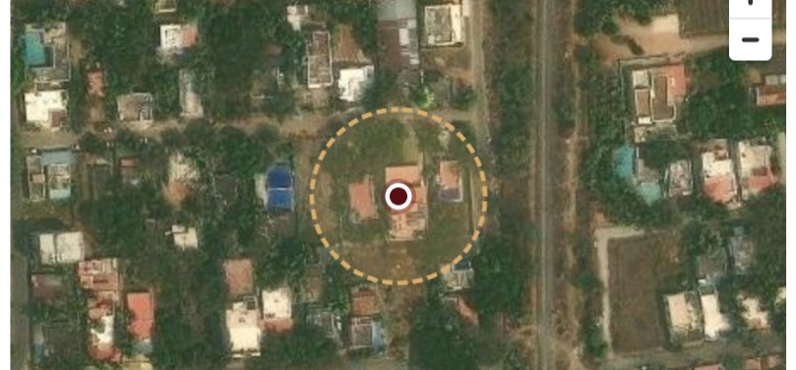
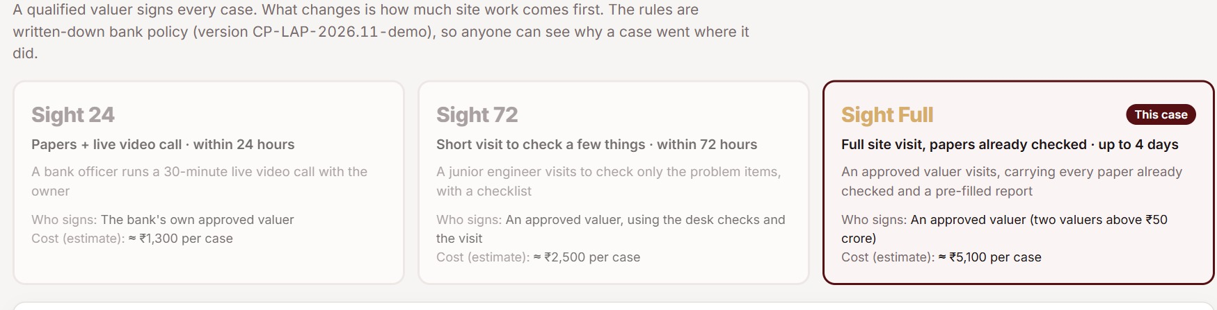
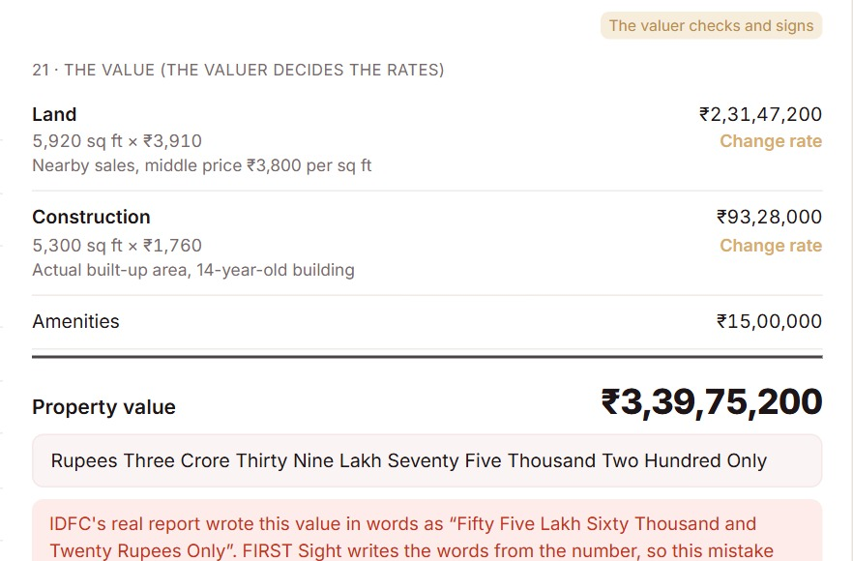
Report 3 Replayed: All Problems Found on Day One
Run through our live prototype, IDFC's Coimbatore case shows the valuer's findings on day one and fixes 2 report errors
How to read this slide: we replayed IDFC's real Report 3 (Coimbatore house, ₹3.40 Cr) in our working prototype. The three panels follow the file through S.I.G.H.T. steps I (Inspect), G (Grade) and H (Human check); the table below compares the result with the report IDFC actually received.
I · INSPECT: DEED VS LAND MAP
G · GRADE: LANE AND SCORE
H · VALUER CO-PILOT SIGNS
The deed lists one survey number, 173A/1F. The FMB sketch and TNGIS map put the building over three, so rule R02 flags a serious problem
One serious problem sends the file to Sight Full; the customer is asked for a rectification deed on day one
The valuer sets land ₹3,910 and building ₹1,760 per sq ft; the system writes the words and applies the 80% rule
1
Customer's map pin
3
Covers 3 survey fields
Sight Score 55
= 100 − 22 serious − 14 for 2 smaller − 8 missing papers − 1 price gap
2
30 m video-inspection ring
Each lost point names its problem
TODAY VS FIRST SIGHT, AND HOW EACH FIX IS DONE
Issue
IDFC's report today
FIRST Sight
How it is done
Survey mismatch
Noted weeks after the visit
Flagged on day 0
Deed vs map, rule R02
Value in words
₹3.40 Cr written as ₹55.6 lakh
Correct words
Built from the figure
Quick-sale value
85%: ₹17 lakh too high
Bank's 80% rule
Policy % applied by code
Visit dates
Two dates: 4 Jul and 7 Aug
Blocks sign-off
Second Sight date check
The problems IDFC's valuer found weeks later surface on day one, and the typing errors can no longer happen

Slide 7







People Stay in Charge; the Tool Does the Typing
Each role keeps its decisions while the system removes typing, chasing and look-ups, so it feels like help, not control
SIX ROLES AROUND ONE PROPERTY FILE
ADOPTION PATH IN FOUR STEPS
Each card shows what the role does today, what changes, and the decision it still owns; the centre is the single file everyone now shares
1
Second Sight checks agency reports first; nobody's job changes
Customer
Sales RM
2
Shadow mode: the system suggests, people still decide
Today: re-sends papers often
Today: chases papers, agencies
3
Pilot champions in two cities coach their peers
Now: asked once, on WhatsApp
Now: sees gaps on day one
Decides: when the video happens
Decides: date promised to client
4
Each lane goes live only after its risk gate is passed
Valuer
Credit officer
NO HUMAN BOTTLENECK
Today: types 10-13 pages
THE PROPERTY FILE
Today: reads long PDF reports
Each lane has an SLA clock and a named owner
Now: checks a pre-filled form
Now: reads a 1-page card
Decides: every rate, the signature
Decides: the credit decision
Unsure AI readings go to a person, source shown
Risk team
Valuation agency
Any flag can be overridden with a written reason
Today: samples reports later
Today: paid per visit, any case
Now: sees each lane's reason
Now: per-lane fee, speed bonus
A guided in-app tour trains users in minutes
Decides: rules, lane go-live
Decides: which complex cases
FIRST Sight is a co-pilot: it removes typing and chasing, while every judgement stays with a named person

Slide 8


A Shadow Pilot Proves Safety Before Scale
1,000 files run side by side in 2 cities; lanes go live only after each gate, and the build pays back in about 20 months
ROLLOUT OVER 24 MONTHS: FIVE PHASES, EACH ENDING IN A GATE
M0
M3
M6
M9
M12
M18
M24
0 Discover
Months 0-2
1 Build
Months 3-5
2 Shadow pilot
Months 6-8
3 Live pilot
Months 9-12
4 Scale
Months 13-24
Study 12 months of IDFC files; draft lane policy; legal opinion
Connect land records; train AI on past reports; reuse video-KYC
1,000 files run both ways in Dehradun and Coimbatore
Sight 72 and Full live; Sight 24 up to ₹50 lakh
All states; Sight 24 up to ₹1 Cr; home loans; alerts
Board approves lanes, shadow only
Security audit, AI check passed
60%+ auto-filled, 0 serious misses
Errors, defaults no worse than today
Quarterly risk-committee review
HOW THE SHADOW PILOT WORKS
BUSINESS CASE (ESTIMATES)
Today's process keeps deciding while FIRST Sight only recommends, so no customer bears any new risk
Cost / check
₹5,500
₹2,860 (−48%)
1
1,000 LAP files in Dehradun and Coimbatore, the cities in IDFC's sample reports
Days to clear
7 days
2.6 days
Each file runs both ways; a control group sets today's baseline
₹9.0 Cr
₹7.7 Cr
₹8 Cr
20 mo
2
saved a year
extra interest
one-time build
payback
3
Measure fields auto-filled, problems caught, value gaps and days
Assumes 34,200 checks a year, ₹4,000 agency fee plus ₹1,500 staff time today, lane mix 35/35/30, 3.5% interest margin
4
From day one, Second Sight checks every agency report
Not counted: home loans on the same system, fraud caught, alerts after the loan
Nothing changes for customers or credit until the pilot proves the fast lanes are as safe as today

Slide 9




Every Risk Has an Owner and a Stop Rule
Seven risks mapped by likelihood and impact, each with a control and an owner; the fast lane pauses itself if risk rises
RISK HEAT MAP
RISK REGISTER: CONTROL AND OWNER FOR EACH RISK
Each numbered risk is placed by likelihood and impact before controls
Risk
How we control it
Owner
1
Owner shows a different house on video
Starts only within 30 m; random prompts; GPS-time stamps; meter vs bill
Technical services
3
4
1
AI misreads a deed or plan
Values quote their exact words; unsure readings go to a person
Model risk team
7
2
3
A fast-lane loan goes bad
Sight 24 capped at 50% of value; defaults tracked against a control group
Chief Risk Officer
2
6
Impact →
4
Regulator questions the lanes
Valuer signs every case; Board-approved policy; video-KYC style controls
Compliance
5
Land data missing or portal down
Missing data sends the file to a slower lane as a manual task
Operations
5
6
Valuers and agencies push back
Per-lane fee with a speed bonus; agencies keep complex, higher-value work
Head of Mortgages
Likelihood →
7
Customer data misused
Consent at upload; data kept in India; names hidden; limited retention (DPDP)
Data Protection Officer
WHO RUNS IT: ONE SPONSOR, CLEAR OWNERS
Sponsor
Steering group
Day-to-day owners
Stop rule: the fast lane pauses itself if defaults or value gaps exceed the control group
Head of Mortgages: business case
CRO, CTO, Compliance, Ops
Credit Policy, Model Risk, Tech, Audit
Clear owners, one sponsor and automatic stop rules keep the programme safe from pilot to scale

