Slide 1

FIRST Sight
Problem Statement 1 · Digital property valuation for Loan Against Property
Check the property file before anyone travels

Slide 2







Executive Summary
Delays come from paperwork, not visits: FIRST Sight checks each file first and visits only where needed
THE PROBLEM
THE SOLUTION
THE OUTCOME
5-7 days, ≈₹5,500
S.I.G.H.T. + 3 lanes
2.6 days, ≈₹2,860
per check today; IDFC's own reports show papers, not visits, cause the delay
AI reads papers on day one, rules pick the visit level, a qualified valuer signs
per check (estimate); ≈₹16.7 Cr a year gained; payback in about 20 months
HOW IT WORKS: FIVE STEPS, S.I.G.H.T.
ALREADY PROVEN (MEASURED)
S Source
I Inspect
G Grade
H Human
T Track
69 / 69
31 / 31
problems caught
report errors caught
All papers asked once, on day one
Papers checked vs land records
Rules pick the visit lane
Video or visit; valuer signs
One-page card, then ongoing watch
0
< 1 US cent
false alarms
AI cost per report
THE ASK
WHY IT IS SAFE
Approve a 1,000-case shadow pilot in Dehradun and Coimbatore; run Second Sight on agency reports from day one
A valuer signs every case
1 in 10 fast cases fully visited
Shadow mode before go-live
Check the property file before anyone travels: faster LAP decisions with no risk control loosened

Slide 3






The Problem, in IDFC's Own Reports
IDFC's three sample appraisals show delay and risk come from papers that disagree, found too late
WHAT IDFC'S 3 SAMPLE REPORTS REVEAL
WHERE THE TIME GOES: REPORT 1
Report 1 · Dehradun · ₹3.19 Cr
25 May · visit
4 Jun · signed
10 days
House signed 10 days after a one-day visit; built 15% over the approved plan
to signature
26 May · draft
Visit: one day. Writing, checking and signing: nine more
Report 2 · Dehradun · ₹20.11 Cr
82%
SECONDARY RESEARCH
Commercial block 82% larger than approved; plot 5,192 sq ft in deeds, 4,139 on map
over approval
RBI 2025 Directions ask for a Board policy and a qualified valuer; no rule needs a visit per case
Report 3 · Coimbatore · ₹3.40 Cr
1 vs 3
LAP is 11% of IDFC's ₹3.47 lakh Cr book; mortgages grew 8.7% vs 35.4% for retail (Q2 FY27)
House deed lists 1 survey number, the land map shows 3; value in words is wrong
survey nos.
99.9% of India's land records are computerised; RBI's ULI serves land records from 8 states
FIVE INSIGHTS THAT SHAPE THE SOLUTION
1
Days are lost after the visit, not at it
2
Most of the report is desk work
3
The real risk is papers that disagree
4
Typing creates errors, like value in words
5
Agencies apply different rules: 80% vs 85%
Fix the paperwork, not just the visit: that is where IDFC's days and risks actually sit

Slide 4












The Gap No One Fills Today
Vendors digitise the visit or sell data; no one decides how much visit each case actually needs
WHAT EXISTS TODAY VS FIRST SIGHT
WHY THE GAP EXISTS
Valuer apps
Data APIs
Loan apps
FIRST Sight
FIRST Sight
Agencies earn per visit
Reads and cross-checks papers
so their tools digitise visits, never remove them
Decides how much visit is needed
Bank-run live video inspection
Data firms stop at data
the visit decision is bank policy only IDFC can set
Pre-fills IDFC's report form
Checks every agency report
Land data is newly usable
Watches property after the loan
records online and ULI live, so the desk check works
e.g. Valocity; AdvaRisk, Square Yards; Finezza · amber dot = partly
FIRST MOVER, AND HOW IDFC STAYS AHEAD
HOW WE EXECUTE IT
Lane rules become IDFC's own policy
Agency report card from day one
Build rules, lanes, Collateral Card
Partner for land data via ULI
Data vendors plug in as partners
Every case enriches the Passport
Reuse IDFC's video-KYC set-up
Start: Second Sight needs no IT link
IDFC can be first to set visits by risk, owning the rules while partners supply the data

Slide 5

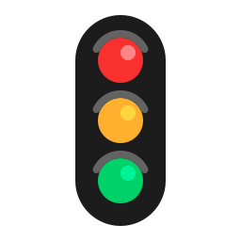







FIRST Sight: How It Works
Five steps check every file on day one; written rules then send each case down the lightest safe lane
S.I.G.H.T.: FIVE STEPS FROM PAPERS TO SIGN-OFF
S · Source
I · Inspect
G · Grade
H · Human check
T · Track
Every paper listed on day one; customer asked once, on WhatsApp
Papers checked against each other, land records, maps and sale prices
Written bank rules pick Sight 24, 72 or Full and explain why
Live video or a visit, then a valuer signs a pre-filled report
One-page Collateral Card; property watched after the loan
THREE LANES: VISIT ONLY AS MUCH AS RISK NEEDS
THE GOLDEN RULE
Sight 24
Clean file, loan up to ₹1 Cr and 50% of value: 30-minute live video
AI reads
35% · ≈₹1,300
Turns each paper into facts, quoting the exact words
Sight 72
1-2 minor issues or a ₹1-5 Cr loan: short visit for those items only
35% · ≈₹2,500
Rules decide
18 checks, lane, value maths and Sight Score, in plain code
Sight Full
Serious issue, over ₹5 Cr or special property: full visit, papers pre-checked
30% · ≈₹5,100
A valuer signs
Lane share and cost are estimates. 1 in 10 Sight 24 cases also gets a full visit, so the fast lane is proven safe
Sets the rates, explains any change, signs every case
AI reads, rules decide, a qualified valuer signs: speed comes from checking papers first, not cutting checks

Slide 6
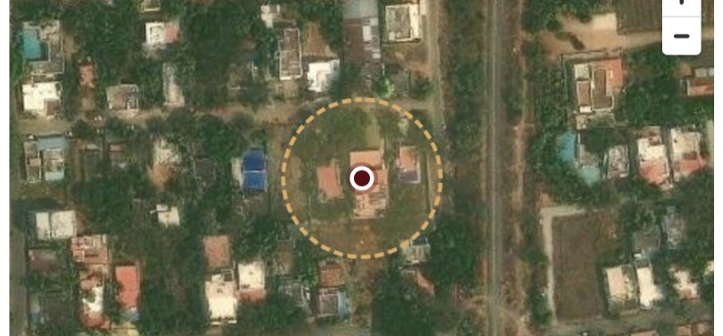
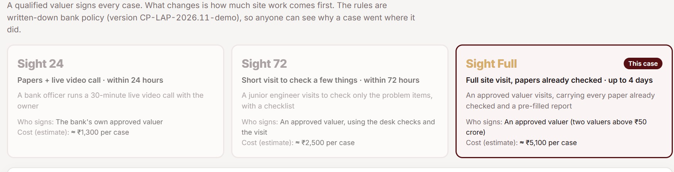
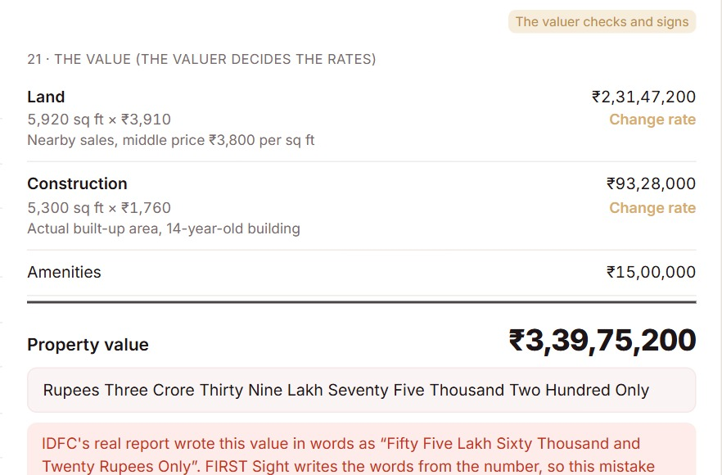
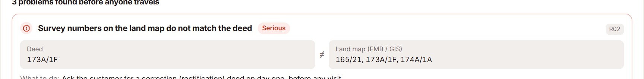
Worked Example: IDFC's Report 3
In our working prototype, the Coimbatore file shows every problem on day one, not weeks after the visit
1 · DAY 0: MISMATCH FOUND
2 · SAME DAY: LANE CHOSEN
3 · VALUER SIGNS
Sight Full, as one serious problem exists; the rectification deed is requested on day one
Live at first-sight-fame.vercel.app; land-record and CERSAI links are simulated
Real property; 30 m video-inspection ring
Words generated from the number
TODAY VS WITH FIRST SIGHT
PROOF IT WORKS (MEASURED)
Today
With FIRST Sight
69 / 69
31 / 31
0
Survey mismatch
Seen only in the final report
Flagged on day 0
issues caught
report errors
false alarms
Value in words
₹3.40 Cr written as ₹55.6 lakh
Written from the number
42-160 s
< 1
31
Quick-sale value
85%, overstating by ₹17 lakh
Bank's 80% rule applied
per report
US cent each
tests passing
The problems IDFC's valuer found late are caught on day one, and the report mistakes cannot happen

Slide 7



People Stay in Control
The tool drafts and flags while people make every call, and each role gains time and visibility
EVERY ROLE GAINS, NO ROLE LOSES CONTROL
ADOPTION IN FOUR STEPS
Customer
Sales RM
Second Sight checks agency reports; no job changes
Asked once on WhatsApp; a 30-minute video, not a wait
Sees missing papers and the lane on day one
Shadow mode: the system suggests, people decide
Controls: When and how the inspection happens
Controls: The customer promise and date
Pilot champions in two cities train their peers
Valuer
Credit officer
Lanes switch on only after the risk gate is passed
Checks a pre-filled form instead of typing 13 pages
Reads a one-page Collateral Card with sources
Controls: Every rate, override and signature
Controls: The credit decision, as today
NO HUMAN BOTTLENECK
Risk team
Valuation agency
Each lane has an SLA clock and a named owner
Unsure AI readings go to a person, with the source shown
Any flag can be overridden with a written reason
Sees why each lane was chosen; audits 1 in 10
Keeps complex work; paid per lane, speed bonus
Controls: The rules, and when lanes switch on
Controls: Its own panel performance score
FIRST Sight is a co-pilot: it removes typing and chasing, while every judgement stays with a named person

Slide 8



Pilot First, Then Scale
A 1,000-case shadow pilot proves safety before any visit is cut; the build pays back in about 20 months
ROLLOUT IN FIVE PHASES, EACH WITH A GATE
0 Discover
Months 0-2
1 Build
Months 3-5
2 Shadow pilot
Months 6-8
3 Live pilot
Months 9-12
4 Scale
Months 13-24
Board approves lanes, shadow mode only
Security audit and AI check passed
60%+ fields auto-filled, zero serious misses
Value errors and defaults no worse than today
Quarterly risk-committee review
HOW THE SHADOW PILOT WORKS
BUSINESS CASE (ESTIMATES)
1
1,000 LAP cases in Dehradun and Coimbatore, the cities in IDFC's sample reports
Cost per check
Today: ₹5,500
₹2,860
with FIRST Sight
2
Both run side by side: today's process decides, FIRST Sight only recommends
Days to clear
Today: 7 days
2.6 days
with FIRST Sight
3
Measure fields auto-filled, problems caught, value gaps and days to clear
₹9.0 Cr
₹7.7 Cr
₹8 Cr
≈20 mo
saving a year
extra interest
to build
payback
4
Quick win on day one: Second Sight checks every agency report, no integration
Assumes 34,200 checks a year, lane mix 35/35/30; at 20% Sight 24, savings still top ₹7 Cr
Nothing changes for customers or credit until the pilot proves the fast lanes are as safe as today

Slide 9


Risks, Owners and Governance
Every risk has a named owner and a stop rule, and the Head of Mortgages sponsors the programme
RISK REGISTER
WHO RUNS IT
Risk
Level
How we control it
Owner
Sponsor
Owner shows a different house on video
High
Geofence, random prompts, GPS stamps, meter vs bill, 1-in-10 visits
Technical services
Head of Mortgages: business case, adoption
AI misreads a deed or plan
Medium
Exact-words proof; unsure readings go to a person; rules decide
Model risk team
Steering committee
A fast-lane loan goes bad
Sight 24 capped at 50% of value; defaults tracked vs a control group
Chief Risk Officer
CRO, CTO, Compliance, Ops; approves gates
Medium
Regulator questions the lanes
Medium
Valuer signs every case; Board-approved policy; video-KYC rules
Compliance
Day-to-day owners
Credit Policy: rules, lanes
Model Risk: AI checks
Tech services: video, valuers
CISO: security
DPO: privacy
Audit: 1-in-10 visits
Land data missing or a portal down
Low
Missing data moves the case to a slower lane; nothing is guessed
Operations
Valuers and agencies resist
Medium
Per-lane pay, speed bonus; agencies keep complex, high-value work
Head of Mortgages
Customer data misused
Low
Consent at upload, India-only data, names hidden, short retention
Data Protection Officer
Stop rule: the fast lane pauses if defaults or value gaps exceed the control group
Clear owners, one sponsor and automatic stop rules keep the programme safe from pilot to scale

