Slide 1

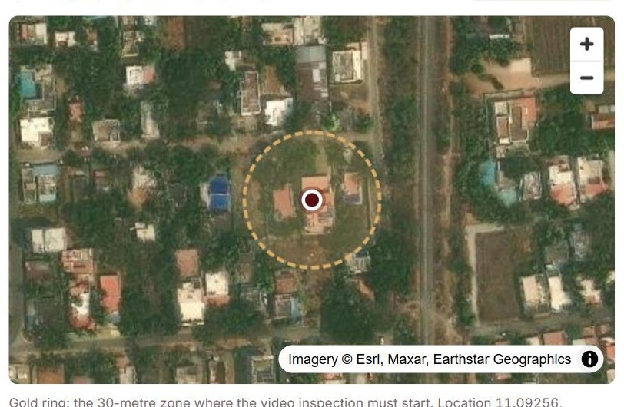

FIRST Sight
7 → 2.6 days
to clear a property (est.)
Check the property file before anyone travels
₹5,500 → ₹2,860
Problem Statement 1 · Digital property valuation for LAP
per property check (est.)
Live: first-sight-fame.vercel.app
≈ 20 months
IDFC Report 3 property
TEAM NAME · Member 1 · Member 2 · Member 3
with its 30 m video ring
Live prototype
to pay back the ₹8 Cr build
scan to try it

Slide 2















FIRST Sight: LAP Property Checks in 2.6 Days, Not 7
The delay is in paperwork, not visits: we check each file on day one and visit only where risk needs it
HOW 100 LAP FILES FLOW THROUGH FIRST SIGHT
Day 1 · S.I.G.H.T.
Sight 24 · 35 files · 24 h
Valuer signs
Source: ask papers once
≈₹1,300 · 30-min live video
Approved panel valuer on every file (RBI 70.2); conflicts blocked
100
Inspect: 20 checks run
Sight 72 · 35 files · 72 h
LAP files
≈₹2,500 · visit flagged items only
arrive
Grade: rules pick a lane
Sight Full · 30 files · ≤ 4 days
→ 1-page Collateral Card to credit
≈₹5,100 · full visit, pre-checked
Only 30 of 100 files need a full visit; 70 clear in 72 hours or less, and every file still ends with a valuer's signature
PROVEN IN TESTS
WHAT IDFC GAINS (ESTIMATES)
WHY IT IS SAFE
THE ASK
69/69
31/31
0
Cost / check
₹5,500
₹2,860
Panel valuer signs every file
Scan to try the live prototype
Days to clear
7 days
2.6 days
One switch turns the AI off
property problems
report errors
false alarms
Sight 24: 4+ nearby sales, ±15%
Credit reads
13 pages
1 page
1
1,000-file shadow pilot
100 hidden mistakes of 17 kinds, planted in 64 files the tool had never seen
Full visits
1 in 10 fast files fully visited
100%
30%
Second Sight from day 1
Video borrows RBI V-CIP controls
2
64 blind files · Nov 2026
₹9.0 Cr cost saved + ₹7.7 Cr interest
Faster, with no control removed
No visit is cut before proof
Sources: IDFC FAME 6.0 case pack; FIRST Sight tests on 10 Nov 2026; RBI CRM Directions 2025, Ch IX. All money figures are estimates.
7 days and ₹5,500 per check → 2.6 days and ₹2,860, with an approved, independent valuer still signing every file

Slide 3
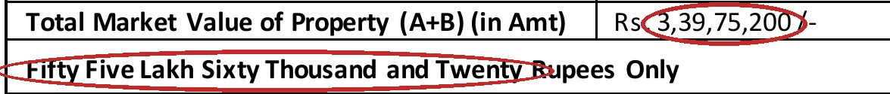











The Delay and the Risk Hide in the Paperwork
IDFC's own 3 reports: the visit takes a day, while papers that disagree surface late and get typed wrong
IDFC REPORT 3: ERRORS THAT REACHED A SIGNED REPORT
WHERE THE DAYS GO: REPORT 1
Value in words: ₹55.6 lakh for a ₹3.40 Cr house, a ₹2.84 Cr gap
Site visit
1 day · 25 May
1
Paperwork
9 days: write, check, sign
The visit is not the delay; the paperwork is
Quick-sale value at 85%; IDFC's other agency uses 80%: ₹17 lakh too high
2
FIVE INSIGHTS → DESIGN CHOICES
Time lost after the visit → pre-fill first
Two visit dates in one signed report: 7 Aug vs 4 Jul
Report is mostly desk work → automate look-ups
3
Risk = papers that disagree → check each pair
Typing creates errors → generate the words
Each error passed the agency's own checks and reached IDFC signed
Agencies differ (80% vs 85%) → one bank rule
ALL 3 SAMPLE REPORTS, FIELD BY FIELD
Each choice fixes a cause seen in the reports
Report →
1 · Dehradun house
2 · Dehradun shop
3 · Coimbatore house
SECONDARY RESEARCH
Value
₹3.19 Cr (land only)
₹20.11 Cr
₹3.40 Cr
RBI CRM 2025 paras 70-73: no visit-per-case rule
Size
15% over approved plan
82% over approved plan
No approved plan given
LAP = 11% of IDFC's ₹3,46,913 Cr loans (Q2 FY27)
Mismatch
282 sq ft to road widening
Plot 5,192 vs 4,139 sq ft
1 survey no. vs 3 on map
Mortgages +8.7% YoY vs retail +35.4% (Q2 FY27)
99.9% land records online; ULI live in 8 states
Error
Plan no., govt rate blank
Govt rate left blank
3 errors (shown above)
Waiting costs ≈₹7.7 Cr interest a year (est.)
None of these mismatches needed a site visit to find
Rules allow it, data exists, and mortgages lag
Sources: IDFC sample reports 1-3; IDFC FIRST Q2 FY27 investor presentation; DoLR DILRMP (Aug 2026); RBI Trend and Progress Report (Dec 2025).
1 day of visit + 9 days of paperwork → fix the paperwork, and both the delay and the risk fall

Slide 4






Lenders Abroad Already Visit Only When Needed
The USA, Australia and UK check first and visit by risk; in India no one decides, so IDFC can be first
WHAT LENDERS ABROAD ALREADY DO, AND WHAT WE TOOK
US
16-17%
AU
12% → 21%
UK
3 steps
IN
1 ID
USA · Fannie Mae, Freddie Mac
Australia · Cotality, big banks
UK · Hometrack and lenders
India · Valocity, AdvaRisk
of agency mortgages skipped the full appraisal (mid-2025)
share of desktop and kerbside valuations
automated value, desktop check, visit only if needed
per property across lenders; instant ownership check
Took: Sight 24 and Sight 72
Took: evidence-strength grade
Took: 3 lanes set on day 1
Took: rule R20, owner history
Every piece already works somewhere; FIRST Sight is the first to put them in one day-1 flow for an Indian bank
WHAT EXISTS IN INDIA VS FIRST SIGHT
WHY THE GAP EXISTS
Valocity
valuer app
AdvaRisk
data APIs
VideoCX
video KYC
FIRST
Sight
Agencies are paid per visit
their tools speed visits up but never remove one
Reads and cross-checks every paper
Data firms sell facts
Decides how much visit a file needs
Live video check with random prompts
the visit level is credit policy only a bank sets
Blocks a conflicted or unapproved valuer
Land data is newly usable
Finds the same property across loans
records online and on ULI enable a desk check
Pre-fills IDFC's own report form
First-mover path
Checks every agency's report
Watches the property after the loan
day 1 Second Sight → month 9 Board-set lanes
We plug their best ideas in (property ID, ownership check) rather than fight them
The decision is policy; only IDFC can own it
Sources: Fannie Mae value acceptance; Cotality (CoreLogic) Australia; Hometrack UK; Valocity, AdvaRisk, VideoCX, Biz2X websites (Nov 2026).
Abroad, check-first is normal; in India no one decides the visit level → IDFC can be first and own the rules

Slide 5






How FIRST Sight Picks the Visit: 20 Checks, 2 Questions
AI reads, written rules pick the lane, a panel valuer signs: the same file always gets the same answer
HOW THE LANE IS PICKED
THE 20 PROPERTY CHECKS (RED = SERIOUS)
Q1 · Serious flag? Loan > ₹5 Cr? Value ≥ ₹50 Cr? Special building? Papers < 70%?
Sight Full · ≤ 4 days · ≈₹5,100
Area, building
Title, papers
Value
Risk, life
yes
Full visit, papers checked first; 2 reports at ₹50 Cr+ (RBI 70.3)
R01 Plot area
R02 Survey no.
R12 Near sales
R10 New sale
no
R03 Pin offset
R05 No plan
R16 LTV limit
R13 Flooding
Q2 · Smaller flag? Loan ₹1-5 Cr? Papers < 90%? LTV > 50%? Sales evidence not strong?
yes
Sight 72 · ≤ 72 h · ≈₹2,500
R04 Over plan
R06 No layout
R17 Big jump
R14 Expiring
Engineer visits flagged items only; panel valuer signs
R07 Widening
R08 CERSAI
R18 Govt rate
R15 Life left
no
No to both questions: a clean, well-evidenced file
Sight 24 · ≤ 24 h · ≈₹1,300
R11 Floors
R09 Owner
R19 2 reports
30-min live video; 4+ nearby sales within 15%; panel valuer signs
R20 2nd loan
Missing data never speeds a file up · 1 in 10 fast files fully visited
New: R19 (RBI para 70.3), R20 (fraud)
ARCHITECTURE: HOSTED IN MUMBAI
Customer app
Consent
AI reader
Data feeds
Rules engine
Valuer app
Credit + LOS
papers once on WhatsApp; live photos
consent first; Aadhaar, PAN, phone masked
reads papers; never decides a lane
ULI land records, CERSAI, GIS maps
20 written checks pick the lane
pre-filled form; panel valuer signs
1-page Collateral Card with sources
Consent before AI · Aadhaar, PAN, phone masked · data in Mumbai · AI off switch keeps rules, video and sign-off running
Day 1: 20 checks → 2 questions → 1 lane, with masked data, an AI off switch and a panel valuer on every file

Slide 6

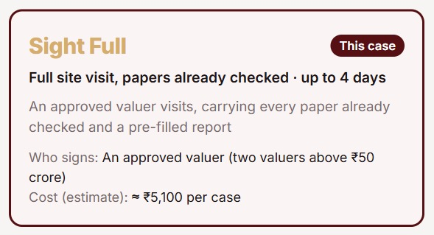
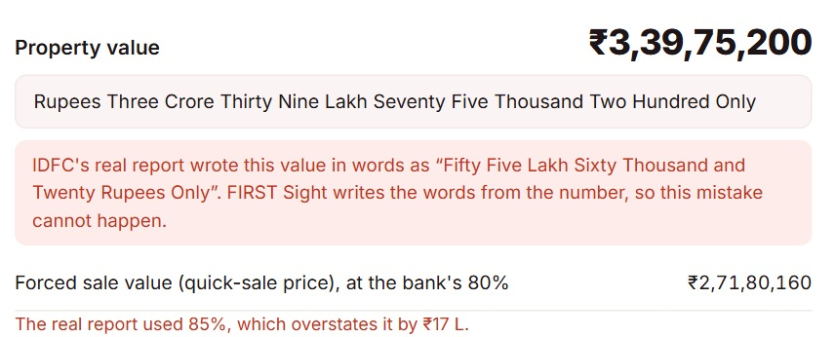
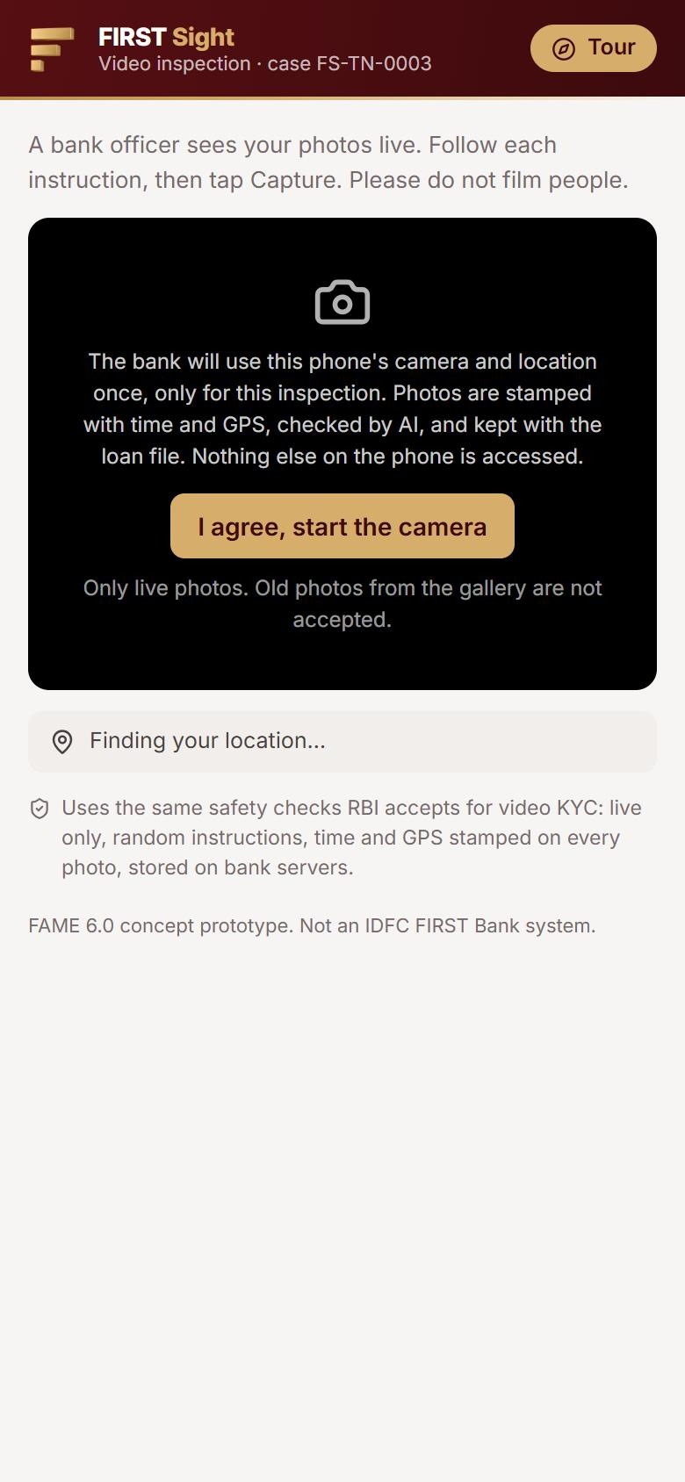

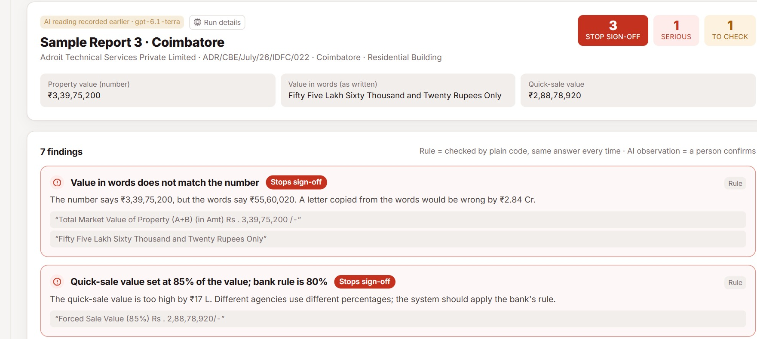





Report 3 Replayed: Every Problem Found on Day One
In our live app, Report 3's problems show on day one, typed errors are blocked and a fraud file is stopped
How to read: the top 3 panels follow IDFC's real Report 3 (₹3.40 Cr) through steps I, G and H; the bottom row shows the 2 features no rival has, plus a fraud test
Try it live
I · INSPECT: DEED VS LAND MAP
G · GRADE: LANE AND SCORE
H · SAME FIELDS, BEFORE AND AFTER
Deed lists 1 survey number (173A/1F); the land map puts the house over 3 → rule R02, serious
IDFC report today
FIRST Sight writes it
Score 55 = 100 − 22 serious − 14 smaller − 8 papers − 1 price
IDFC's valuer caught it only at the end
Rectification deed asked for on day 1
Words from the figure; 80% rule: ₹17 lakh fixed
V-PIP: VIDEO FROM OWNER'S PHONE
SECOND SIGHT: AGENCY REPORTS
SYNTHETIC FRAUD FILE (CASE 6)
Officer's QR opens the video
Owner name differs on the electricity bill
Live photos only; fakes flagged
Another lender's live loan (CERSAI)
Sold 41 days ago at 37% above nearby
GPS and time on every photo
Same house applied for at Kanpur (R20)
Meter read by AI in 5.6 s
Seller's valuer blocked at sign-off
Report 3: 3 sign-off stops, 1 serious; needs no bank system, so it can start day 1
Result: Sight Score 7 → Sight Full, stopped before anyone travels
Borrows RBI V-CIP controls
Problems found weeks after the visit → found on day 0, with typing errors blocked and a fraud file stopped at sign-off

Slide 7


A Shadow Pilot Proves Safety, Then It Pays Back
1,000 files run side by side, lanes go live only after each gate, and the ₹8 Cr build pays back by month 20
ROLLOUT, GATES AND CUMULATIVE CASH
0 Discover M0-2
1 Build M3-5
2 Shadow pilot M6-8
3 Live pilot M9-12
4 Scale M13-24
Gate: Board approves lanes, shadow only
Gate: security audit, AI check passed
Gate: 60%+ auto-filled, 0 misses, AI ≥ 98%
Gate: errors, defaults no worse than today
Gate: quarterly risk-committee review
Cumulative cash, ₹ Cr (estimate) · low point −₹8 Cr at month 8
+₹18 Cr by month 36
₹0
Payback ≈ month 20
M0
M6
M12
M18
M24
M30
M36
PEOPLE STAY IN CHARGE
BUILD COST (EST.)
GAIN, ₹ CR, IF 1 INPUT MOVES
Role
What changes for them
Still decides
₹4.5
₹1.5
₹1
₹1
Kept: 1-3 pts
12.9-20.6
Customer
asked once; consents once; can ask for a person
video timing
Checks: 25-45k
14.3-19.6
Product and tech team: ₹4.5 Cr
Valuer
must be on the approved panel and declare independence
the value; signs
ULI, CERSAI, LOS links: ₹1.5 Cr
Fee: ₹3-5k
14.3-19.1
AI, cloud, security: ₹1.0 Cr
Credit officer
reads a 1-page Collateral Card with sources
credit decision
Training, change: ₹1.0 Cr
Sight 24: 20-50%
14.8-18.2
Valuation agency
per-lane fee plus speed bonus; keeps complex work
cases it takes
Run: ₹2.5 Cr a year
Margin: 3-4%
15.6-17.8
Not counted: fraud avoided, home-loan reuse, post-loan alerts
KPIs: 60%+ fields accepted · < 20% overrides · sign-off < 1 day
Base ₹16.7 Cr a year
Sources: Team model: 34,200 checks a year; ₹4,000 fee + ₹1,500 staff time today; mix 35/35/30; 2-pt drop-off; 3.5% margin. All estimates.
₹8 Cr build → ₹16.7 Cr a year at full scale, and nothing changes for customers or credit until the pilot proves it

Slide 8



Every Risk Has an Owner; Every Rule Has a Control
9 risks drop after controls, every RBI and privacy rule maps to a control, and we name our offshore-AI gap
RISK HEAT MAP: BEFORE → AFTER
RISK REGISTER (RISK 8 IS OUR ONE OPEN GAP)
Before controls
After controls
Risk
Level
How we control it
Owner
3
7
1
4
3
4
1
Wrong house shown
High
Geofence, random prompts, meter
Tech services
9
2
AI misreads a deed or plan
Med
Exact-words proof; unsure → a person
Model risk team
Impact →
2
6
8
1
7
3
A fast-lane loan goes bad
Med
LTV ≤ 50%; 1 in 10 fully visited
Chief Risk Officer
8
9
4
Regulator questions lanes
Med
Panel valuer signs; Board lane policy
Compliance
5
2
6
5
5
Land data missing
Low
Gaps send the file to a slower lane
Operations
6
Agencies push back
Med
Per-lane fee plus speed bonus
Head of Mortgages
Likelihood →
Likelihood →
7
Customer data misused
Med
Aadhaar, PAN, phone masked before AI
Privacy (DPO)
8
AI provider is offshore
High
Masked text now; India host by pilot
CTO + DPO
No risk stays in a red zone after controls
9
Valuer collusion, conflict
High
Panel, independence check; 1-in-10 audit
Credit Policy
REGULATORY FIT: RULE BY RULE
GOVERNANCE
Rule
What FIRST Sight does
Status
Sponsor: Head of Mortgages
RBI CRM 2025 · para 70.2
Only approved, independent panel valuers sign
Built
business case and adoption
RBI CRM 2025 · para 70.3
2 reports at ₹50 Cr+, lower value used (R19)
Built
Steering: CRO, CTO, Compliance, Ops
Ch X + SARFAESI s.23
CERSAI search day 1; filed within 30 days
Built, sim.
approves every gate
Digital Lending Dir. 2025
Consent first; numbers masked; data in Mumbai
Built
Owners: Credit Policy, Model Risk, Tech
Digital Lending · offshore
India-hosted model or 24-hour deletion
At pilot
plus Audit for 1-in-10 full visits
DPDP Act + Rules 2025
Notice, purpose-bound consent, person review
Built
Stop rule: the fast lane pauses if defaults or value gaps beat the control group
RBI FREE-AI 2025
Rules decide; AI off switch; disclosed; blind test
Built
Sources: RBI CRM Directions 2025 (RBI/DOR/2025-26/157) Ch IX-X; SARFAESI s.23; Digital Lending Directions 2025; DPDP Rules 2025; FREE-AI 2025.
9 risks before controls → all lower after, with one sponsor, named owners and a fast lane that pauses itself

Slide 9

Appendix A1: The Evidence Behind Every Number
How each claim was measured, the 3-year numbers and their assumptions, and what only a pilot can prove
BLIND TEST ON FILES THE TOOL NEVER SAW
FIRST THREE YEARS, ₹ CR (ESTIMATES)
Checks on
Files
Planted
Caught
False alarms
₹ Cr
Year 1
Year 2
Year 3
Property
40 (8 clean)
69 · 11 kinds
69
0
Money saved
2.26
6.77
9.03
Reports
24 (IDFC-based)
31 · 6 kinds
31
0
Extra interest earned
1.93
5.78
7.70
Run 10 Nov 2026 · plus 36 automated tests
Running cost
−2.50
−2.50
−2.50
LIVE AI ON IDFC'S REAL REPORTS
Net gain
1.68
10.05
14.23
Total so far, after ₹8 Cr build
−6.32
3.73
17.96
Run
Time
AI cost
Result
Rolled out 25% · 75% · 100%; cash turns positive in year 2
Report 1
42 s
$0.0046
same findings, 0 missed, 0 extra
Report 2
160 s
$0.0041
same findings, 0 missed, 0 extra
ASSUMPTIONS REGISTER, BY SENSITIVITY
Report 3
55 s
$0.0054
all 3 sign-off stops found
Assumption
Base
Tested
Gain, ₹ Cr/yr
Swing
V-PIP photo
5.6 s
$0.0001
flagged a screen photo
Customers kept
2 pts
1-3 pts
12.9-20.6
High
Under ₹1 of AI cost per report, measured 10 Nov 2026
Checks a year
34,200
25k-45k
14.3-19.6
High
WHAT IS NOT PROVEN YET
Agency fee
₹4,000
₹3k-5k
14.3-19.1
Med
AI on messy Hindi, Tamil scans → answer-key test pack next
Sight 24 share
35%
20-50%
14.8-18.2
Med
Real lane mix, customers kept → only IDFC's own files show it
ULI, CERSAI links simulated → connected in Build (M3-5)
Interest margin
3.5%
3-4%
15.6-17.8
Low
We name the gaps; the shadow pilot closes them
Worst single case still ₹12.9 Cr a year
Sources: FIRST Sight blind test and live AI runs, 10 Nov 2026; app business-case model (rollout 25% · 75% · 100%). Money figures are estimates.
Measured: 100 of 100 caught, 3 reports read in < 3 min → estimated: ₹18 Cr ahead by year 3

Slide 10
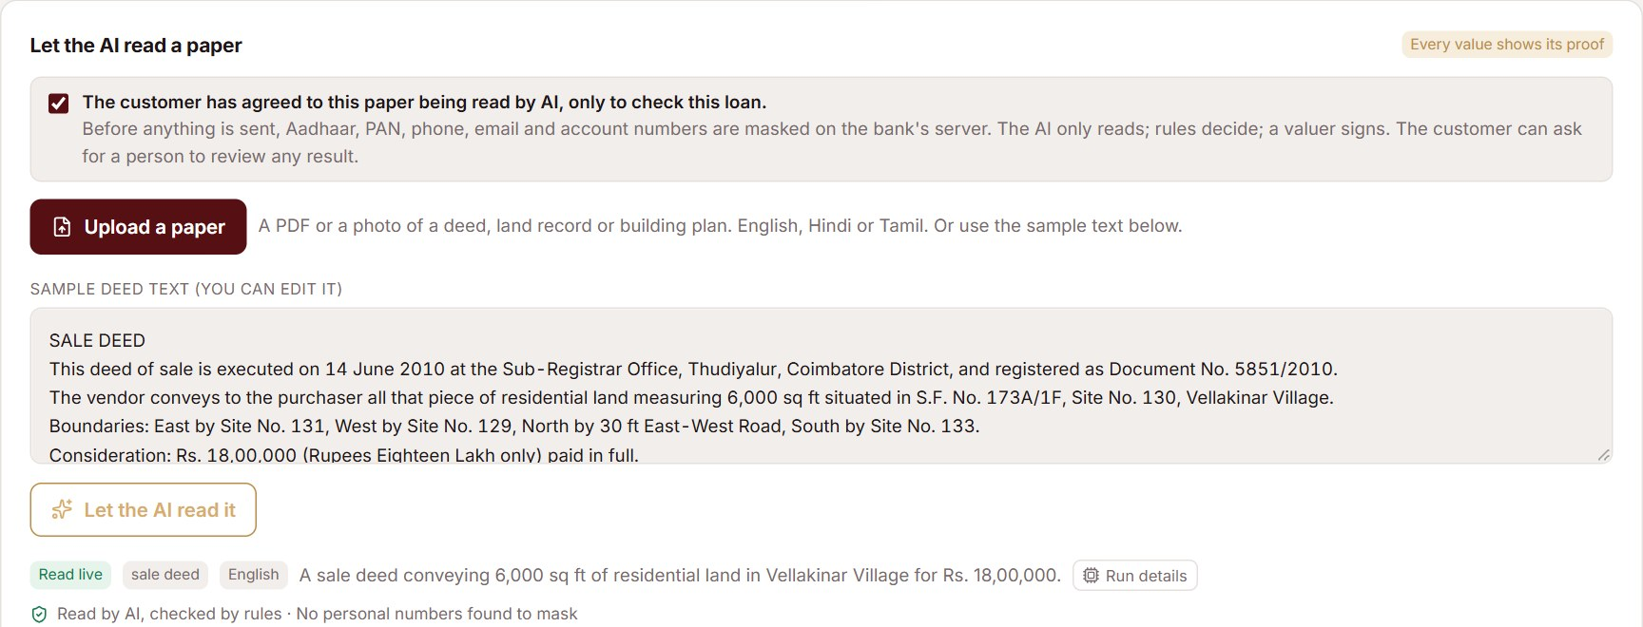
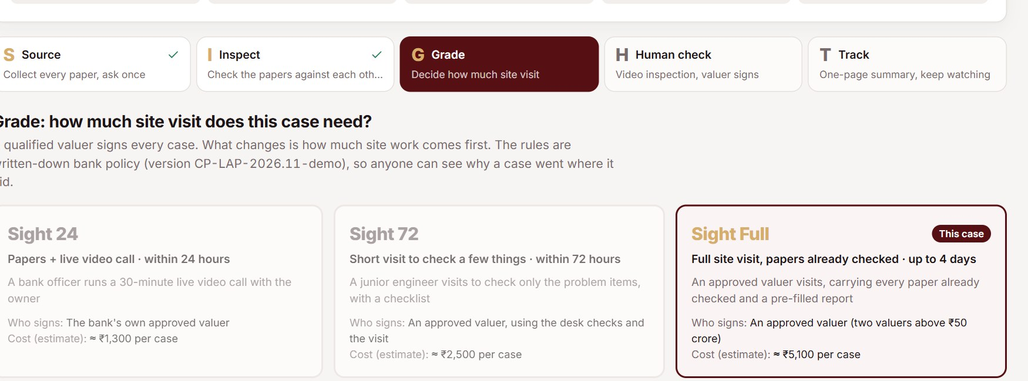
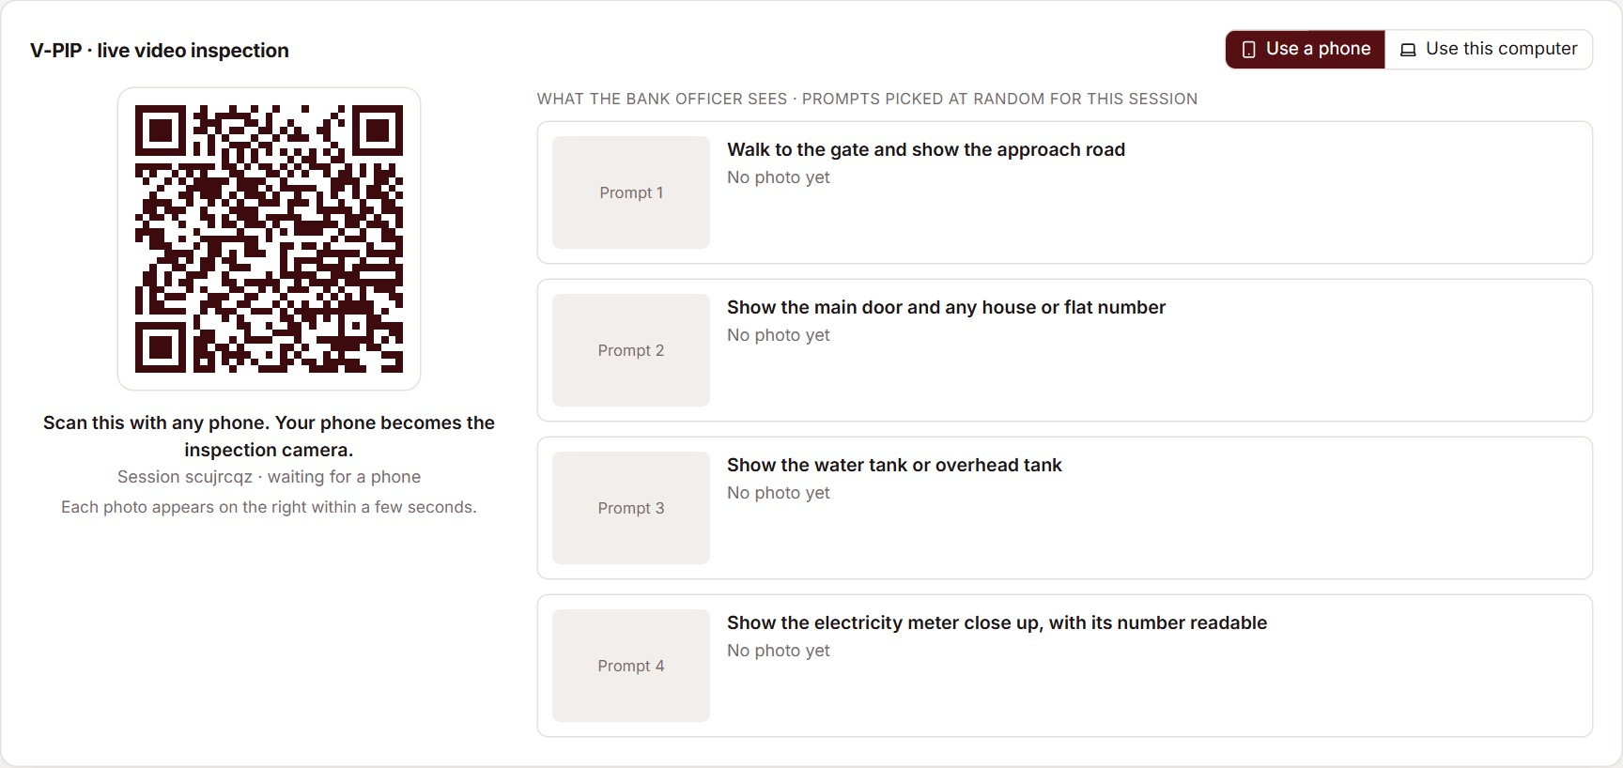
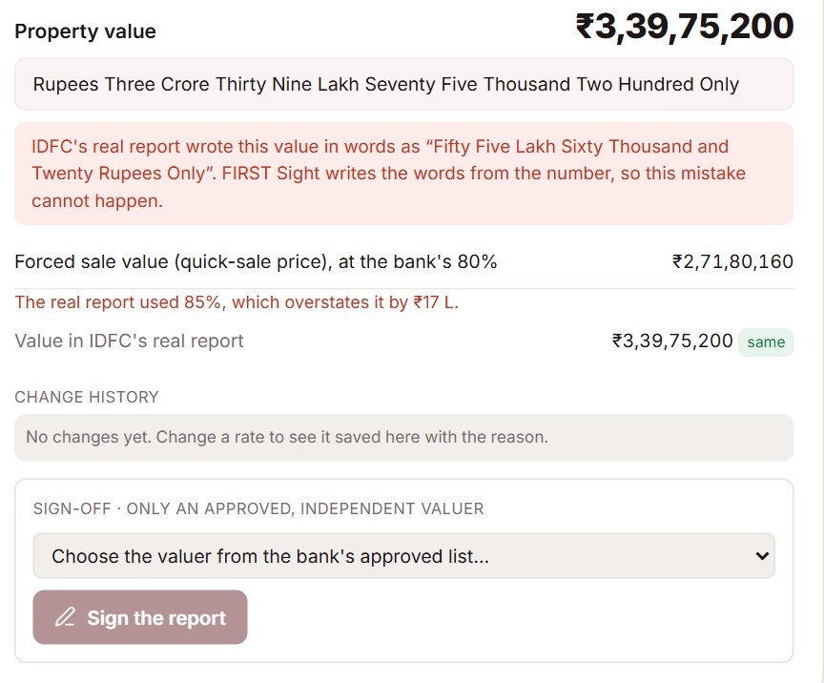
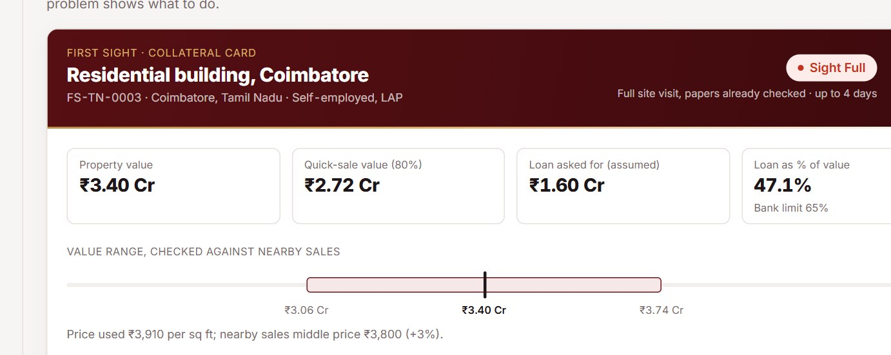
Appendix A2: The Live Prototype, Step by Step
Scan the code and the guided tour runs a real IDFC case from first paper to signed Collateral Card
TRY IT LIVE
1 · CONSENT, THEN AI READS
2 · RULES PICK THE LANE
3 · V-PIP VIDEO CHECK
first-sight-fame.vercel.app
Simulated: ULI, CERSAI, panel list
Consent first; numbers masked; every value shows its proof
Report 3 → Sight Full, with the reason and the Sight Score
Owner's phone is the camera; officer sees GPS, time, prompts
Works on any phone, no login
REFERENCES
4 · PANEL VALUER SIGNS
5 · COLLATERAL CARD
6 · SECOND SIGHT
1. RBI CRM Directions 2025
2. RBI Digital Lending Dir. 2025
3. RBI FREE-AI Framework 2025
4. DPDP Act 2023, Rules 2025
5. SARFAESI s.23 (CERSAI)
6. Fannie Mae value acceptance
7. Cotality (CoreLogic) AU
8. Hometrack UK; PwC AVM 2026
9. IDFC Q2 FY27 deck; DILRMP
Words come from the figure; only approved valuers sign
Value range checked against nearby sales, for credit
Any agency report checked; 3 sign-off stops on Report 3
Full links: solution document
Sources: Screens captured 10 Nov 2026 from first-sight-fame.vercel.app (hosted in Mumbai). Bank systems are simulated; customer names are made up.
A 13-page typed report → 6 checked steps and a 1-page Collateral Card, live today at first-sight-fame.vercel.app

