Slide 1




FIRST Sight: Check the Property File Before Anyone Travels
Problem Statement 1 · Digital property valuation for Loan Against Property · Live: first-sight-fame.vercel.app
Photo
Photo
Photo
Photo
Member 1
Member 2
Member 3
Member 4
Try it live
Team NAME

Slide 2














FIRST SIGHT - DIGITAL PROPERTY CHECKS FOR LAP
From a 7-day, ₹5,500 visit for every file to a day-1 check, 3 risk lanes and a panel valuer's signature
THE PROBLEM
THE STRATEGY
THE OUTCOME
7 days | ₹5,500
4 Pillars | 3 Lanes
2.6 days | ₹2,860
per check | 3 of 3 IDFC reports hid a mismatch
day-1 check → visit by risk → valuer signs
₹16.7 Cr a year (est.) | payback ≈ 20 months
THE PROBLEM - FOUR NUMBERS THAT DEMAND ACTION
THREE PHASES - FROM SHADOW TO SCALE
7 days
9 days
3 of 3
₹7.7 Cr
PHASE 1 - PROVE
PHASE 2 - GO LIVE
PHASE 3 - SCALE
to clear today
of paperwork
reports wrong
interest lost
Months 0-8
Months 9-12
Months 13-24
The visit takes a day; the paperwork and its errors take the rest
1,000-file shadow pilot
Lanes live in 2 cities
All LAP + home loans
Proof built ✓
Speed proven ✓
Payback ≈ M20 ✓
THE BLUEPRINT - 4 PILLARS + 1 SIGNATURE
Each phase proves the next | No phase is skipped
Day-1 check
3 lanes
Video, valuer
Second Sight
FINANCIAL TRANSFORMATION - TODAY TO FULL SCALE
20 checks, day 1
35/35/30 by risk
1-page card
any agency report
₹5,500
₹2,860
7
2.6
100%
30%
13
1
Approved panel valuer signs every file → 1-page Collateral Card
COST / CHECK
DAYS
FULL VISITS
PAGES READ
Pillars 1 and 4 start in month 1; lanes wait for the pilot
₹9.0 Cr saved + ₹7.7 Cr interest = ₹16.7 Cr a year (est.)
THREE ADVANTAGES NO COMPETITOR CAN REPLICATE
SIX MILESTONE GATES - PROOF AT EVERY STAGE
IDFC's own 3 reports, replayed live
Proof on the bank's own paper
BOARD
BUILT
PROVEN
LIVE
PAYBACK
SCALED
Only tool that sets the visit level
Visit level is bank policy
M2
M5
M8
M12
M20
M24
Live app today, hosted in Mumbai
Pilot-ready, not a concept
Policy ok
Audit ok
0 misses
Risk flat
Cash ≥ ₹0
All LAP
Each one is built and working today
Miss a gate and the steering committee reviews
Sources: IDFC FAME 6.0 case pack; FIRST Sight tests, 10 Nov 2026; RBI CRM Directions 2025. Money figures are estimates.
4 pillars | 3 lanes | 1 signature: 7 days and ₹5,500 → 2.6 days and ₹2,860 per check, payback ≈ 20 months

Slide 3




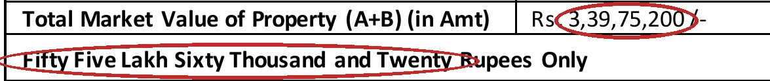


PILLAR 1: DAY-1 CHECK - EVERY PAPER CROSS-CHECKED FIRST
Objective: check every LAP file 20 ways on day 1, so errors like Report 3's surface before anyone travels
THE PROBLEM
WHY THIS APPROACH
EXPECTED OUTCOMES
OPERATIONAL TIMELINE - 12 MONTHS
3 of 3
1 vs 9 days
100/100
20 rules signed ✓
AI ≥ 98% ✓
reports hid a mismatch found only after the visit
the visit takes 1 day; the paperwork takes 9
mistakes caught in 64 blind files · 0 false alarms
Rules from IDFC
ULI, CERSAI links
Shadow: 1,000 files
Every new file
M0-2
M3-5
M6-8
M9-12
S.I.G.H.T. ON DAY 1 - 4 STEPS, 20 CHECKS
Month 9: every new LAP file checked on day 1
SOURCE
Day 0
Papers
KEY RISKS & MITIGATIONS
Papers asked once; consent first; ID numbers masked
Asked once
AI misreads
Land data gap
INSPECT
Day 0
Per report
Unsure → a person
Gap → slower lane
AI reads deed, plan and tax receipt, each value with proof
< 3 min, < ₹1
Hindi, Tamil
Data misuse
CHECK
Day 0-1
Blind test
Answer-key test
Masked before AI
20 rules compare papers, land map, CERSAI, nearby sales
100/100 caught
Every control is built and testable today
FLAG
Day 1
Report 3
KPIs & STRATEGIC IMPACT
Each flag names the 2 papers that disagree and the fix
Survey gap found
Day 1: every paper read, cross-checked and flagged with its proof
SUCCESS KPIs
WHY THIS MATTERS?
IDFC'S REPORT 3 - 3 ERRORS, ALL SIGNED, ALL FOUND ON DAY 1
≥ 98%
60%+
3 of 3
fixed day 1
AI accuracy
auto-filled
₹17 lakh
over-value
1
₹55.6 lakh in words for a ₹3.40 Cr house
0
Day 1
2
Quick-sale 85%, not 80%: ₹17 lakh high
misses
flags found
₹2.84 Cr
gap caught
3
2 visit dates: 7 Aug vs 4 Jul
Each error passed the agency's own checks; FIRST Sight flags all 3 on day 1
Errors are caught before money moves
Sources: IDFC sample reports 1-3; FIRST Sight blind test and live AI runs, 10 Nov 2026; DoLR DILRMP (Aug 2026).
Problems found weeks after the visit → found on day 1, before anyone travels (100 of 100 in blind tests)

Slide 4




PILLAR 2: THREE LANES - VISIT ONLY WHERE RISK NEEDS IT
Objective: send 70 of 100 files through a 24- or 72-hour lane by 2 written rules, a panel valuer signing each
THE PROBLEM
WHY THIS APPROACH
EXPECTED OUTCOMES
OPERATIONAL TIMELINE - 12 MONTHS
100%
2 questions
2.6 days
Board approves ✓
0 misses ✓
of files get one full visit, whatever the risk
written rules: same file, same lane, every time
not 7, at ≈₹2,860 a check, not ₹5,500 (est.)
Board lane policy
Rules engine
Lanes in shadow
Sight 24, 72 live
M0-2
M3-5
M6-8
M9-12
3 LANES - SET ON DAY 1 BY 2 WRITTEN QUESTIONS
Month 12: 70 of 100 files clear in 72 h or less
SIGHT 24
≤ 24 h
35 of 100 files
KEY RISKS & MITIGATIONS
No flag, LTV ≤ 50%, 4+ sales within 15%: live video
≈₹1,300
Fast loan fails
Regulator query
SIGHT 72
≤ 72 h
35 of 100 files
LTV ≤ 50%; audits
Panel valuer signs
Smaller flag or loan ₹1-5 Cr: engineer visits flags only
≈₹2,500
Wrong lane
Agency pushback
SIGHT FULL
≤ 4 days
30 of 100 files
Rules versioned
Per-lane fee, bonus
Serious flag, loan > ₹5 Cr, ₹50 Cr+ (2 reports, RBI 70.3)
≈₹5,100
Speed never outruns the safety net
SAFETY NET
Always
Audit
KPIs & STRATEGIC IMPACT
1 in 10 fast files fully visited; gaps never speed a file
10% of fast
70 of 100 files clear in 72 h or less; a panel valuer still signs every file
SUCCESS KPIs
WHY THIS MATTERS?
WHY CHECK-FIRST WORKS - 4 MARKETS ALREADY DO IT
70%
2.6
₹9.0 Cr
saved a year
fast lanes
days, avg
4.4 days
per file
US
16-17%
AU
12% → 21%
UK
3 steps
IN
1 ID
< 20%
0 rise
skipped appraisal
desktop, kerbside
AVM → desk → visit
one property ID
overrides
in defaults
30%
full visits
We borrow what works abroad and plug in India's best ideas
Faster for 70 files, no weaker for any
Sources: Fannie Mae value acceptance; Cotality (CoreLogic) Australia; Hometrack UK; RBI CRM Directions 2025 paras 70-73.
Every file visited the same way → 3 lanes by risk: 7 days and ₹5,500 → 2.6 days and ₹2,860 (est.)

Slide 5


PILLAR 3: VIDEO + VALUER - PHONE VISITS, VALUER SIGNS
Objective: a safe video visit on the owner's phone, and an error-proof report for the valuer
THE PROBLEM
WHY THIS APPROACH
EXPECTED OUTCOMES
OPERATIONAL TIMELINE - 12 MONTHS
2 errors
Live video
1 page
Panel list ✓
Video = visit ✓
in Report 3: value in words, 85% quick-sale
borrows RBI V-CIP controls: live and stamped
for credit instead of 13, signed by a panel valuer
Panel + video rules
V-PIP, Co-Pilot
Beside full visits
Video in Sight 24
M0-2
M3-5
M6-8
M9-12
4 PARTS - FROM THE OWNER'S PHONE TO A SIGNED CARD
Month 12: Sight 24 cleared by video within 24 h
V-PIP VIDEO
30 min
Meter read
KEY RISKS & MITIGATIONS
Officer's QR opens the call; live photos, random prompts
5.6 s
Wrong house
Valuer conflict
FRAUD GUARDS
Live
Fake photo
Geofence, prompts
Independence check
GPS and time stamps; geofence; screen photos flagged
Flagged
Offshore AI
Valuers resist
VALUER CO-PILOT
< 1 day
Sign-off
Masked; India host
Valuer sets rates
Form pre-filled; approved panel valuer sets rates, signs
< 1 day
A person signs; AI never decides
COLLATERAL CARD
Day 2-3
Credit reads
KPIs & STRATEGIC IMPACT
1 page for credit; every number links to its source
1 page, not 13
The phone replaces travel, not judgement: the valuer decides every rate
SUCCESS KPIs
WHY THIS MATTERS?
WHY VIDEO - AND NOT THE ALTERNATIVES
60%+
< 1 day
₹17 lakh
value fixed
fields kept
sign-off
₹1,300
per check
Full visit, every file
Desk check only
Live owner video
30 min
0
≤ 4 days · ≈₹5,100
no site proof for LAP
30 min · ≈₹1,300
video visit
unapproved
1 page
for credit
Video keeps site proof at about a quarter of the cost
Typing errors cannot reach credit
Sources: RBI KYC Master Direction (V-CIP controls); FIRST Sight prototype tests, 10 Nov 2026; IDFC sample Report 3.
A 13-page typed report → a 1-page card signed by an approved panel valuer, with typing errors blocked

Slide 6

PILLAR 4: SECOND SIGHT - CHECK EVERY AGENCY REPORT FROM DAY 1
Objective: check every agency report IDFC already gets, with no bank system, while lanes are piloted
THE PROBLEM
WHY THIS APPROACH
EXPECTED OUTCOMES
OPERATIONAL TIMELINE - 12 MONTHS
80% vs 85%
No IT link
3 stops
Live day 1 ✓
Report card ✓
two agencies, two quick-sale rules for one bank
upload any report PDF; it works from day 1
on Report 3, 1 serious, before credit saw it
Upload any report
All agencies
Agency report card
Feeds lane rules
M1
M2-3
M4-6
M7-12
4 CHECKS ON EVERY AGENCY REPORT - FROM DAY 1
Month 1: every agency report checked before credit
NUMBER VS WORDS
Instant
Report 3
KEY RISKS & MITIGATIONS
Value in words must match the figure
₹2.84 Cr gap
Agency disputes
False alarms
BANK RULES
Instant
Report 3
Flag shows 2 papers
0 in 24 tests
Quick-sale %, LTV, govt rate applied the bank's way
₹17 lakh
Poor scans
Data leaves IDFC
PAPERS VS REPORT
Day 1
Report 3
Unsure → a person
Mumbai; masked
Survey numbers, area, dates checked against papers
1 serious
Flags are evidence, not verdicts
FRAUD SIGNALS
Day 1
Case 6
KPIs & STRATEGIC IMPACT
Same house on another loan (R20), resale, seller's valuer
Stopped
Works on any PDF today: no bank system, no integration, no wait
SUCCESS KPIs
WHY THIS MATTERS?
REPORT 3 - BEFORE AND AFTER SECOND SIGHT
100%
0
Day 1
no IT needed
checked
wrong stops
₹17 lakh
found, Rpt 3
IDFC report
Words
₹55.6 lakh
₹3.40 Cr
Day 1
31/31
Sale %
85%
80%
go-live
caught
1 view
agency card
Both errors stopped at sign-off, before credit saw them
The day-1 wedge that earns trust for the lanes
Sources: IDFC sample Report 3; FIRST Sight Second Sight run and fraud test (Case 6), 10 Nov 2026.
Agency reports trusted as typed → every report checked on day 1, with no bank system needed

Slide 7

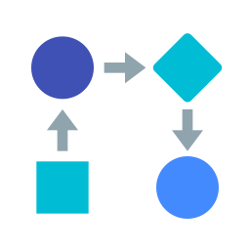

COMBINED SUMMARY - THE 4 PILLARS ADD UP
Objective: 4 pillars that feed each other, so ₹8 Cr of build returns ₹16.7 Cr a year and pays back by month 20
FINANCIAL RESULT
HOW IT WORKS
WHAT IT UNLOCKS
COMBINED IMPACT - TODAY VS FULL SCALE
₹16.7 Cr
4 Pillars
Home loans
Metric
Today
FIRST Sight
Impact
Cost per check
₹5,500
₹2,860
−48%
a year: ₹9.0 Cr saved + ₹7.7 Cr interest (est.)
each feeds the next, starting on day 1
the same system, about twice the cases
Days to clear
7
2.6
−4.4 days
HOW THE FOUR PILLARS FEED EACH OTHER
Full site visits
100 of 100
30 of 100
−70%
Credit reads
13 pages
1 page
−12 pages
Day-1 check
3 lanes
Video, valuer
Second Sight
Errors found
after visit
day 1
pre-visit
flags, day 1
70% fast
1-page card
day-1 value
Yearly gain
-
₹16.7 Cr
+₹16.7 Cr
Checks feed lanes, lanes cut visits, the valuer signs; Second Sight starts it
Every metric moves the right way at once
WHAT EACH PILLAR DELIVERS
CASH POSITIVE AT M20, +₹18 CR BY M36
Pillar
Action
Financial impact
Strategic impact
P1 Day-1 check
20 checks, day 1
Stops ₹17 lakh errors
Flags before travel
Low point −₹8 Cr at month 8
P2 Three lanes
35/35/30 by 2 rules
₹9.0 Cr saved a year
2.6 days, not 7
₹0
P3 Video + valuer
V-PIP, Co-Pilot
₹1,300 vs ₹5,500
1 page for credit
Payback ≈ month 20
M0
M12
M24
M36
P4 Second Sight
Every agency report
No IT cost to start
Value from day 1
Build ₹8 Cr: team 4.5 · links 1.5 · AI, cloud 1.0 · training 1.0
All 4 together
Day 1 → signed
₹16.7 Cr a year
Payback ≈ M20
Run: ₹2.5 Cr a year, already in the numbers
Not counted: fraud avoided, home-loan reuse, post-loan alerts
Every pillar ends in money, time or proof
Sources: Team model: 34,200 checks a year; ₹4,000 fee + ₹1,500 staff time; mix 35/35/30; 2-pt drop-off; 3.5% margin. All estimates.
₹8 Cr build → ₹16.7 Cr a year at full scale (est.), and nothing changes for credit until the pilot proves it

Slide 8

MASTER ROADMAP AND GOVERNANCE - 24 MONTHS
Objective: 4 streams, gated phases, every RBI rule mapped and every risk owned, with a stop rule from day 1
24-MONTH ROADMAP - 4 STREAMS RUN CONCURRENTLY
RISK REGISTER - 9 RISKS, BEFORE → AFTER
PROVE (M0-8)
GO LIVE (M9-12)
SCALE (M13-24)
Wrong house shown
High
Low
DAY-1 CHECK
Rules + AI built
All new LAP files
Home loans added
Geofence, random prompts · Tech services
AI misreads a deed
Med
Low
THREE LANES
Shadow, 1,000 files
Sight 24, 72 live
All branches
Unsure → a person checks · Model risk
Fast-lane loan goes bad
Med
Med
VIDEO + VALUER
Panel + V-PIP built
Video in Sight 24
Co-Pilot for all
LTV ≤ 50%; 1-in-10 audit · CRO
SECOND SIGHT
Live from month 1
Agency report card
Feeds lane rules
Regulator questions lanes
Med
Low
Panel valuer; Board policy · Compliance
All 4 streams start in month 1; each lane goes live only after its gate
Land data missing
Low
Low
Gaps go to a slower lane · Operations
7 RULES - WHERE FIRST SIGHT MEETS EACH
Agencies push back
Med
Low
Per-lane fee + bonus · Head of Mortgages
Rule
What FIRST Sight does
Status
Customer data misused
Med
Low
RBI CRM 2025 · para 70.2
Only approved, independent valuers sign
Aadhaar, PAN, phone masked · DPO
Built
AI provider is offshore
High
Low
RBI CRM 2025 · para 70.3
2 reports at ₹50 Cr+, lower value used
Built
Masked now; India host at pilot · CTO
Ch X + SARFAESI s.23
CERSAI search day 1; filed in 30 days
Valuer collusion, conflict
High
Low
Built, sim.
Independence check; audit · Credit Policy
Digital Lending 2025
Consent; numbers masked; data in Mumbai
Built
No risk stays High after its control
Digital Lending · offshore
India-hosted model or 24-hour deletion
At pilot
WHO OWNS IT - ONE SPONSOR
DPDP Act + Rules 2025
Notice, purpose-bound consent, review
Built
Sponsor: Head of Mortgages. Steering: CRO, CTO, Compliance, Ops
RBI FREE-AI 2025
Off switch, disclosure, blind test
Built
Stop rule: the fast lane pauses if defaults beat the control group
6 of 7 built in the prototype; offshore AI is closed at pilot
Sources: RBI CRM Directions 2025 (RBI/DOR/2025-26/157) Ch IX-X; SARFAESI s.23; Digital Lending Directions 2025; DPDP Rules 2025; FREE-AI 2025.
4 streams, 9 risks owned, 7 rules mapped: a plan specific enough to run and safe enough to approve

Slide 9
APPENDIX

Slide 10


APPENDIX A - BENCHMARKS & EVIDENCE BASE
Every material number rests on a third-party source or a measured test, and we name what is still an estimate
MARKET & INDUSTRY BENCHMARKS
KEY ASSUMPTIONS REGISTER
Source
Fact
So what
Assumption
Value
Basis
Pillar
Swing
Fannie Mae · 2025
16-17% skipped full appraisal
Check-first is safe
Checks a year
34,200
₹11,000 Cr ÷ ₹45 L × 1.4
P2
High
Cotality AU · 2025
Desktop share 12% → 21%
Desk checks growing
Customers kept
2 pts
estimate; pilot tests it
P1-3
High
Hometrack UK
AVM → desktop → visit
Our 3 lanes mirror it
Agency fee
₹4,000
published ₹4.5-5k
P2
Med
IDFC Q2 FY27
LAP = 11% of ₹3,46,913 Cr
LAP matters to IDFC
Lane mix
35/35/30
US, AU desktop shares
P2
Med
IDFC Q2 FY27
Mortgages +8.7% vs 35.4%
Speed is the lever
Staff time
₹1,500
credit + technical review
P2
Low
Interest margin
3.5%
below IDFC's margin
All
Low
DILRMP · 2026
99.9% land records online
Desk checks possible
Build cost
₹8 Cr
team, links, AI, training
All
Med
Abroad it is proven; in India the data now exists
Running cost
₹2.5 Cr/yr
cloud, AI, support
All
Low
PROOF ON IDFC'S OWN REPORTS - MEASURED 10 NOV 2026
Rollout
25-100%
3-year ramp
All
Med
Test
Set-up
Result
High-sensitivity inputs are exactly what the pilot measures
Property test
40 files, 69 hidden, 11 kinds
69/69, 0 false alarms
NOT PROVEN YET - THE PILOT TESTS EACH
Report test
24 files, 31 hidden, 6 kinds
31/31, 0 wrong stops
AI on messy Hindi, Tamil scans → answer-key pack
Live AI, 3 reports
42-160 s, < $0.006 each
= manual reading
Real lane mix, customers kept → IDFC files only
V-PIP photo
5.6 s, $0.0001
screen photo flagged
ULI, CERSAI links simulated → built M3-5
Plus 36 automated tests; all 3 report values matched to the rupee
We name the gaps; the shadow pilot closes them
Every material assumption has a source or a test: this plan is grounded in evidence, not optimism

Slide 11
APPENDIX B - FINANCIALS AND UNIT ECONOMICS
The 3-year cash view, the cost and time of each lane, where the ₹8 Cr goes, and how far the gain can move
FIRST THREE YEARS (₹ CR) - ROLLED OUT 25% · 75% · 100%
UNIT ECONOMICS - COST AND TIME PER LANE
₹ Cr
Year 1
Year 2
Year 3
Lane
Share
Cost / check
Time
Signs
Money saved
2.26
6.77
9.03
Sight 24
35%
≈₹1,300
≤ 24 h
panel
Extra interest earned
1.93
5.78
7.70
Sight 72
35%
≈₹2,500
≤ 72 h
panel
Running cost
−2.50
−2.50
−2.50
Sight Full
30%
≈₹5,100
≤ 4 days
panel ×2*
Net gain
1.68
10.05
14.23
Weighted
100%
≈₹2,860
2.6 days
-
Total so far, after ₹8 Cr build
−6.32
3.73
17.96
Today
100%
≈₹5,500
7 days
panel
Cash turns positive in year 2
*2 reports at ₹50 Cr+ (RBI 70.3); weighted cost 48% lower
₹8 CR BUILD - WHERE IT GOES
STRESS TEST - WORST CASE STILL ₹12.9 CR A YEAR
₹4.5
₹1.5
₹1
₹1
Kept: 1-3 pts
12.9-20.6
Product and tech team: ₹4.5 Cr
Checks: 25-45k
14.3-19.6
ULI, CERSAI, LOS links: ₹1.5 Cr
AI, cloud, security: ₹1.0 Cr
Fee: ₹3-5k
14.3-19.1
Training, change: ₹1.0 Cr
Run: ₹2.5 Cr a year (cloud, AI, support), in every year above
Sight 24: 20-50%
14.8-18.2
Not counted: fraud avoided, home-loan reuse, post-loan alerts
Margin: 3-4%
15.6-17.8
Over half the build is people; no new branches or hardware
Base ₹16.7 Cr a year
₹8 Cr build → ₹17.96 Cr ahead by year 3 (est.); worst single case still ₹12.9 Cr a year

Slide 12
References & Sources
All regulatory, market and evidence claims in this deck are drawn from the sources below.
1. RBI AND REGULATION
2. GLOBAL PRECEDENTS
• RBI Credit Risk Management Directions 2025
• Fannie Mae value acceptance
rbidocs.rbi.org.in/rdocs/notification/PDFs/12CREDITRISKMANAGEMENT101025A3E4BB4EE6BE4F34AD6CA725BB95A4AD.PDF
singlefamily.fanniemae.com/property-valuation/value-acceptance
• Cotality (CoreLogic) Australia, digital valuations
• RBI Digital Lending Directions 2025 (summary)
cotality.com/au/insights/articles/digital-valuations-surge-as-data-transforms-the-mortgage-industry
mondaq.com/india/fin-tech/1636908/digital-lending-directions-2025
• Hometrack UK, automated valuation
• RBI FREE-AI Framework 2025 (summary)
hometrack.com/uk/automated-valuation-model/
khaitanco.com/sites/default/files/2025-08/Ergo - FREE AI Framework - 28 Augusut 2025.pdf
• PwC AVM benchmarking survey 2026
pwc.co.uk (AVM benchmarking survey 2026)
• DPDP Rules 2025 (summary)
india-briefing.com/news/dpdp-rules-2025-india-data-protection-law-compliance-40769.html
3. INDIA MARKET AND IDFC
• IDFC FIRST Bank Q2 FY27 investor presentation
• RBI Master Direction on IT outsourcing (summary)
LAP share, mortgage and retail growth
khaitanco.com/thought-leaderships/RBI-Releases-Master-Direction-To-Regulate-Outsourcing-of-IT-Services
• DoLR DILRMP dashboard (Aug 2026)
land records online
4. FIRST SIGHT EVIDENCE
• RBI Trend and Progress Report (Dec 2025)
• Live prototype
ULI rollout
first-sight-fame.vercel.app
• Valocity India
• FIRST Sight solution document
valocityglobal.com/en-in
10 Nov 2026
• IDFC FAME 6.0 case pack
sample valuation reports 1-3

Slide 13
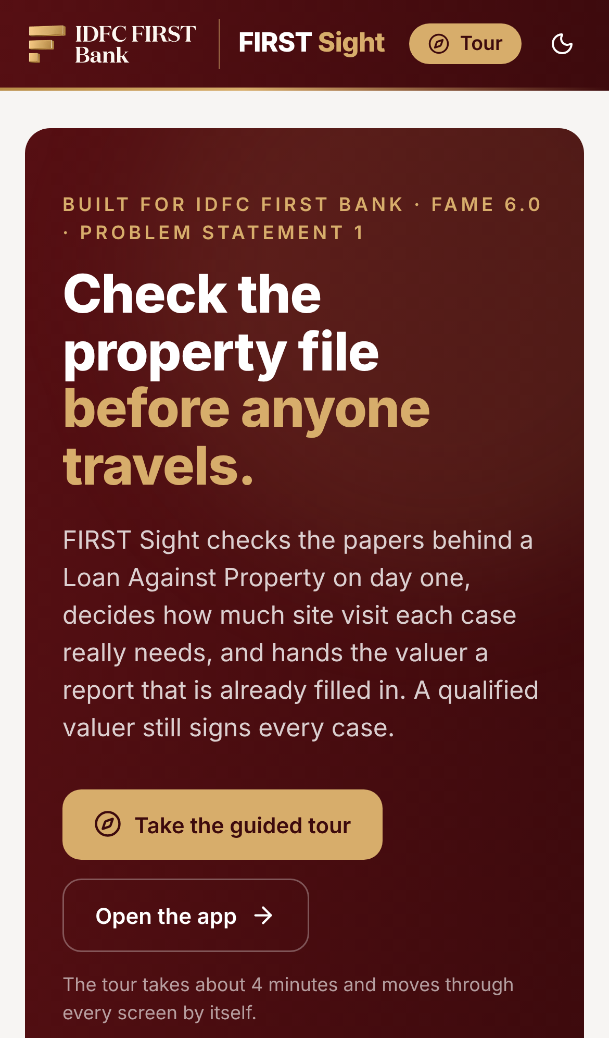
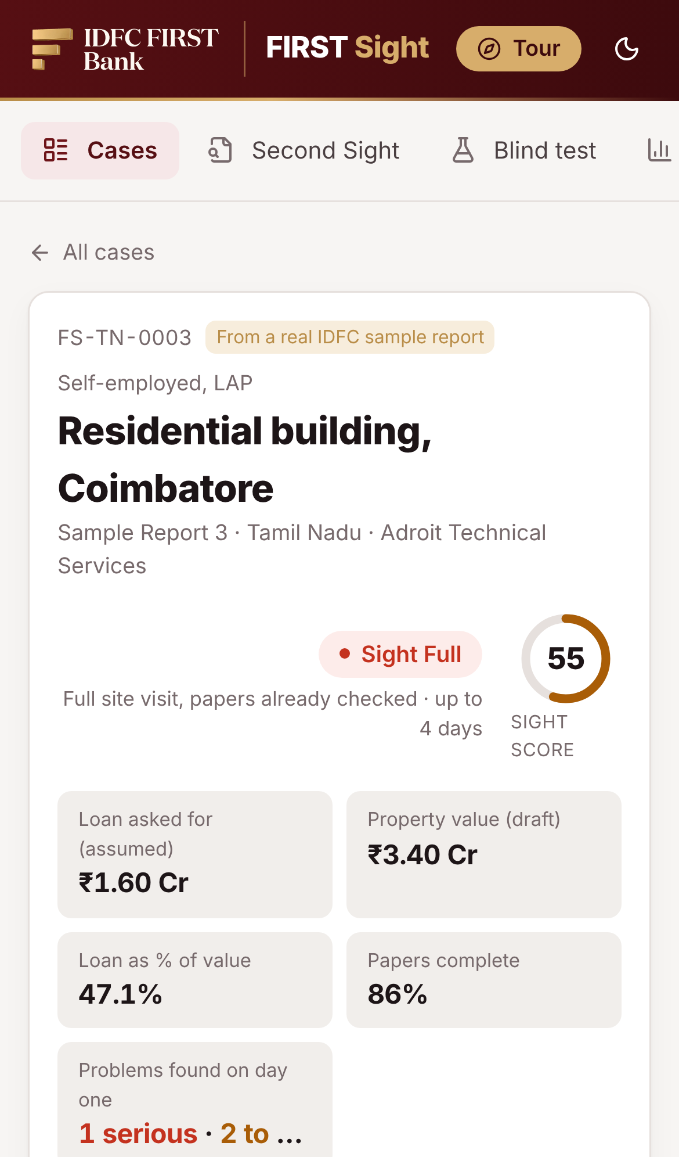
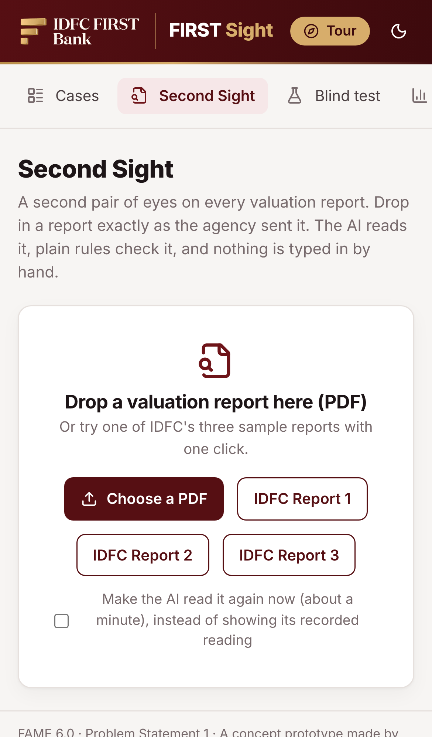
LIVE PROTOTYPE DEMO
Click >> https://first-sight-fame.vercel.app
Scan to try it
guided tour starts itself
1 · Landing and guided tour
2 · Report 3: Sight Full, score 55
3 · Second Sight on any report

Slide 14
THANK
YOU!

