Slide 1

Introduction

Slide 2
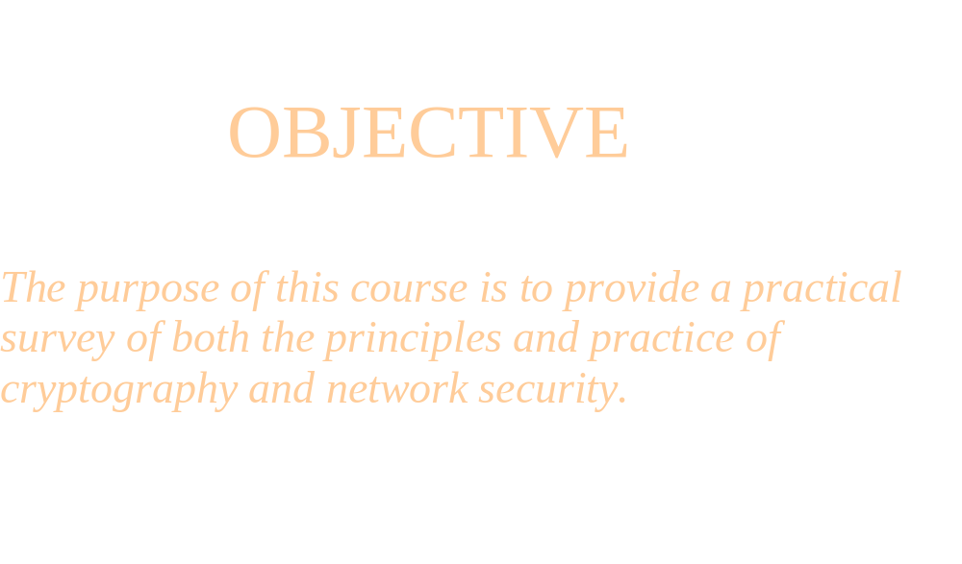
CS596A
Computer Security I

Slide 3
Text Book
“ Cryptography and Network Security “ 6th Edition, by William Stallings, Prentice Hall.
ISBN:0-13-973819-3
Reading:
“ The Code Book “ by Simon Singh, Doublelady, ISBN:0-385-49531-5
Reference Book:
“ Cryptography and Data Security” by Dorothy Denning, Addision-Wesley, ISBN:0-201-10150-5

Slide 4
Introduction
Definition
Cryptology consists of
Cryptography-method of permuting data
Cryptanalysis-revealing the secret of data permutation

Slide 5
The Cipher of Marry Queen of Scots
For thousands of years, kings, queens and generals have relied on efficient communication in order to govern their countries and command their armies. At the same time, they all aware of the consequences of their messages falling into the wrong hands…………………………
(“The Code Book” By SIMON SINGH)

Slide 6
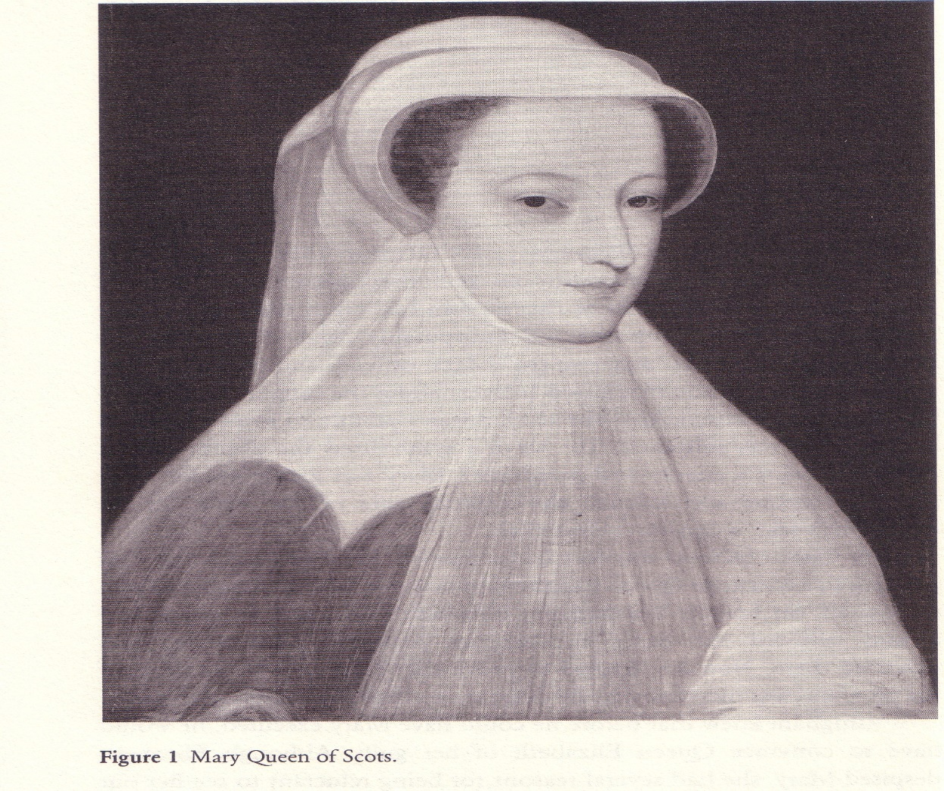
Mary Queen
At the late 16th century
Mary Queen trusted her
Encryption was
completely secure.
Therefore, she relied on
this encryption system
to communicate with
her trusted people and
planed her conspiracy.
But the truth is that her
encryption was not
secure, so her plan was
revealed……….

Slide 7
Secret Communication
Plaintext Ciphertext Plaintext
Encryption Key Decryption Key
Problems: 1.Key distribution
2. Data encryption
Encryption
Decryption

Slide 8
Key Distribution
One-Key (Symmetric) System--- a secret session key is secretly distributed between the sender and receiver (trusted messengers).

Slide 9
Key Distribution
One-Key (Symmetric) System--- a secret session key is secretly distributed between the sender and receiver.
Two-Key (Asymmetric/ Public-key) System --- a pair of (public key, private key) is associated with each user. Public key can be made publicly known.

Slide 10
Key Distribution
One-Key (Symmetric) System--- a secret session key is secretly distributed between the sender and receiver.
Two-Key (Asymmetric/ Public-key) System --- a pair of (public key, private key) is associated with each user. Public key can be made publicly known.
No-Key System--- no key arrangement is needed.

Slide 11
One-Key System
Plaintext Ciphertext Plaintext
Encryption Key Decryption Key
Example: Encryption Key=3; Decryption Key=-3
plain: a b c d e f q h i j k l m n o p q r s t u v w x y z
Cipher: D E F G H I J K L M N O P Q R S T U V W X Y Z A B C
Encryption
Decryption

Slide 12
Two-Key System
Plaintext Ciphertext Plaintext
Encryption Key Decryption Key
When Encryption Key= Receiver’s Public Key,
Decryption Key= Receiver’s Private Key,
This provides “Data Confidentiality”.
When Encryption Key= Sender’s Private Key,
Decryption Key= Sender’s Public Key,
This provides “Data Authentication” → ciphertext is called “Digital Signature”.
Encryption
Decryption

Slide 13
No-Key System
A B
EA(m)
EB(EA(m))
EB(m)
EA(m):message is encrypted by A.

Slide 14
Security Services
Data Confidentiality– Data is protected and can only be read by legitimate users.

Slide 15
Security Services
Data Confidentiality– Data is protected and can only be read by legitimate users.
User Authentication– e.g. Password

Slide 16
Security Services
Data Confidentiality– Data is protected and can only be read by legitimate users.
User Authentication– e.g. Password
Data Authentication– Data has not been changed.

Slide 17
Security Services
Data Confidentiality– Data is protected and can only be read by legitimate users.
User Authentication– e.g. Password
Data Authentication– Data has not been changed.
Non-repudiation– e.g. digital signature

Slide 18
Cryptanalysis
Ciphertext-only Attack—analyze the frequency of words or letters.

Slide 19
Cryptanalysis
Ciphertext-only Attack---analyze the frequency of words or letters.
Known-plaintext Attack--- part of the plaintext may be revealed, so attackers can attack the ciphertext base on the known-plaintext.

Slide 20
Cryptanalysis
Ciphertext-only Attack---analyze the frequency of words or letters.
Known-plaintext Attack---part of the plaintext may be revealed, so attackers can attack the ciphertext base on the known-plaintext.
Chosen plaintext Attack---Plaintext message chosen by attackers, together with its corresponded decrypted plaintext generated with a secret key.

Slide 21
Security
Computational Security—Security depends on computational complexity of problems, such as the factoring problem.
Historical development of factoring a composite number
Year | Number of digits | Computers | Time
1983 | 47 | Hp mini computer | 3 days
1983 | 69 | Cray Super computer | 32 hours
1988 | 90 | 25 SUN work station | Few weeks
1989 | 106 | 80 SUN work station | Few weeks
1993 | 110 | 1288128 CPU (0.2MIPS each) | One month
1994 | 129 | 1600 computers | Eight month

Slide 22
Security
Computational Security
Perfect Security—Security does not depend on any computational problem.

