Slide 1

Conventional Encryptions

Slide 2
Steganography—Secret Writing
Character marking
Invisible Marking
Pin punctures
Water marking

Slide 3
Classical Encryption Technique
Substitution Technique—substitute each plaintext character by a different character.

Slide 4
Classical Encryption Technique
Substitution Technique—substitute each plaintext character by a different character.
Transposition Technique– alter the order of plaintext characters.

Slide 5
Caesar Cipher
The Caesar Cipher replaces each letter of the alphabet with the letter standing three places further down the alphabet.
plain: a b c d e f q h i j k l m n o p q r s t u v w x y z
Cipher: D E F G H I J K L M N O P Q R S T U V W X Y Z A B C
Example: plain: meet me after the toga party
cipher: PHHW PH DIWHU WKH WRJD SDUWB
Encryption Key=3
Decryption Key=-3

Slide 6
Caesar Cipher
Caesar Cipher is not secure. Attackers can use frequency analysis to break the ciphertext.

Slide 7
Polyalphabetic Ciphers:
Playfair Cipher
Key word: MONARCHY
Plaintext: MEET ME
Ciphertext: CLKL CL
M | O | N | A | R
C | H | Y | B | D
E | F | G | I , J | K
L | P | Q | S | T
U | V | W | X | Z

Slide 8
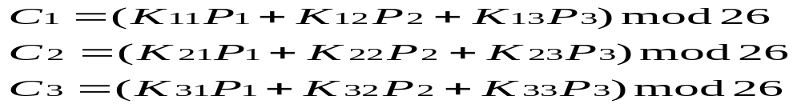
Polyalphabetic Ciphers:
Hill Cipher
Hill Cipher was developed by the
mathematician Lester Hill in 1929.
The substitution is determined by m linear
equations in which each character is assigned
a numerical value between 0 to 25. For 3x3 Hill cipher,

Slide 9
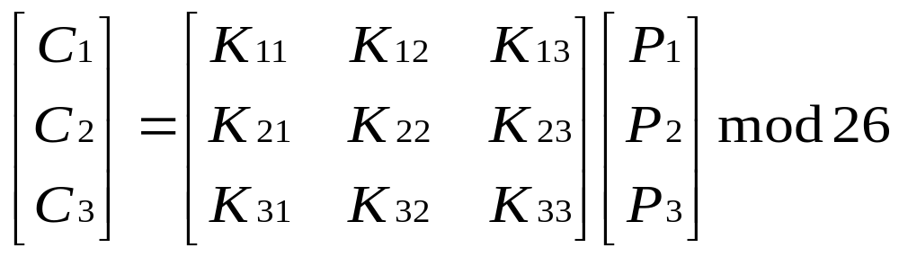
Polyalphabetic Ciphers:
Hill Cipher
or, we can write C=KP nod 26.

Slide 10
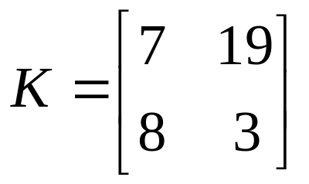
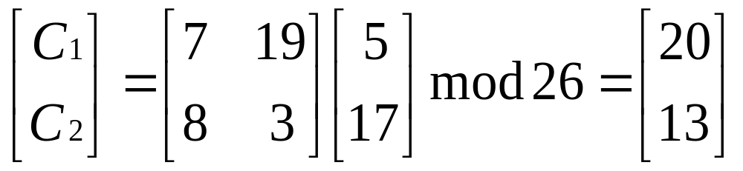
Polyalphabetic Ciphers:
Hill Cipher
Example:
What will be the ciphertext
of “F R” ?
The 20 represents “U”, and the 13 represents “N”.
The ciphertext of “F R” is “U N”.

Slide 11
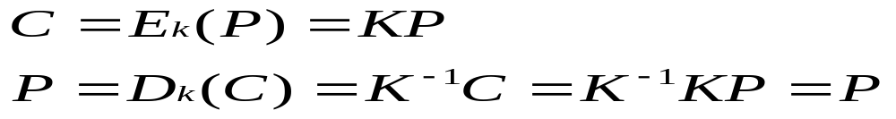
Polyalphabetic Ciphers:
Hill Cipher
If we want to decrypt the ciphertext, we need
to find the inverse of K, ( i. e. K ˉ¹).
In general terms, the Hill cipher can be
expressed as follows:

Slide 12
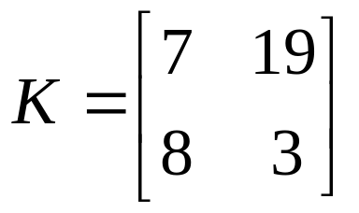
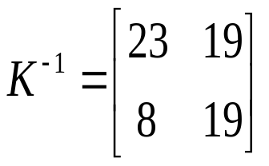
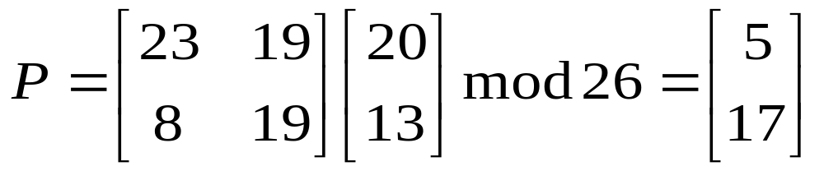
Polyalphabetic Ciphers:
Hill Cipher
Example: Given K and the ciphertext, “UN”, how to recover the plaintext?
We have
We can find
So,

Slide 13
Run-Key Cipher
The best-known, and one of the simplest,
algorithm is referred to as the Vigenère
Cipher.
Key: deceptivedeceptivedeceptive
Plaintext: wearediscoveredsaveyourself
Ciphertext: ZICVTWQNGRZGVTWAVZHCQYGLMGJ
Key word is “ deceptive”

Slide 14
One-Time Pad
The One-Time Pad cipher was developed by Joseph Mauborgne. He suggested that using a random key that was truly as long as the message, with no repetitions. Such scheme is unbreakable.
Problem: A long secret random key needs to be secretly distributed to the sender and the receiver .

Slide 15
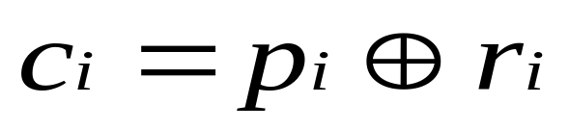
One-Time Pad
Conventionally, linear feedback shift register (LFSR) is used to generate a pseudo-random sequence. The output of this sequence is used to encrypt plaintext.
Example:
Plaintext: 0 1 1 0 11 0 1
random sequence: 1 0 1 1 0 1 1 0
ciphertext: 1 1 0 1 1 0 1 1
“ Exclusive-OR”

Slide 16
Transposition Technique
Example: Encrypt the message “I meet you at
church” with key “2413”.
1 2 3 4
i m e e
t y o u
a t c h
u r c h
So, the ciphertext is “mytreuhhitaueocc”.

