Slide 1

Public-Key Distribution Algorithms

Slide 2
Merkle’s Public-Key Distribution Algorithm
In 1974, Merkle proposed an algorithm to distribute a secret key over insecure communication channel. Communications of the ACM originally rejected Merkle’s paper; but it published Merkle’s paper in 1978.

Slide 3

Merkle’s Algorithm
Step 1: A randomly selects secret keys and for each secret key, A uses a 20-bit random number (approximately key size) to encrypt it. Let’s denote Ki for i= 1,2,…….., , as secret key and
Ci=Eri(Ki) for i= 1,2, …, , as key-encrypted key.
{Ci| i=1,2,……., } are sent to B.

Slide 4

Merkle’s Algorithm
Step 2: B randomly selects a CB from
{ Ci| i=1,2,……., }, and B takes 2 minutes to decrypt KB from CB. ( Assume B can try keys/sec). B uses KB to encrypt a pre-defined message and sends it to A.

Slide 5
Merkle’s Algorithm
Step 3: A exhausts secret keys to decrypt the ciphertext. A takes 2 minutes to identify KB.

Slide 6
Security
An attacker takes (2 minutes per key) * = 9 months to get full knowledge of secret keys (The same knowledge of keys as A knows).

Slide 7

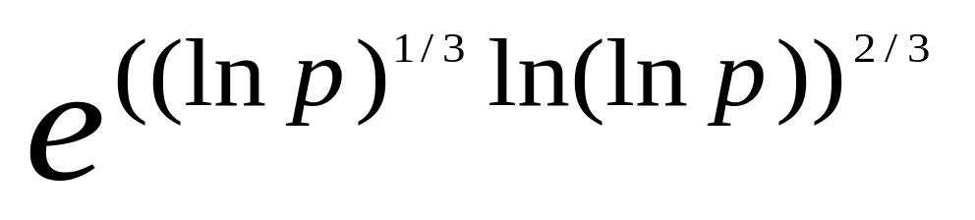
Discrete Logarithm problem
Definition:
Given: y,α and p
where α is a primitive element,
and p is a large prime (i.e. at least 512
bits)
Find: x such that y = mod p.
Complexity:
Sub-exponential complexity.

Slide 8
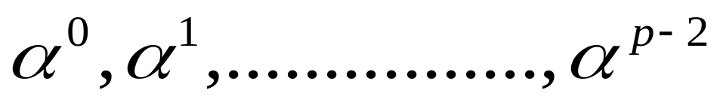
Diffie-Hellman’s Public-Key Distribution Algorithm
Public parameters:
p: a large prime
α: a primitive element in GF(p)
Note: A primitive element is a generator that can generate p-1 different integers,like
{ }.

Slide 9
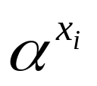
Diffie-Hellman’s Public-Key Distribution Algorithm
=>
private key: each user randomly selects
xi ∈[1, p-1]
public key: yi= mod p
A B
yA
yB

Slide 10
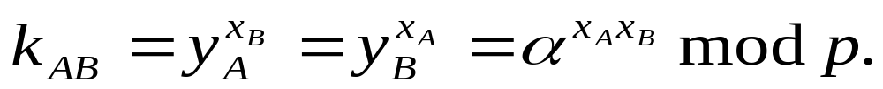
Diff-Hellman’s Public-Key Distribution Algorithm
(continue)
=>
The common secret key is

Slide 11
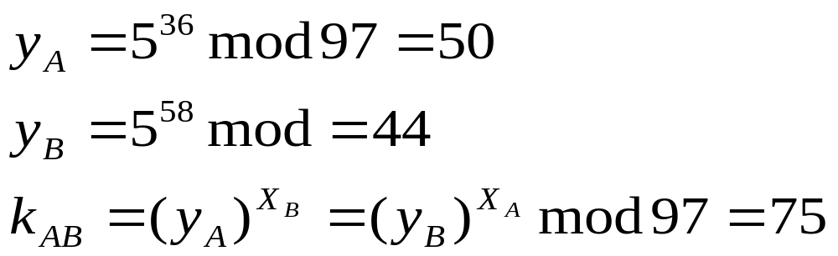
Problem:
yA / yB needs to be authenticated.
Example:
p=97, α=5
xA=36 and xB=58
then

