Slide 1

Key Recovery (Escrow)

Slide 2
SKIPJACK
In April 1993, the Clinton administration announced a proposed encryption technology that, according to the announcement “ will bring the Federal Government together with industry in a voluntary program to improve the security and privacy of telephone communication while meeting the legitimate needs of law enforcement.” Subsequently, in July 1993, a more formal announcement appeared in the Federal Register as a request for comments on a proposed Federal Information Processing Standard.

Slide 3
SKIPJACK
A major objective of this initiative is to enable law enforcement agencies to continue, when lawfully authorized, to monitor and wiretap private communications in the face of increasing sophistication and prevalence of commercial encryption technology.
The other principle objective is to provide the public with access to sophisticated and powerful encryption technology to meet private needs, especially those of business, for maintaining confidentiality.
The initiative is limited to telephone-based conversation, including voice, facsimile, and computer information communicated in a telephone system.
The SKIPJACK algorithm is substantially stronger than DES and should therefore be a welcome improvement to business users.

Slide 4
SKIPJACK
Law enforcement agencies are not in a position to directly decrypt encrypted communications. Instead, it is necessary to obtain a pair of keys from two separate “ escrow agencies” that when combined provide a key that can be used for decryption.
The rationale for this dual system is that it will (1) help government agencies and the private sector develop and use cost-effective products to protect information, and (2) at the same time preserve the ability of federal, state, and local law enforcement agencies to intercept lawfully the phone conversations of criminals, such as terrorists, drug dealers, and child pornographers.

Slide 5
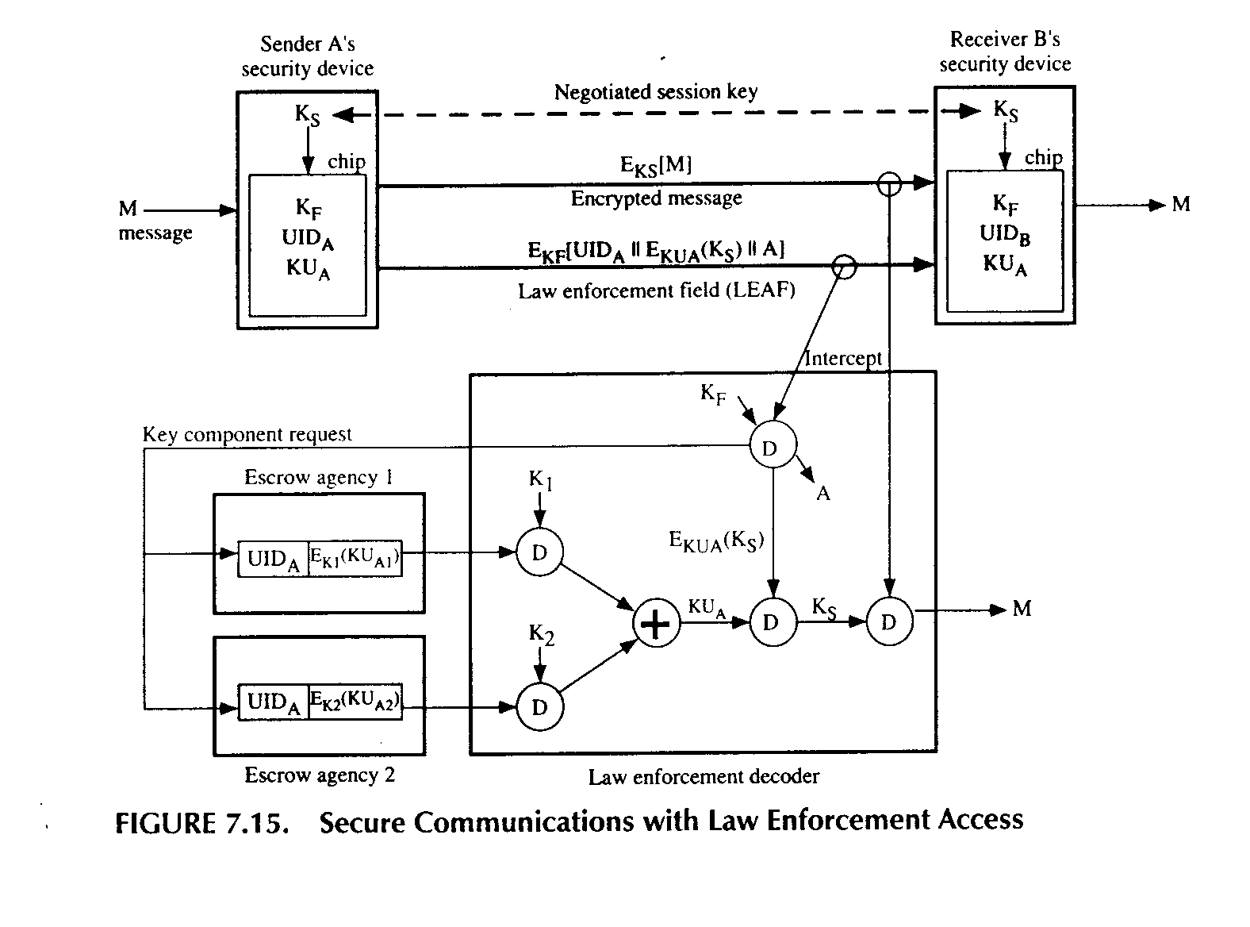
SKIPJACK

Slide 6

Operational Description
Any device, telephone, terminal, modem, and so on that uses the SKIPJACK scheme is equipped with a tamper-proof chip responsible for encryption and decryption.
The chip does not provide any key distribution service. Key distribution must be achieved manually or by using a mutually acceptable scheme, such as Diffie-Hellman key exchange.
Once a key Ks has been agreed for a session, two parties may exchange messages encrypted using the SKIPJACK encryption/decryption algorithm. Thus, a message from user A to user B would be encrypted as follows:
where M is the message and Ks is the session key.

Slide 7
Operational Description
In addition, at least once during information exchange, A must transmit a law enforcement field (LEAF) that will enable law enforcement agencies to recover the message.

Slide 8
Operational Description
Definition of the parameters:
KF = 80-bit family key.
UID = an identifier unique to a particular SKIPJAC
chip.
KU = device-unique key. KU= KU1⊕ KU2
KU1, KU2 = a pair of key components.
K1, K2 = secret key-encrypting keys
Ks = session key
P = authentication code.

Slide 9
Operational Description
The LEAF that is transmitted as part of a communication has the following general format:
EKF(UIDA || EKUA(KS) || PA)
The general procedure is as follows. If a law enforcement agency intends to eavesdrop on a conversation, it applies for a court order that grants the authorization to eavesdrop and to obtain the necessary keys. The law enforcement agency can then intercept the LEAF in one direction for that conversation. The law enforcement device is equipped with the family key for this family of chips and can therefore recover the UID of the sending device, the session key encrypted using the device-unique key, and the authentication code for this LEAF. Once the LEAF is authenticated, the agency can apply to two separate escrow agencies. Each agency maintains a database that contains the UDI and one of the two key components for each chip, the latter in encrypted form.

Slide 10
Operational Description
When both encrypted key components are returned, the agency can perform the following:
1. Recover key components:
KUA1= DK1[EK1(KUA1)]; KUA2= DK2[EK2(KUA2)]
where K1 and K2 are secret keys known only to the
requesting agency.
2. Generate device-unique key:
KUA= KUA1⊕ KUA2
3.Recover session key:
Ks = DKUA[EKUA(Ks)]
4. Recover message:
M=DKs[Eks(M)]

Slide 11
SKIPJACK
The SKIPJACK algorithm itself is classified by the U.S. government as SECRET. It is important to note, however, that the reason for classifying the algorithm is not related to its cryptographic strength. That is, it is asserted that knowledge of the algorithm does not make the system more vulnerable to cryptanalysis. Rather, the motivation for classifying the algorithm is to prevent the construction of devices that fail to properly implement the LEAF but that interoperate with legitimate SKIPJACK devices.

Slide 12
The SKIPJACK Algorithm
SKIPJACK is a block cipher that uses an 80-bit key to encrypt data in blocks of 64 bits. The algorithm involves 32 rounds of processing for a single encryption or decryption, using a complex nonlinear function for each round. As with DES, four modes of operation can be used for SKIPJACK: electronic (ECB) mode, cipher block chaining (CBC) mode, cipher feedback(CFB) mode, and output feedback (OFB) mode.
SKIPJACK was designed and evaluated by the National Security Agency (NSA), using building blocks and techniques that date back more than 40 years. The actual design effort began in 1987.

Slide 13
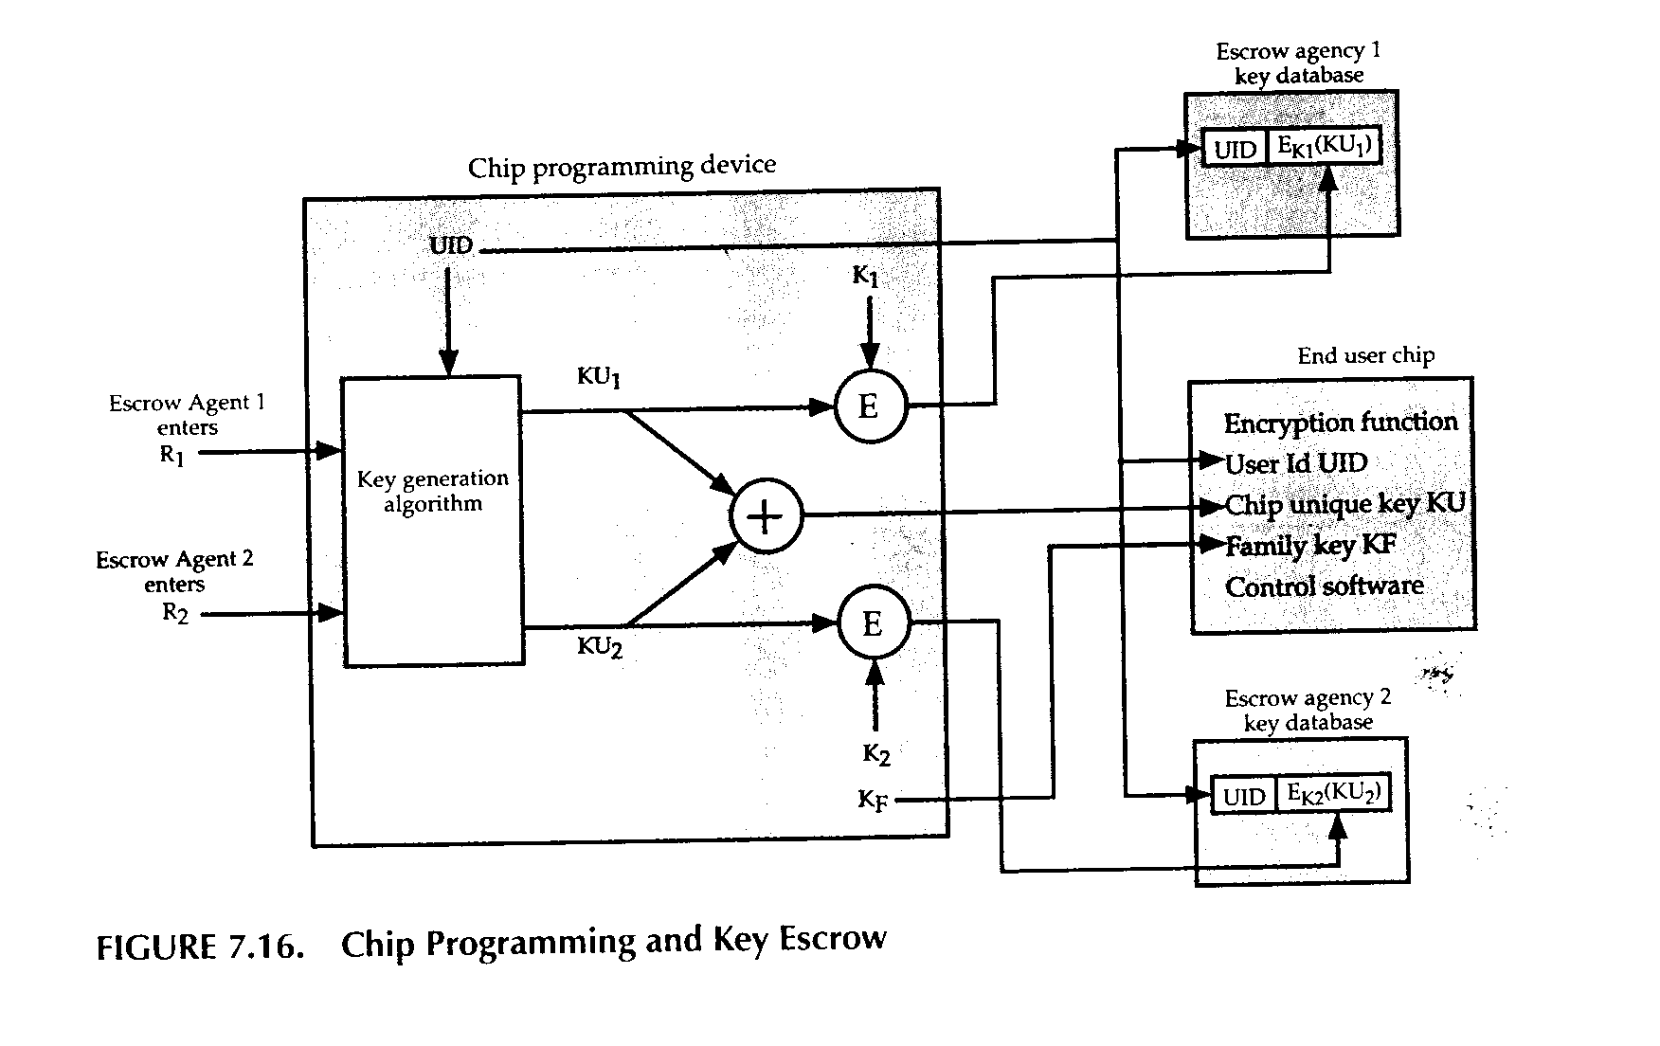
Chip Programming

Slide 14
Conclusion of the SKIPJACK Review Panel
Under an assumption that the cost of processing power is halved every 18 months, it will be 36 years before the cost of breaking SKIPJACK by exhaustive search will equal to the cost of breaking the Data Encryption Standard today. Thus, there is no significant risk that SKIPJACK will be broken by exhaustive search in the next 30 to 40 years.
There is no significant risk that SKIPJACK can be broken through a shortcut method of attack
Although the internal structure of SKIPJACK must be classified in order to protect law enforcement and national security objectives, that strength of SKIPJACK against a cryptanalytic attack does not depend on the secrecy of the algorithm.

