Slide 1
CS5542 Lecture 9 Regression and Classification Review

Slide 2
Regression

Slide 3
Regression
For classification the output(s) is nominal
In regression the output is continuous
Function Approximation
Many models could be used – Simplest is linear regression
Fit data with the best hyper-plane which "goes through" the points
For each point the difference between the predicted point and the actual observation is the residue
y
x
Notes:
Non-linear regression models later

Slide 4
Prediction (Regression)
How Prediction is similar to classification?
First, construct a model
Second, use model to predict unknown value
Major method for prediction is regression
Linear and multiple regression
Non-linear regression
How Prediction is different from classification?
Classification refers to predict categorical class label
Prediction models continuous-valued functions

Slide 5
Types of Regression Models
Notes:
27
This teleology is based on the number of explanatory variables & nature of relationship between X & Y.

Slide 6
Linear Regression

Slide 7
Simple Linear Regression
For now, assume just one (input) independent variable x, and one (output) dependent variable y
Multiple linear regression assumes an input vector x
Multivariate linear regression assumes an output vector y
We "fit" the points with a line (i.e. hyper-plane)
Which line should we use?
Choose an objective function
For simple linear regression we choose sum squared error (SSE)
Σ (predicted_{i} – actual_{i})² = Σ (residue_{i})²
Thus, find the line which minimizes the sum of the squared residues (e.g. least squares)
This mimics the case where data points were sampled from the actual hyperplane with Gaussian noise added
Notes:
Hyperplane for multiple linear regression

Slide 8
Linear Equations
Notes:
28

Slide 9
Linear Regression Model
Relationship Between Variables Is a Linear Function
Population Y-Intercept
Population Slope
Random Error
Y
=
β
+
β
X
+
ε
i
0
1
i
i
Dependent (Response) Variable (e.g., CD+ c.)
Independent (Explanatory) Variable (e.g., Years s. serocon.)

Slide 10
Population & Sample Regression Models
Population
Random Sample
Unknown Relationship
☺
☺
☺
☺
☺
☺
☺
Notes:
34

Slide 11
Population Linear Regression Model
Observedvalue
ε_{i} = Random error
Observed value
Notes:
35

Slide 12
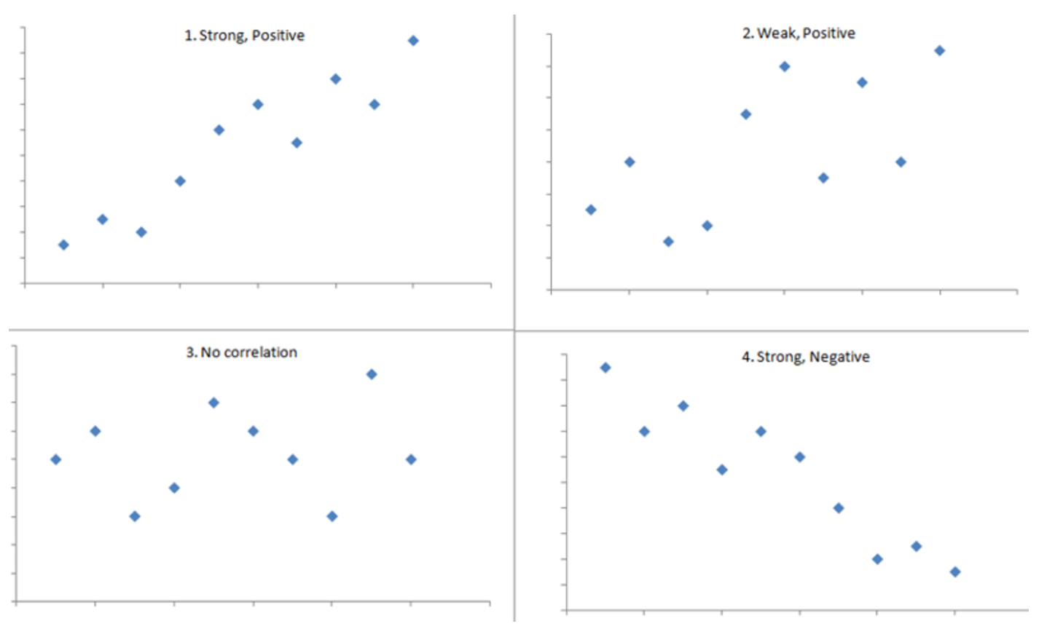
Correlation Analysis
The ranges between -1 and +1 and quantifies the direction and strength of the linear association between the two variables.
a strong positive association (r=0.9) on the correlation between infant birth weight and birth length
a weaker association (r=0,2) on the correlation between age and body mass index;
the lack of association (r approximately = 0) between the extent of media exposure and sexual activity
the strong negative association (r= -0.9) between #hours of aerobic exercise per week and %body fat.
Source: http://sphweb.bumc.bu.edu/otlt/mph-modules/bs/bs704_correlation-regression/bs704_correlation-regression_print.html

Slide 13
Estimating Parameters: Least Squares Method
Notes:
40

Slide 14
Scatter plot
Plot of All (X_{i}, Y_{i}) Pairs
Suggests How Well Model Will Fit
Y
60
40
20
0
X
0
20
40
60

Slide 15
Thinking Challenge
How would you draw a line through the points? How do you determine which line ‘fits best’?
Y
60
40
20
0
X
0
20
40
60
Notes:
42

Slide 16
Thinking Challenge
How would you draw a line through the points? How do you determine which line ‘fits best’?
Slope changed?
Y
60
40
20
0
X
0
20
40
60
Intercept changed?
Notes:
43

Slide 17
Least Squares
‘Best Fit’ Means Difference Between Actual Y Values & Predicted Y Values Are a Minimum. But Positive Differences Off-Set Negative. So square errors!
LS Minimizes the Sum of the Squared Differences (errors) (SSE)
Notes:
51

Slide 18
Least Squares Graphically
Notes:
52

Slide 19
Coefficient Equations
Prediction equation
Sample slope
Sample Y - intercept

Slide 20
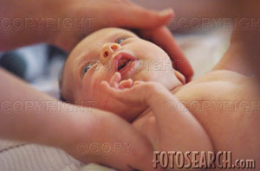
Parameter Estimation Example
Obstetrics: What is the relationship between Mother’s Estriol level & Birthweight using the following data?
Estriol Birthweight
(mg/24h) (g/1000)
1 1 2 1 3 2 4 2 5 4

Slide 21
Scatterplot: Birthweight vs. Estriol Level
Birthweight
Estriol level
Notes:
57

Slide 22
Computation Table
Notes:
54

Slide 23
Parameter Estimation Solution Table
Notes:
58

Slide 24
Parameter Estimation Solution
Notes:
59

Slide 25
Parameter Estimation Thinking Challenge
You’re a Vet epidemiologist for the county cooperative. You gather the following data:
Food (lb.) Milk yield (lb.) 4 3.0 6 5.5 10 6.5 12 9.0
What is the relationship between cows’ food intake and milk yield?
© 1984-1994 T/Maker Co.
Notes:
62

Slide 26
Scattergram Milk Yield vs. Food Intake
M. Yield (lb.)
Food intake (lb.)
Notes:
65

Slide 27
Parameter Estimation Solution Table
Notes:
66

Slide 28
Parameter Estimation Solution
Notes:
67

Slide 29
Classification

Slide 30
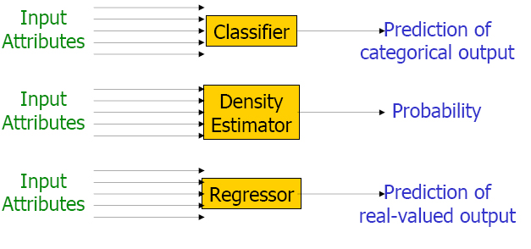
Two Key Types of Prediction

Slide 31
Classification
There is something you want to predict (“the label”)
The thing you want to predict is categorical
The answer is one of a set of categories, not a number
CORRECT/WRONG (sometimes expressed as 0,1)
WILL DROP OUT/WON’T DROP OUT
WILL SELECT PROBLEM A,B,C,D,E,F, or G

Slide 32
Classification
Associated with each label are a set of “features”, which maybe you can use to predict the label
Skill pknow time totalactions right
ENTERINGGIVEN 0.704 9 1 WRONG
ENTERINGGIVEN 0.502 10 2 RIGHT
USEDIFFNUM 0.049 6 1 WRONG
ENTERINGGIVEN 0.967 7 3 RIGHT
REMOVECOEFF 0.792 16 1 WRONG
REMOVECOEFF 0.792 13 2 RIGHT
USEDIFFNUM 0.073 5 2 RIGHT
….

Slide 33
Classification
The basic idea of a classifier is to determine which features, in which combination, can predict the label
Skill pknow time totalactions right
ENTERINGGIVEN 0.704 9 1 WRONG
ENTERINGGIVEN 0.502 10 2 RIGHT
USEDIFFNUM 0.049 6 1 WRONG
ENTERINGGIVEN 0.967 7 3 RIGHT
REMOVECOEFF 0.792 16 1 WRONG
REMOVECOEFF 0.792 13 2 RIGHT
USEDIFFNUM 0.073 5 2 RIGHT
….

Slide 34
Classification
One way to classify is with a Decision Tree
PKNOW
<0.5
>=0.5
TIME
TOTALACTIONS
<6s.
>=6s.
<4
>=4
RIGHT
WRONG
RIGHT
WRONG

Slide 35
Decision Tree

Slide 36
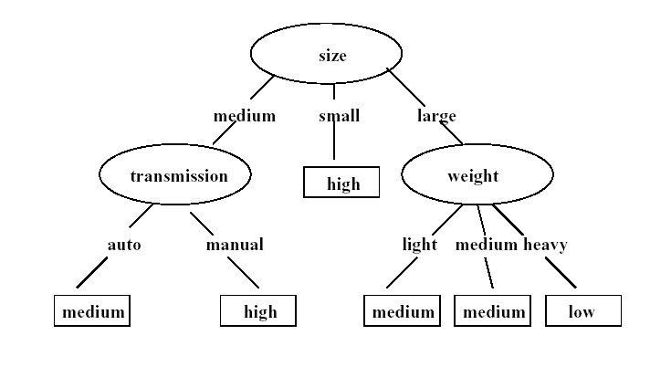
Decision Tree
Each non-leaf node corresponds to an attribute of objects
Each branch from a non-leaf node to its children represents a value of the attribute.
Each leaf node in a decision tree is labeled by a class of the objects
Classification using decision trees Starting from the root an object follows the path to a leaf node which gives the class of the object taking branches according to its values along the way

Slide 37
Training Dataset & Decision Tree
Output: A Decision Tree for “buys_computer”
age?
<=30
overcast
>40
30..40
student?
yes
credit rating?
no
yes
excellent
fair
no
yes
no
yes

Slide 38
Algorithm for Decision Tree Induction
Basic algorithm (a greedy algorithm)
Tree is constructed in a top-down recursive divide-and-conquer manner
At start, all the training examples are at the root
Attributes are categorical (if continuous-valued, they are discretized in advance)
Examples are partitioned recursively based on selected attributes
Test attributes are selected on the basis of a heuristic or statistical measure (e.g., information gain)
Conditions for stopping partitioning
All samples for a given node belong to the same class
There are no remaining attributes for further partitioning – majority voting is employed for classifying the leaf
There are no samples left

Slide 39
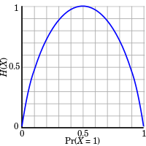

Entropy: Information Gain (ID3/C4.5)
ID3 by Ross Quinlan
Information Gain (based on Entropy): select the attribute which has the smallest entropy (or largest information gain) value.
The concept used to quantify information
to measure the amount of uncertainty (“entropy”)
When all data in a set belong to a single class, there is no uncertainty, entropy = 0.
Probability, 0 <= p <=1: log (1/p)
Expected information based on probability of an event: p log(1/p) = - p log(p)
Joint Event: The average amount of information that
we receive with every event
= -$\sum_{i}{p_{i}\log{p_{i}}}$

Slide 40
Analysis of Decision Tree Algorithm
Advantages:
Easy to understand
Easy to generate rules
Reduce problem complexity
Disadvantages:
Training time is relatively expensive
A document is only connected with one branch
Once a mistake is made at a higher level, any subtree is wrong
Does not handle continuous variable well
May suffer from overfitting

Slide 41

Evaluation

Slide 42
Evaluation
Evaluation for Classification
Accuracy, Precision, and recall
Squared error

Slide 43
Basic Measures for Text Retrieval
FN
TP
FP
Pr=Precision=TP/(TP+FP)
R =Recall = TP/(TP+FN)
F-Measure = 2Pr*R/(Pr+R)
Relevant
Relevant & Retrieved
Retrieved
All Documents
Precision: the percentage of retrieved documents that are in fact relevant to the query (i.e., “correct” responses)
Recall: the percentage of documents that are relevant to the query and were, in fact, retrieved
|
{
Relevant
}
∩
{
Retrieved
}
|
Recall
=
|
{
Relevant
}
|

Slide 44
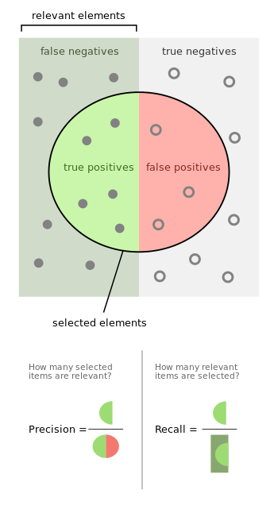
Precision Vs Recall

Slide 45
Classifier Evaluation Metrics: Confusion Matrix
Confusion Matrix:
Actual class\Predicted class | C₁ | ¬ C₁
C₁ | True Positives (TP) | False Negatives (FN)
¬ C₁ | False Positives (FP) | True Negatives (TN)
Example of Confusion Matrix:
Actual class\Predicted class | buy_computer = yes | buy_computer = no | Total
buy_computer = yes | 6954 | 46 | 7000
buy_computer = no | 412 | 2588 | 3000
Total | 7366 | 2634 | 10000
Given m classes, an entry, CM_{i,j} in a confusion matrix indicates # of tuples in class i that were labeled by the classifier as class j
May have extra rows/columns to provide totals
45

Slide 46
Classifier Evaluation Metrics: Accuracy, Error Rate, Sensitivity and Specificity
A\P | C | ¬C
C | TP | FN | P
¬C | FP | TN | N
 | P’ | N’ | All
Class Imbalance Problem:
One class may be rare, e.g. fraud, or HIV-positive
Significant majority of the negative class and minority of the positive class
Sensitivity: True Positive recognition rate
Sensitivity = TP/P
Specificity: True Negative recognition rate
Specificity = TN/N
Classifier Accuracy, or recognition rate: percentage of test set tuples that are correctly classified
Accuracy = (TP + TN)/All
Error rate: 1 – accuracy, or
Error rate = (FP + FN)/All
46

Slide 47
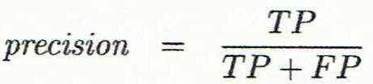
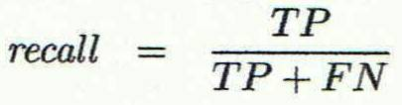
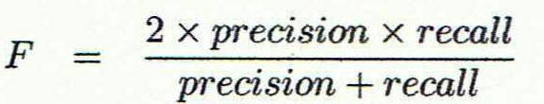
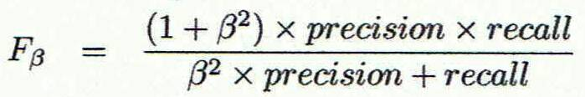
Classifier Evaluation Metrics: Precision and Recall, and F-measures
Precision: exactness – what % of tuples that the classifier labeled as positive are actually positive
Recall: completeness – what % of positive tuples did the classifier label as positive?
Perfect score is 1.0
Inverse relationship between precision & recall
F measure (F₁ or F-score): harmonic mean of precision and recall,
F_{ß}: weighted measure of precision and recall
assigns ß times as much weight to recall as to precision
47

Slide 48
Example: Classifier Evaluation Metrics
Actual Class\Predicted class | cancer = yes | cancer = no | Total | Recognition(%)
cancer = yes | 90 | 210 | 300 | 30.00 (sensitivity)
cancer = no | 140 | 9560 | 9700 | 98.56 (specificity)
Total | 230 | 9770 | 10000 | 96.50 (accuracy)
Predicated Class
Sensitivity = TP/P = 90/300 = 30%
A\P | C | ¬C
C | TP | FN | P
¬C | FP | TN | N
 | P’ | N’ | All
Actual Class
Specificity = TN/N = 9560/9700 = 98.55%
Accuracy = (TP + TN)/All = (90+9560)/10000 = 96.5%
Error rate = (FP + FN)/All = (140+210)/10000 = 3.5%
Precision=TP/(TP+FP) = 90/230 = 39.13%
Recall = TP/(TP+FN) = 90/300 = 30%
F-Measure = 2Pr*R/(Pr+R) = 2*39.13*30/(39.13+30) = 33.9
48

Slide 49
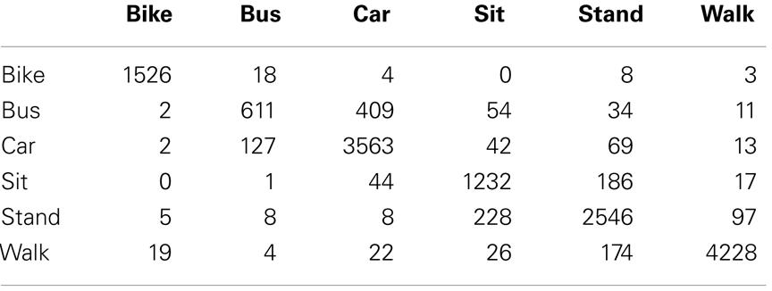
Example: Confusion Matrix for Activity Recognition
Predicted
Actual
Example:
Precision (Bike) = TP/(TP+FP) = 1526/(1526+2+2+0+5+19) = 0.98
Recall (Bike) = TP/(TP+FN) = 1526/(1526+18+4+0+8+3) = 0.97
F-Measure = 2x0.98x0.97/(0.98+0.97) = 0.97

Slide 50
Predictor Error Measures
Measure predictor accuracy: measure how far off the predicted value is from the actual known value
Loss function: measures the error between y_{i} and the predicted value y_{i}’
Absolute error: | y_{i} – y_{i}’|
Squared error: (y_{i} – y_{i}’)²
Test error (generalization error): the average loss over the test set
Mean absolute error: Mean squared error:
Relative absolute error: Relative squared error:
The mean squared-error exaggerates the presence of outliers
Popularly use (square) root mean-square error, root relative squared error
50
Notes:
50

Slide 51
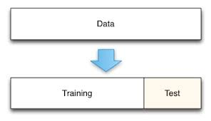
Evaluating Classifier Accuracy: Holdout Method
Holdout method
Given data is randomly partitioned into two independent sets
Training set (e.g., 2/3) for model construction
Test set (e.g., 1/3) for accuracy estimation
Random sampling: a variation of holdout
Repeat holdout k times, accuracy = avg. of the accuracies obtained
51

Slide 52
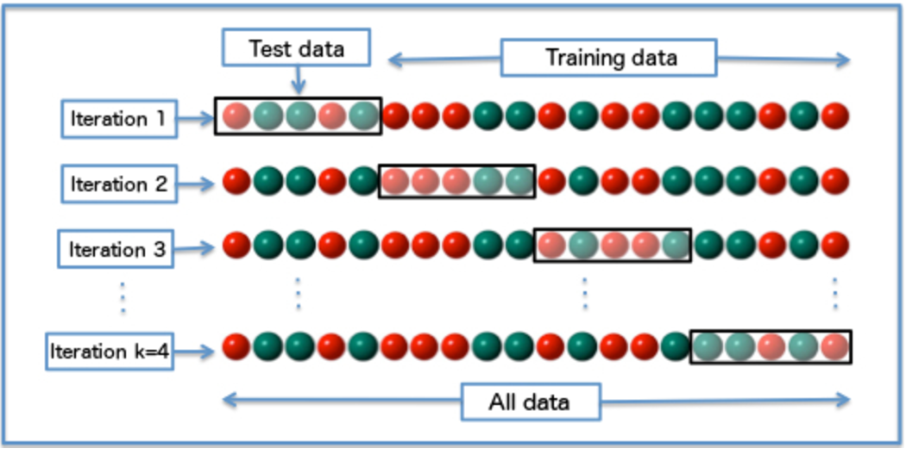
Evaluating Classifier Accuracy: Cross-Validation Methods
Cross-validation (k-fold, where k = 10 is most popular)
Randomly partition the data into k mutually exclusive subsets, each approximately equal size
At i-th iteration, use D_{i} as test set and others as training set
Leave-one-out: k folds where k = # of tuples, for small sized data
*Stratified cross-validation*: folds are stratified so that class dist. in each fold is approx. the same as that in the initial data
Diagram of k-fold cross-validation with k=4.
52

Slide 53
Issues Affecting Model Selection
Accuracy
classifier accuracy: predicting class label
Speed
time to construct the model (training time)
time to use the model (classification/prediction time)
Robustness: handling noise and missing values
Scalability: efficiency in disk-resident databases
Interpretability
understanding and insight provided by the model
Other measures, e.g., goodness of rules, such as decision tree size or compactness of classification rules
53
Notes:
53

