Slide 1
CS5542 Big Data Analytics and Apps
Introduction to BDAA

Slide 2
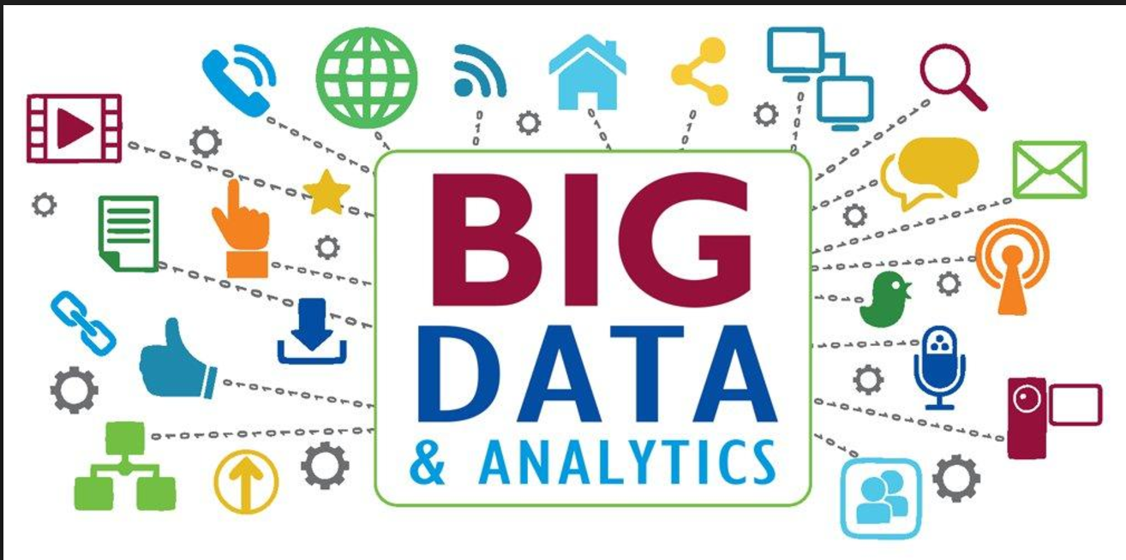
Big Data Analytics

Slide 3
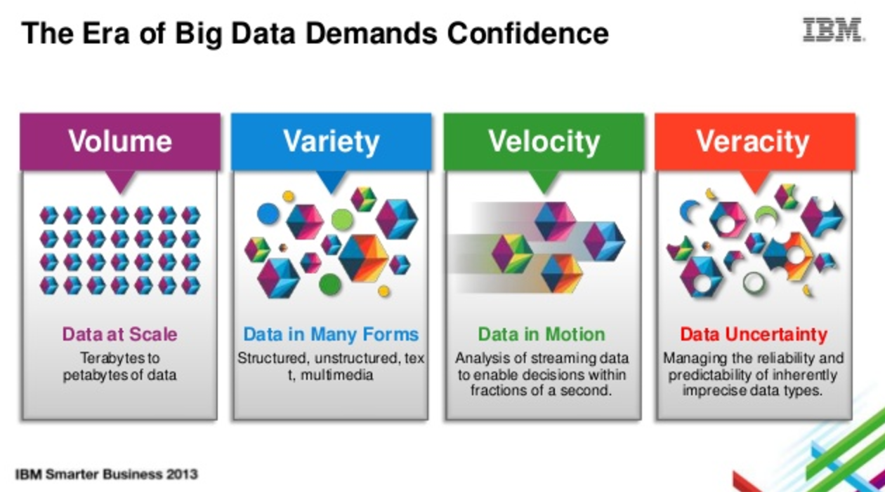
Big Data Characteristics
http://www.slideshare.net/ibmsverige/building-confidence-in-big-data

Slide 4
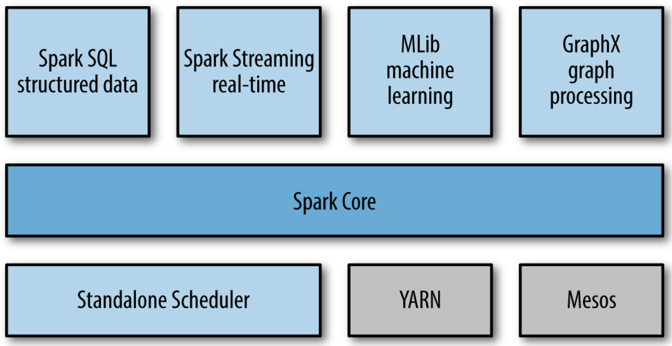
Apache Spark: Parallel Engine
https://www.safaribooksonline.com/library/view/learning-spark/9781449359034/ch01.html

Slide 5
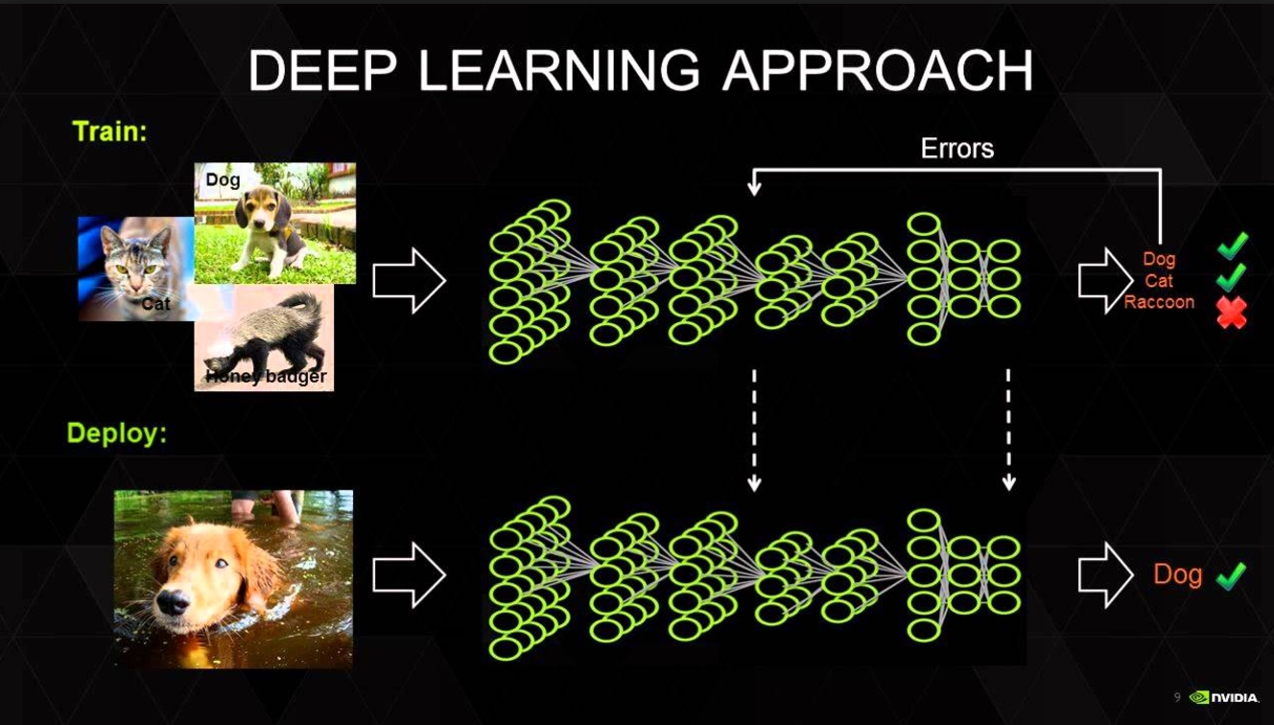
Deep Learning

Slide 6
Deep Learning
Why Is Deep Learning Hot Right Now? https://youtu.be/1G0e-mR9a4k
AI Trends in 2019
https://youtu.be/BlPFE7R8psk
“Deep Learning” Yoshua Bengio: ICDM-2016 Keynote http://icdm2016.eurecat.org/wp-content/uploads/2016/05/ICDM-Barcelona-13Dec2016-YoshuaBengio.pdf
Deep Learning Tutorials: http://deeplearning.net/tutorial/

Slide 7
Visual Question Answering using Deep Learning
Visual question/answering system demo
http://visualqa.csail.mit.edu/
https://cloudcv.org/vqa/
http://iamaaditya.github.io/2016/04/visual_question_answering_demo_notebook
Project Domains
Smart Space (home, office, transportation, etc)
Smart City
Health Care
Education
Entertainment (Music, Movie, Game, Sports, etc)

