Slide 1
CS5542 Big Data Analytics & App
Tensor Flow

Slide 2
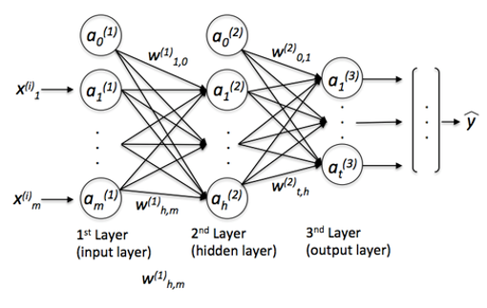
Neural Networks
Neural networks are a paradigm for processing information loosely based on the idea of neurons that communicate information in the brain and spinal cord [1][2]

Slide 3
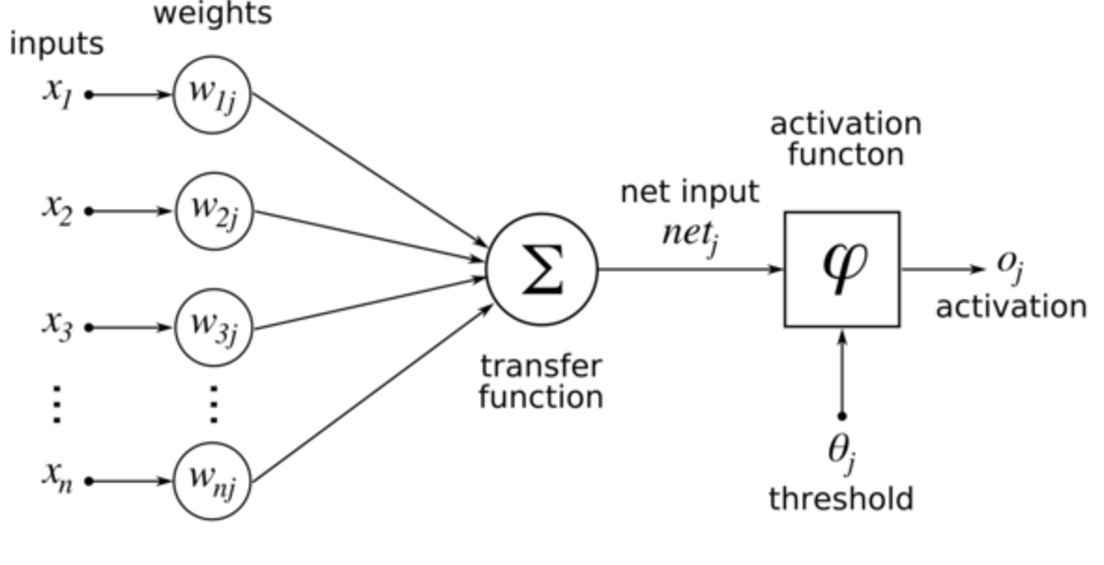
Neuron and Activation Function

Slide 4
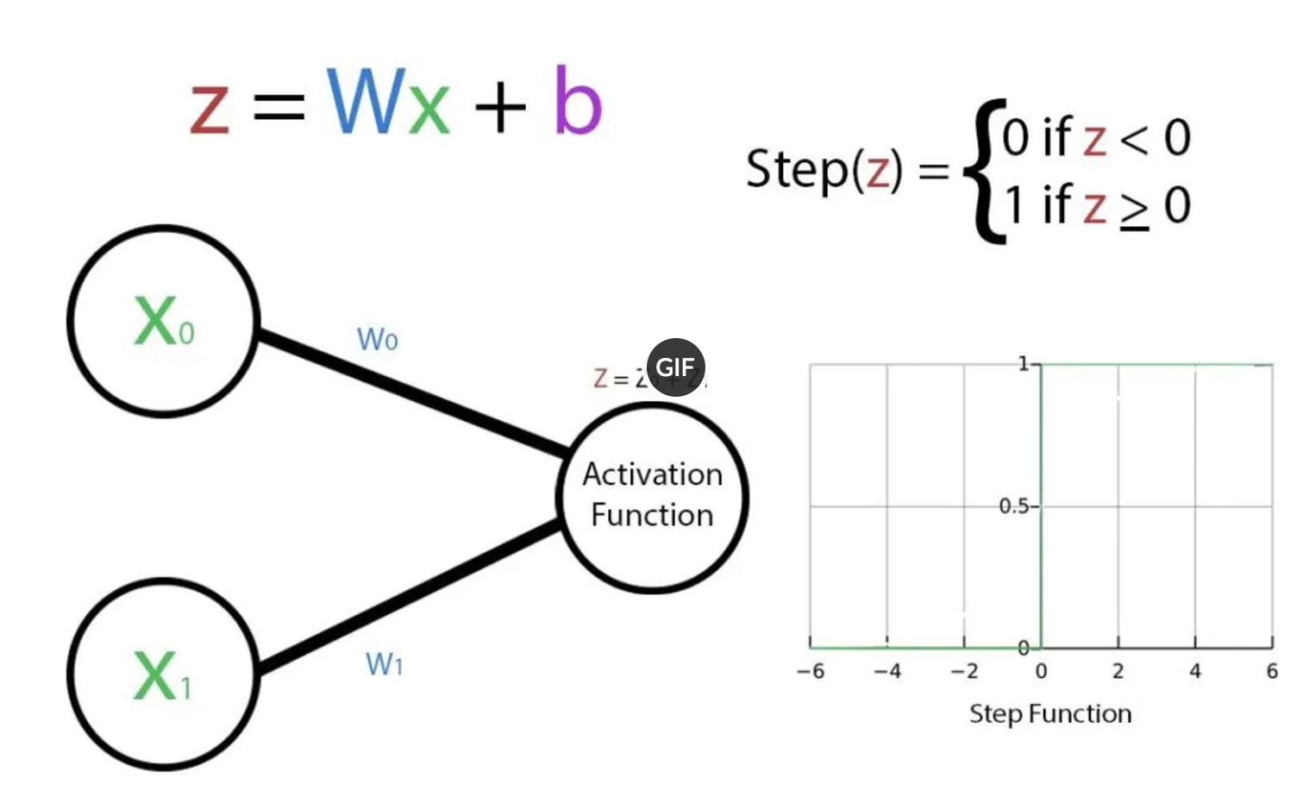
Activation Function
The input to an activation function is always Wx + b. x is the previous node’s output, W is the weights, and b is the biases.
http://www.machinephilosopher.com/activation-function-neural-network/

Slide 5
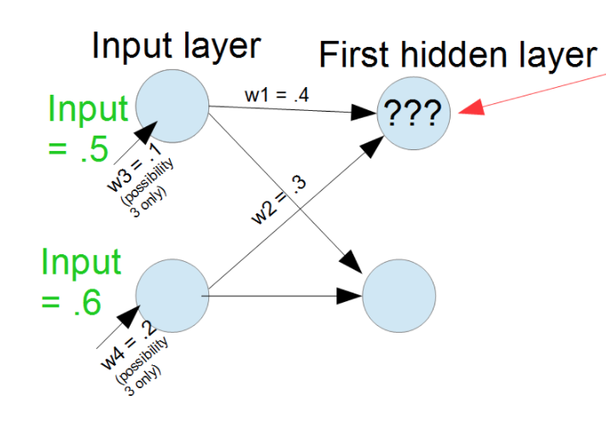
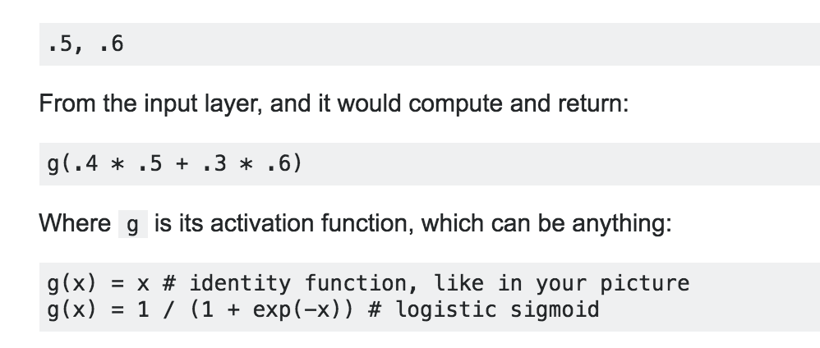
Example: Neural Network
Each unit of the input layer, in top-to-bottom order, passes its assigned value to each neuron of the first hidden layer. Then, each hidden layer neuron multiplies each of these values (x1, x2, ..., xm) with its weight vector (w1, w2, ..., wm), sums the multiplied values (x1*w1 + x2*w2 + ... + xm*wm), applies its activation function to this sum (logistic, tanh, identity function) and returns the value computed by the activation function to the next layer.

Slide 6
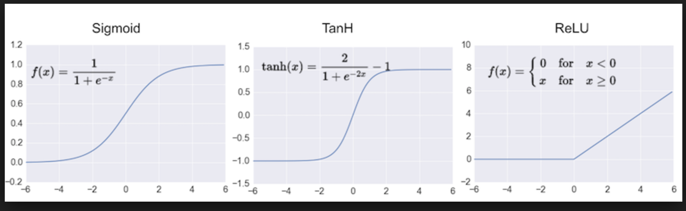
Activation Function
Rectified Linear Unit (ReLU).
https://en.wikipedia.org/wiki/Activation_function

Slide 7
Examples of Neural Network Use
Medicine
Per IOM (Institute of Medicine, 2015) one of ten patient deaths in the US is due to misdiagnosis.
NNs can be used in diagnosis of multiple sclerosis, colon cancer, pancreatic disease, gynecological diseases, diabetes, coronary artery disease, breast/thyroid cancer and others. [3]
Finance
In 2014, card not present fraud was $2.9B in US – expected to be $6.4B by 2018.
NNs can be used for credit card fraud detection along with other machine learning approaches such as Support Vector Machines, K-nearest neighbor, etc. [4]
Network Security
The direct annual loss in 2011 from global cyber crime was $114B.
Authors propose a Artificial Immune System that uses neural networks as detectors. [5]
Energy Efficiency
During the next 10 years, electricity demand expected to grow by 13% to 15% per year.
Authors describe a system using neural networks that can communicate with electricity grids.
Expected to reduce energy loss from 16% to between 3% -- 5%. [6]

Slide 8
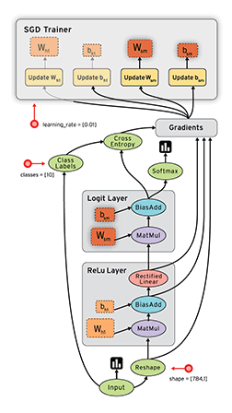
TensorFlow
Purpose: Machine Learning & Deep Neural Networks research
Open Source (By Google)
Numerical Computation using data flow graphs
Nodes:
Mathematical Operations
Data Edges (Tensor):
Multi-Dimensional Arrays
www.tensorflow.org
Video: https://www.youtube.com/watch?v=bYeBL92v99Y

Slide 9
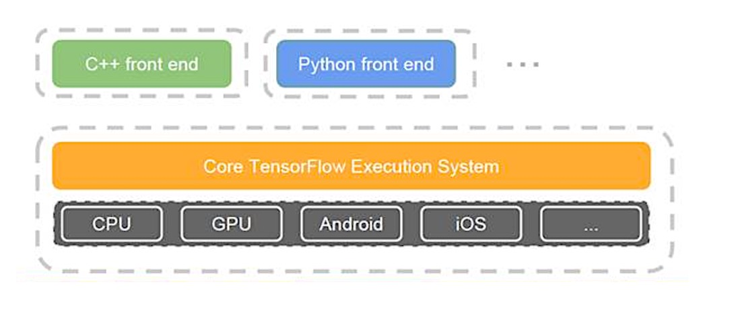
TensorFlow Architecture

Slide 10
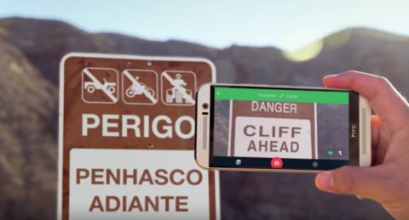
How TensorFlow is used today

Slide 11
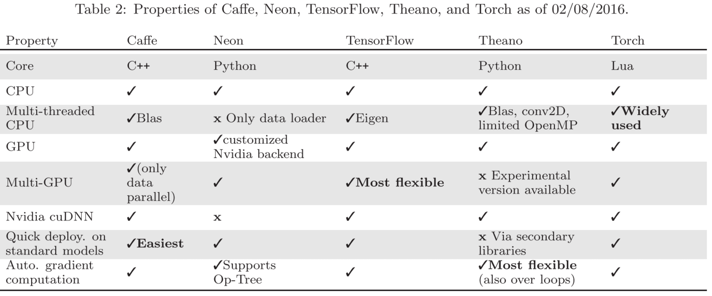
http://img.blog.csdn.net/20160702180739029

Slide 12
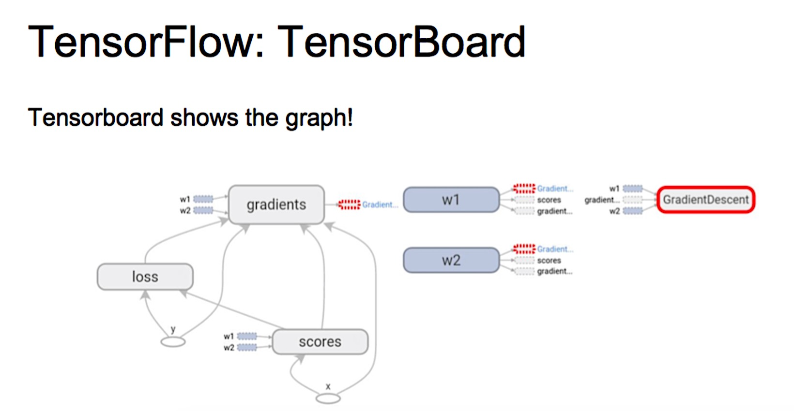

Slide 13
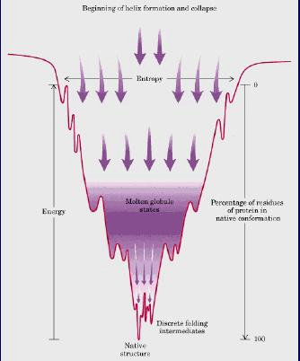
Gradient Descent Method
Gradient is the slope of a function.
Optimization is finding the “best” (minimum) value of the function.
The “turning points” of a function depend on the order of the function.
Not all turning points are minima.
The least of all the minimum points is called the “global” minimum.
Every minimum is a “local” minimum.

Slide 14
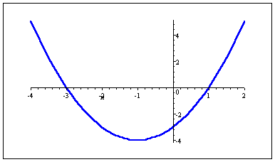
Optimization: Gradient
Simplest example - quadratic function in 1 variable:
f( x ) = x² + 2x – 3
Want to find value of x where f( x ) is minimum
f( x ) is minimum where gradient of f( x ) is zero in all directions

Slide 15
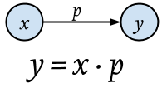
Gradient Descent Algorithm
Representation of the model y=f(x)
https://medium.com/onfido-tech/machine-learning-101-be2e0a86c96a

Slide 16
For a given set of training data X and outcomes y, we want to find the model parameters w that minimize the total loss over all X, y.
Loss Function
Suppose target outcomes come from set Y
Binary classification: Y = { 0, 1 }
Regression: Y = ℜ (real numbers)
A loss function maps decisions to costs:
defines the penalty for predicting when the true value is
Standard choice for classification: 0/1 loss (same as misclassification error)
Standard choice for regression: squared loss

Slide 17
References
[1] Raschka, S. (2016). What is the difference between deep learning and ‘Regular’ machine learning. www.kdnuggets.com, Diagram accessed 7-1-16.
[2] Geoffrey Hinton, et al (2012). Neural networks for machine learning course. U of Toronto, Coursera.com, Oct 2012. Accessed 2013.
[3] Amato, F., et al (2013). Artificial neural networks in medical diagnosis. J Applied Biomedicine. 11:47-58.
[4] Deshpande, PM, et al., (2016 Jan). Applications of data mining techniques for fraud detection in credit-debit card transactions. ISJRD, Conference on Technological Advancement and Automatization in Engineering. 339-345.
[5] Komar, M., et al (2016). Intelligent cyber defense system. ICTERI, Kyiv, Ukraine, June 21-24 meeting, 534-549.
[6] Buyuk, OO, et al (2016). A novel application to increase energy efficiency using artificial neural networks. IEEE. 1-5.

