Slide 1
CS5542 Big Data Analytics and Applications Tutorial 4 Tensorflow – Image Classification-CNN

Slide 2
Tensor Flow
TensorFlow is an open source library created for Python by the Google Brain team.
TensorFlow compiles many different algorithms and models together, enabling the user to implement deep neural networks for use in tasks like image recognition/classification and natural language processing.
TensorFlow is a powerful framework that functions by implementing a series of processing nodes, each node representing a mathematical operation, with the entire series of nodes being called a "graph".

Slide 3
Keras
Keras is a high-level API (application programming interface) that can use TensorFlow's functions underneath (as well as other ML libraries like Theano).
Keras was designed with user-friendliness and modularity as its guiding principles.
In practical terms, Keras makes implementing the many powerful but often complex functions of TensorFlow as simple as possible, and it's configured to work with Python without any major modifications or configuration.

Slide 4
Image Recognition (Classification)
Image recognition refers to the task of inputting an image into a neural network and having it output some kind of label for that image.
The label that the network outputs will correspond to a pre-defined class.
There can be multiple classes that the image can be labeled as, or just one. If there is a single class, the term "recognition" is often applied, whereas a multi-class recognition task is often called "classification"

Slide 5
Feature extraction
In order to carry out image recognition/classification, the neural network must carry out feature extraction. Features are the elements of the data that you care about which will be fed through the network. In the specific case of image recognition, the features are the groups of pixels, like edges and points, of an object that the network will analyze for patterns.
Feature recognition (or feature extraction) is the process of pulling the relevant features out from an input image so that these features can be analyzed. Many images contain annotations or metadata about the image that helps the network find the relevant features.

Slide 6
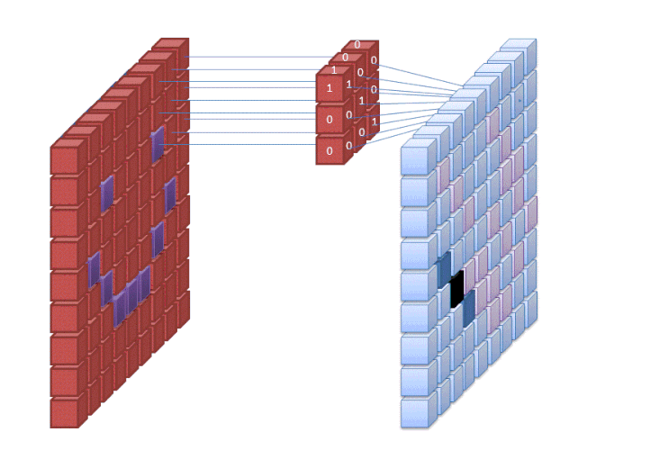
Feature Extraction with filters

Slide 7
Convolutional Neural Network (CNN)
The first layer of a neural network takes in all the pixels within an image. After all the data has been fed into the network, different filters are applied to the image, which forms representations of different parts of the image. This is feature extraction and it creates "feature maps".
This process of extracting features from an image is accomplished with a "convolutional layer", and convolution is simply forming a representation of part of an image.
Hence, the term Convolutional Neural Network (CNN) is derived from this convolution concept. CNN are type of neural network most used in image classification/recognition.

Slide 8
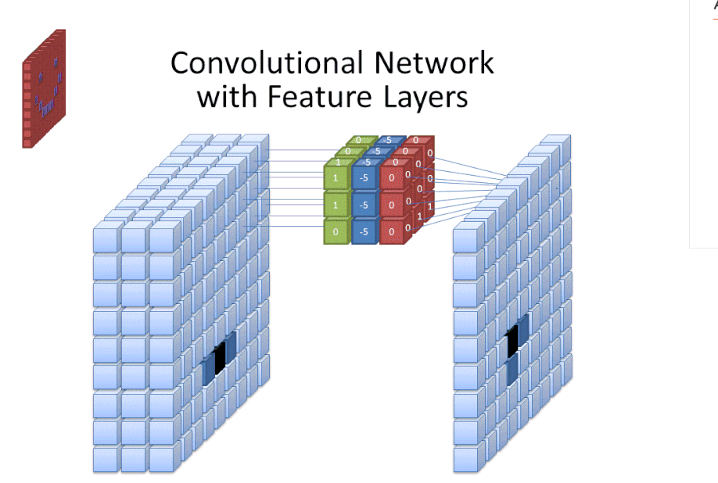

Slide 9
Filters in CNN
A filter is what the network uses to form a representation of the image.
Neural Network use filter size to determine how much of the image the network examine in one time.
Filter size affects how much of the image, how many pixels, are being examined at one time.
A common filter size used in CNNs is 3, and this covers both height and width, so the filter examines a 3 x 3 area of pixels.

Slide 10
Activation Functions
After the feature map of the image has been created, the values that represent the image are passed through an activation function or activation layer.
The activation function takes values that represent the image, which are in a linear form (i.e. just a list of numbers) thanks to the convolutional layer, and increases their non-linearity since images themselves are non-linear.
The typical activation function used to accomplish this is a Rectified Linear Unit (ReLU), although there are some other activation functions that are occasionally used

Slide 11
Pooling layer
After the data is activated, it is sent through a pooling layer. Pooling "downsamples" an image, meaning that it takes the information which represents the image and compresses it, making it smaller.
When we look at an image, we typically aren't concerned with all the information in the background of the image, only the features we care about, such as people or animals.
A pooling layer in a CNN will abstract away the unnecessary parts of the image, keeping only the parts of the image it thinks are relevant, as controlled by the specified size of the pooling layer.
Because it has to make decisions about the most relevant parts of the image, the hope is that the network will learn only the parts of the image that truly represent the object in question.

Slide 12
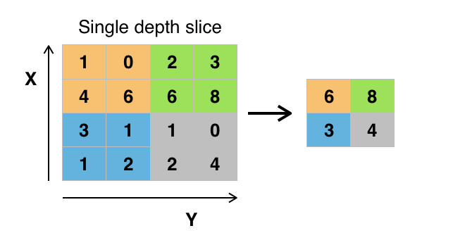
Max Pooling
There are various ways to pool values, but max pooling is most used. Max pooling obtains the maximum value of the pixels within a single filter (within a single spot in the image). This drops 3/4ths of information, assuming 2 x 2 filters are being used.

Slide 13
Flattening
The final layers of our CNN, the densely connected layers, require that the data is in the form of a vector to be processed. For this reason, the data must be "flattened". The values are compressed into a long vector or a column of sequentially ordered numbers.

Slide 14
Fully Connected Layer
The final layers of the CNN are densely connected layers, or an artificial neural network (ANN).
The primary function of the ANN is to analyze the input features and combine them into different attributes that will assist in classification.
These layers are essentially forming collections of neurons that represent different parts of the object in question, and a collection of neurons may represent the floppy ears of a dog or the redness of an apple.
When enough of these neurons are activated in response to an input image, the image will be classified as an object.

Slide 15
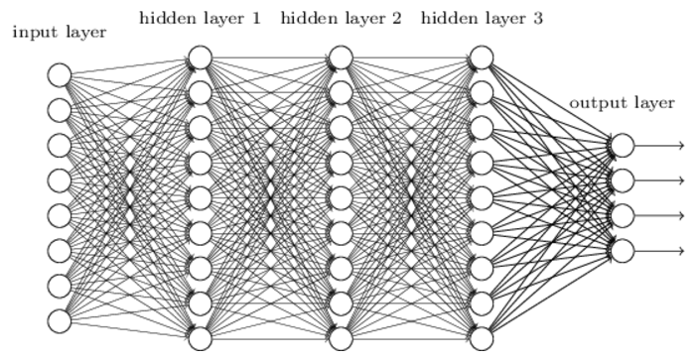
Convolutional Networks

Slide 16
Shared weights and biases
Same weights and bias for each of the 24x24 hidden neurons
all the neurons in the first hidden layer detect exactly the same feature just at different locations in the input image
Informally, the feature detected by a hidden neuron can be said as the kind of input pattern that will cause the neuron to activate: it might be an edge in the image, for instance, or maybe some other type of shape
This makes convolutional networks – translation invariance of images
the map from the input layer to the hidden layer a feature map
The shared weights and bias are often said to define a kernel or filter
Greatly reduces number of parameters involved

Slide 17
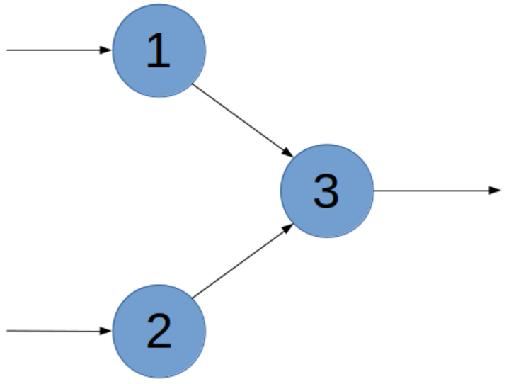
Dropout
dropout is a form of regularization to avoid overfitting
dropout as a form of ensemble learning
At each training step in a mini-batch, the dropout procedure creates a different network (by randomly removing some units), which is trained using backpropagation as usual
The effect of this is that neurons are prevented from co-adapting too much which makes overfitting less likely
At test case the whole network is used (all units) but with scaled down weights. Mathematically this approximates ensemble averaging (using the geometric mean as average)
There is also something called dropconnect but this is the same principle for connections between nodes. In general, the effect of dropconnect is less consequent and less strong as compared to dropout.

Slide 18
One hot vector
labels as "one-hot vectors“
0 in most dimensions, and 1 in a single dimension
For example, 3 would be [0,0,0,1,0,0,0,0,0,0]

