Slide 1
CS5542: Big Data Analytics and Apps
Spark
References:
Spark programming guide http://spark.apache.org/docs/latest/quick-start.html
Introduction to Spark: http://stanford.edu/~rezab/sparkclass/slides/itas_workshop.pdf

Slide 2
Spark vs. Hadoop
Spark is an open source cluster computing environment similar to Hadoop, developed at the University of California, Berkeley
Machine Learning
Spark Streaming
Faster Batch
Spark enables in-memory distributed datasets that optimize iterative workloads in addition to interactive queries.
Spark is complementary to Hadoop and can run side by side over the Hadoop file system.
Spark supports to build large-scale and low-latency data analytics applications.
http://www.ibm.com/developerworks/library/os-spark/

Slide 3
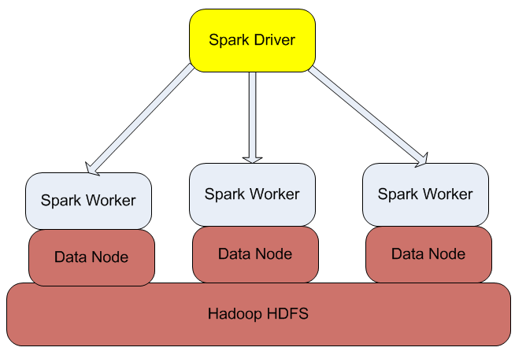
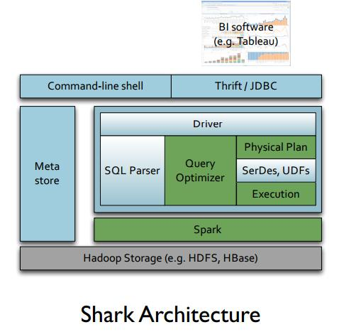
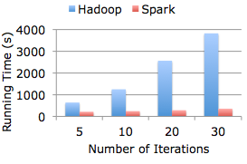
Hadoop/Spark Architecture
up to 100 times faster.
http://www.datasciencecentral.com/profiles/blogs/spark-shark-and-mesos-data-analytics-stack
https://bighadoop.wordpress.com/2014/04/03/apache-spark-a-fast-big-data-analytics-engine/

Slide 4
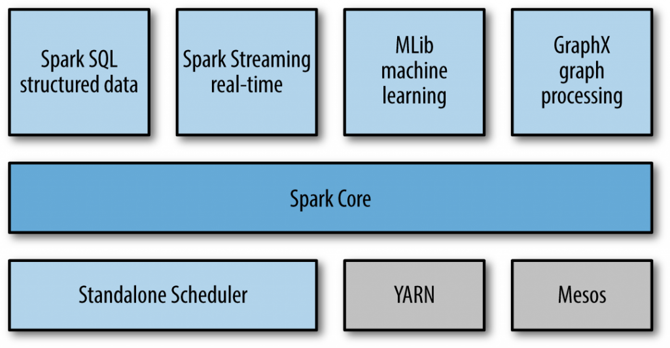
Spark Architecture
http://malsolo.com/blog4java/?p=679

Slide 5
Spark Components
Spark Core: A high level programming framework
These steps are define by RDD (Resilient Distributed Datasets)
The main programming abstraction that represent a collection of items distributed across many compute nodes that can be manipulated in parallel.
Spark SQL: for querying data via SQL.
Spark Streaming: for real-time processing of live streams of data.
GraphX: a library for manipulating graphs and performing graph-parallel computations.
MLLib: a library for machine learning providing algorithms for doing so (classification, regression, …)
http://malsolo.com/blog4java/?p=679

Slide 6

Spark: Master and Clusters
master connects to a cluster manager to allocate resources across applications
acquires executors on cluster nodes – processes run compute tasks, cache data
sends app code to the executors
sends tasks for the executors to run

Slide 7
Spark: Resilient Distributed Datasets (RDD)
RDD - the primary abstraction in Spark – a fault-tolerant collection of elements that can be operated on in parallel
There are currently two types:
parallelized collections – take an existing Scala collection and run functions on it in parallel
Hadoop datasets – run functions on each record of a file in HDFS or any other storage systems
Spark can create RDDs from any file stored in HDFS or Amazon S3, Hypertable, HBase, etc.

Slide 8
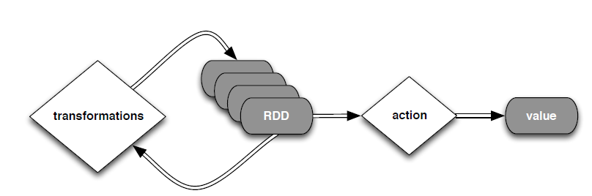
Spark: Resilient Distributed Datasets (RDD)
Two types of operations: transformations and actions
Transformations are lazy (not computed immediately)
The transformed RDD gets recomputed when an action is run.
RDD can be persisted into storage in memory or disk

Slide 9
Spark: Transformations
Transformations create a new dataset from an existing one
All transformations in Spark are lazy: remember the transformations applied to some base dataset
optimize the required calculations
recover from lost data partitions

Slide 10
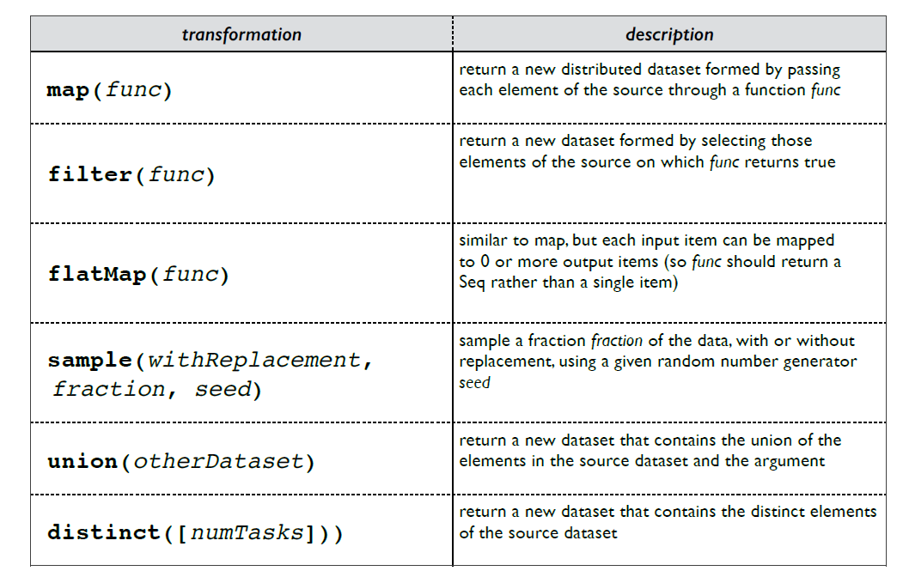
Spark: Transformations

Slide 11
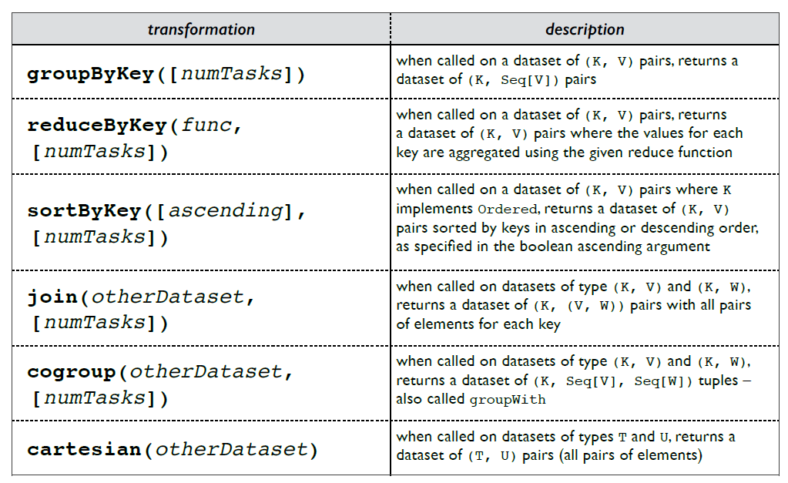
Spark: Transformations

Slide 12
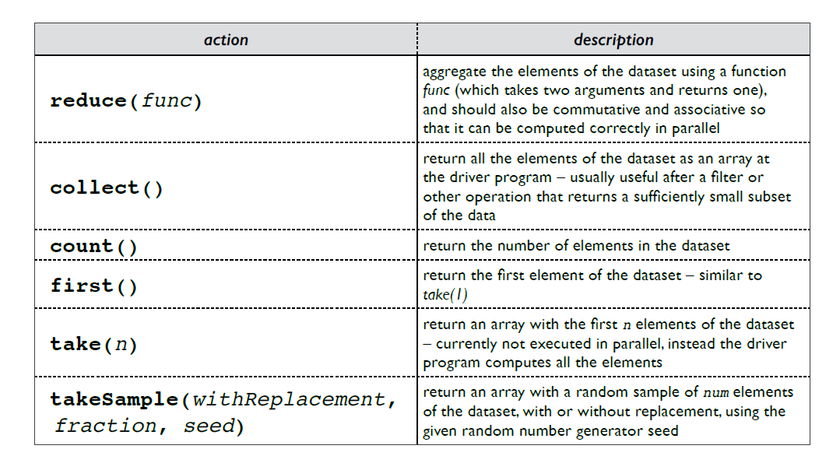
Spark: Actions

Slide 13
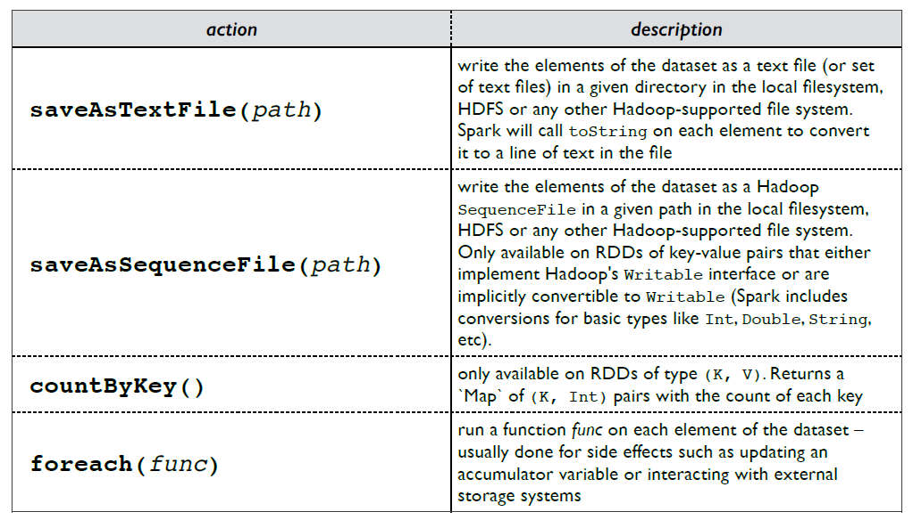
Spark: Actions

Slide 14
Spark: Persistence
Spark can persist (or cache) a dataset in memory across operations
Each node stores in memory any slices of it that it computes and reuses them in other actions on that dataset – often making future actions more than 10x faster
The cache is fault-tolerant: if any partition of an RDD is lost, it will automatically be recomputed using the transformations that originally created it

Slide 15
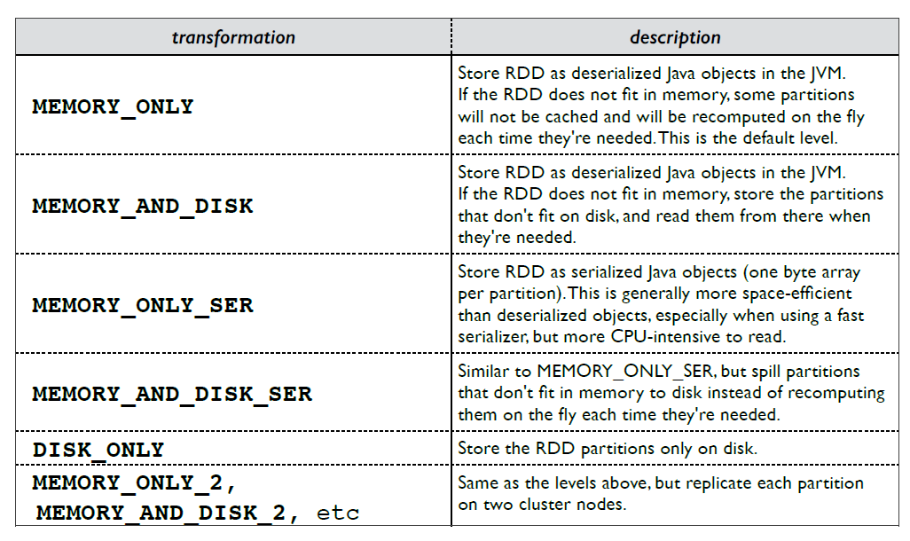
Spark: Persistence
http://spark.apache.org/docs/latest/programming-guide.html#rdd-persistence

Slide 16
Spark: Broadcast variables
Broadcast variables let programmer keep a read-only variable cached on each machine rather than shipping a copy of it with tasks
E.g., to give every node a copy of a large input dataset efficiently
Spark also attempts to distribute broadcast variables using efficient broadcast algorithms to reduce communication cost

Slide 17
Spark: Accumulators
Accumulators are variables that can only be “added” to through an associative operation
Used to implement counters and sums, efficiently in parallel
Spark natively supports accumulators of numeric value types and standard mutable collections, and programmers can extend for new types
Only the driver program can read an accumulator’s value, not the tasks

