Slide 1
CS5542 Big Data Analytics and Applications Tutorial 1 – Introductions

Slide 2
Topics to cover
Introductions
Google Colab
Github
ICP/Lab Submission Guidelines

Slide 3

Google Colab
Brief Introduction
https://www.youtube.com/watch?v=inN8seMm7UI
Same as Jupyter Notebook
has important libraries already installed
Give some free GPU space
Preexisting visualizations
Many other features

Slide 4
Google Colab
1) Sign into your Gmail account
2) Go to
https://colab.research.google.com/notebooks/intro.ipynb#recent=true
3) Cick on New Notebook and start coding
4) You can Save the Colab Notebook on the Github by clicking File> Save a copy in Github

Slide 5

Github
Software development platform
Brings together the world's largest community of developers to discover, share, and build better software
Projects on GitHub can be public or private

Slide 6
Git Basic Tasks
1. Create Git remote repository using Git account
2. Clone Git repository to your local
3. Use Git to add file into local
4. Modify files and use Git to commit change
5. Use Git to push the commit to remote
6. Use Git to pull (sync) content with remote

Slide 7
Git Project Management Tasks
1. Use Git to branch a project
2. Use Git to check different branches
3. Use Git to merge different versions

Slide 8
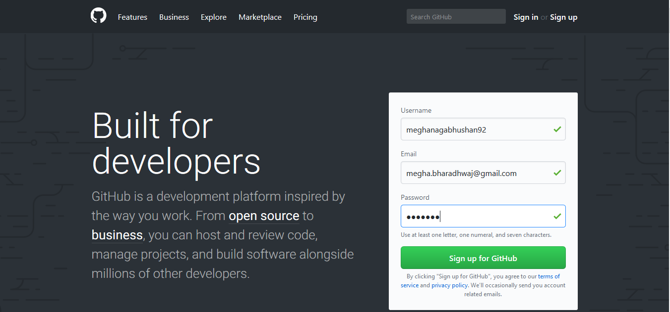
Git 1. Create Git Account

Slide 9
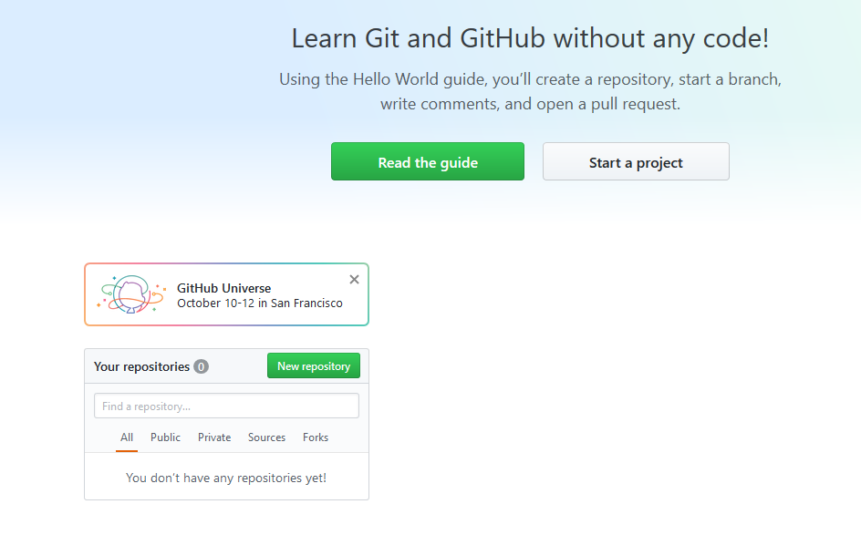
Git 2. Create Repository

Slide 10
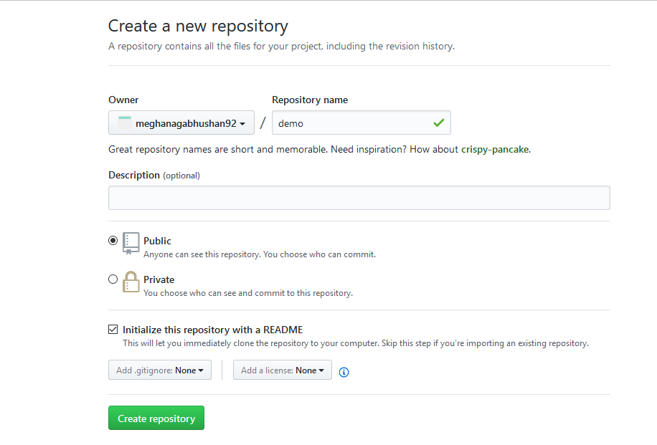
Git 2. Create Repository
create a sample repository.

Slide 11
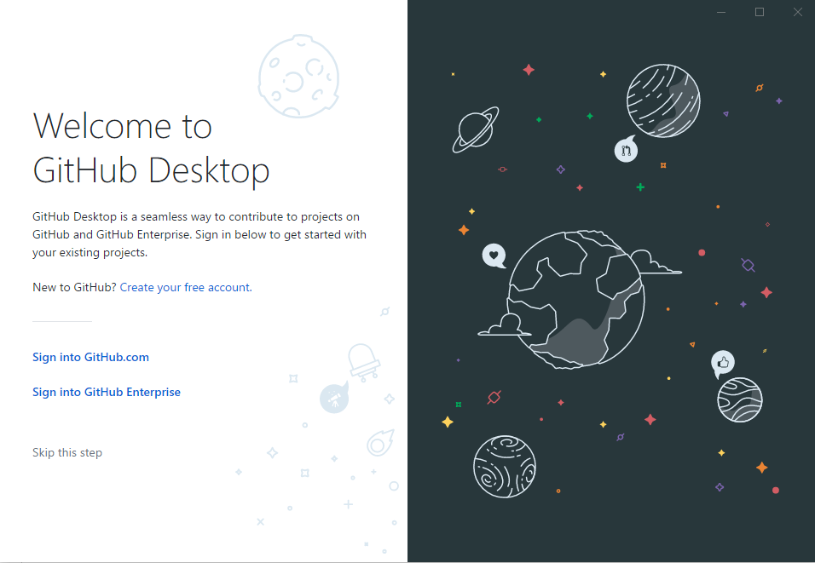
Git Desktop
Download git using this link - https://git-scm.com/downloads
Download Github Desktop using this link - https://desktop.github.com/

Slide 12

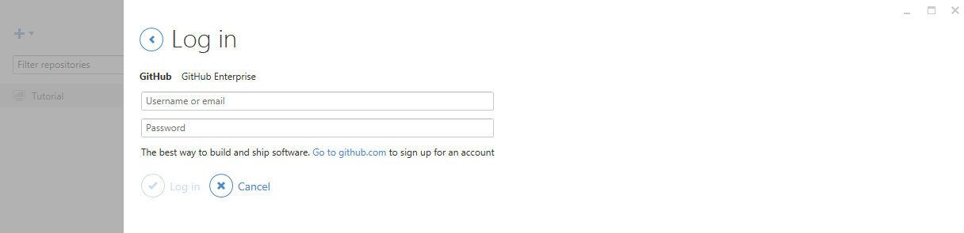
Git
For Windows user, please open GitHub desktop by double clicking icon
login to your GitHub desktop with your GitHub account (It is very important to login before you do the rest of steps. Because after you login, you secure connection has been made)

Slide 13
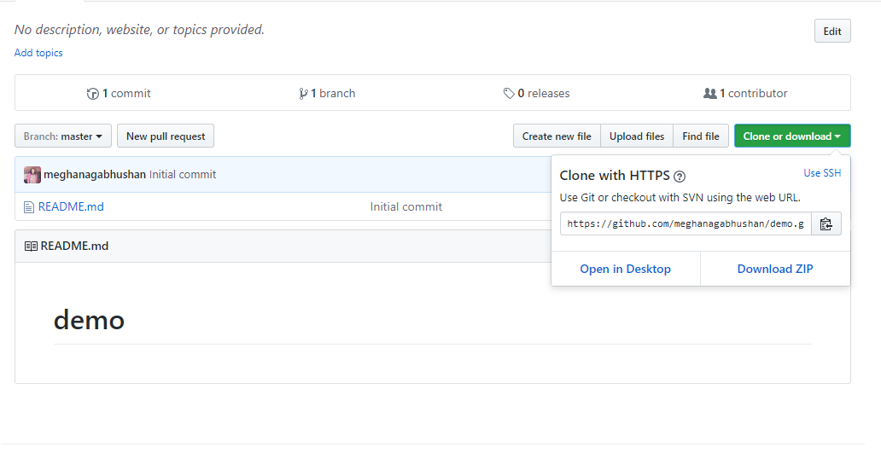
Git 3. Clone repository to your local
Click on "Clone or Download" -> "Open in Desktop".

Slide 14
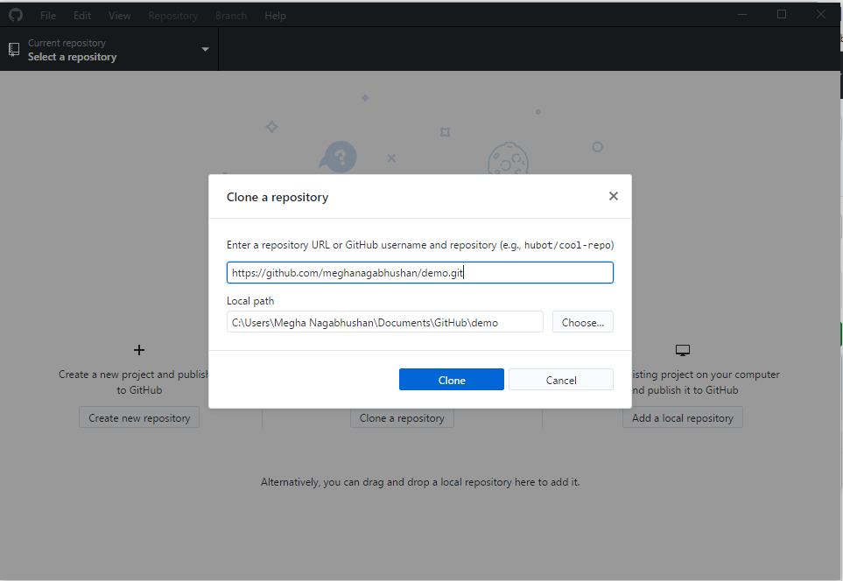
Git 3. Clone repository to your local
Choose the path to save your repository.

Slide 15
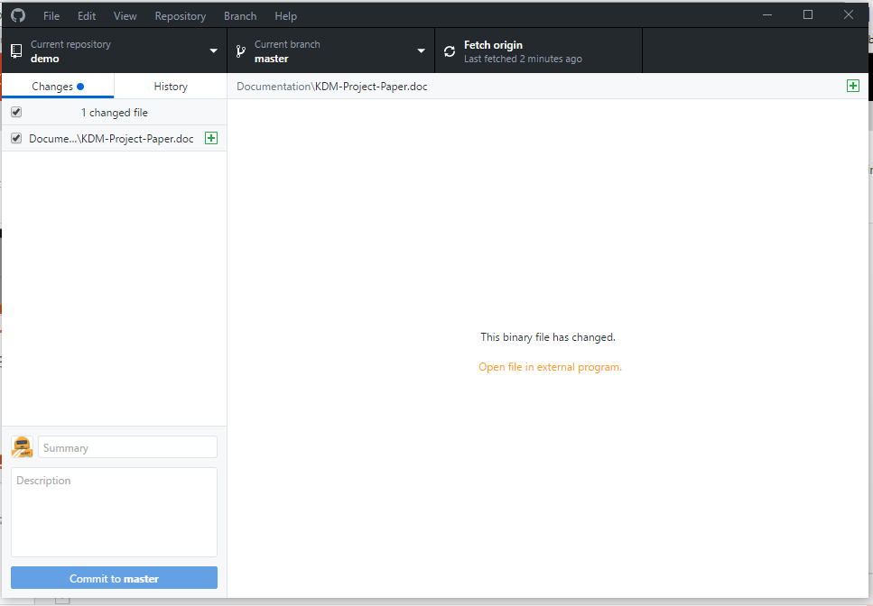
Git 4. Add file to local Repository
Go to the location of your repository.
Create a Source and Documentation folder.
Add a sample file in the Documentation folder.

Slide 16
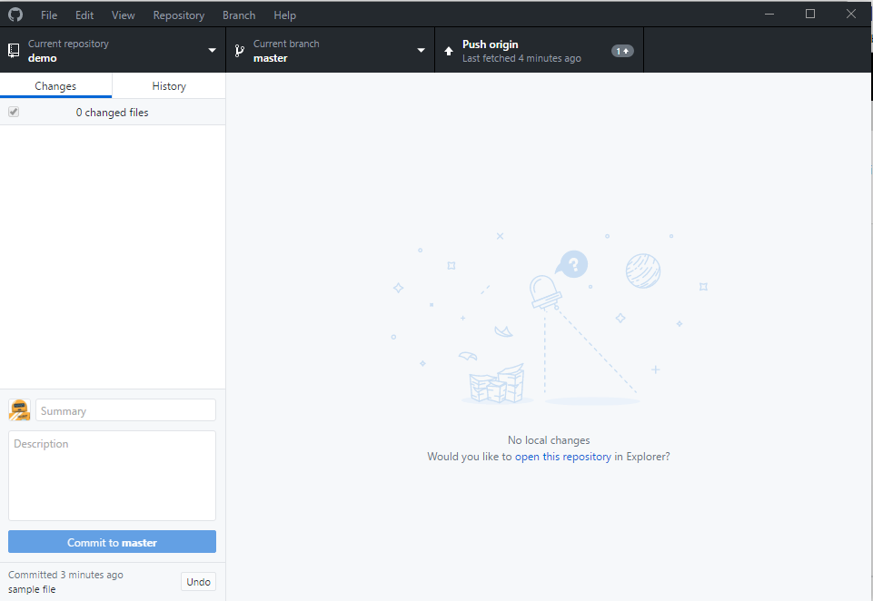
Git 5. Commit this change
Fill summary and description boxes and click on Commit to master.

Slide 17
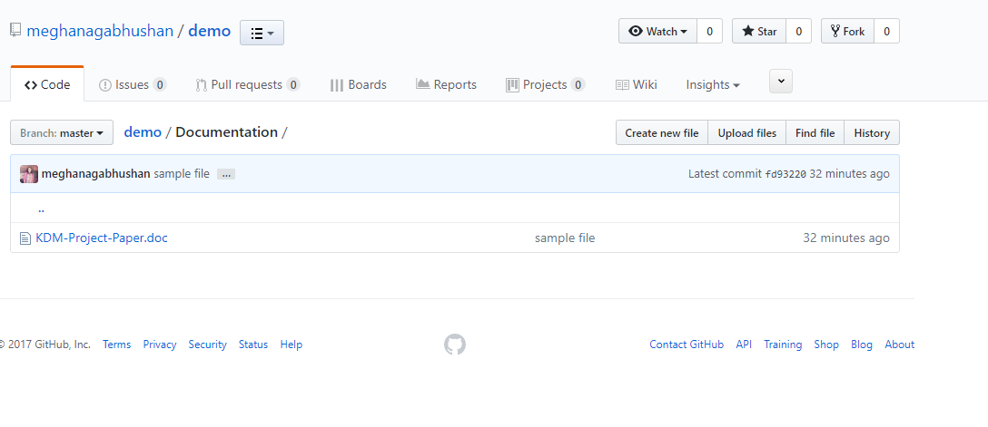
Git 6. Push the change to remote
Click on "Push origin" at the top of the git desktop screen.
Open the repository on your Github. The file will now be visible in your repository.

Slide 18
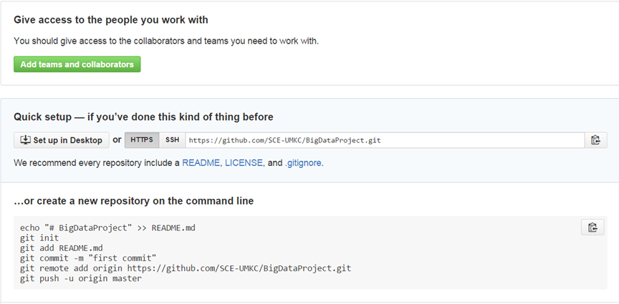
Git bash 3. Clone repository to your local
Copy the repository link git clone https://github.com/xxxxxxx.git

Slide 19
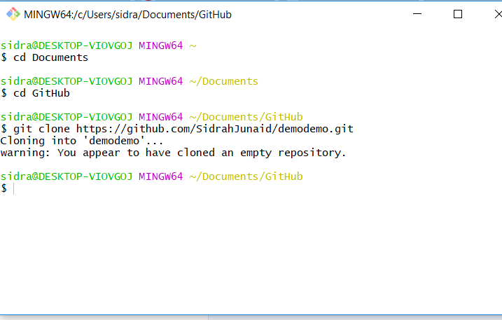
Git bash 3. Clone repository to your local
Open git bash and clone repository in your desired folder

Slide 20
After clone, you will find a folder has the same name as repository
Use the following command to go inside the folder
cd <folder_name> (e.g., cd BigDataProject)

Slide 21
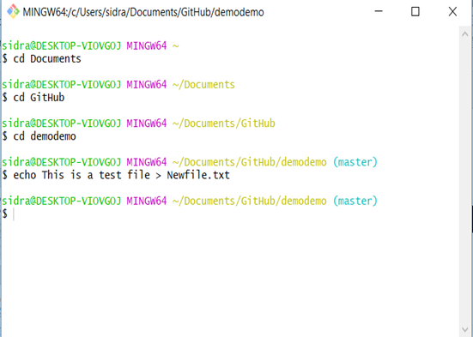
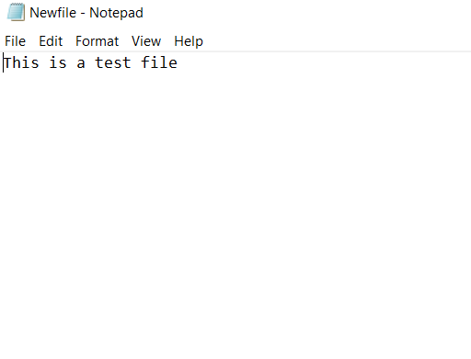
Git bash 4. Add file to local repository
For creating a text file window users

Slide 22
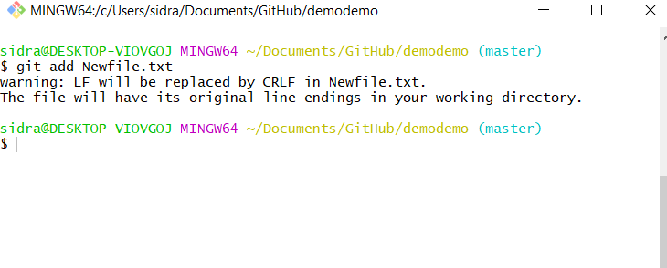
Git bash 4. Add a file from local

Slide 23
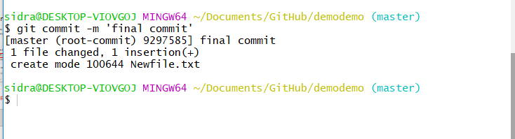
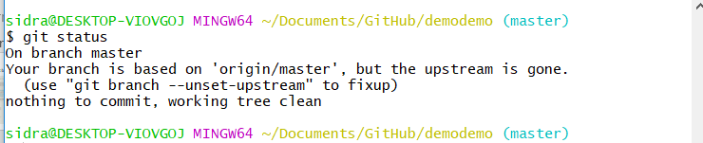
Git bash 5. Commit this change
After commit, you can check git status to see if work directory clean

Slide 24
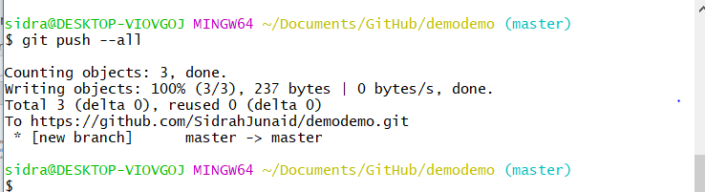
Git bash 6. Push the change to remote
Push all changes to remote Github

Slide 25
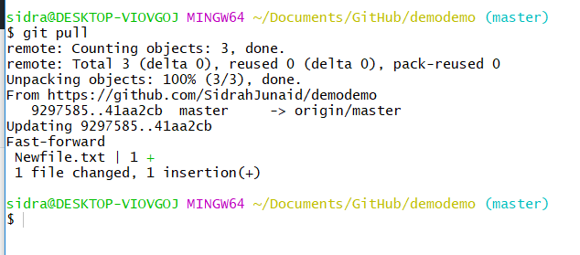
Git bash 7. Sync local with remote
If something change in remote, for sync purpose, you can type

Slide 26
Git Project Management 1. Branch
Create a branch
Delete a branch
Force delete a branch
Rename current branch

Slide 27
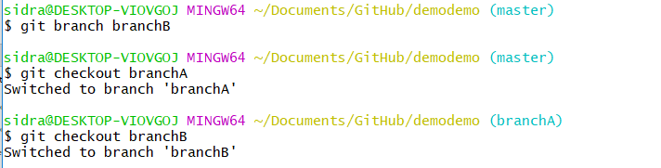
Git Project Management 2. Checkout
A and B has to checkout their own branch to work on

Slide 28
Git Project Management 3. Merge
•User A works on featureA, after finish, user A commit it with the message ‘finish featureA’
•git commit –m ‘finish featureA’
•User B works on featureB, after finish, user B commit it with the message ‘finish featureB’
•git commit –m ‘finish featureB’
•User C works on main features on master branch, user C commit it with the message ‘finish main features’
•git commit –m ‘finish main features’

Slide 29
For now, Windows users have done all basic steps.
But for Linux and Mac users, there are some more steps

Slide 30
(Non-Windows User)
• For Linux or Mac user, we have more work to do before pushing change to remote
Here are the steps
1. Generating new SSH Key and adding SSH Key to the ssh-agent
2.Adding a new SSH key to your GitHub account

Slide 31
1. Generating new SSH Key and adding SSH Key to the ssh-agent
•1. Generate a SSH key with your GitHub email address
ssh-keygen -t rsa -b 4096 -C “your_email@example.com”
•2. It will ask you the file name
Enter a file in which to save the key (/Users/you/.ssh/id_rsa): [Press enter]
•3. Save this key and passphrase. Give the key name and make passphrase as empty.
Enter passphrase (empty for no passphrase): [Type a passphrase]
Enter same passphrase again: [Type passphrase again]
•For example:
we give key name as id_rsa, key pair would be: id_rsa and id_rsa.pub

Slide 32
Contd…
4. Adding SSH key to the ssh-agent
eval "$(ssh-agent -s)”
5. If you're using macOS Sierra 10.12.2 or later, you will need to modify your ~/.ssh/config file to automatically load keys into the ssh-agent and store passphrases in your keychain.
Host * s
AddKeysToAgent yes
UseKeychain yes
IdentityFile ~/.ssh/id_rsa
6. Adding ssh key to ssh-agent
ssh-add -K ~/.ssh/id_rsa

Slide 33
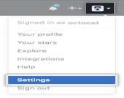


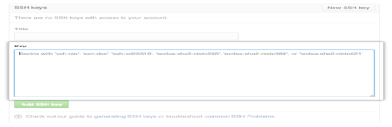

2. Adding SSH key to Github account
1. Copy key to your GitHub account
In the user bar in the top-right corner of page,
click setting button
2. Click SSH Keys in the left sidebar
3. Click Add SSH key
4.In the Title field, add a descriptive label for key
Paste your key into the "Key" field
5. Click Add key.

Slide 34
Testing
6. SSH to GitHub for testing ssh -T git@github.com
7. Switching remote URLs from HTTPs to SSH
git remote set-url origin git@gxxxxxx.gits

Slide 35
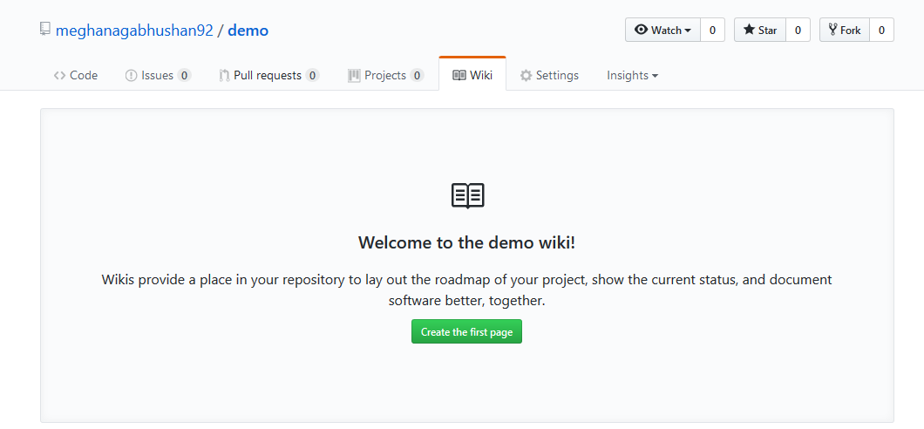
Wiki
Every GitHub repository comes equipped with a section for hosting documentation, called a wiki.

Slide 36
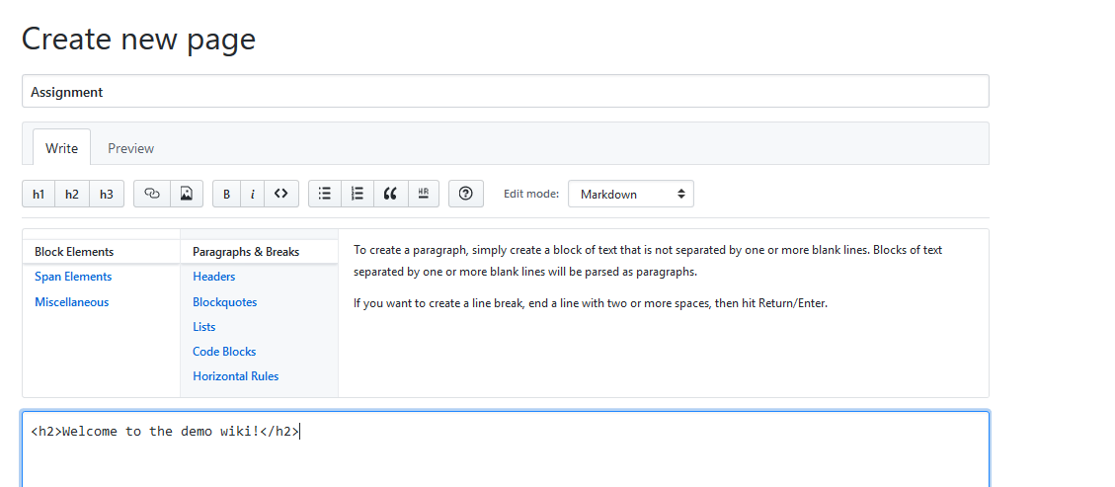
Wiki

Slide 37
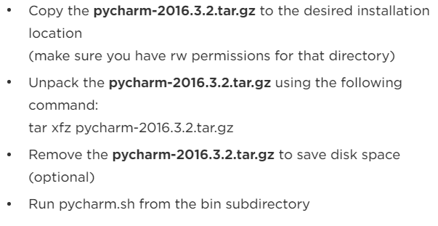
PyCharm
https://www.jetbrains.com/pycharm/download/#section=linux

Slide 38
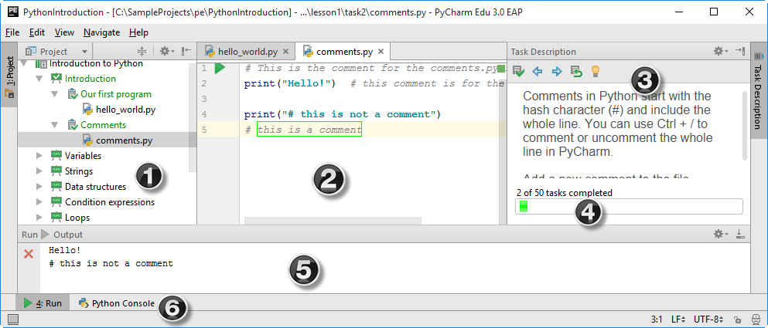
PyCharm
Notes:
Where (1) is the Project tool window that shows the project itself, (2) is the editor, (3) is the Task Description tool window with the course progress bar (4) , (5) is the Run tool window and (6) is the Python Console tool button.

Slide 39
Wiki: Lab Submission
Create a repository for all Lab assignment submissions
Create a folder for each lab assignment and place all code inside source code folder
Use Github wiki pages to submit reports for each lab
Include all wiki links in README.md file
Include the Youtube video link in Wiki and README page

Slide 40
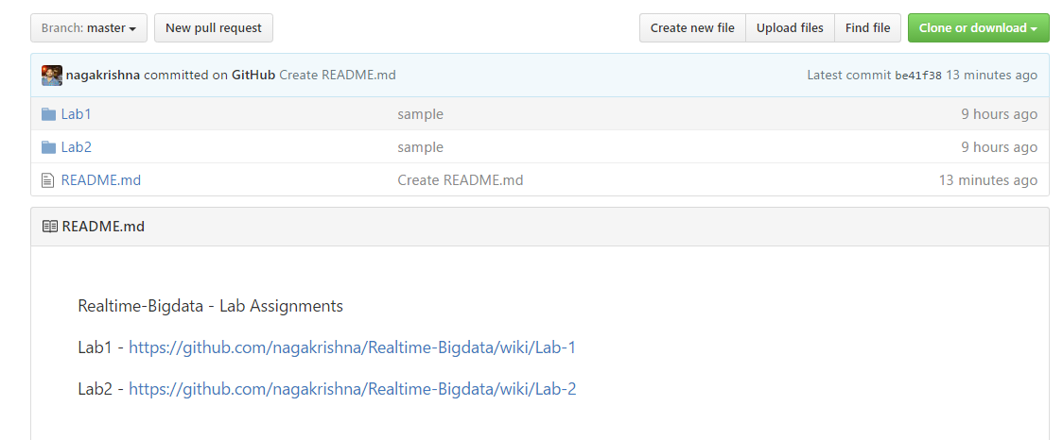
Wiki: Lab Submission

Slide 41
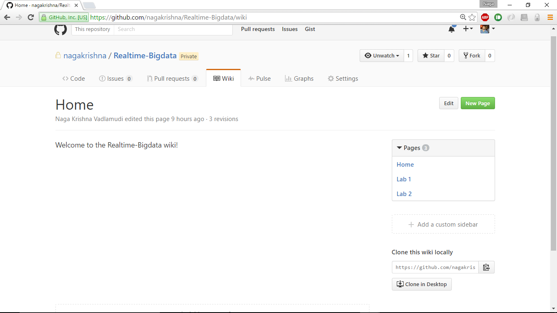
Wiki: Lab Submission

Slide 42
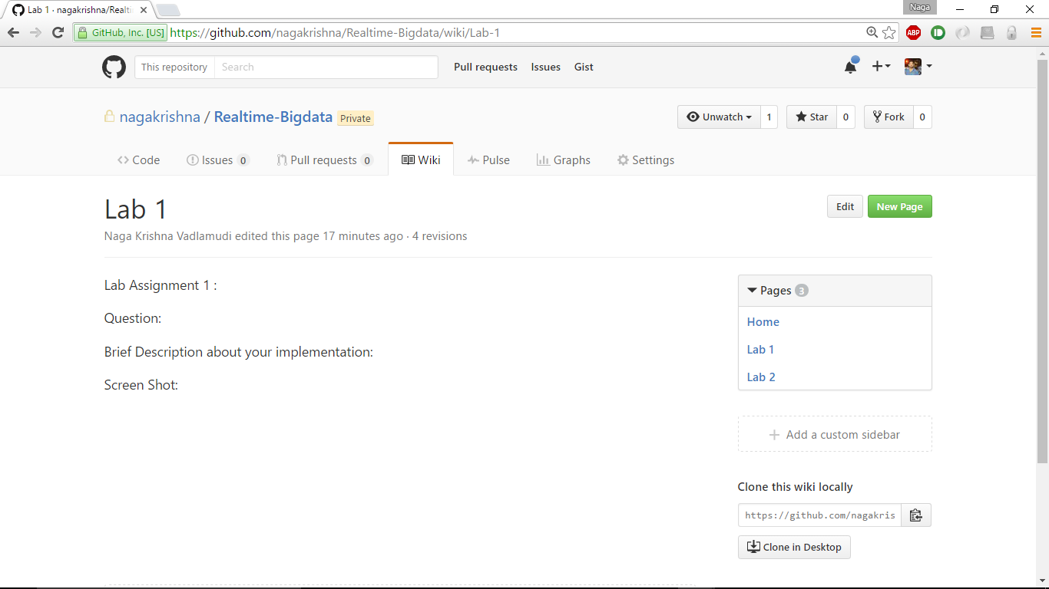
Wiki: Lab Submission

Slide 43
END

